Slide 1


j | v | w | x | y | z | zz | qu | ch
sh | th | ng | ai | ee | igh | oa | oi | oo
ow | ar | air | ear | er | ur | or | ure
Compare 'oo' (short) & 'oo' (long)
Lesson 40
vs.
short sound
long sound

Slide 2





Compare vowel digraphs oo (short) and oo (long).
Recall all GPCs learned so far using flashcards.
Review Alphabet Song.
Review Vowel Song.
Phonemic Awareness Cards
Grapheme to Phoneme Cards
Phoneme Frame Cards
Alien Word Cards
Common Exception Word Cards
High Frequency Word Cards
JNL691
JNL686
JNL689
JNL692
JNL687
JNL688

Slide 3























Recall all GPCs learned so far using flashcards.

Slide 4


















Recall all GPCs learned so far using flashcards.

Slide 5

Review the Alphabet Song
a, b, c, d, e, f, g (pause)
h, i, j, k, l, m, n (pause)
o, p, q (pause) r, s, t (pause)
u v w (pause) x y z (pause)
Now I know my abc's, Next time won't you sing with me.

Slide 6
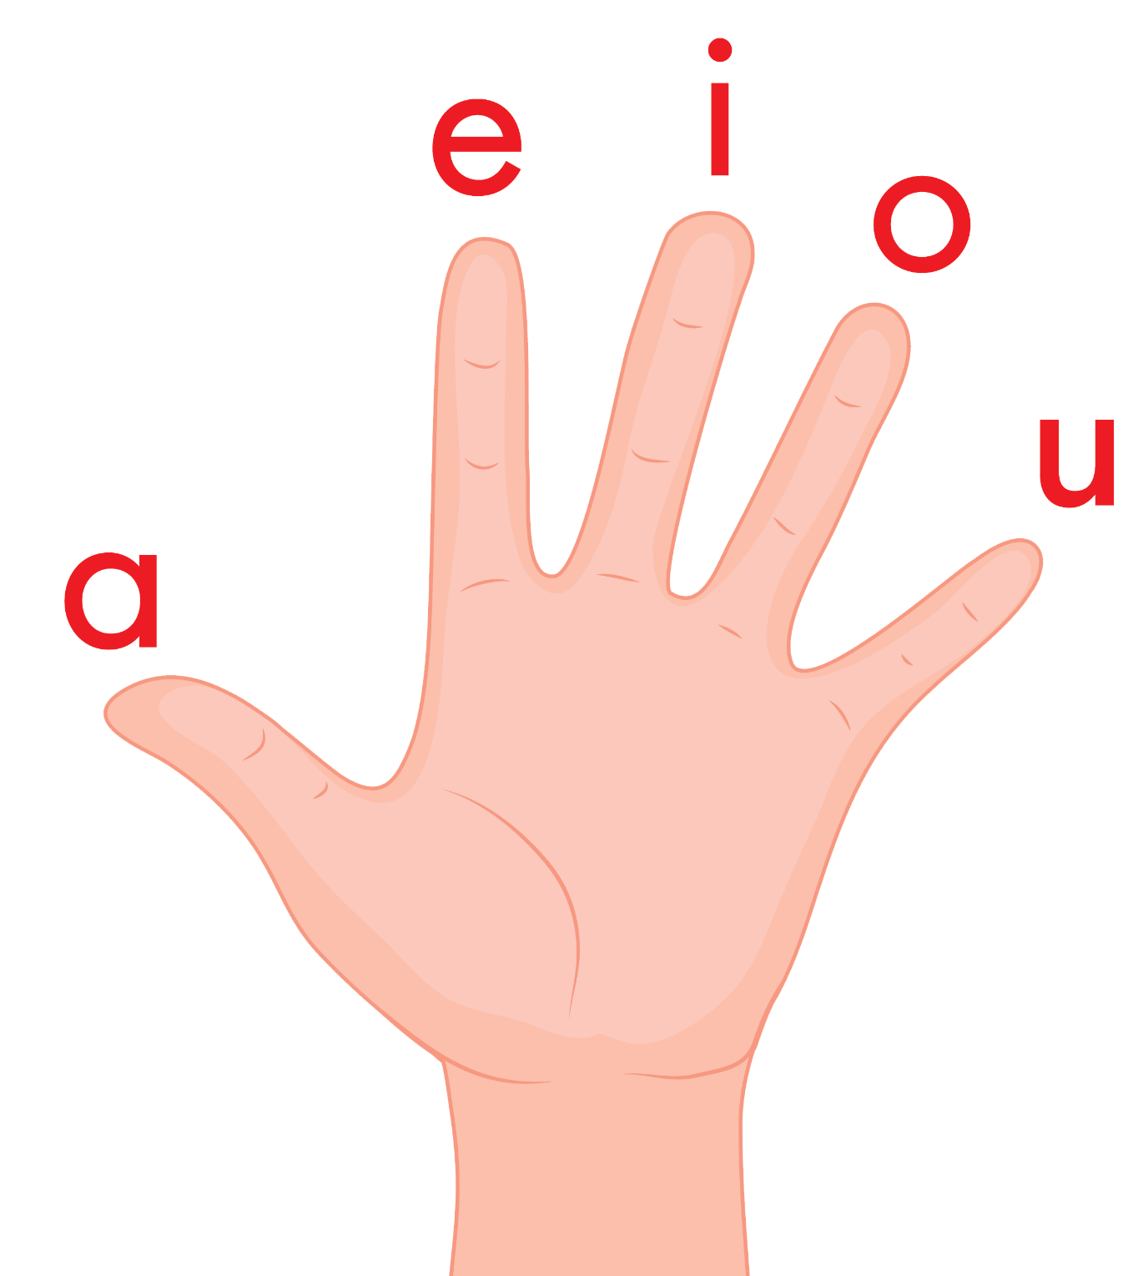
Review the Vowel Hand Song
a, e, i, o, u a, e, i, o, u a, e, i, o, u (short sounds only)
are short vowels that we use
a vowel is in every word, a vowel is in every word,
a vowel is in every word that we read or write.

Slide 7
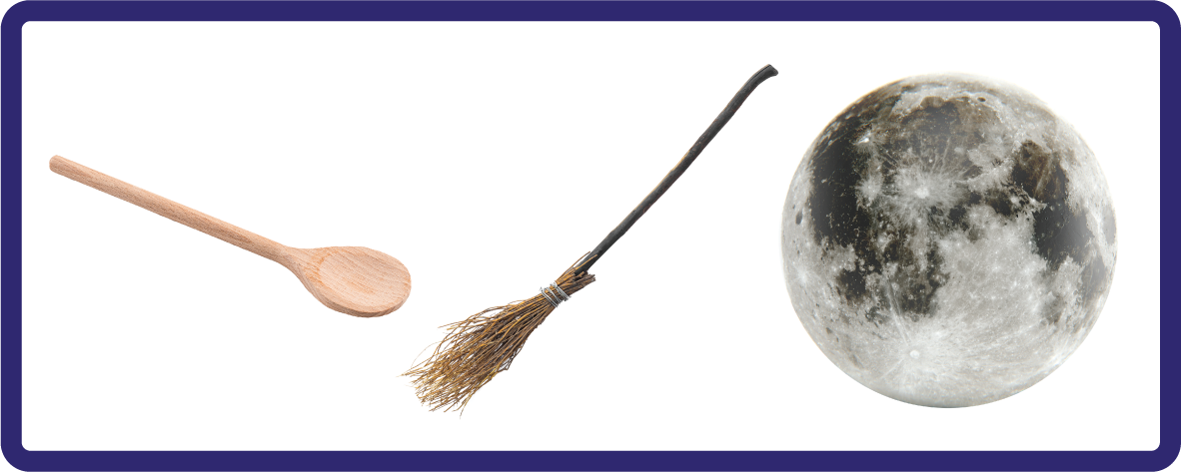
Hear Phonemes
USING JNL691
FRONT

Slide 8
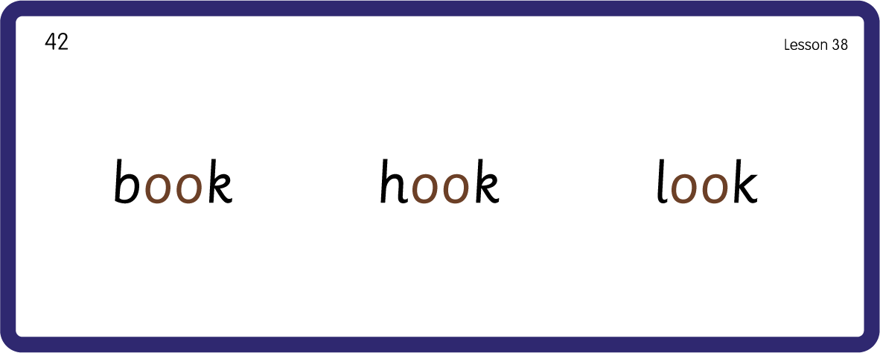

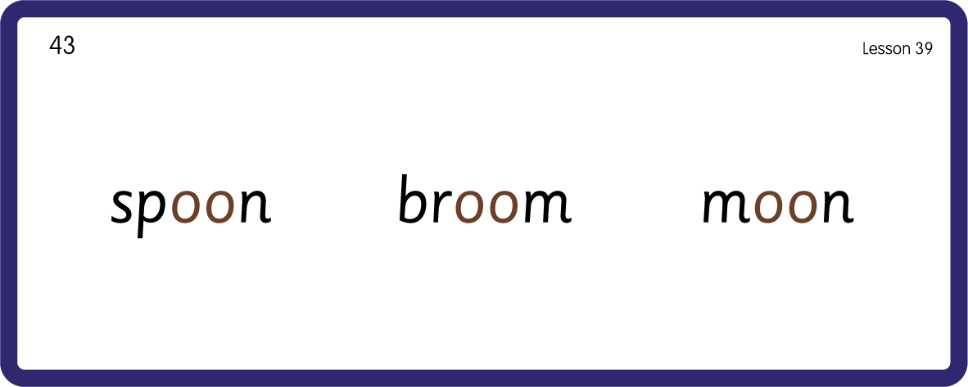
Hear Phonemes
/oo/
short sound
/oo/
long sound
USING JNL691
BACK

Slide 9
Teach Grapheme Caption
USING JNL686
FRONT

Slide 10
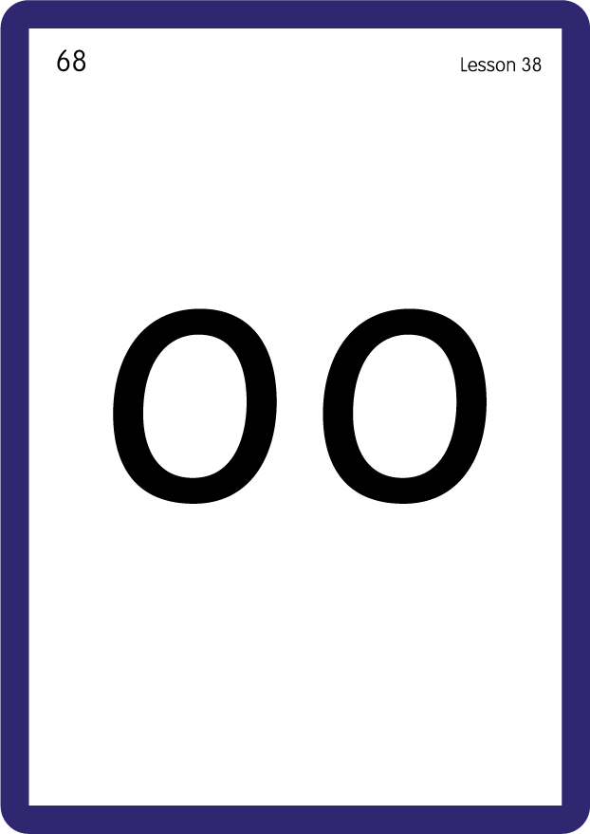
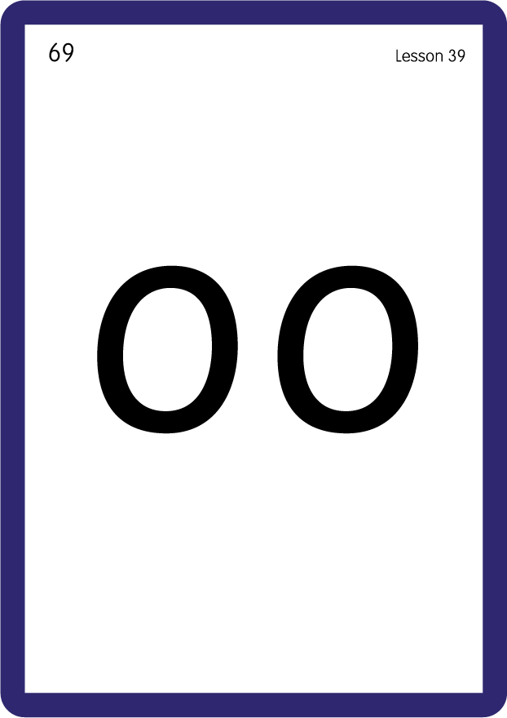
Review Lowercase Formation
USING JNL686
BACK

Slide 11

Explain Decoding

Slide 12
Model Blending Phonemes
b
oo
k
USING SOUND BUTTONS
Sound Buttons
Vowel
Consonant
Consonant Digraph
Long Vowel Sound
R-controlled Digraph
Split Digraph
Syllable / Silent Letter

Slide 13
Model Blending Phonemes
m
oo
n
USING SOUND BUTTONS
Sound Buttons
Vowel
Consonant
Consonant Digraph
Long Vowel Sound
R-controlled Digraph
Split Digraph
Syllable / Silent Letter

Slide 14
Model Blending Phonemes
c
oo
k
USING SOUND BUTTONS
Sound Buttons
Vowel
Consonant
Consonant Digraph
Long Vowel Sound
R-controlled Digraph
Split Digraph
Syllable / Silent Letter

Slide 15
Model Blending Phonemes
p
oo
l
USING SOUND BUTTONS
Sound Buttons
Vowel
Consonant
Consonant Digraph
Long Vowel Sound
R-controlled Digraph
Split Digraph
Syllable / Silent Letter

Slide 16

Explain Encoding

Slide 17
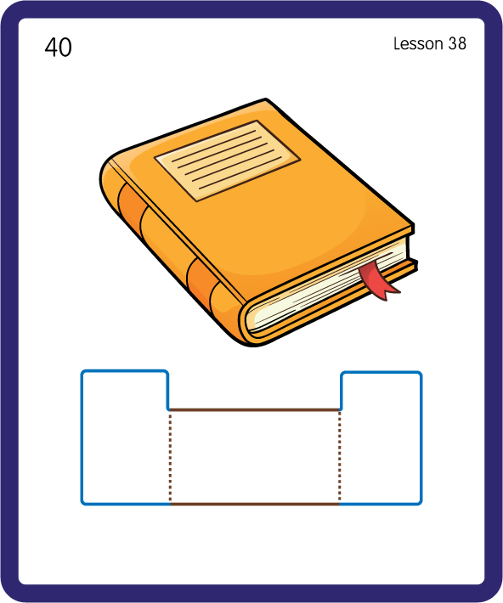
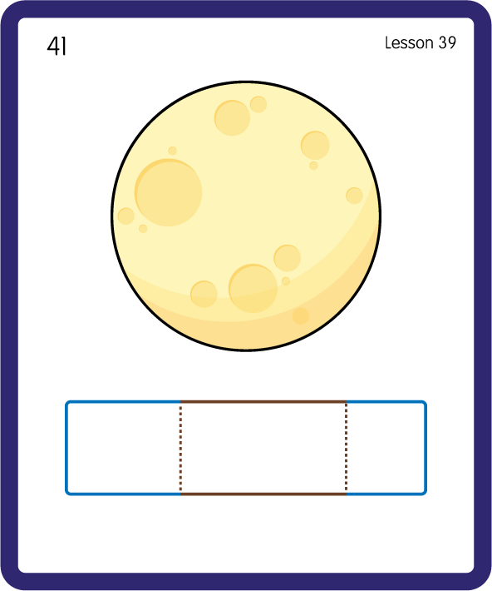
Build a Decodable Word
USING JNL689
BACK

Slide 18

Build a Decodable Word
USING JNL689
FRONT

Slide 19


Practise with Alien Words
USING JNL692
BACK

Slide 20

Practise with Alien Words
USING JNL692
FRONT

Slide 21

Practise Common Exception Words
USING JNL687
FRONT

Slide 22
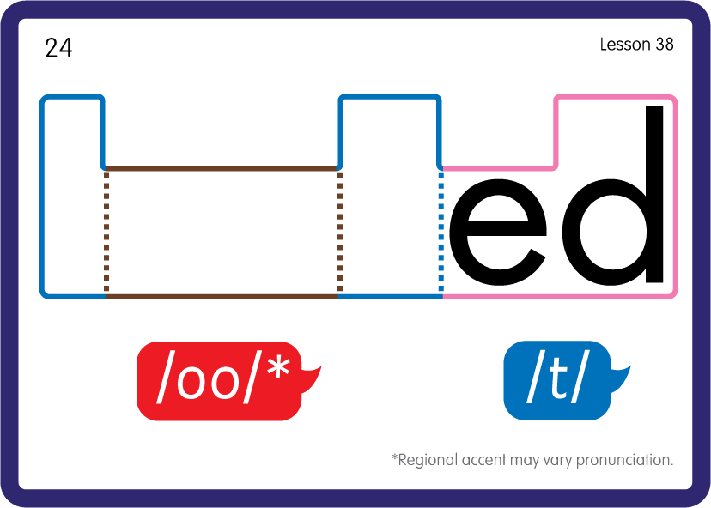
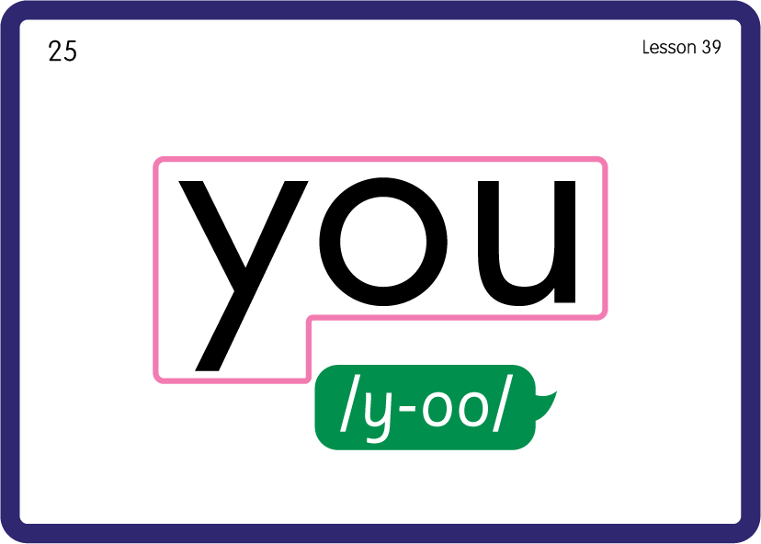
Practise Common Exception Words
USING JNL687
BACK

Slide 23

Practise High Frequency Words
USING JNL688
FRONT

Slide 24
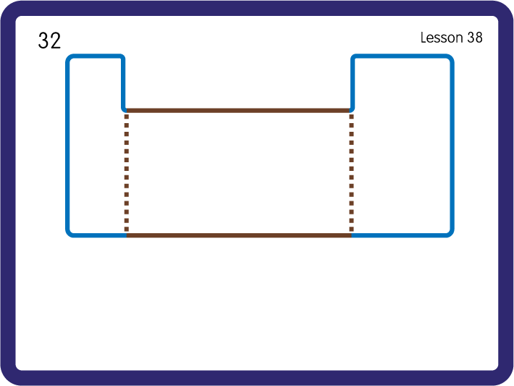
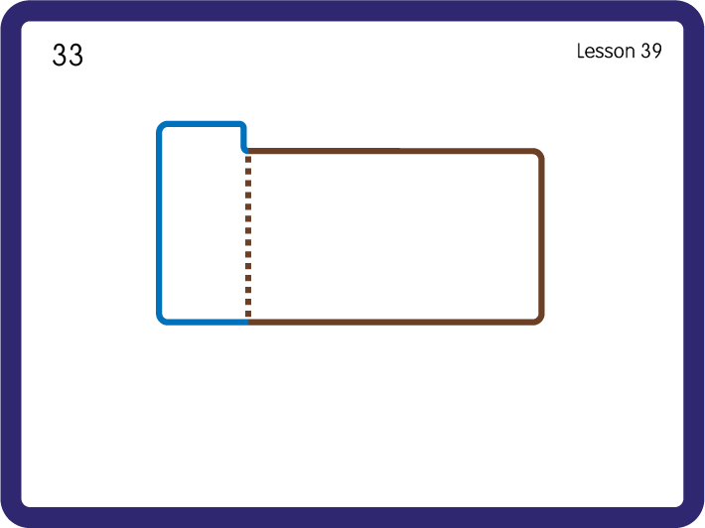
Practise High Frequency Words
USING JNL688
BACK

