Slide 1


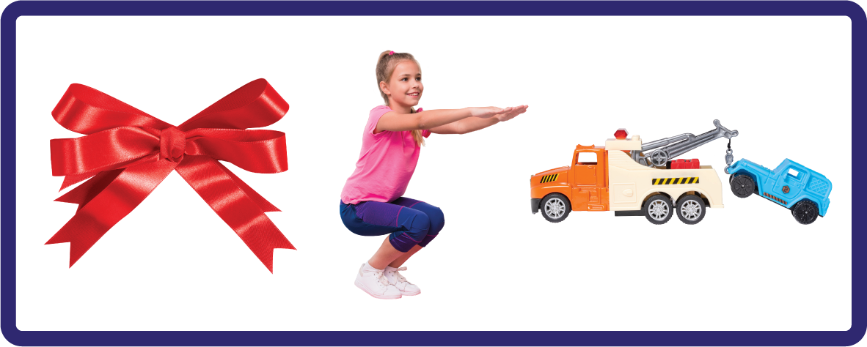
j | v | w | x | y | z | zz | qu | ch
sh | th | ng | ai | ee | igh | oa | oi | oo
ow | ar | air | ear | er | ur | or | ure
Digraph 'ow' (/oa/)
Lesson 42

Slide 2

Learn and practise digraph ow (/oa/).
Recall all GPCs learned so far using flashcards.
Review Phase 2 Common Exception Words as I is no go to into the put his has of pull full.
Phonemic Awareness Cards
Grapheme to Phoneme Cards
Phoneme Frame Cards
Alien Word Cards
JNL691
JNL686
JNL689
JNL692

Slide 3























Recall all GPCs learned so far using flashcards.

Slide 4





















Recall all GPCs learned so far using flashcards.

Slide 5














Review Phase 2 Common Exception Words as I is no go to into the put his has of pull full.

Slide 6






















Review Phase 3 Common Exception Words push they me we be he she my by looked you.

Slide 7
Hear Phonemes
USING JNL691
FRONT

Slide 8
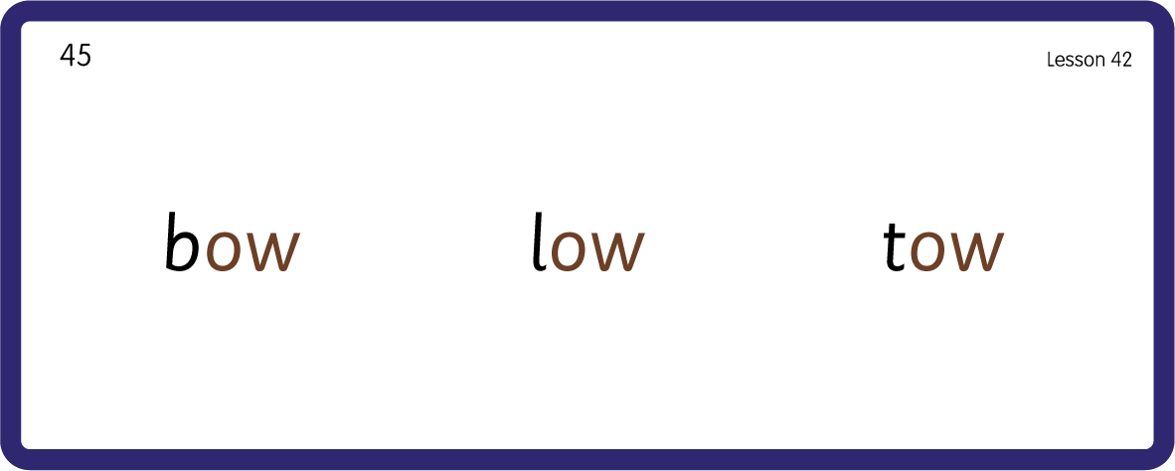
Hear Phonemes
USING JNL691
BACK

Slide 9
Teach Grapheme Caption
USING JNL686
FRONT

Slide 10

Review Lowercase Formation
USING JNL686
BACK

Slide 11

Explain Decoding

Slide 12
Model Blending Phonemes
b
ow
USING SOUND BUTTONS
Sound Buttons
Vowel
Consonant
Consonant Digraph
Long Vowel Sound
R-controlled Digraph
Split Digraph
Syllable / Silent Letter

Slide 13
Model Blending Phonemes
l
ow
USING SOUND BUTTONS
Sound Buttons
Vowel
Consonant
Consonant Digraph
Long Vowel Sound
R-controlled Digraph
Split Digraph
Syllable / Silent Letter

Slide 14

Explain Encoding

Slide 15
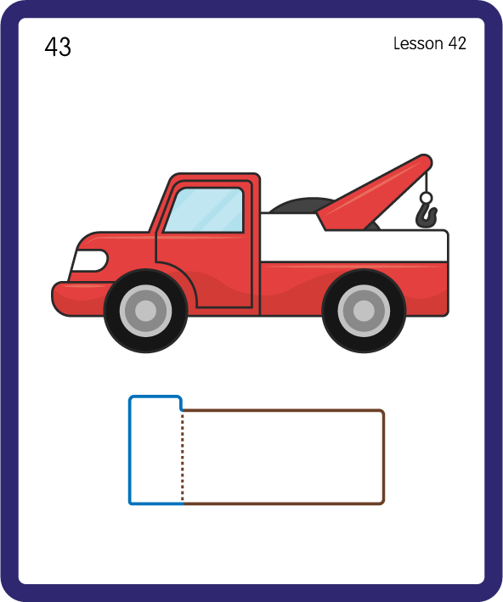
Build a Decodable Word
USING JNL689
BACK

Slide 16
Build a Decodable Word
USING JNL689
FRONT

Slide 17
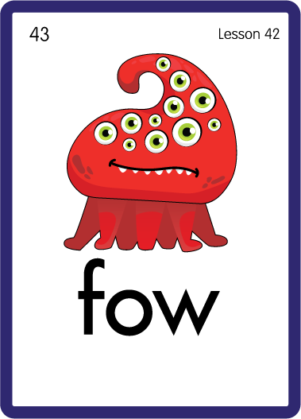
Practise with Alien Words
USING JNL692
BACK

Slide 18
Practise with Alien Words
USING JL692
FRONT

Slide 19

Practise Building Words
PRACTISE – 10MINS
b
l
r
s
t
m
ow
USING MAGNETIC LETTERS AND A WHITEBOARD

Slide 20
Practise Building Words
PRACTISE – 10MINS
b
l
r
s
t
m
ow
bow low row tow sow mow
USING MAGNETIC LETTERS AND A WHITEBOARD

