Slide 1




j | v | w | x | y | z | zz | qu | ch
sh | th | ng | ai | ee | igh | oa | oi | oo
ow | ar | air | ear | er | ur | or | ure
Review Common Exception Words
Lesson 45

Slide 2

Learn and practise Common Exception Words.
Recall all GPCs learned so far using flashcards.
Review all Phase 3 Common Exception Words learned so far.
Common Exception Words Phase 2
Common Exception Words Phase 3
JNL687
JNL687

Slide 3























Recall all GPCs learned so far using flashcards.

Slide 4






















Recall all GPCs learned so far using flashcards.

Slide 5













Review Phase 2 Common Exception Words as I is no go to into the put his has of pull full.

Slide 6


















Review Phase 3 Common Exception Words push they me we be he she my by looked you.

Slide 7
Practise Common Exception Words
USING JNL687
FRONT

Slide 8


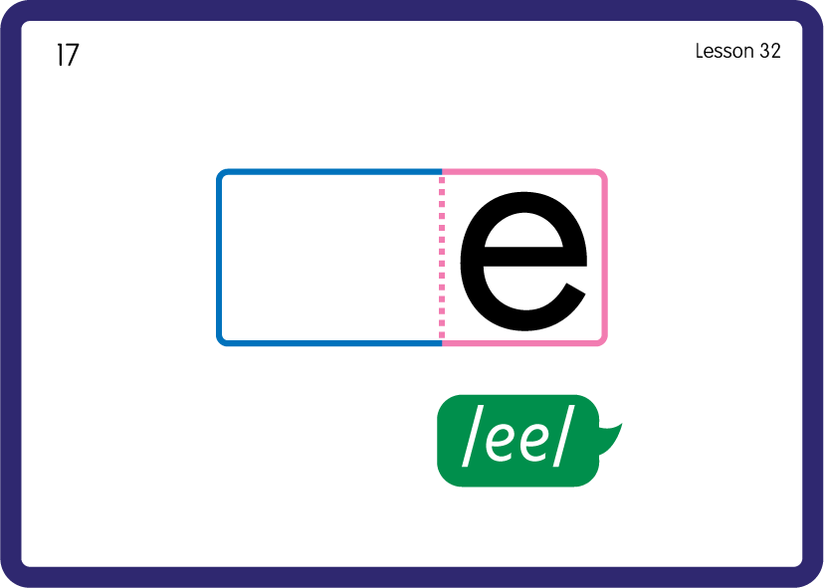
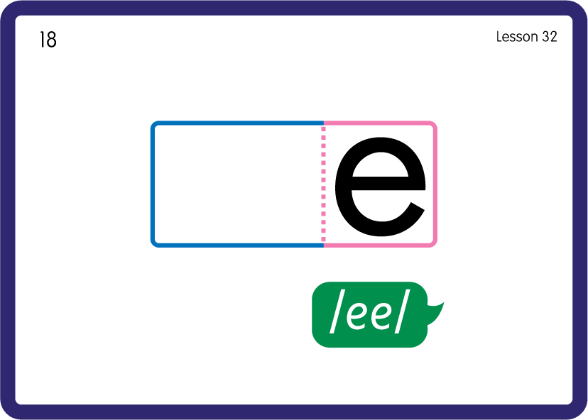



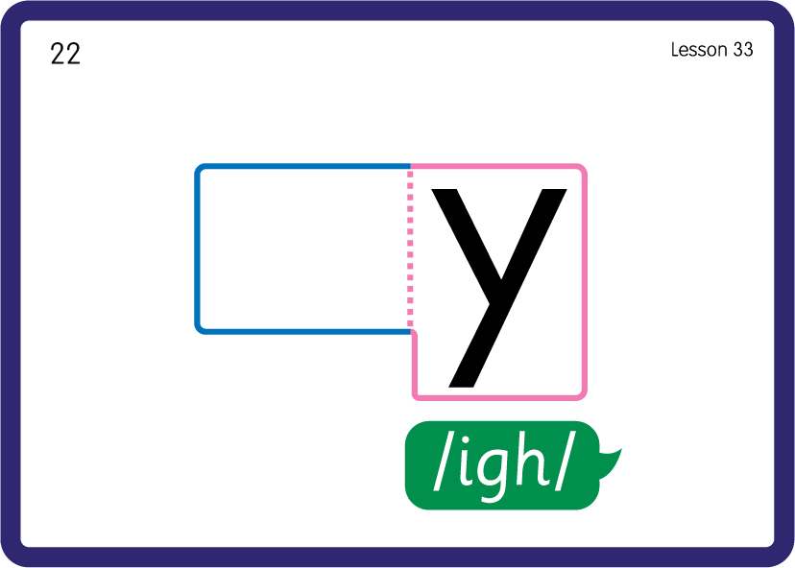
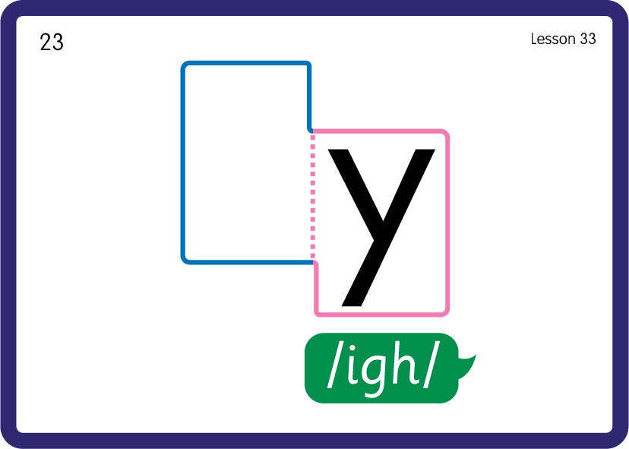
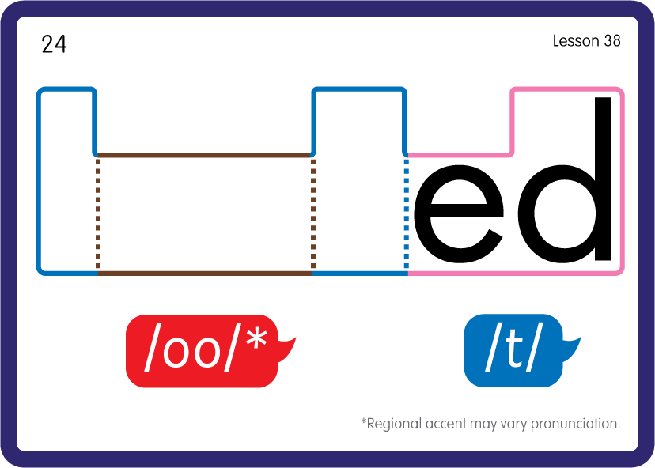

Practise Common Exception Words
USING JNL687
FRONT

Slide 9











Practise High Frequency Words
USING JNL688
FRONT

Slide 10
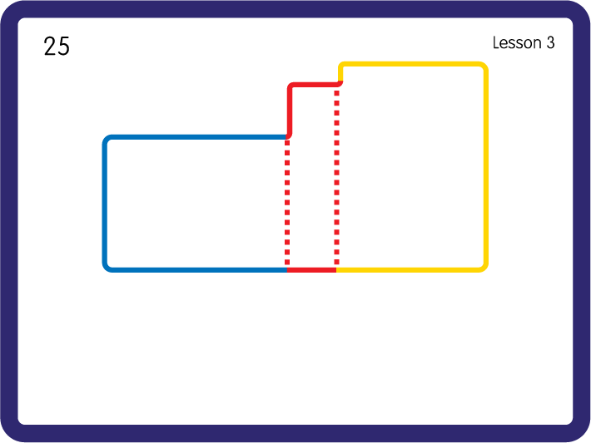
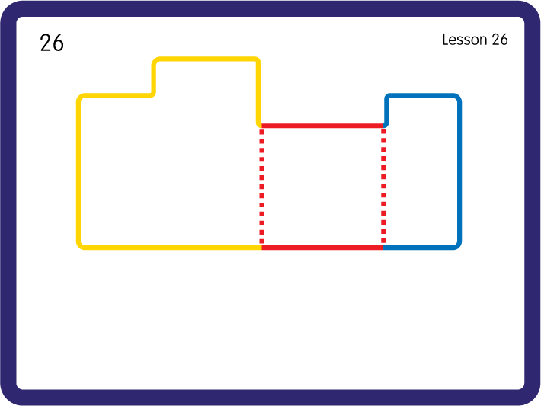
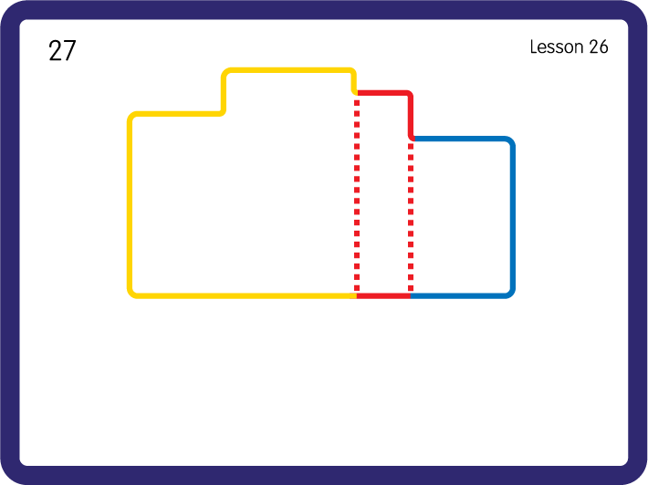
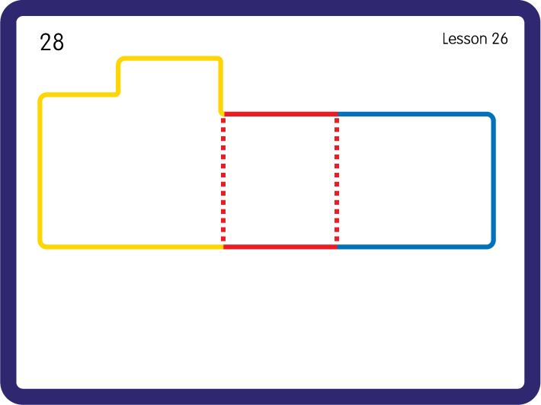
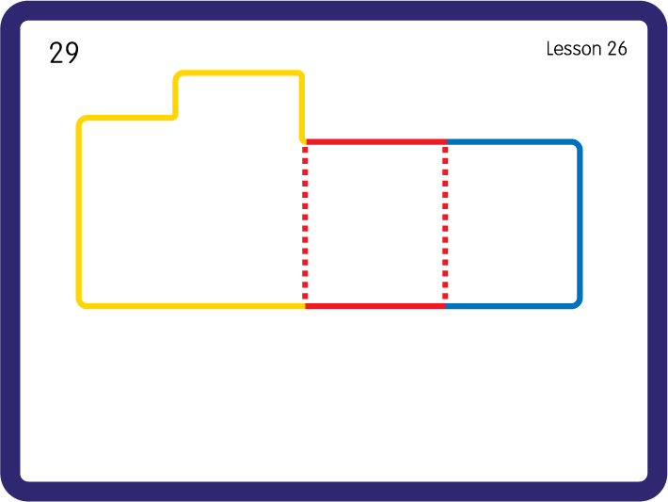
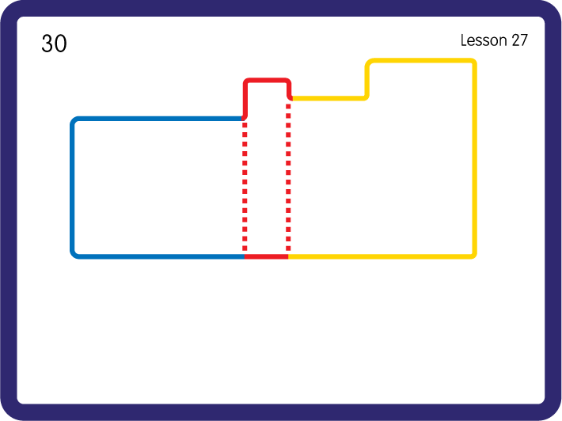
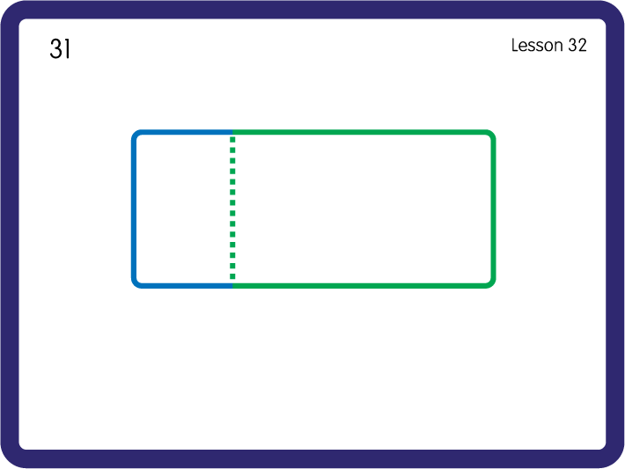
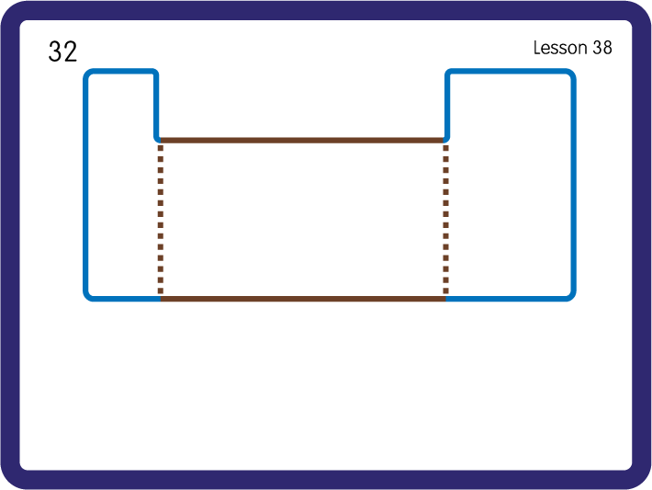
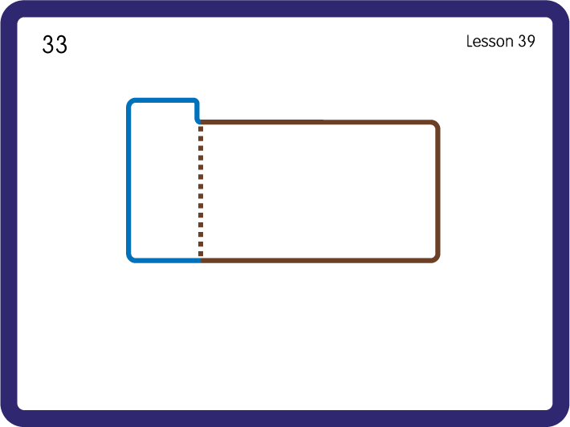
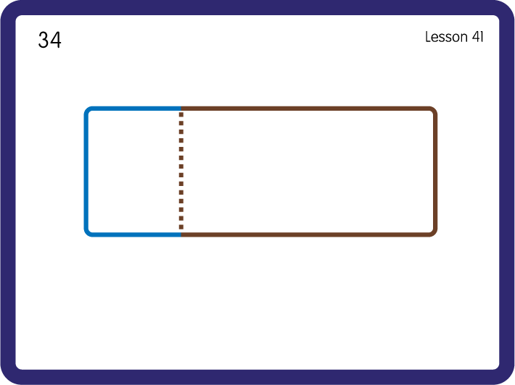
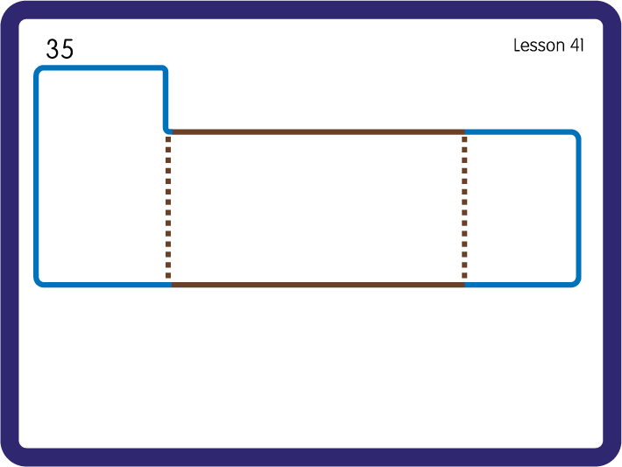
Practise High Frequency Words
USING JNL688
FRONT

