Slide 1




j | v | w | x | y | z | zz | qu | ch
sh | th | ng | ai | ee | igh | oa | oi | oo
ow | ar | air | ear | er | ur | or | ure
Review Common Exception Words and High Frequency Words
Lesson 50

Slide 2


Learn and practise Common Exception Words and High Frequency Words.
Recall all GPCs learned so far using flashcards.
Review all Phase 3 Common Exception Words learned so far push they me we be he she my by looked you are there.
Common Exception Word Cards Phase 2
Common Exception Word Cards Phase 3
High Frequency Word Cards
JNL687
JNL687
JNL688

Slide 3























Recall all GPCs learned so far using flashcards.

Slide 4
























Recall all GPCs learned so far using flashcards.

Slide 5













Review Phase 2 Common Exception Words as I is no go to into the put his has of pull full.

Slide 6




















Review Phase 3 Common Exception Words push they me we be he she my by looked you are there.

Slide 7
Practise Common Exception Words
USING JNL687
FRONT

Slide 8
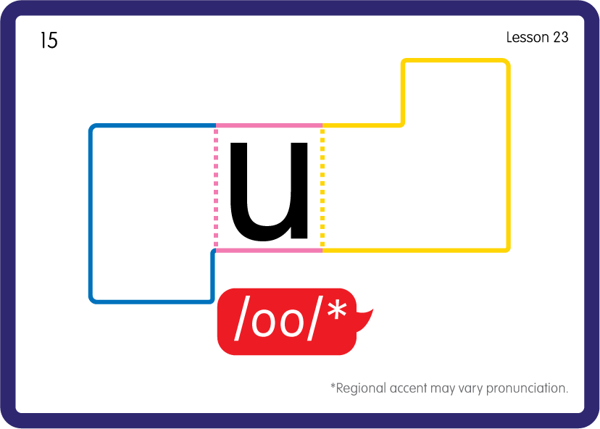
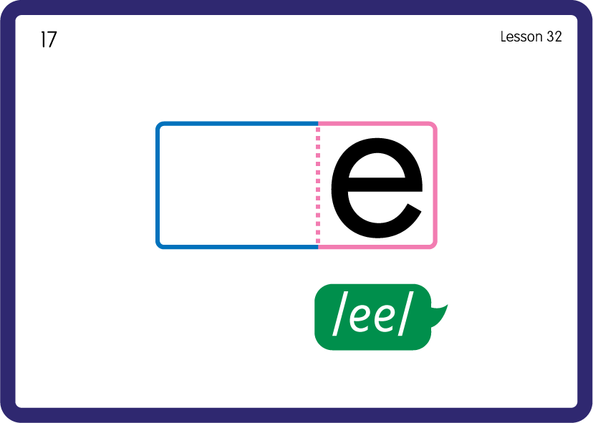
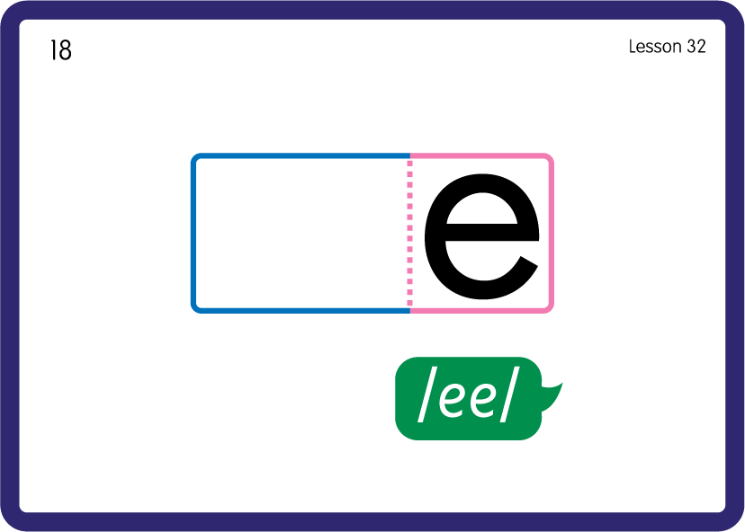
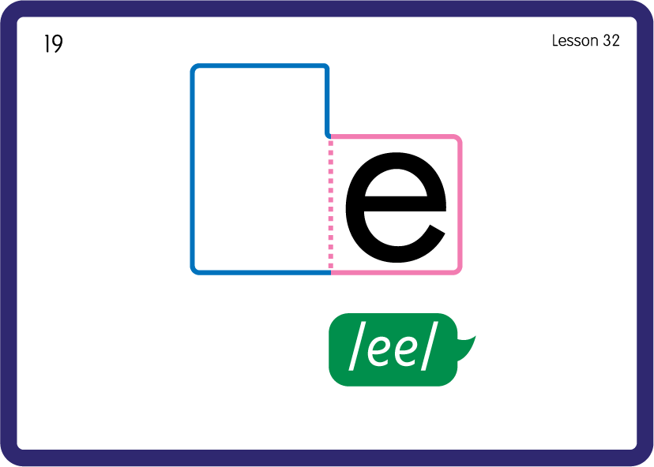
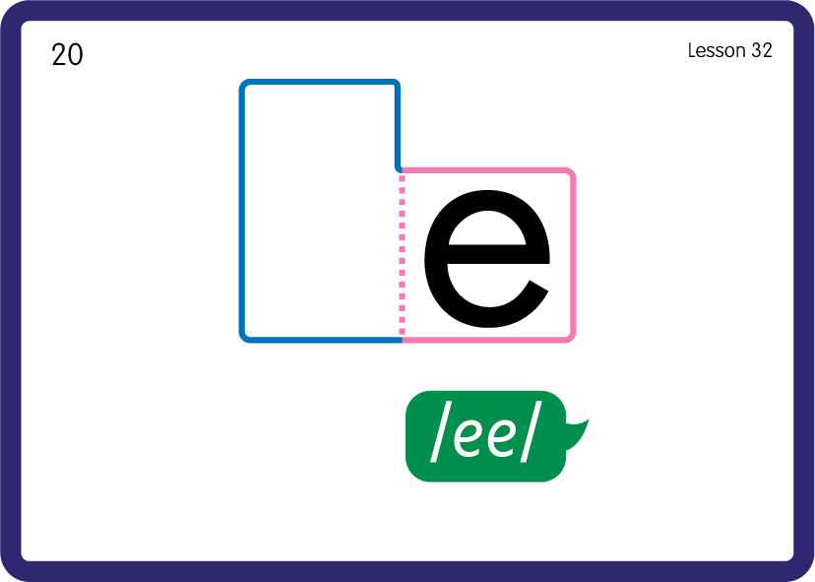
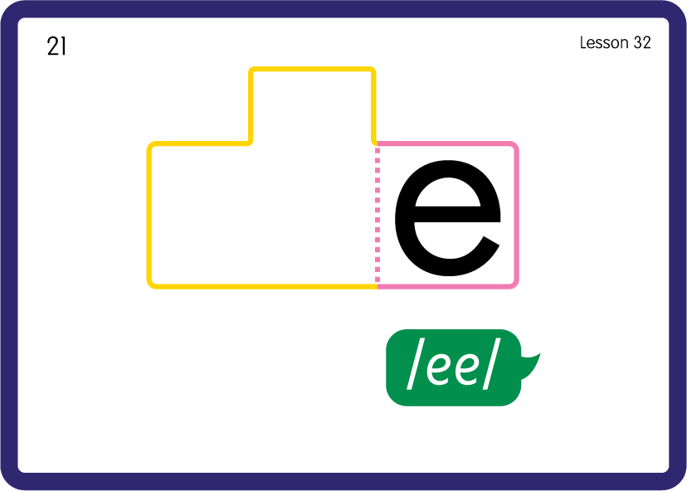
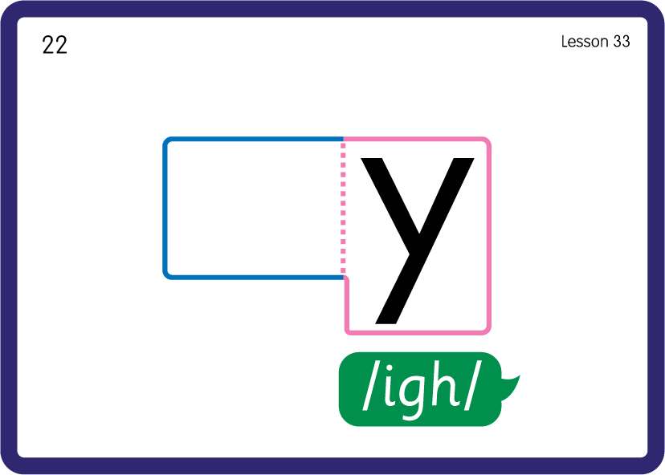
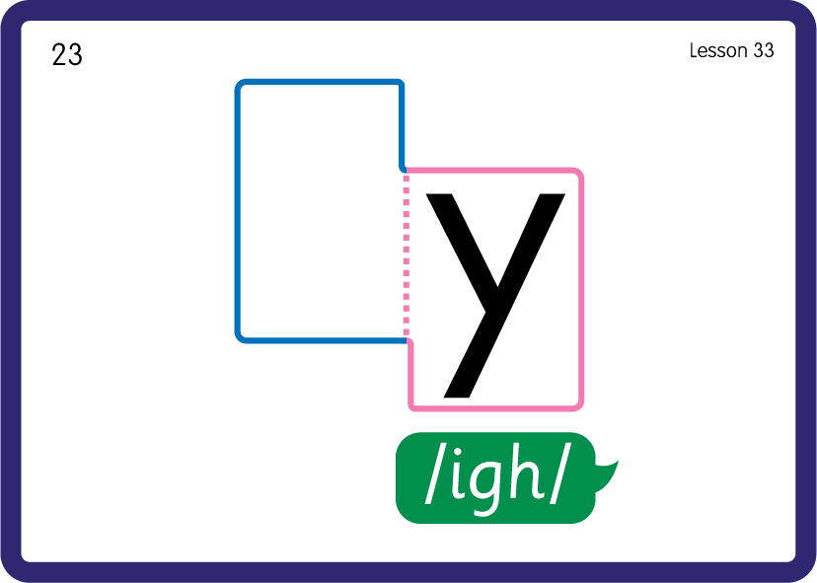
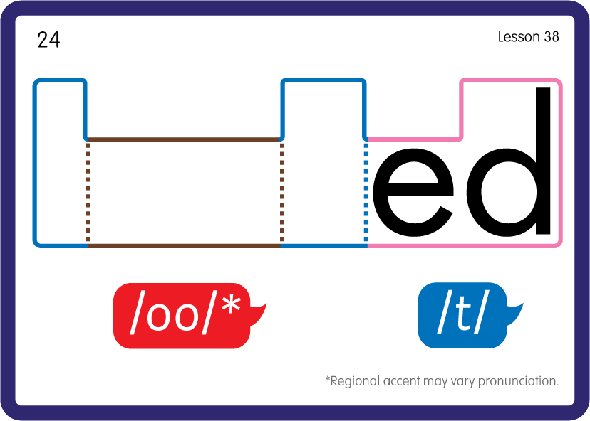



Practise Common Exception Words
USING JNL687
FRONT

Slide 9










Practise High Frequency Words
USING JNL688
FRONT

Slide 10
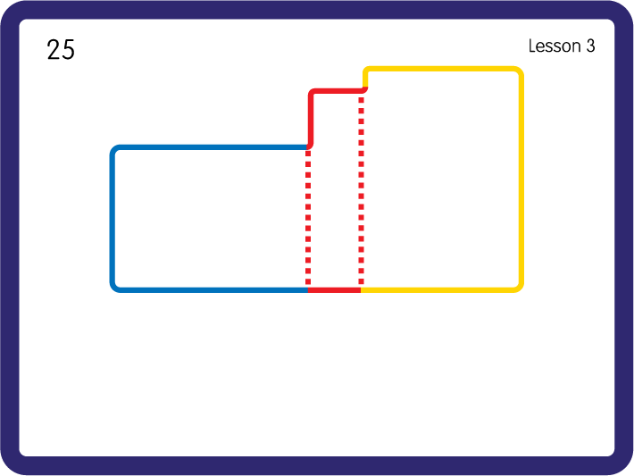
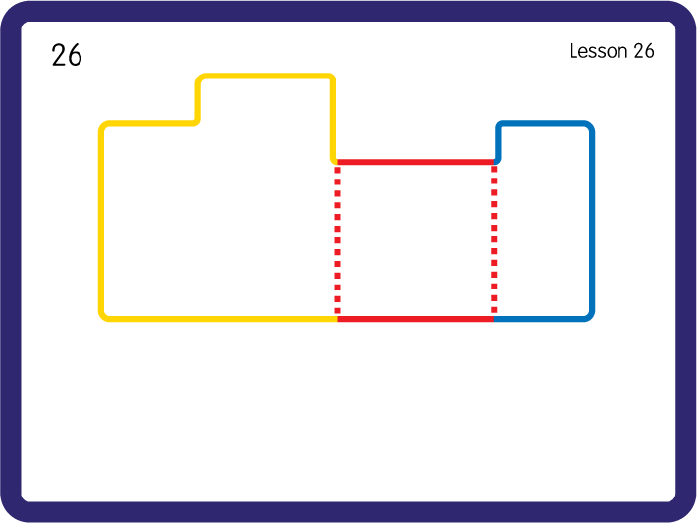
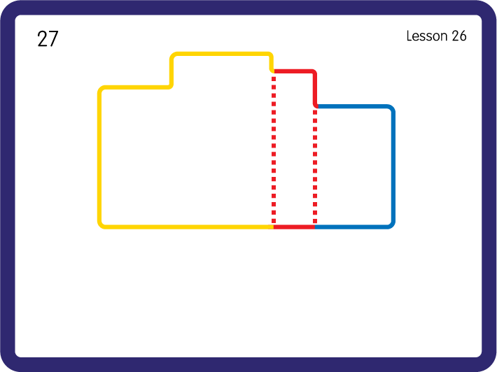
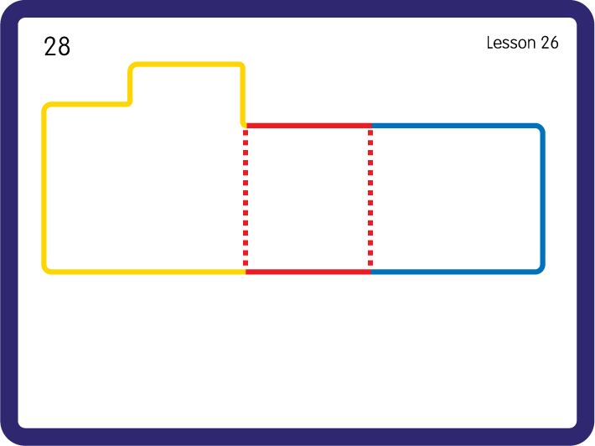
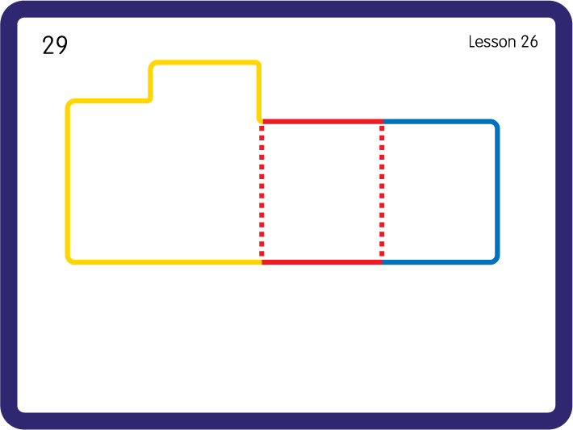
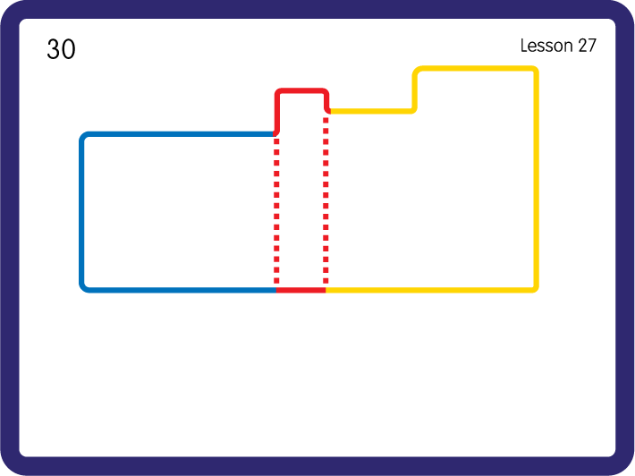
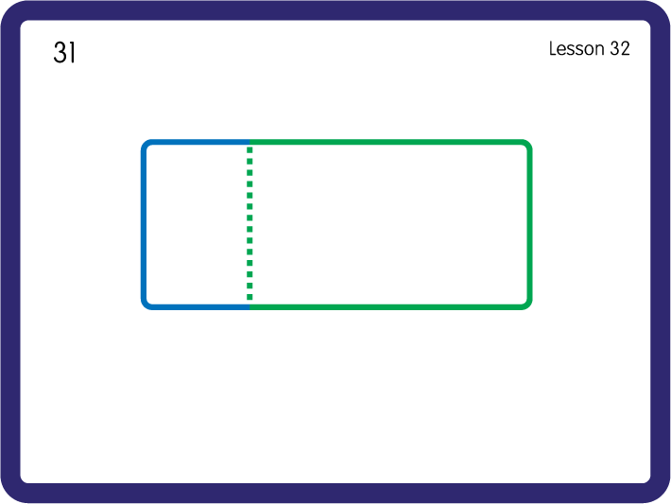
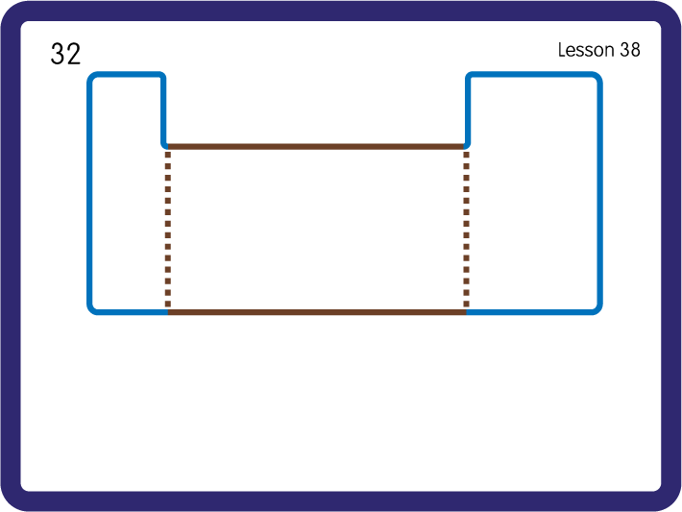
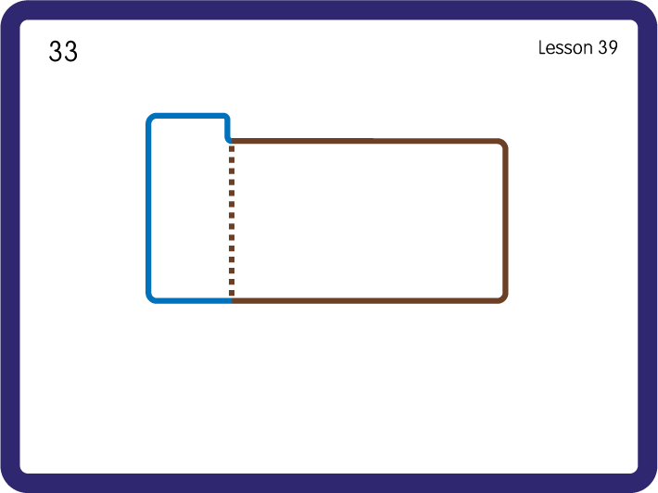
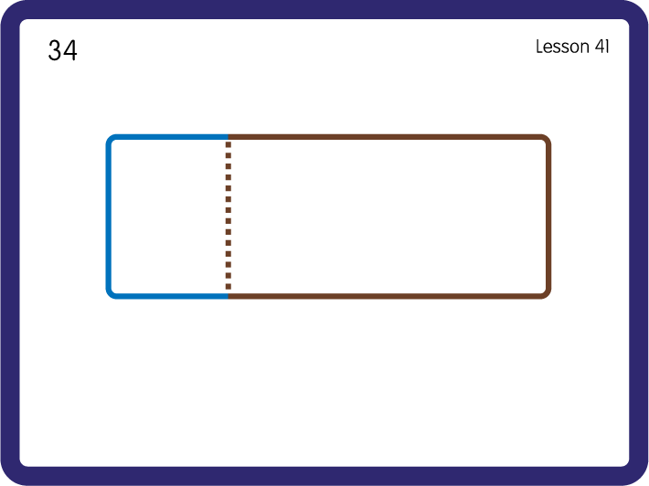
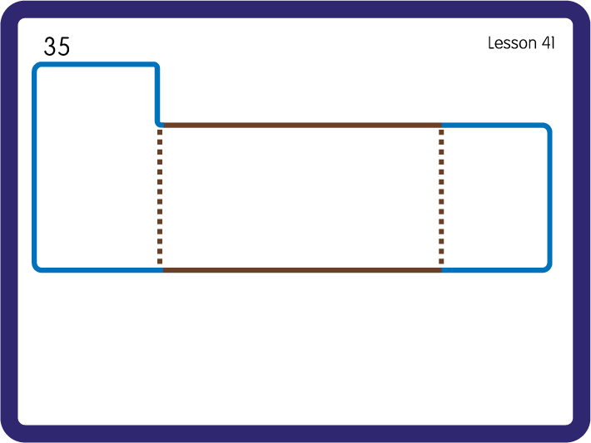
Practise High Frequency Words
USING JNL688
FRONT

