Slide 1



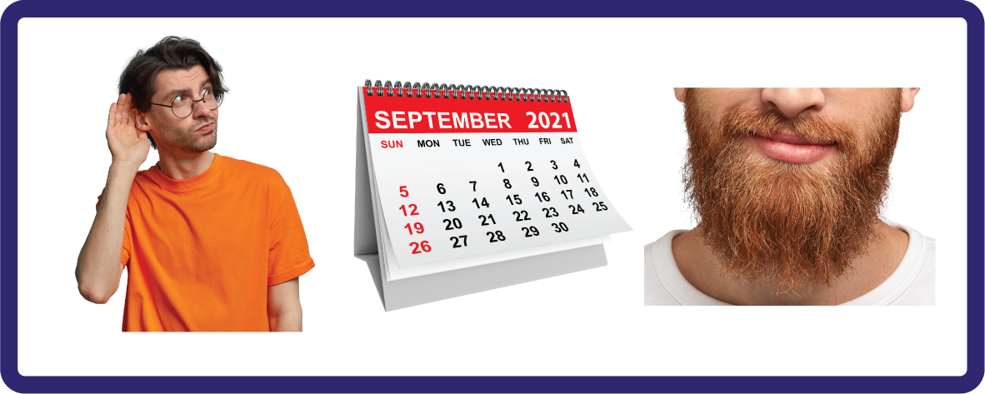
j | v | w | x | y | z | zz | qu | ch
sh | th | ng | ai | ee | igh | oa | oi | oo
ow | ar | air | ear | er | ur | or | ure
R-controlled Trigraph 'ear'
Lesson 51

Slide 2

Learn and practise r-controlled trigraph ear.
Recall all GPCs learned so far using flashcards.
Review Phase 2 & 3 Common Exception Words:
as I is no go to into the put his has of pull full
push they me we be he she my by looked you are there
Phonemic Awareness Cards
Grapheme to Phoneme Cards
Phoneme Frame Cards
Alien Word Cards
Common Exception Word Cards
JNL691
JNL686
JNL689
JNL692
JNL687

Slide 3























Recall all GPCs learned so far using flashcards.

Slide 4


















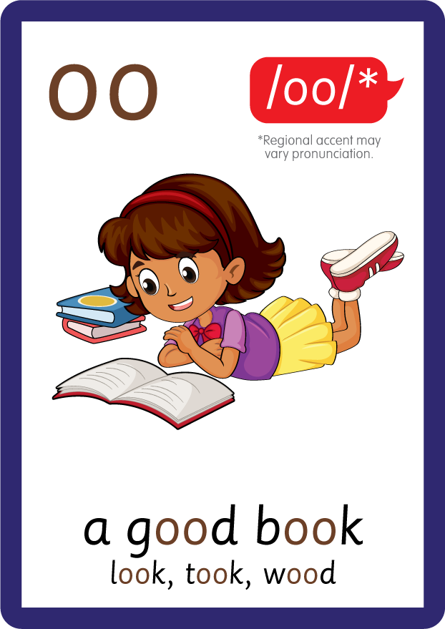





Recall all GPCs learned so far using flashcards.

Slide 5









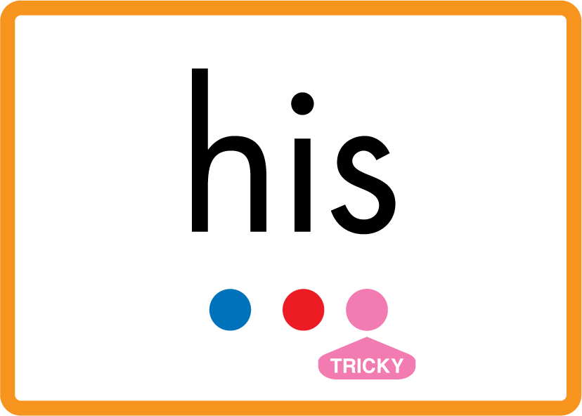




Review Phase 2 Common Exception Words as I is no go to into the put his has of pull full.

Slide 6



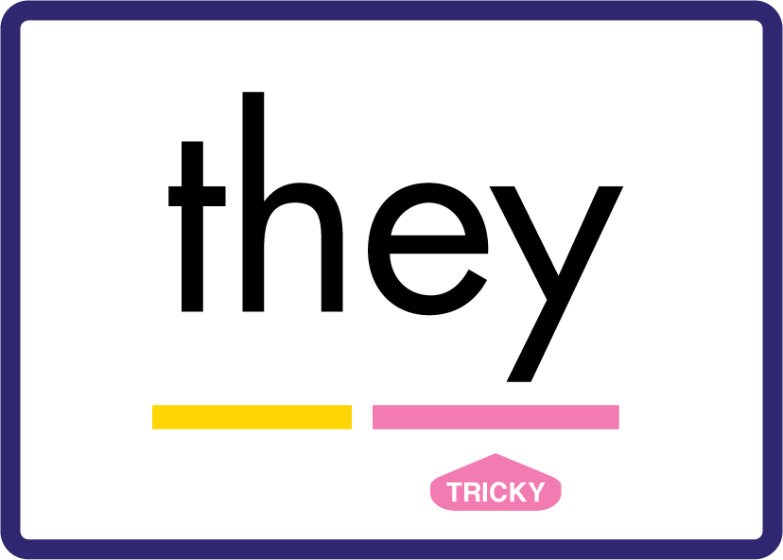






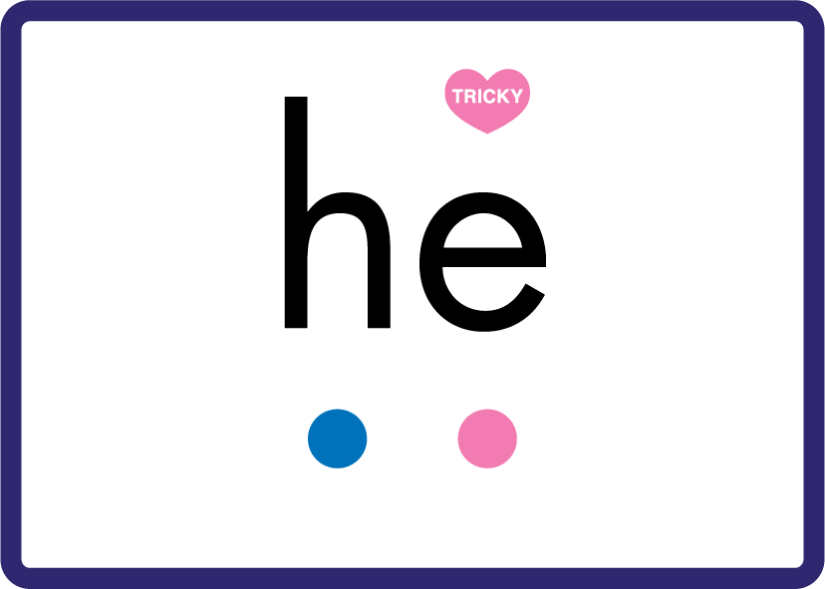













Review Phase 3 Common Exception Words push they me we be he she my by looked you are there.

Slide 7
Hear Phonemes
USING JNL691
FRONT

Slide 8
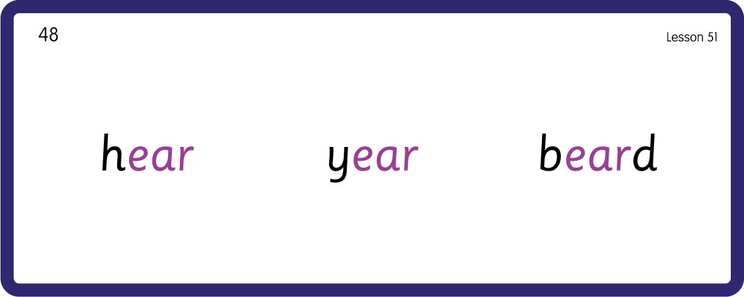
Hear Phonemes
USING JNL691
BACK

Slide 9
Teach Grapheme Caption
USING JNL686
FRONT

Slide 10
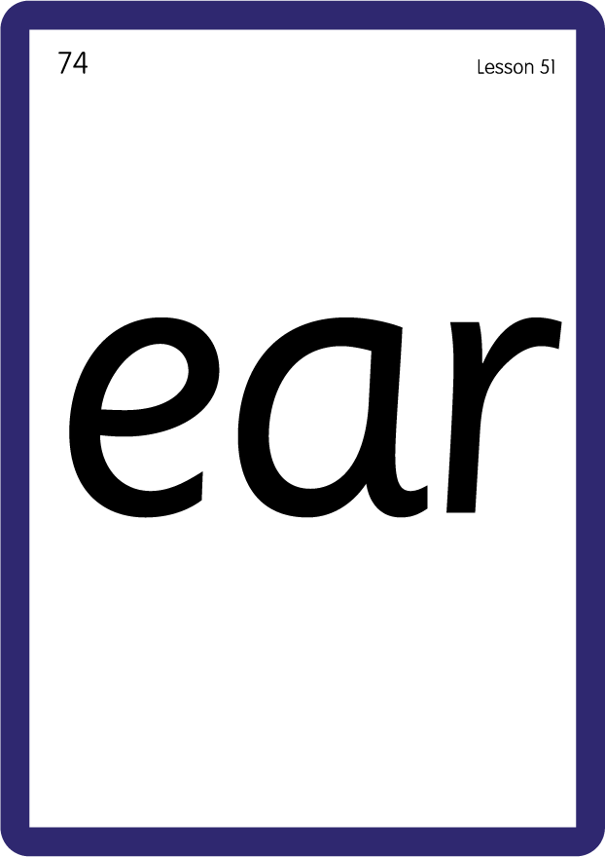
Review Lowercase Formation
USING JNL686
BACK

Slide 11

Explain Decoding

Slide 12
Model Blending Phonemes
h
ear
USING SOUND BUTTONS
Sound Buttons
Vowel
Consonant
Consonant Digraph
Long Vowel Sound
R-controlled Digraph
Split Digraph
Syllable / Silent Letter

Slide 13
Model Blending Phonemes
y
ear
USING SOUND BUTTONS
Sound Buttons
Vowel
Consonant
Consonant Digraph
Long Vowel Sound
R-controlled Digraph
Split Digraph
Syllable / Silent Letter

Slide 14

Explain Encoding

Slide 15
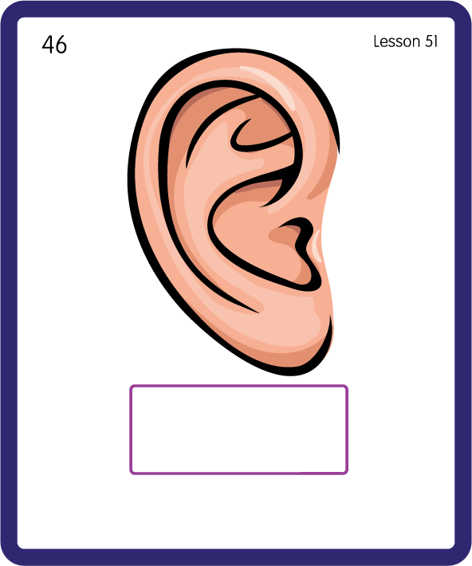
Build a Decodable Word
USING JNL689
BACK

Slide 16
Build a Decodable Word
USING JNL689
FRONT

Slide 17
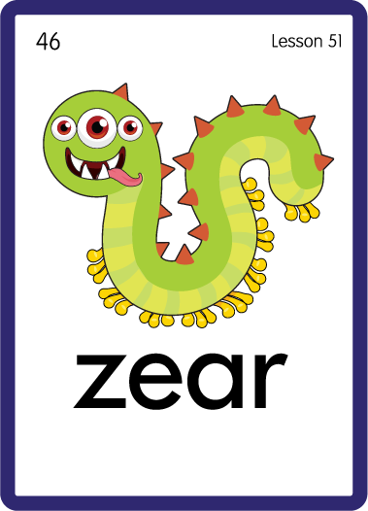
Practise with Alien Words
USING JNL692
BACK

Slide 18
Practise with Alien Words
USING JNL692
FRONT

Slide 19
Practise Common Exception Words
USING JNL687
FRONT

Slide 20
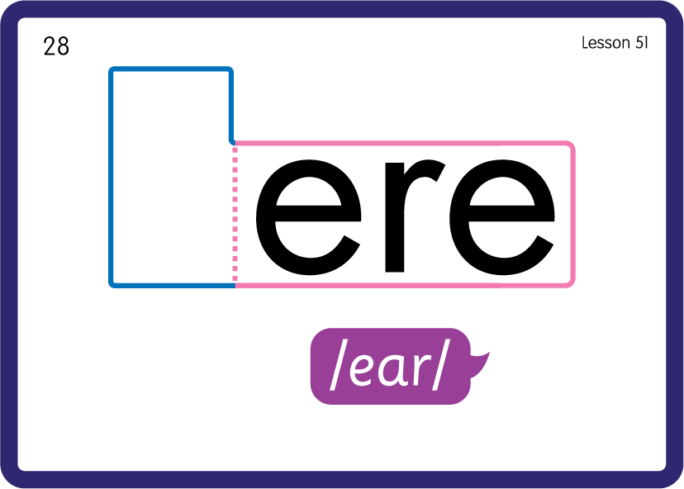
Practise Common Exception Words
USING JNL687
BACK

Slide 21

Practise Building Words
PRACTISE – 10MINS
t
d
f
h
n
g
y
r
ear
USING MAGNETIC LETTERS AND A WHITEBOARD

Slide 22
Practise Building Words
PRACTISE – 10MINS
t
d
f
h
n
g
y
r
ear
ear tear dear fear hear near gear year rear
USING MAGNETIC LETTERS AND A WHITEBOARD

