Slide 1




j | v | w | x | y | z | zz | qu | ch
sh | th | ng | ai | ee | igh | oa | oi | oo
ow | ar | air | ear | er | ur | or | ure
R-controlled Digraph 'er'
Lesson 52

Slide 2


Learn and practise r-controlled digraph er.
Recall all GPCs learned so far using flashcards.
Review Alphabet Song.
Phonemic Awareness Cards
Grapheme to Phoneme Cards
Phoneme Frame Cards
Alien Word Cards
Common Exception Word Cards
High Frequency Word Cards
JNL691
JNL686
JNL689
JNL692
JNL687
JNL688

Slide 3























Recall all GPCs learned so far using flashcards.

Slide 4

























Recall all GPCs learned so far using flashcards.

Slide 5














Review Phase 2 Common Exception Words as I is no go to into the put his has of pull full.

Slide 6

























Review Phase 3 Common Exception Words push they me we be he she my by looked you are there here.

Slide 7

Review the Alphabet Song.
a, b, c, d, e, f, g (pause)
h, i, j, k, l, m, n (pause)
o, p, q (pause) r, s, t (pause)
u v w (pause) x y z (pause)
Now I know my abc's, Next time won't you sing with me.

Slide 8
Hear Phonemes
USING JNL691
FRONT

Slide 9
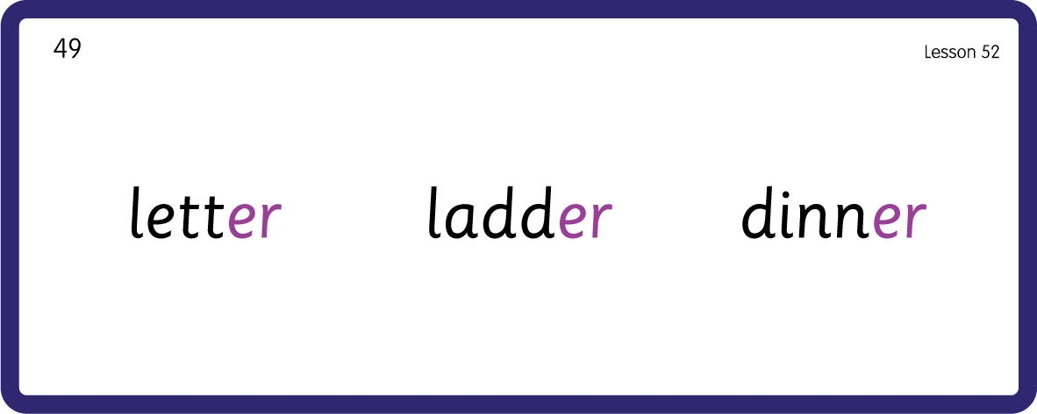
Hear Phonemes
USING JNL691
BACK

Slide 10
Teach Grapheme Caption
USING JNL686
FRONT

Slide 11
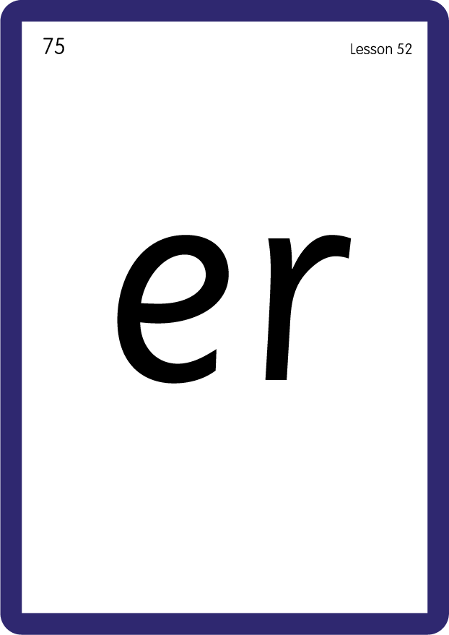
Review Lowercase Formation
USING JNL686
BACK

Slide 12

Explain Decoding

Slide 13
Model Blending Phonemes
l
e
t t
er
USING SOUND BUTTONS
Sound Buttons
Vowel
Consonant
Consonant Digraph
Long Vowel Sound
R-controlled Digraph
Split Digraph
Syllable / Silent Letter

Slide 14
Model Blending Phonemes
l
dd
er
a
USING SOUND BUTTONS
Sound Buttons
Vowel
Consonant
Consonant Digraph
Long Vowel Sound
R-controlled Digraph
Split Digraph
Syllable / Silent Letter

Slide 15

Explain Encoding

Slide 16
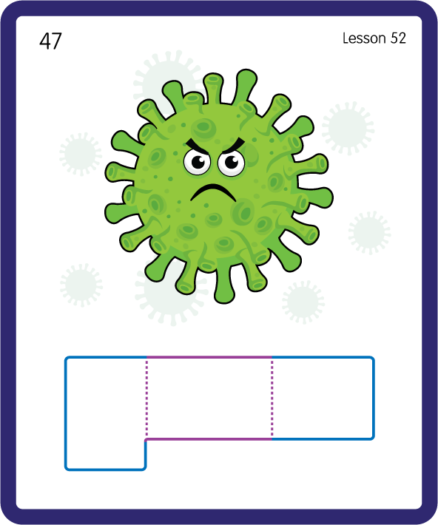
Build a Decodable Word
USING JNL689
BACK

Slide 17
Build a Decodable Word
USING JNL689
FRONT

Slide 18
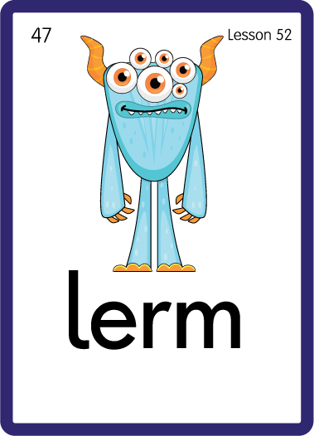
Practise with Alien Words
USING JNL692
BACK

Slide 19
Practise with Alien Words
USING JNL692
FRONT

Slide 20
Practise Common Exception Words
USING JNL687
FRONT

Slide 21
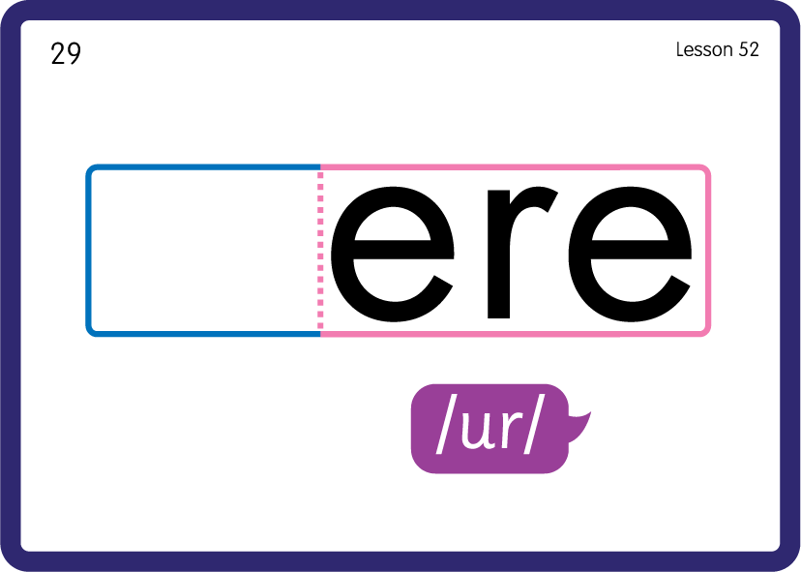
Practise Common Exception Words
USING JNL687
BACK

Slide 22
Practise High Frequency Words
USING JNL688
FRONT

Slide 23
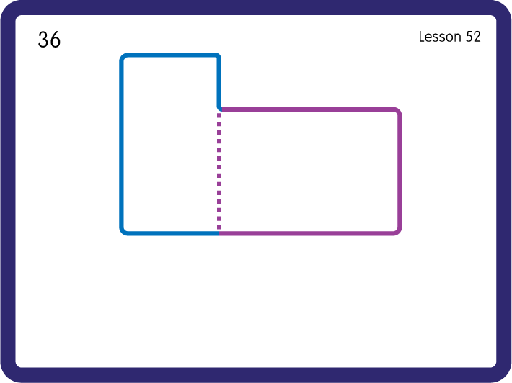
Practise High Frequency Words
USING JNL688
BACK

Slide 24

Practise Building Words
PRACTISE – 10MINS
g
t
m
n
p
c
d
n
l
a
i
d
or
er
USING MAGNETIC LETTERS AND A WHITEBOARD

Slide 25
Practise Building Words
PRACTISE – 10MINS
g
t
m
n
p
c
d
n
l
a
i
d
or
er
germ term perm corner ladder dinner
USING MAGNETIC LETTERS AND A WHITEBOARD

