Slide 1

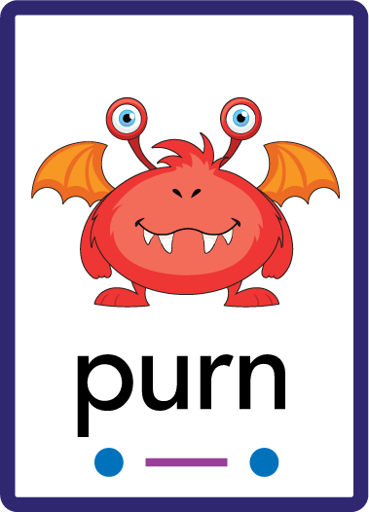
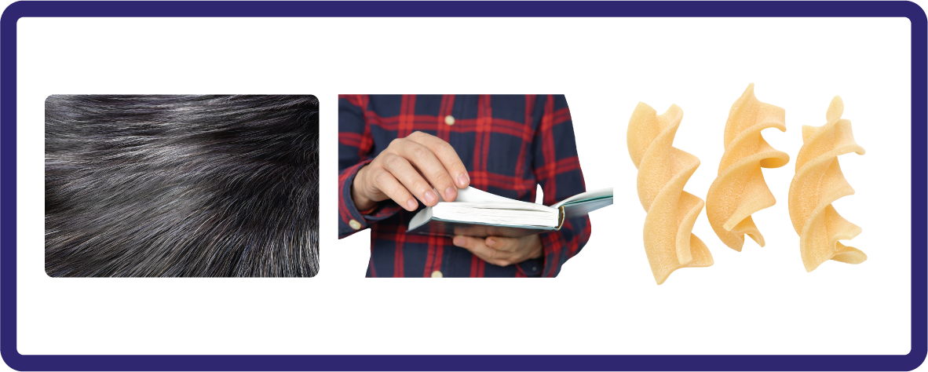
j | v | w | x | y | z | zz | qu | ch
sh | th | ng | ai | ee | igh | oa | oi | oo
ow | ar | air | ear | er | ur | or | ure
R-controlled Digraph 'ur'
Lesson 53

Slide 2

Learn and practise r-controlled digraph ur.
Recall all GPCs learned so far using flashcards.
Review Phase 2 & 3 Common Exception Words:
as I is no go to into the put his has of pull full
push they me we be he she my by looked you are there
Phonemic Awareness Cards
Grapheme to Phoneme Cards
Phoneme Frame Cards
Alien Word Cards
JNL691
JNL686
JNL689
JNL692

Slide 3























Recall all GPCs learned so far using flashcards.

Slide 4






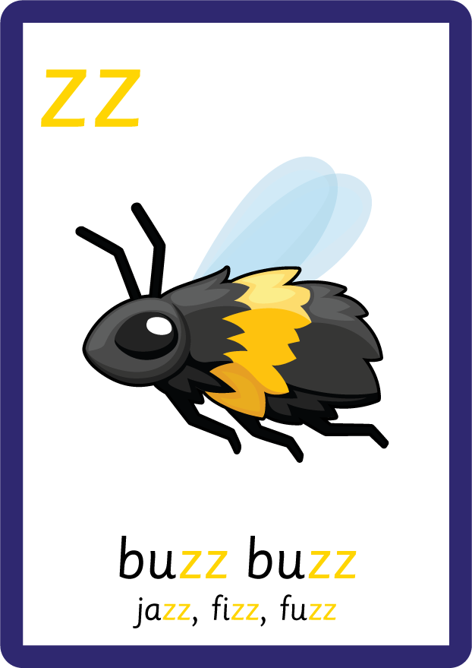



















Recall all GPCs learned so far using flashcards.

Slide 5














Review Phase 2 Common Exception Words as I is no go to into the put his has of pull full.

Slide 6








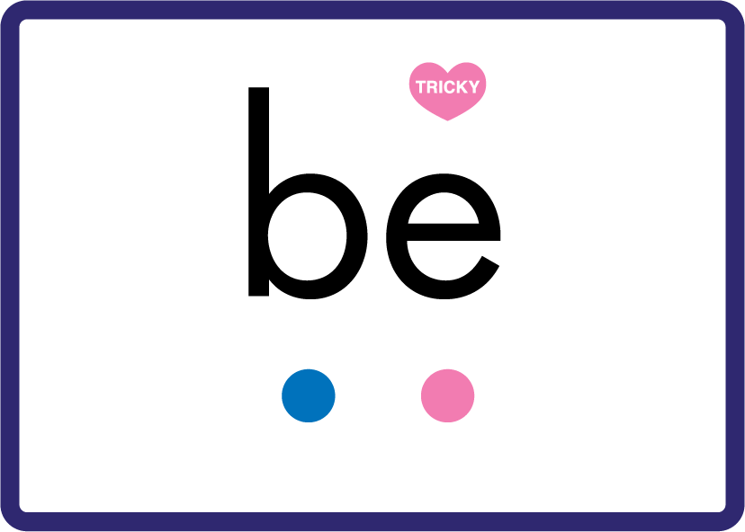





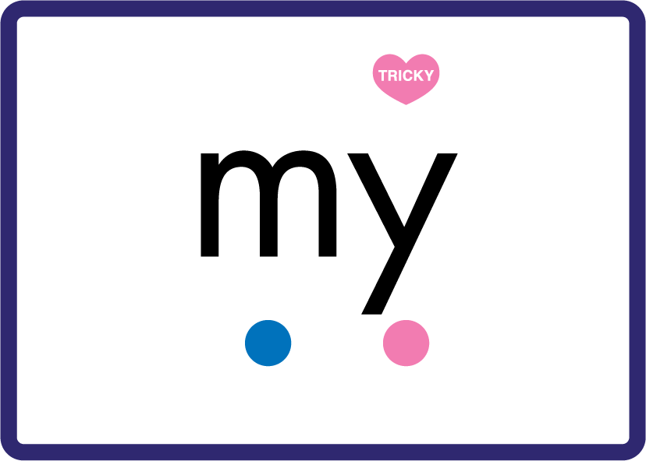











Review Phase 3 Common Exception Words push they me we be he she my by looked you are there here were.

Slide 7
Hear Phonemes
USING JNL691
FRONT

Slide 8
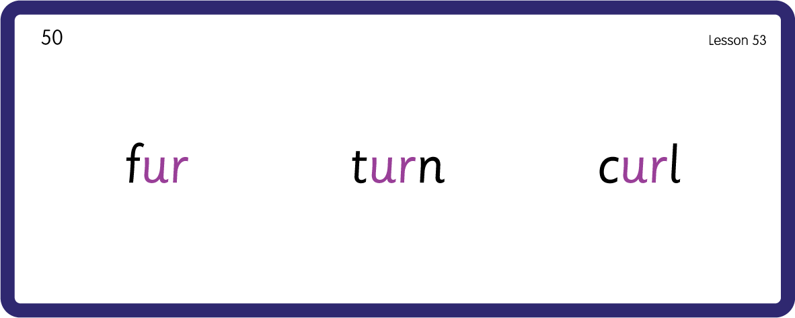
Hear Phonemes
USING JNL691
BACK

Slide 9
Teach Grapheme Caption
USING JNL686
FRONT

Slide 10
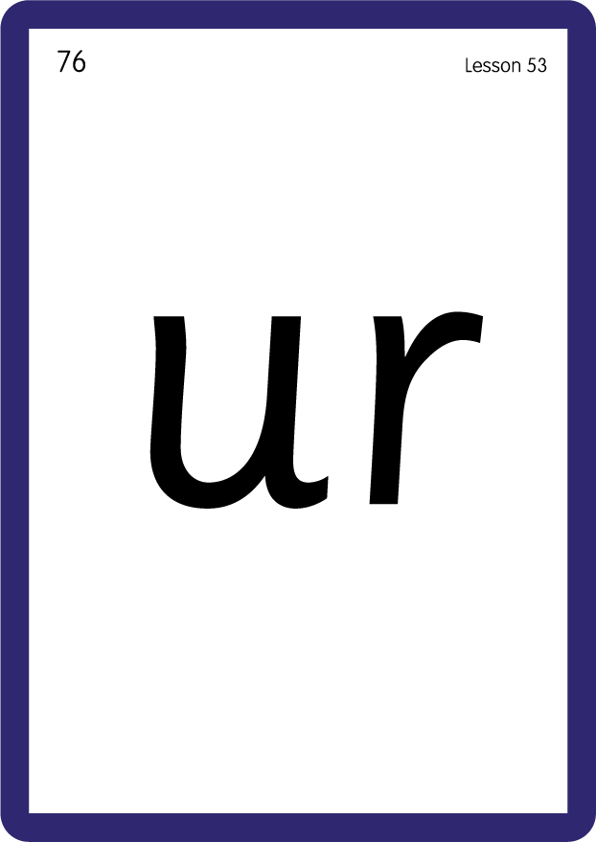
Review Lowercase Formation
USING JNL686
BACK

Slide 11

Explain Decoding

Slide 12
Model Blending Phonemes
f
ur
USING SOUND BUTTONS
Sound Buttons
Vowel
Consonant
Consonant Digraph
Long Vowel Sound
R-controlled Digraph
Split Digraph
Syllable / Silent Letter

Slide 13
Model Blending Phonemes
t
ur
n
USING SOUND BUTTONS
Sound Buttons
Vowel
Consonant
Consonant Digraph
Long Vowel Sound
R-controlled Digraph
Split Digraph
Syllable / Silent Letter

Slide 14

Explain Encoding

Slide 15
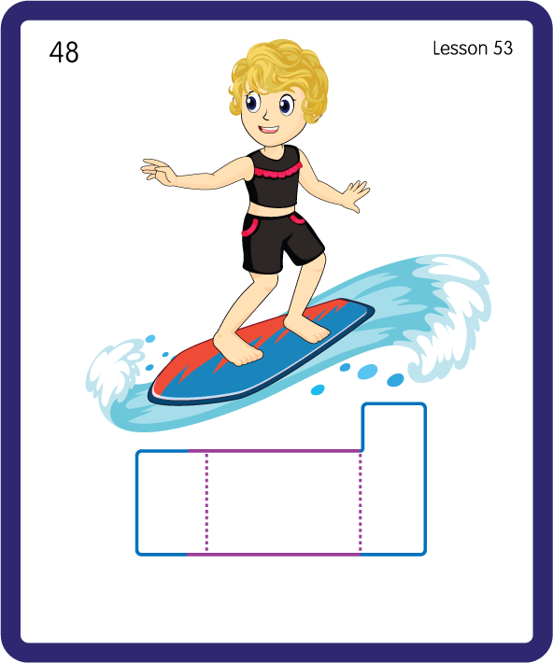
Build a Decodable Word
USING JNL689
BACK

Slide 16
Build a Decodable Word
USING JNL689
FRONT

Slide 17
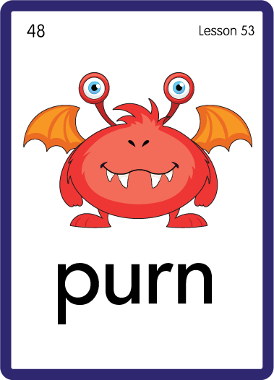
Practise with Alien Words
USING JNL692
BACK

Slide 18
Practise with Alien Words
USING JNL692
FRONT

Slide 19

Practise Building Words
PRACTISE – 10MINS
f
b
n
p
t
h
s
c
l
ur
USING MAGNETIC LETTERS AND A WHITEBOARD

Slide 20
Practise Building Words
PRACTISE – 10MINS
f
b
n
p
t
h
s
c
l
ur
fur burn burp hurt turn surf curl
USING MAGNETIC LETTERS AND A WHITEBOARD

