Slide 1


j | v | w | x | y | z | zz | qu | ch
sh | th | ng | ai | ee | igh | oa | oi | oo
ow | ar | air | ear | er | ur | or | ure
Compare 'er' and 'ur'
Lesson 54
vs.

Slide 2





Compare r-controlled digraphs er and ur.
Recall all GPCs learned so far using flashcards.
Review Alphabet Song.
Phonemic Awareness Cards
Grapheme to Phoneme Cards
Phoneme Frame Cards
Alien Word Cards
Common Exception Word Cards
High Frequency Word Cards
JNL691
JNL686
JNL689
JNL692
JNL687
JNL688

Slide 3























Recall all GPCs learned so far using flashcards.

Slide 4

























Recall all GPCs learned so far using flashcards.

Slide 5

Review the Alphabet Song.
a, b, c, d, e, f, g (pause)
h, i, j, k, l, m, n (pause)
o, p, q (pause) r, s, t (pause)
u v w (pause) x y z (pause)
Now I know my abc's, Next time won't you sing with me.

Slide 6
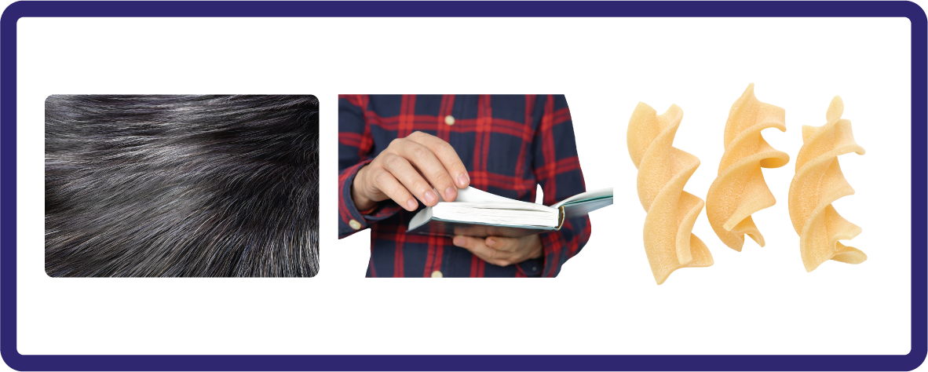
Hear Phonemes
USING JNL691
FRONT

Slide 7
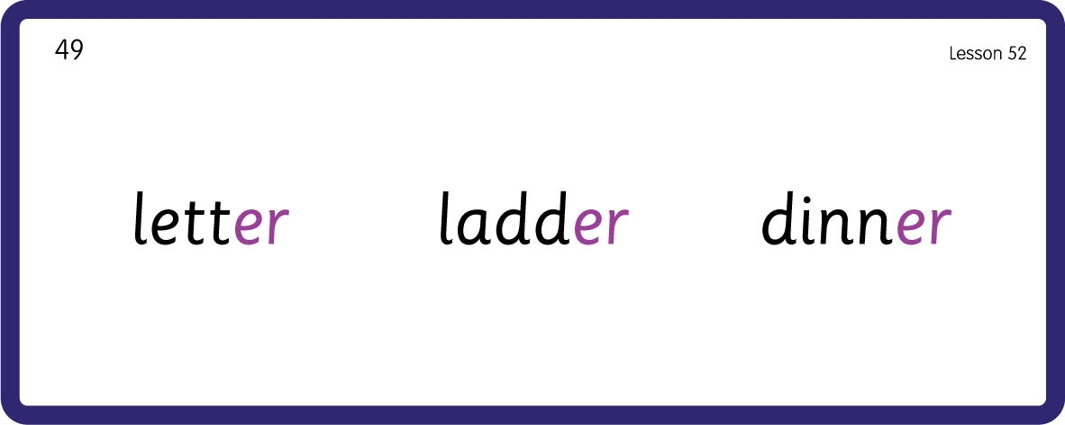

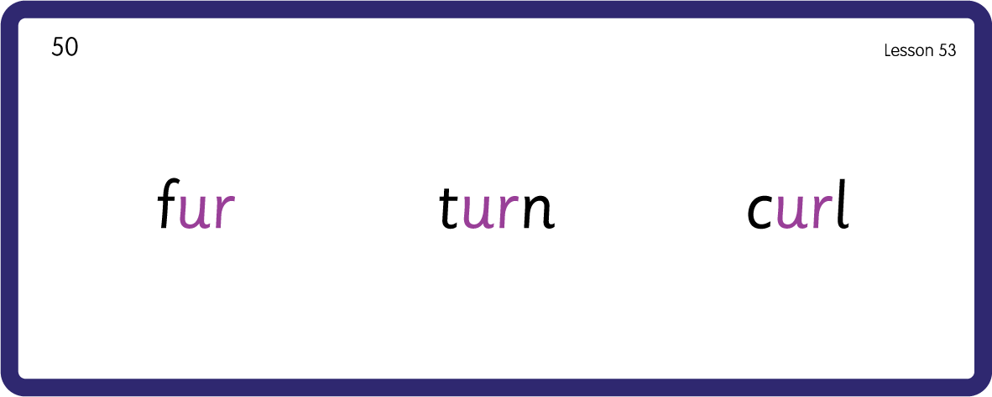
Hear Phonemes
/er/
/ur/
USING JNL691
BACK

Slide 8
Review Grapheme Caption
USING JNL686
FRONT

Slide 9
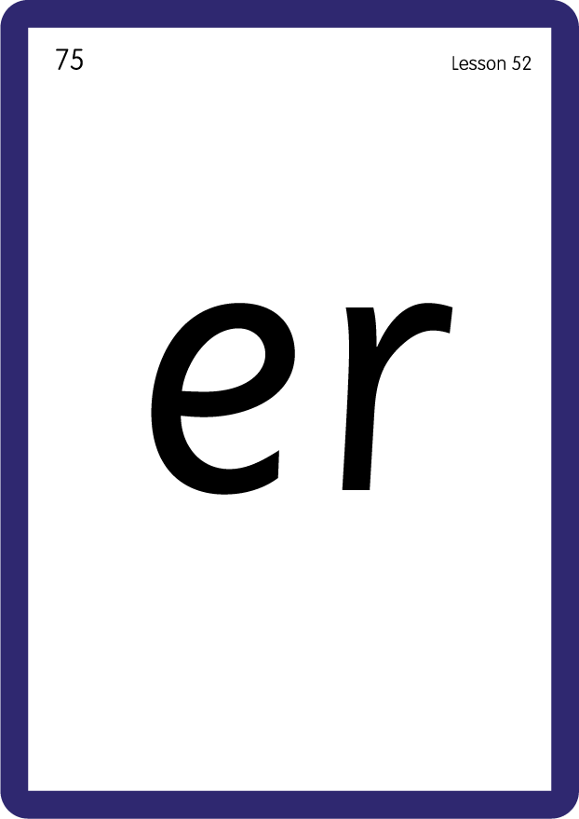
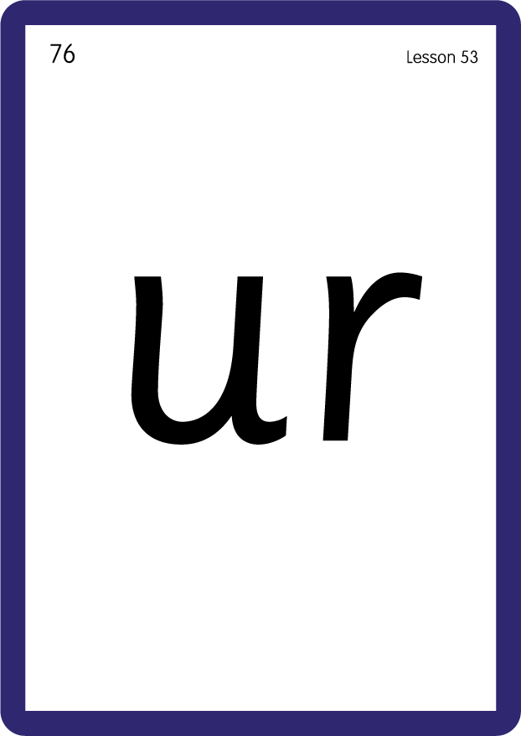
Review Lowercase Formation
USING JNL686
BACK

Slide 10

Explain Decoding

Slide 11
Model Blending Phonemes
b
o
x
er
USING SOUND BUTTONS
Sound Buttons
Vowel
Consonant
Consonant Digraph
Long Vowel Sound
R-controlled Digraph
Split Digraph
Syllable / Silent Letter

Slide 12
Model Blending Phonemes
b
ur
n
USING SOUND BUTTONS
Sound Buttons
Vowel
Consonant
Consonant Digraph
Long Vowel Sound
R-controlled Digraph
Split Digraph
Syllable / Silent Letter

Slide 13
Model Blending Phonemes
d
i
nn
er
USING SOUND BUTTONS
Sound Buttons
Vowel
Consonant
Consonant Digraph
Long Vowel Sound
R-controlled Digraph
Split Digraph
Syllable / Silent Letter

Slide 14
Model Blending Phonemes
c
ur
l
USING SOUND BUTTONS
Sound Buttons
Vowel
Consonant
Consonant Digraph
Long Vowel Sound
R-controlled Digraph
Split Digraph
Syllable / Silent Letter

Slide 15

Explain Encoding

Slide 16

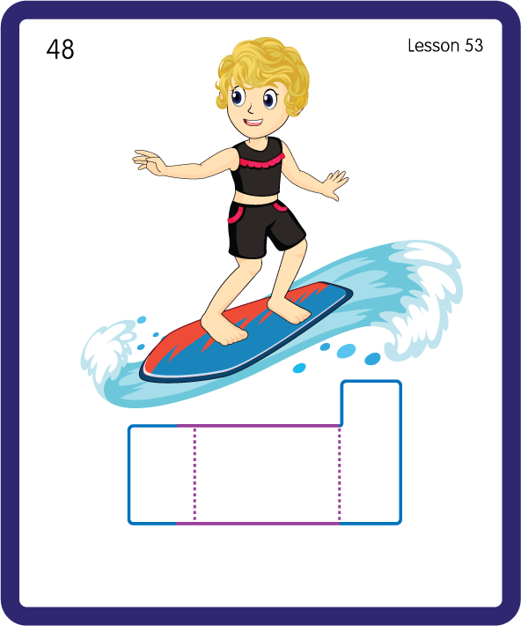
Build a Decodable Word
USING JNL689
BACK

Slide 17

Build a Decodable Word
USING JNL689
FRONT

Slide 18

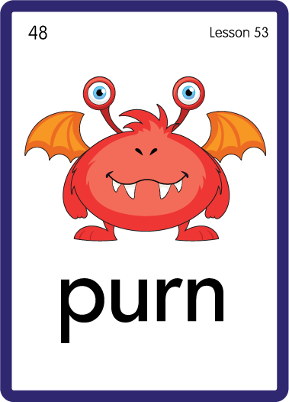
Practise with Alien Words
USING JNL692
BACK

Slide 19

Practise with Alien Words
USING JNL692
FRONT

Slide 20
Practise Common Exception Words
USING JNL687
FRONT

Slide 21
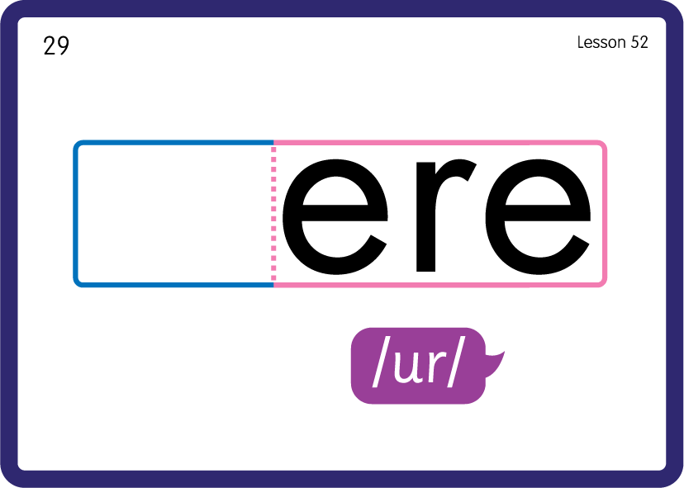
Practise Common Exception Words
USING JNL687
BACK

Slide 22
Practise High Frequency Words
USING JNL688
FRONT

Slide 23
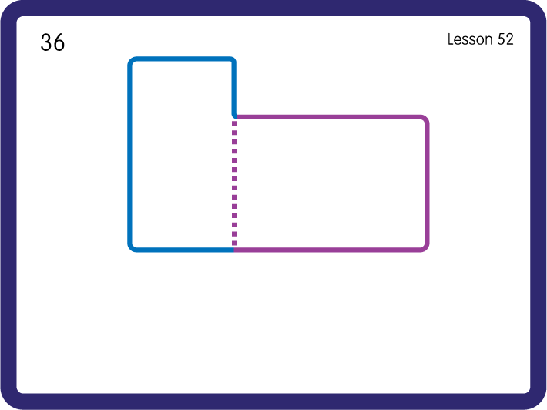
Practise High Frequency Words
USING JNL688
BACK

