Slide 1
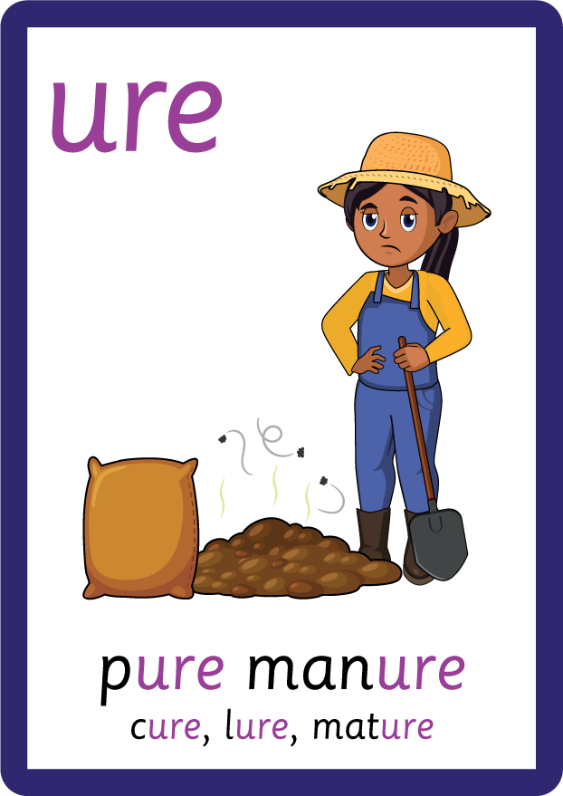


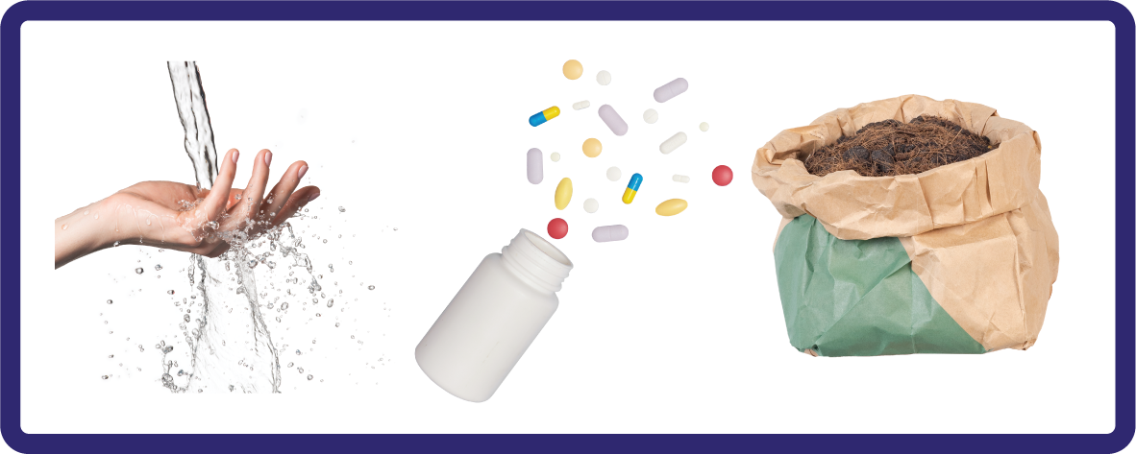
j | v | w | x | y | z | zz | qu | ch
sh | th | ng | ai | ee | igh | oa | oi | oo
ow | ar | air | ear | er | ur | or | ure
R-controlled Trigraph 'ure'
Lesson 57

Slide 2

Learn and practise r-controlled trigraph ure.
Recall all GPCs learned so far using flashcards.
Review Alphabet Song.
Phonemic Awareness Cards
Grapheme to Phoneme Cards
Phoneme Frame Cards
Alien Word Cards
Common Exception Word Cards
JNL691
JN686
JN689
JN692
JN687

Slide 3























Recall all GPCs learned so far using flashcards.

Slide 4




























Recall all GPCs learned so far using flashcards.

Slide 5














Review Phase 2 Common Exception Words as I is no go to into the put his has of pull full.

Slide 6



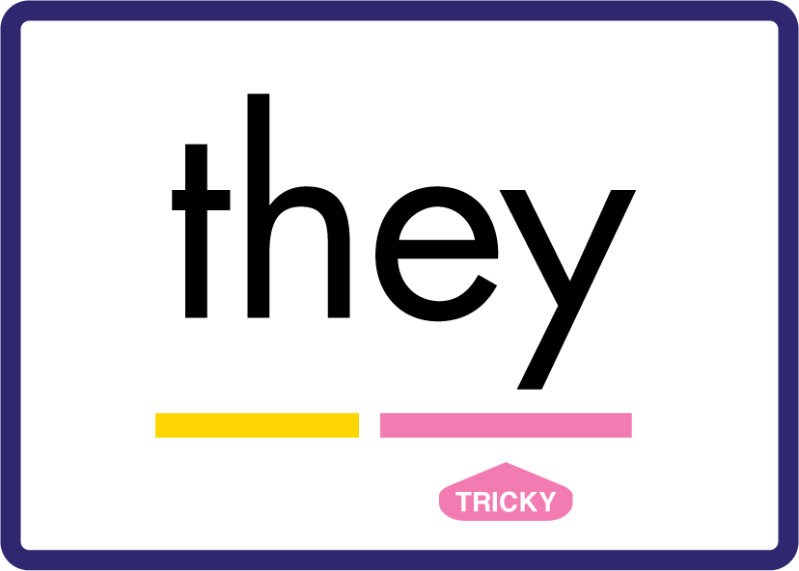




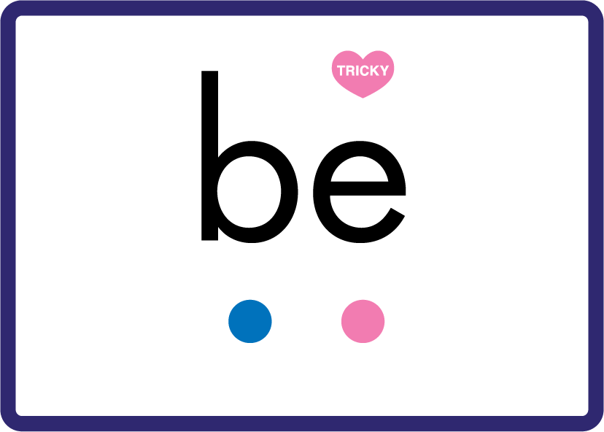





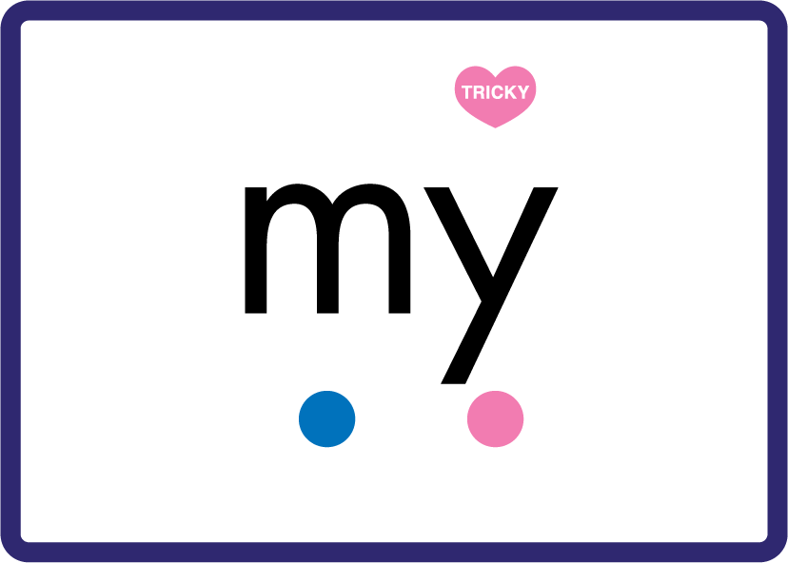

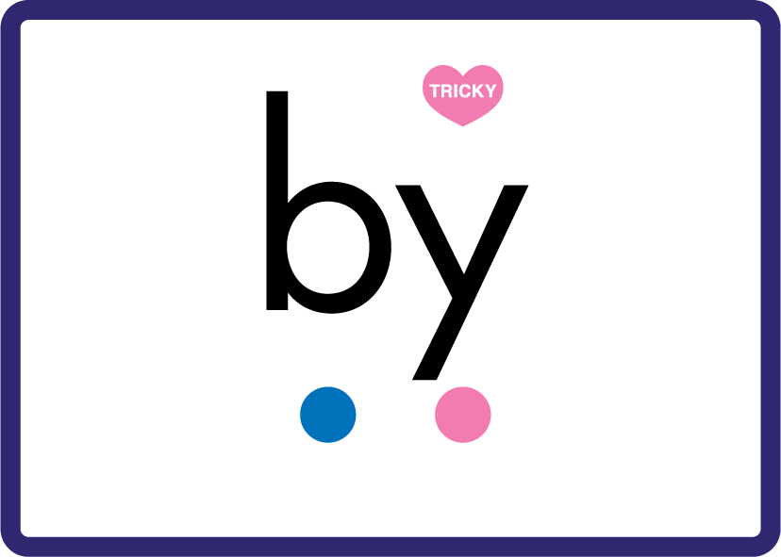









Review Phase 3 Common Exception Words push they me we be he she my by looked you are there here were.

Slide 7

Review the Alphabet Song.
a, b, c, d, e, f, g (pause)
h, i, j, k, l, m, n (pause)
o, p, q (pause) r, s, t (pause)
u v w (pause) x y z (pause)
Now I know my abc's, Next time won't you sing with me.

Slide 8
Hear Phonemes
USING JN691
FRONT

Slide 9
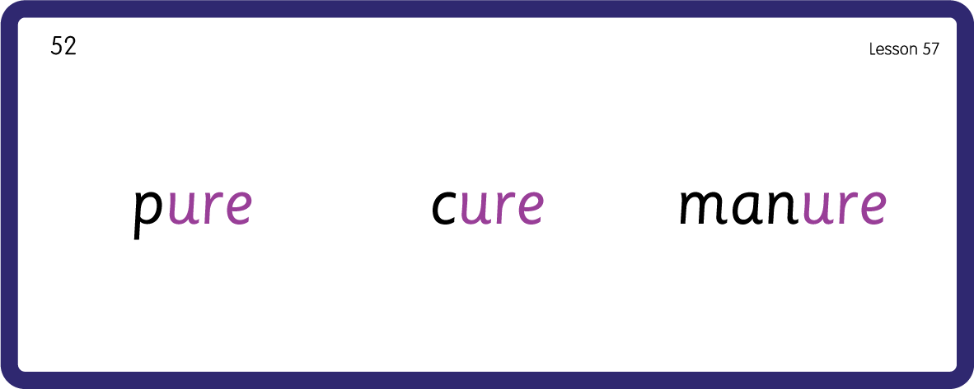
Hear Phonemes
USING JN691
BACK

Slide 10
Teach Grapheme Caption
USING JN686
FRONT

Slide 11

Review Lowercase Formation
USING JN686
BACK

Slide 12

Explain Decoding

Slide 13
Model Blending Phonemes
d
v
e
n
a
t
ure
USING SOUND BUTTONS
Sound Buttons
Vowel
Consonant
Consonant Digraph
Long Vowel Sound
R-controlled Digraph
Split Digraph
Syllable / Silent Letter

Slide 14
Model Blending Phonemes
c
ure
USING SOUND BUTTONS
Sound Buttons
Vowel
Consonant
Consonant Digraph
Long Vowel Sound
R-controlled Digraph
Split Digraph
Syllable / Silent Letter

Slide 15

Explain Encoding

Slide 16
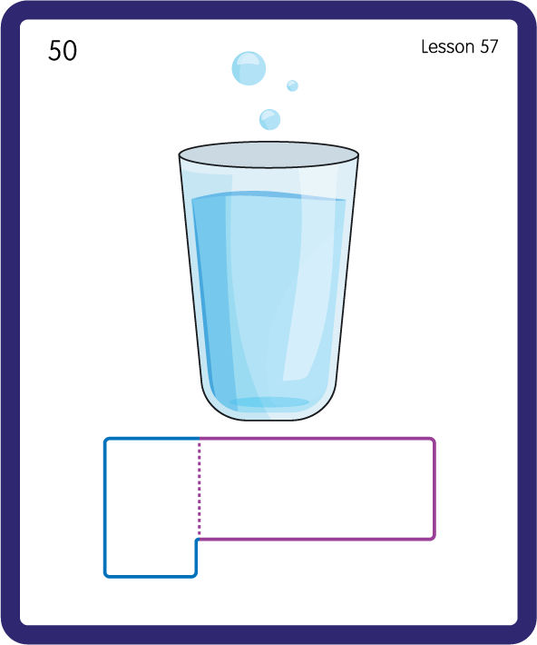
Build a Decodable Word
USING JN689
BACK

Slide 17
Build a Decodable Word
USING JN689
FRONT

Slide 18
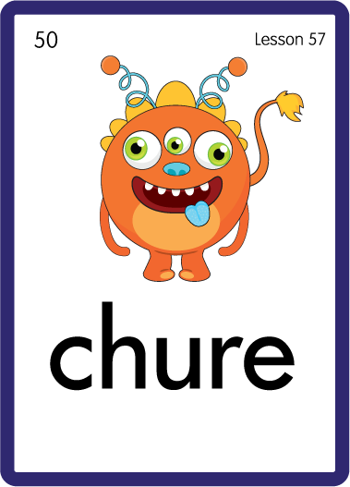
Practise with Alien Words
USING JN692
BACK

Slide 19
Practise with Alien Words
USING JN692
FRONT

Slide 20
Practise Common Exception Words
USING JN687
FRONT

Slide 21
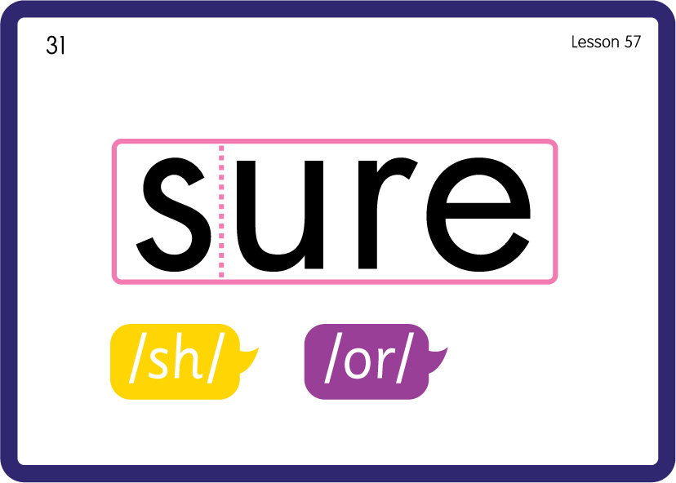
Practise Common Exception Words
USING JN687
FRONT

Slide 22

Practise Building Words
PRACTISE – 10MINS
p
c
m
a
t
ure
USING MAGNETIC LETTERS AND A WHITEBOARD

Slide 23
Practise Building Words
PRACTISE – 10MINS
p
c
m
a
n
ure
pure cure manure
USING MAGNETIC LETTERS AND A WHITEBOARD

