Slide 1


j | v | w | x | y | z | zz | qu | ch
sh | th | ng | ai | ee | igh | oa | oi | oo
ow | ar | air | ear | er | ur | or | ure
Compare 'ur' and 'ure'
Lesson 58
vs.

Slide 2

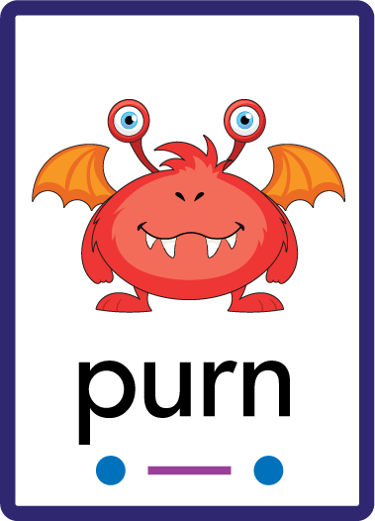
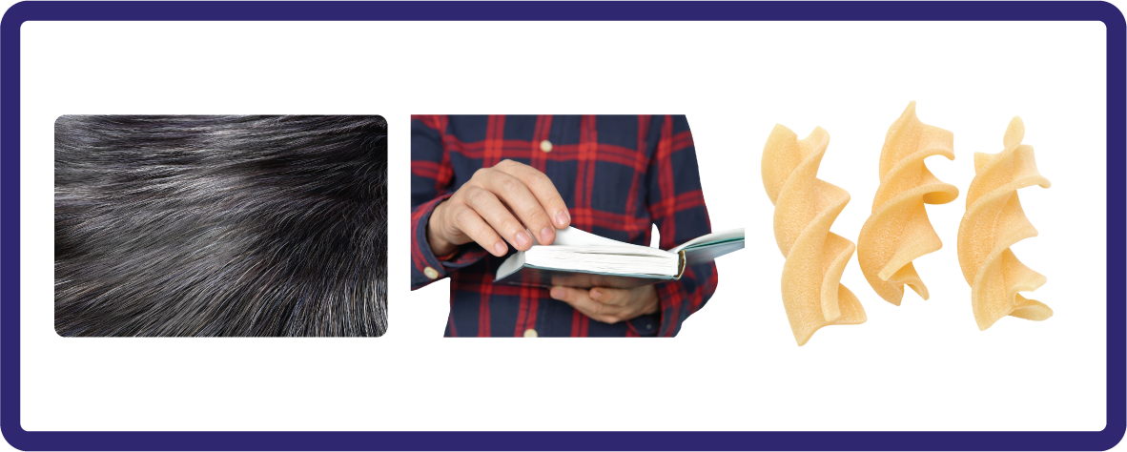
Compare r-controlled digraph ur and trigraph ure.
Recall all GPCs learned so far using flashcards.
Review Alphabet Song.
Phonemic Awareness Cards
Grapheme to Phoneme Cards
Phoneme Frame Cards
Alien Word Cards
JN691
JN686
JN689
JN692

Slide 3























Recall all GPCs learned so far using flashcards.

Slide 4



























Recall all GPCs learned so far using flashcards.

Slide 5

Review the Alphabet Song.
a, b, c, d, e, f, g (pause)
h, i, j, k, l, m, n (pause)
o, p, q (pause) r, s, t (pause)
u v w (pause) x y z (pause)
Now I know my abc's, Next time won't you sing with me.

Slide 6
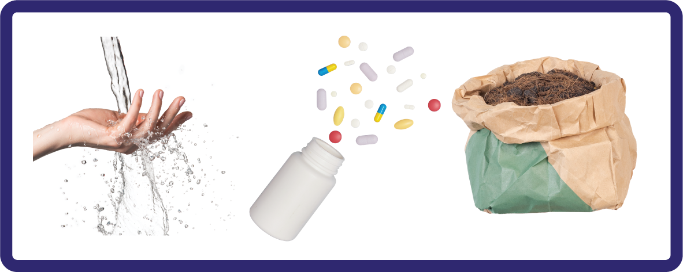
Hear Phonemes
USING JN691
FRONT

Slide 7
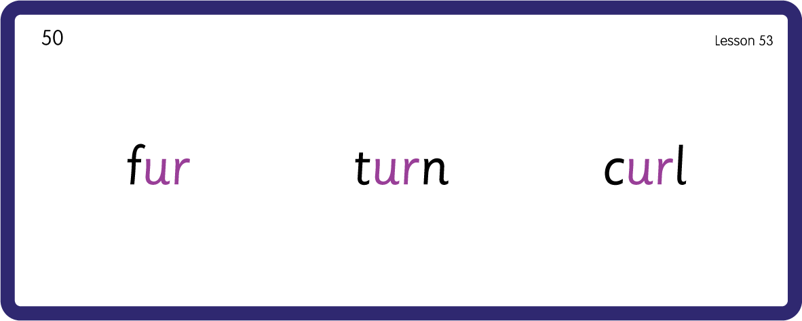

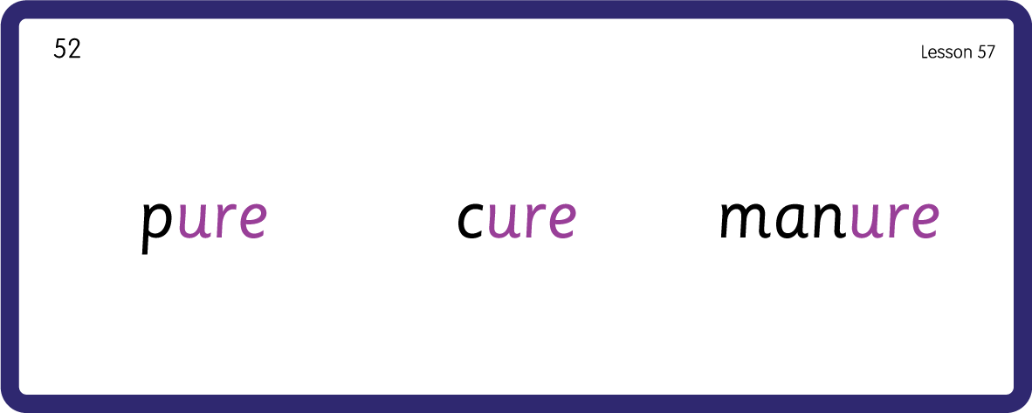
Hear Phonemes
/ur/
/ure/
USING JN691
BACK

Slide 8
Review Grapheme Caption
USING JN686
FRONT

Slide 9
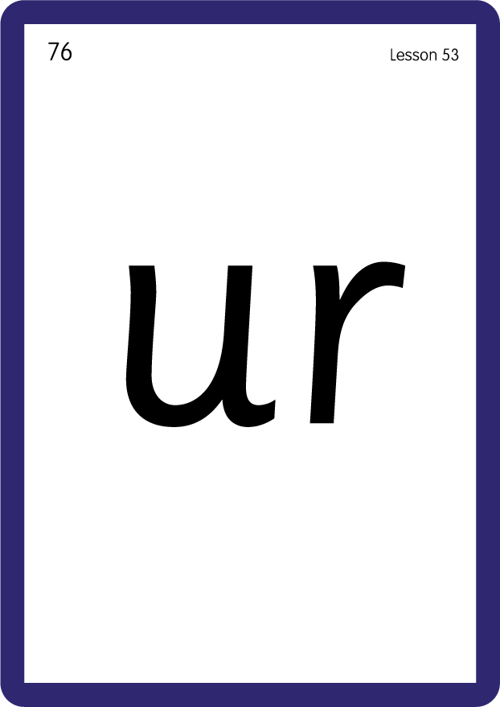

Review Lowercase Formation
USING JN686
BACK

Slide 10

Explain Decoding

Slide 11
Model Blending Phonemes
f
ur
USING SOUND BUTTONS
Sound Buttons
Vowel
Consonant
Consonant Digraph
Long Vowel Sound
R-controlled Digraph
Split Digraph
Syllable / Silent Letter

Slide 12
Model Blending Phonemes
p
ure
USING SOUND BUTTONS
Sound Buttons
Vowel
Consonant
Consonant Digraph
Long Vowel Sound
R-controlled Digraph
Split Digraph
Syllable / Silent Letter

Slide 13
Model Blending Phonemes
b
ur
p
USING SOUND BUTTONS
Sound Buttons
Vowel
Consonant
Consonant Digraph
Long Vowel Sound
R-controlled Digraph
Split Digraph
Syllable / Silent Letter

Slide 14
Model Blending Phonemes
m
a
t
ure
USING SOUND BUTTONS
Sound Buttons
Vowel
Consonant
Consonant Digraph
Long Vowel Sound
R-controlled Digraph
Split Digraph
Syllable / Silent Letter

Slide 15

Explain Encoding

Slide 16
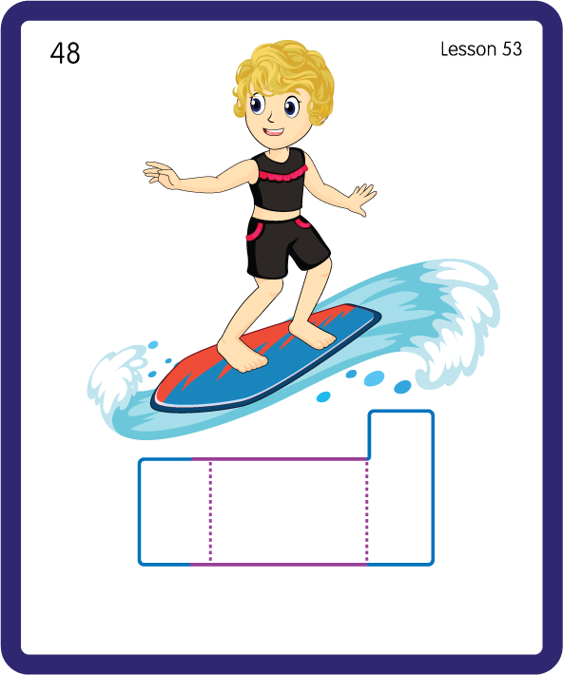
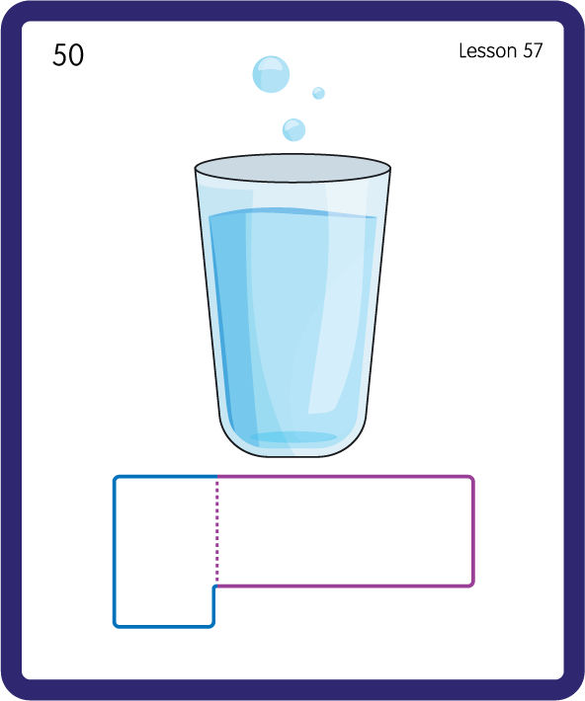
Build a Decodable Word
USING JN689
BACK

Slide 17

Build a Decodable Word
USING JN689
FRONT

Slide 18
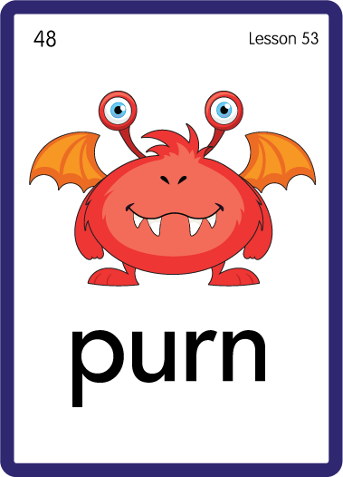

Practise with Alien Words
USING JN692
BACK

Slide 19

Practise with Alien Words
USING JN692
FRONT

Slide 20

