Slide 1



j | v | w | x | y | z | zz | qu | ch
sh | th | ng | ai | ee | igh | oa | oi | oo
ow | ar | air | ear | er | ur | or | ure
Review or ure ur/ure
Lesson 59

Slide 2


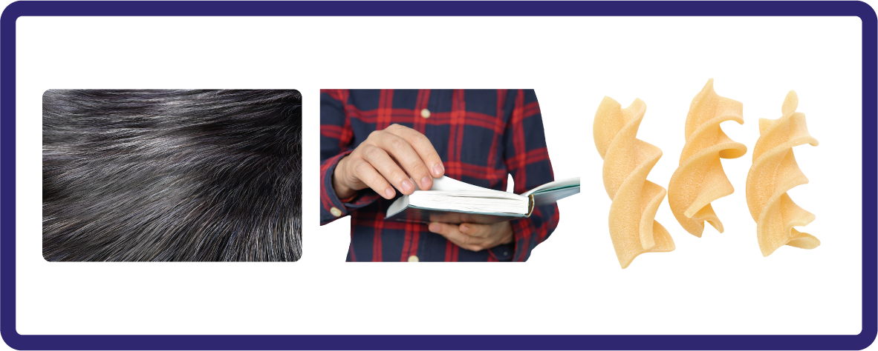


Learn and practise or ure and ur/ure.
Recall all GPCs learned so far using flashcards.
Review all Phase 3 Common Exception Words learned so far push they me we be he she my by looked you are there here were.
Phonemic Awareness Cards
Grapheme to Phoneme Cards
Phoneme Frame Cards
Alien Word Cards
Common Exception Word Cards
High Frequency Word Cards
JN691
JN686
JN689
JN692
JN687
JN688

Slide 3























Recall all GPCs learned so far using flashcards.

Slide 4


























Recall all GPCs learned so far using flashcards.

Slide 5














Review Phase 2 Common Exception Words as I is no go to into the put his has of pull full.

Slide 6


























Review Phase 3 Common Exception Words push they me we be he she my by looked you are there here were.

Slide 7
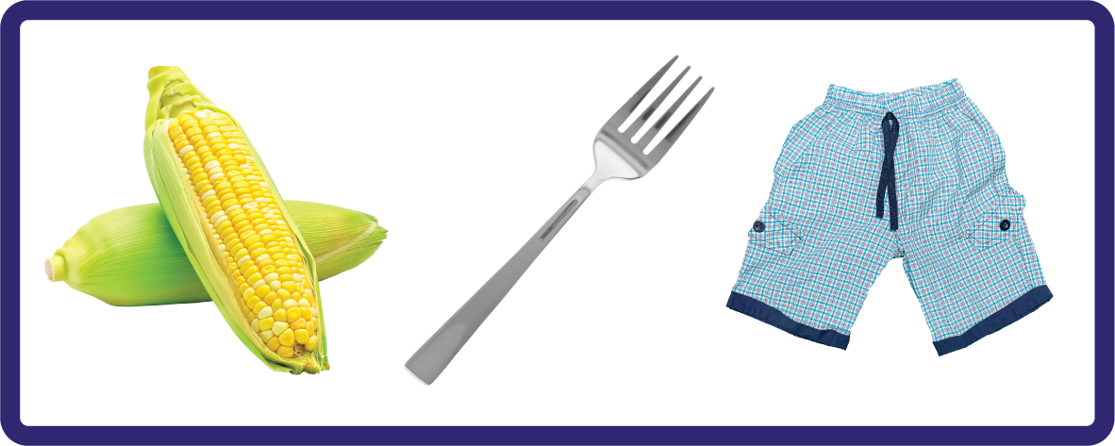

Hear Phonemes
USING JN691
FRONT

Slide 8
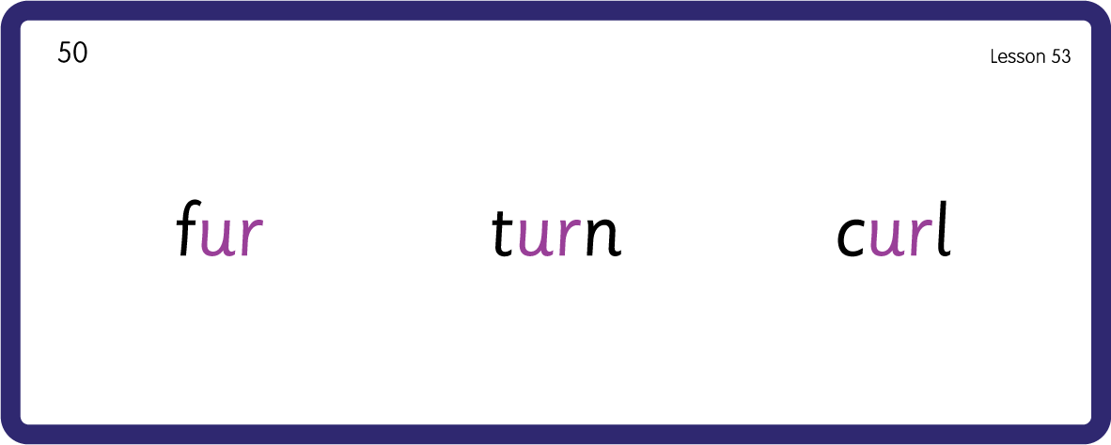
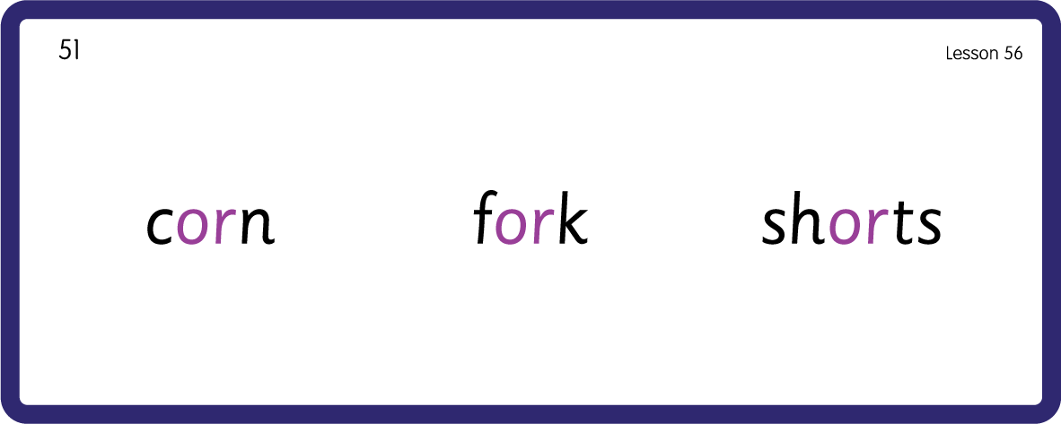

Hear Phonemes
USING JN691
BACK

Slide 9
Review Grapheme Caption
USING JN686
FRONT

Slide 10



Review Lowercase Formation
USING JN686
BACK

Slide 11
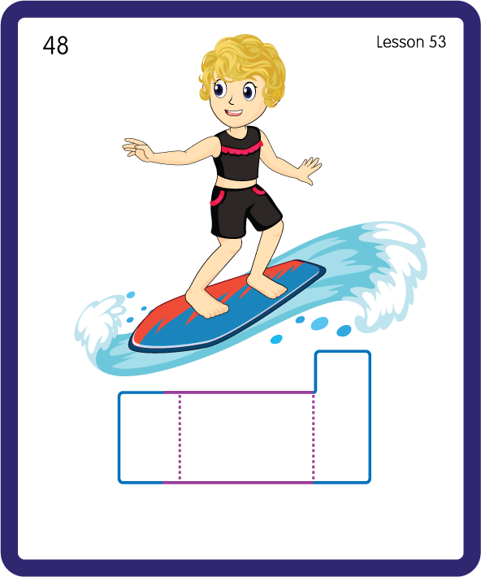
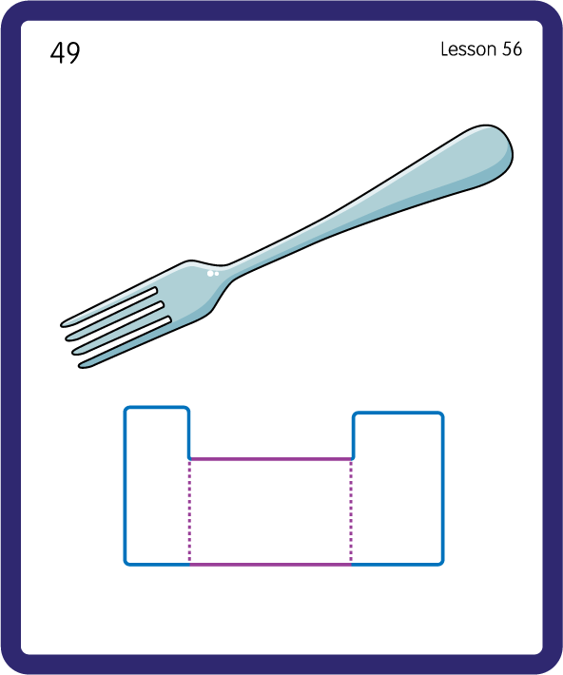
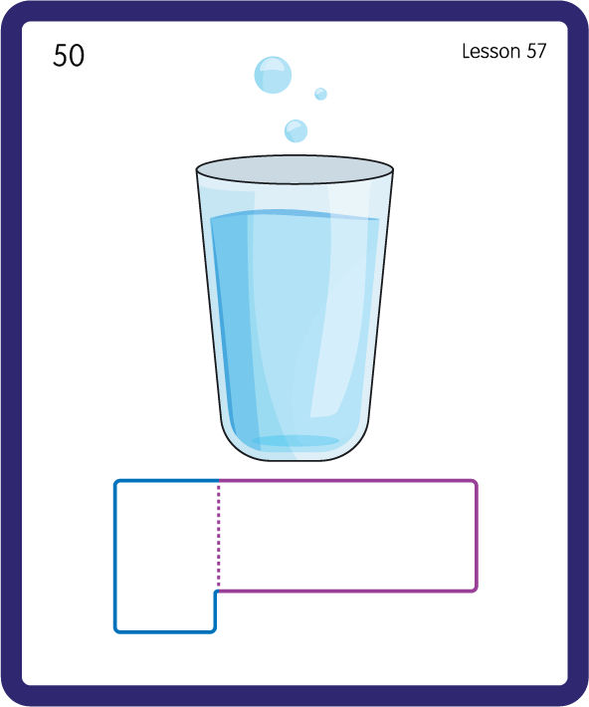
Build a Decodable Word
USING JN689
BACK

Slide 12


Build a Decodable Word
USING JN689
FRONT

Slide 13
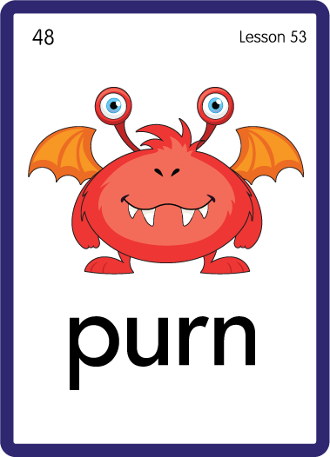


Practise with Alien Words
USING JN692
BACK

Slide 14


Practise with Alien Words
USING JN692
FRONT

Slide 15

Practise Common Exception Words
USING JN687
FRONT

Slide 16
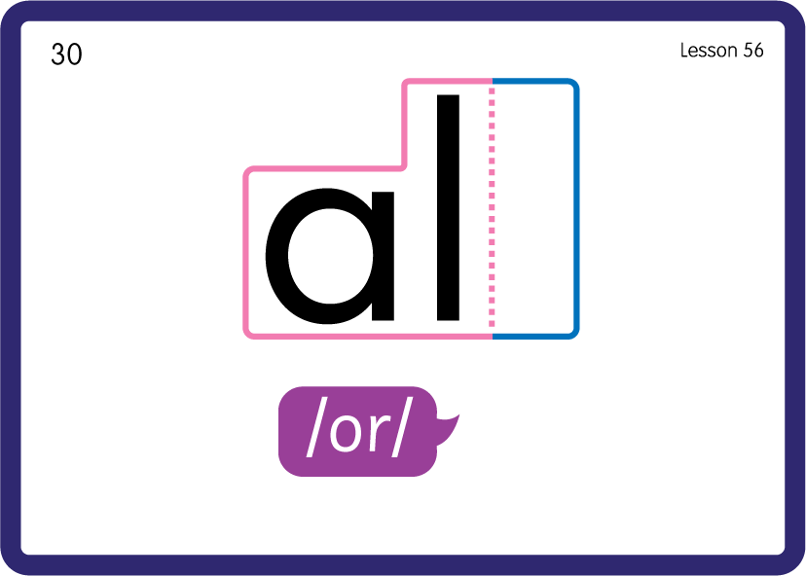
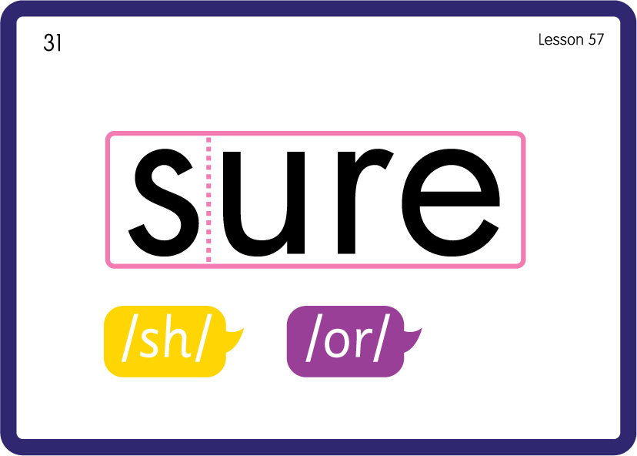
Practise Common Exception Words
USING JN687
BACK

Slide 17
Practise High Frequency Words
USING JN688
FRONT

Slide 18
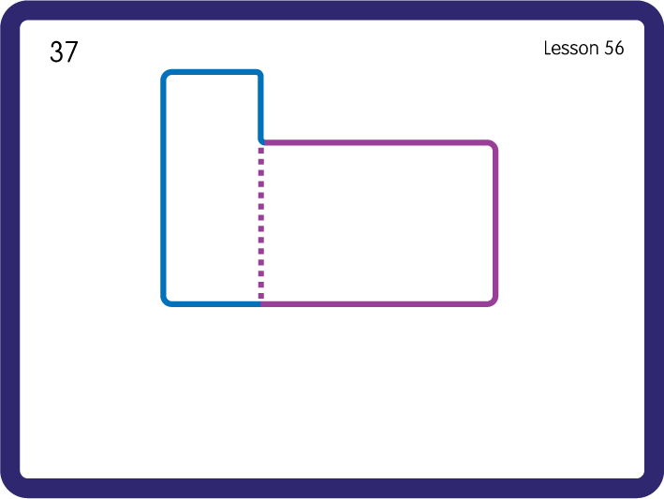
Practise High Frequency Words
USING JN688
BACK

Slide 19

