Slide 1


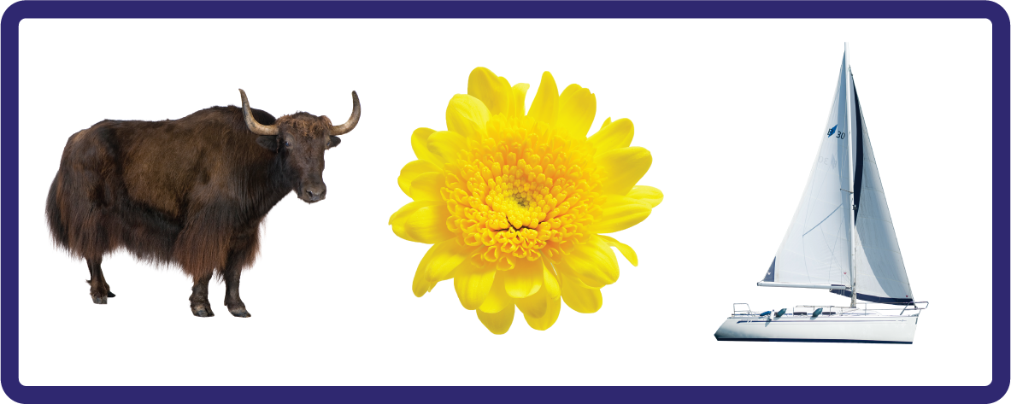
j | v | w | x | y | z | zz | qu | ch
sh | th | ng | ai | ee | igh | oa | oi | oo
ow | ar | air | ear | er | ur | or | ure
Letter Sound 'y'
Lesson 6

Slide 2

Learn and practise letter / sound y.
Recall all GPCs learned so far using flashcards.
Review Phase 2 Common Exception Words as I is no go to into the put his has of pull full.
Phonemic Awareness Cards
Grapheme to Phoneme Cards
Phoneme Frame Cards
Alien Word Cards
JNL691
JNL686
JNL689
JNL692

Slide 3






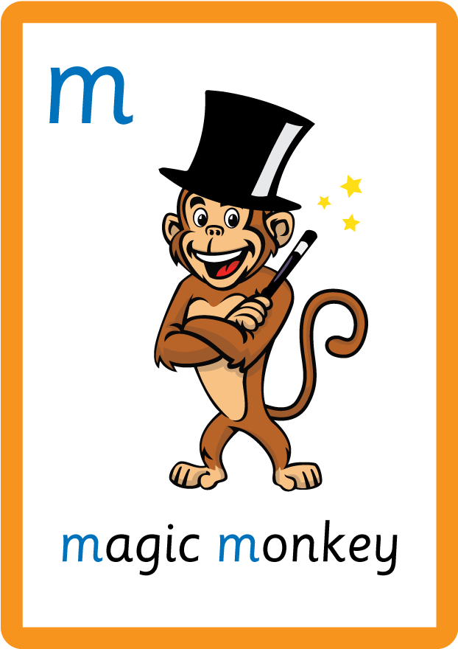
















Recall all GPCs learned so far using flashcards.

Slide 4




Recall all GPCs learned so far using flashcards.

Slide 5






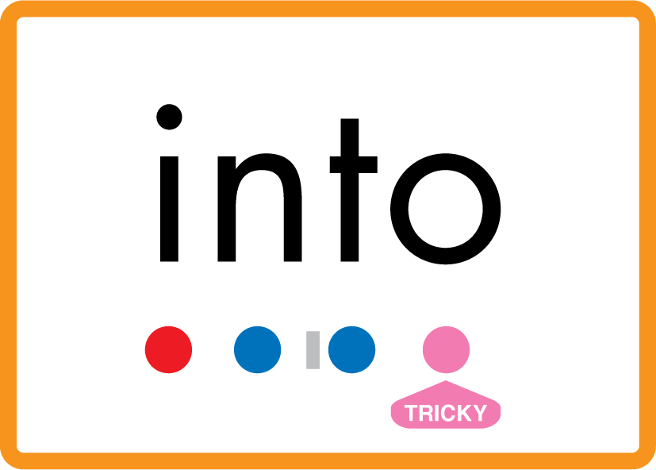
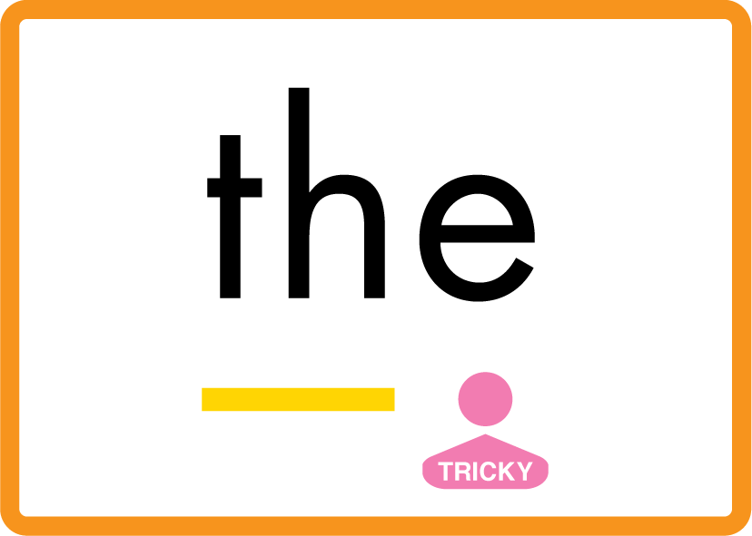
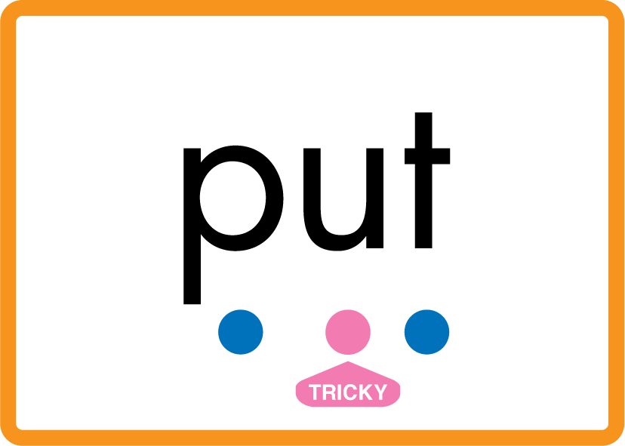
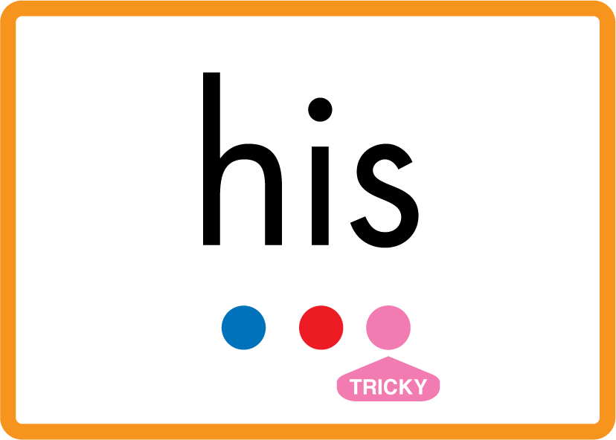


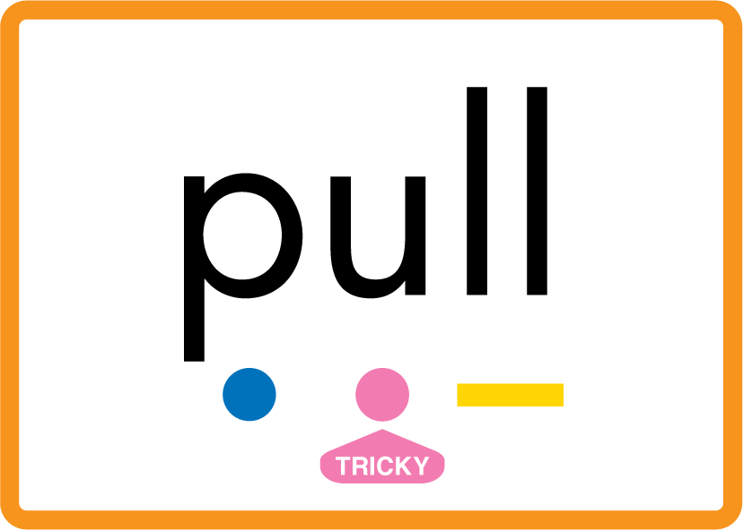
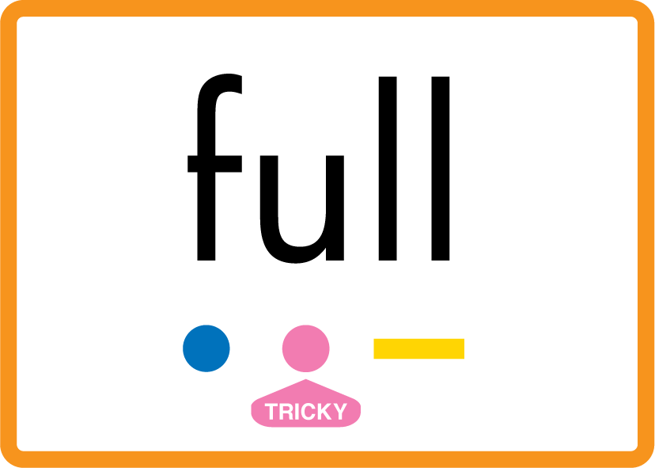
Review Phase 2 Common Exception Words as I is no go to into the put his has of pull full.

Slide 6
Hear Phonemes
USING JNL691
FRONT

Slide 7
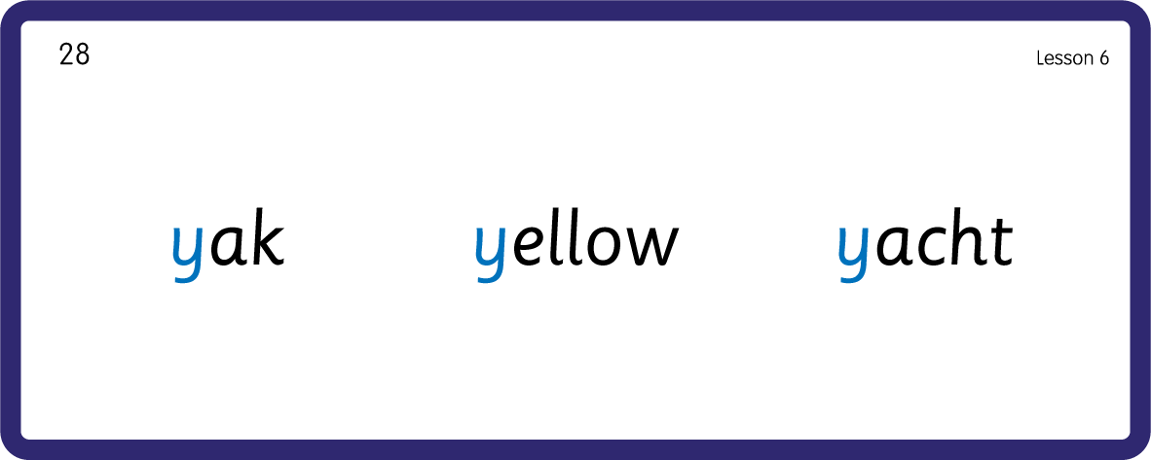
Hear Phonemes
USING JNL691
BACK

Slide 8
Teach Grapheme Caption
USING JNL686
FRONT

Slide 9
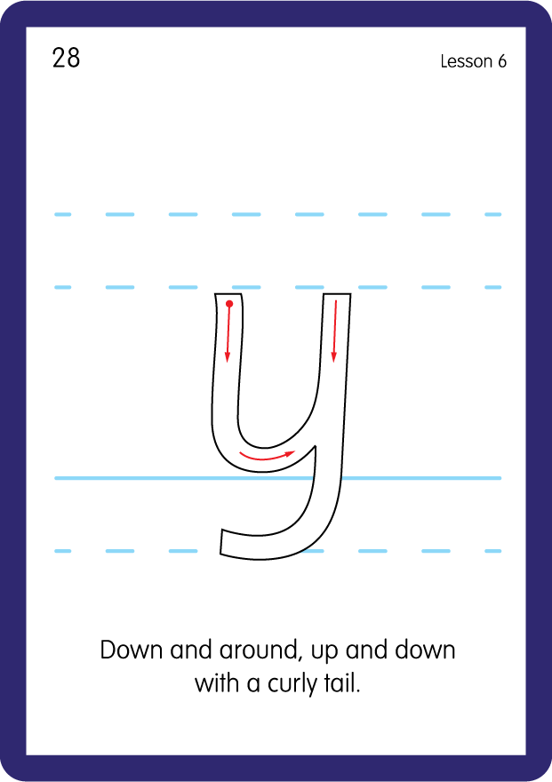
Teach Lowercase Formation
USING JNL686
BACK

Slide 10

Explain Decoding

Slide 11
Model Blending Phonemes
y
a
p
USING SOUND BUTTONS
Sound Buttons
Vowel
Consonant
Consonant Digraph
Long Vowel Sound
R-controlled Digraph
Split Digraph
Syllable / Silent Letter

Slide 12
Model Blending Phonemes
y
e
t
USING SOUND BUTTONS
Sound Buttons
Vowel
Consonant
Consonant Digraph
Long Vowel Sound
R-controlled Digraph
Split Digraph
Syllable / Silent Letter

Slide 13
Model Blending Phonemes
y
a
m
USING SOUND BUTTONS
Sound Buttons
Vowel
Consonant
Consonant Digraph
Long Vowel Sound
R-controlled Digraph
Split Digraph
Syllable / Silent Letter

Slide 14

Explain Encoding

Slide 15
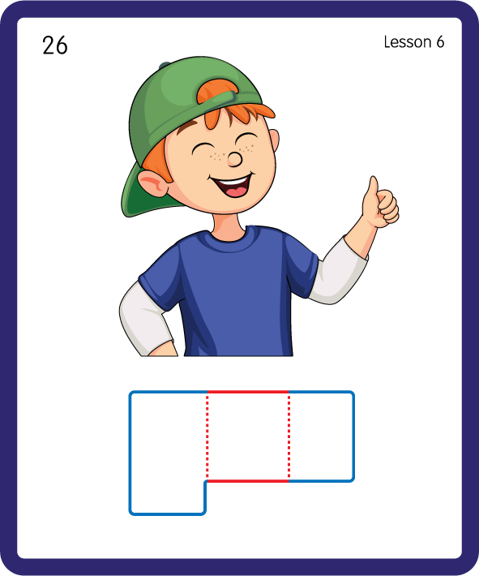
Build a Decodable Word
USING JNL689
BACK

Slide 16
Build a Decodable Word
USING JNL689
FRONT

Slide 17
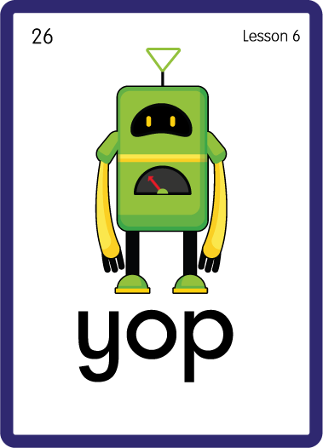
Practise with Alien Words
USING JNL692
BACK

Slide 18
Practise with Alien Words
USING JNL692
FRONT

Slide 19

Practise Building Words
PRACTISE – 10MINS
s
a
t
p
m
e
ll
y
USING MAGNETIC LETTERS AND A WHITEBOARD

Slide 20
Practise Building Words
PRACTISE – 10MINS
s
a
t
p
m
e
ll
y
yes yet yap yam yell yak
USING MAGNETIC LETTERS AND A WHITEBOARD

Slide 21
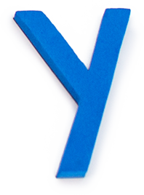
Draw ‘y’ in a variety of sizes and media, for example using chalk to draw on the ground.
Make grapheme with playdough.
Explore words in environment for decoding.
y

