Slide 1


j | v | w | x | y | z | zz | qu | ch
sh | th | ng | ai | ee | igh | oa | oi | oo
ow | ar | air | ear | er | ur | or | ure
Syllables
Lesson 63

Slide 2



Learn and practise syllables.
Recall all GPCs learned so far using flashcards.
Review Phase 2 Common Exception Words as I is no go to into the put his has of pull full.
Common Exception Word Cards Phase 2
Common Exception Word Cards Phase 3
High Frequency Word Cards
JN687
JN687
JN688

Slide 3























Recall all GPCs learned so far using flashcards.

Slide 4


















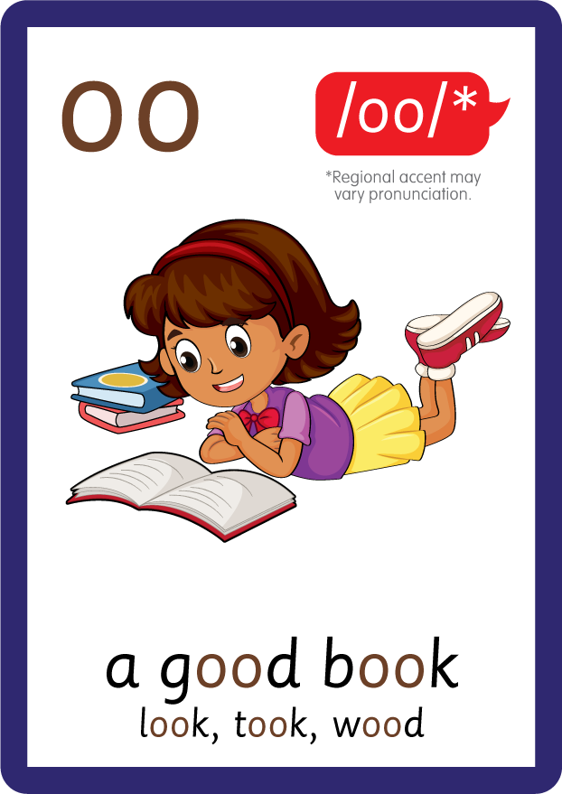









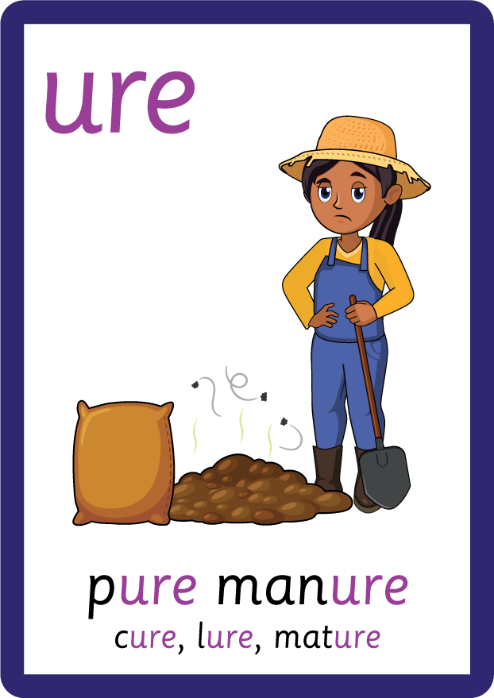
Recall all GPCs learned so far using flashcards.

Slide 5





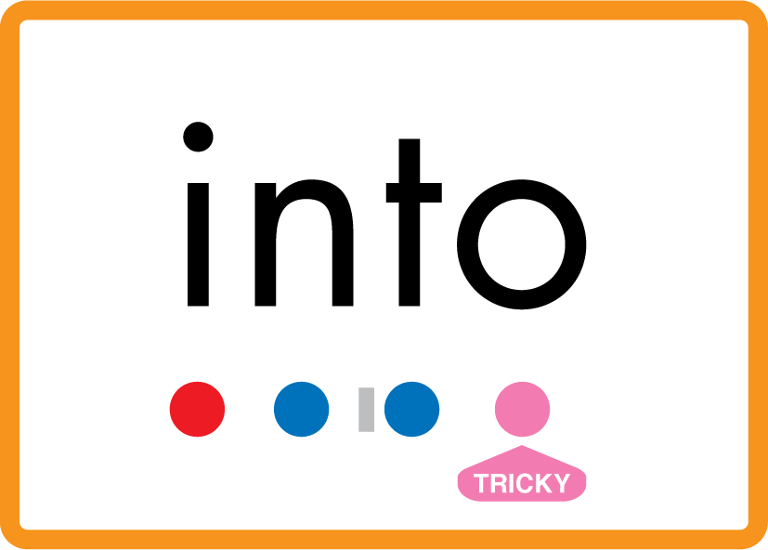

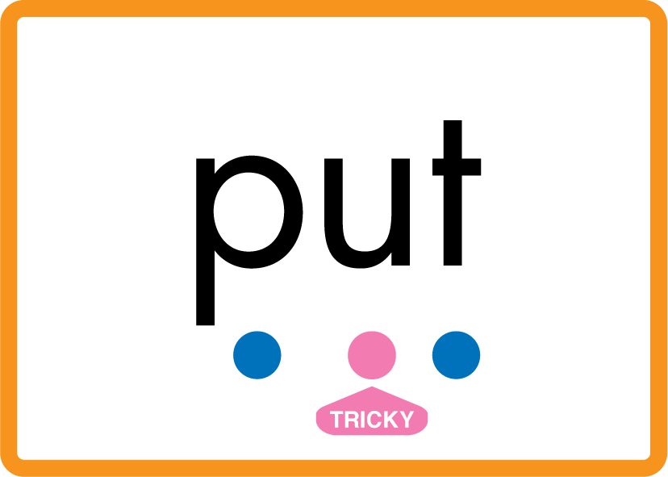
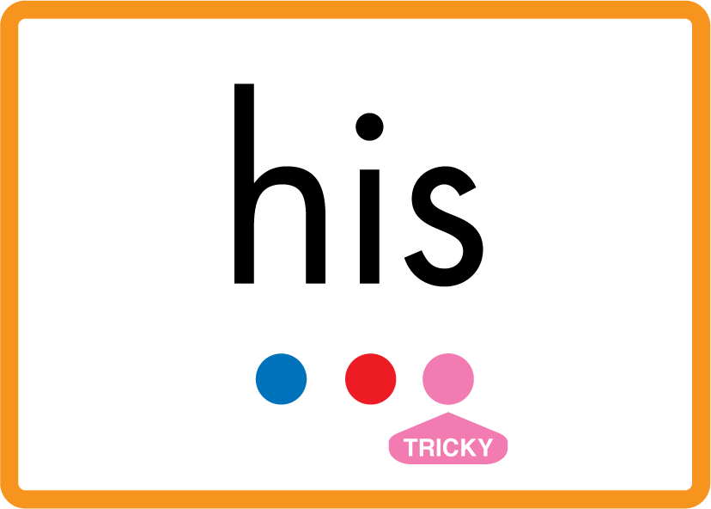



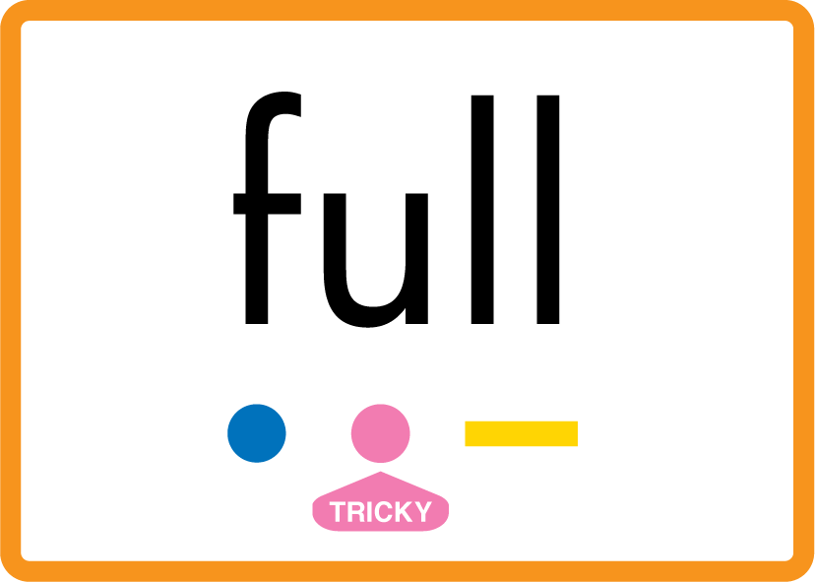
Review Phase 2 Common Exception Words as I is no go to into the put his has of pull full.

Slide 6


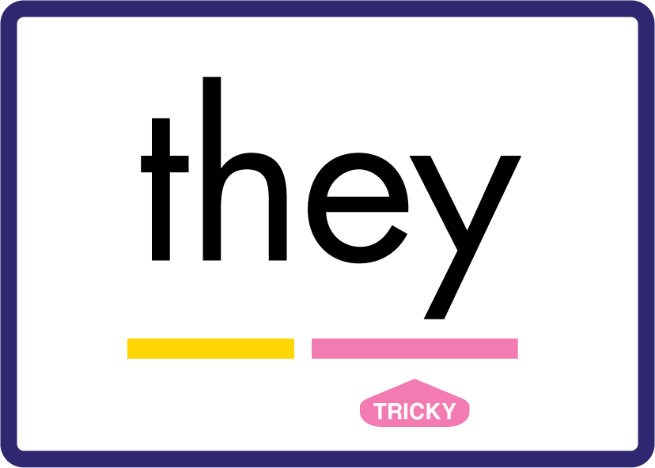



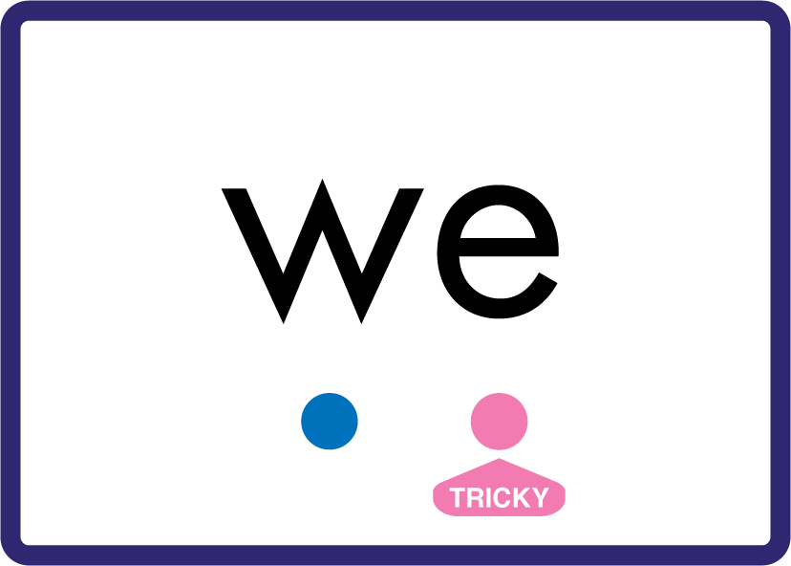





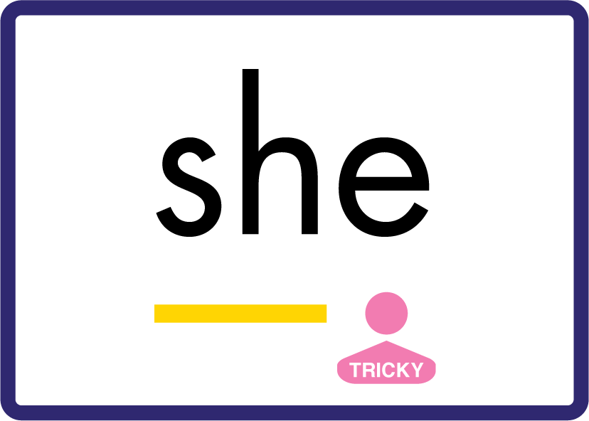







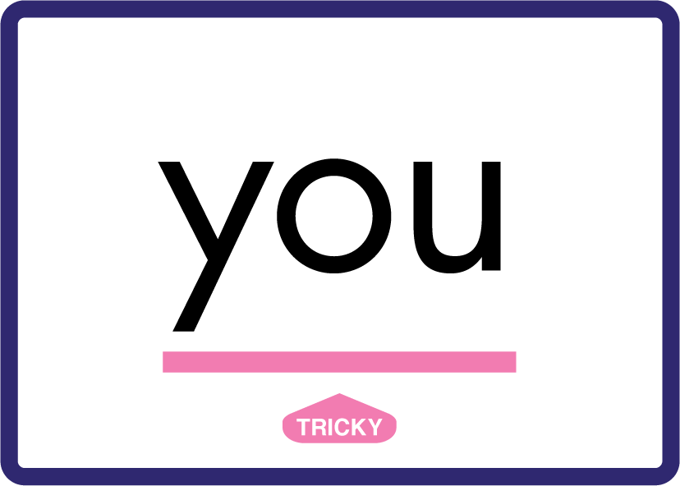






Review Phase 3 Common Exception Words push they me we be he she my by looked you are there here were all sure.

Slide 7
Hear Syllables
hotpot
pigpen
farmer
USING BODY PERCUSSION
Sound Buttons
Vowel
Consonant
Consonant Digraph
Long Vowel Sound
R-controlled Digraph
Split Digraph
Syllable / Silent Letter

Slide 8
Hear Syllables
hot pot
pig pen
farm er
USING BODY PERCUSSION
Sound Buttons
Vowel
Consonant
Consonant Digraph
Long Vowel Sound
R-controlled Digraph
Split Digraph
Syllable / Silent Letter

Slide 9

Explain Decoding

Slide 10
Model Blending Phonemes
h
o
t
p
o
t
USING SOUND BUTTONS
Sound Buttons
Vowel
Consonant
Consonant Digraph
Long Vowel Sound
R-controlled Digraph
Split Digraph
Syllable / Silent Letter

Slide 11
Model Blending Phonemes
h
o
t
p
o
t
USING SOUND BUTTONS
Sound Buttons
Vowel
Consonant
Consonant Digraph
Long Vowel Sound
R-controlled Digraph
Split Digraph
Syllable / Silent Letter

Slide 12
Model Blending Phonemes
p
i
g
p
e
n
USING SOUND BUTTONS
Sound Buttons
Vowel
Consonant
Consonant Digraph
Long Vowel Sound
R-controlled Digraph
Split Digraph
Syllable / Silent Letter

Slide 13
Model Blending Phonemes
p
i
g
p
e
n
USING SOUND BUTTONS
Sound Buttons
Vowel
Consonant
Consonant Digraph
Long Vowel Sound
R-controlled Digraph
Split Digraph
Syllable / Silent Letter

Slide 14

Explain Encoding

Slide 15
Practise Building Multi-Syllabic Words
f
m
ar
er
USING A PHONEME FRAME
Sound Buttons
Vowel
Consonant
Consonant Digraph
Multi Sound
Long Vowel Sound
R-controlled Digraph
Split Digraph
Syllable / Silent Letter
Notes:
Use a phoneme frame to show the children how to build the word ‘farmer’ with letters

