Slide 1





























j | v | w | x | y | z | zz | qu | ch
sh | th | ng | ai | ee | igh | oa | oi | oo
ow | ar | air | ear | er | ur | or | ure
Review Phase 3
Lesson 65
(Note: due to the amount of content in Phase 3, an additional lesson can be used for consolidating learning)

Slide 2





Learn and practise Common Exception Words and High Frequency Words.
Recall all GPCs learned so far using flashcards.
Review all Phase 3 Common Exception Words learned so far push they me we be he she my by looked you are there here were all sure.
All Phase 3 Supplementary Resources can be used as part of Review
Common Exception Word Cards Phase 3
Phonemic Awareness Cards
Grapheme to Phoneme Cards
Phoneme Frame Cards
Alien Word Cards
High Frequency Word Cards
JN691
JN686
JN689
JN692
JN687
JN688

Slide 3























Recall all GPCs learned so far using flashcards.

Slide 4
Recall all GPCs learned so far using flashcards.

Slide 5














Review Phase 2 Common Exception Words as I is no go to into the put his has of pull full.

Slide 6



























Review Phase 3 Common Exception Words push they me we be he she my by looked you are there here were all sure.

Slide 7
Find a Grapheme
j | v | w | x | y | z | zz | qu | ch
sh | th | ng | ai | ee | igh | oa | oi | oo
ow | ar | air | ear | er | ur | or | ure
WHEN GIVEN A SOUND
FRONT

Slide 8
Find a Grapheme
j | v | w | x | y | z | zz | qu | ch
sh | th | ng | ai | ee | igh | oa | oi | oo
ow | ar | air | ear | er | ur | or | ure
WHEN GIVEN A LETTER NAME
FRONT

Slide 9
Match a Lowercase & Uppercase Letter
a b c d e f g h i j k l m n o p q r s t u v w x y z
A B C D E F G H I J K L M N O P Q R S T U V W X Y Z
WHEN GIVEN A LETTER NAME
FRONT

Slide 10
Practise Common Exception Words
USING JN687
FRONT

Slide 11
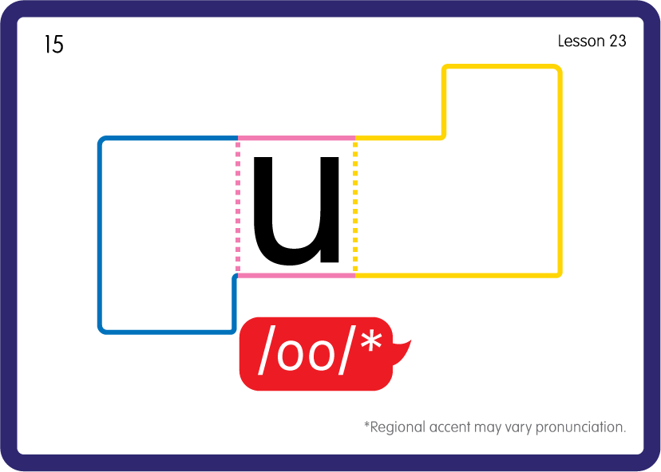

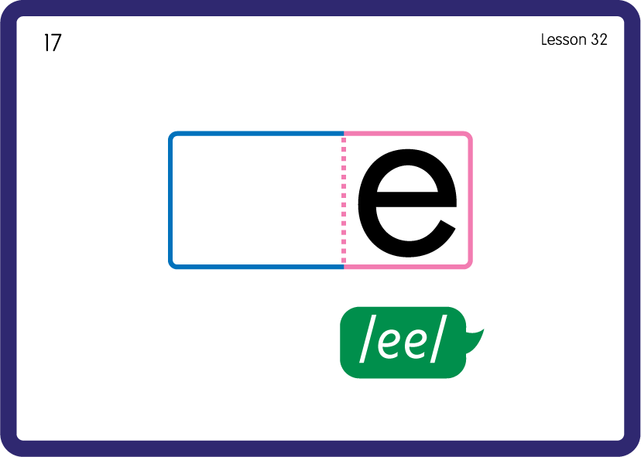
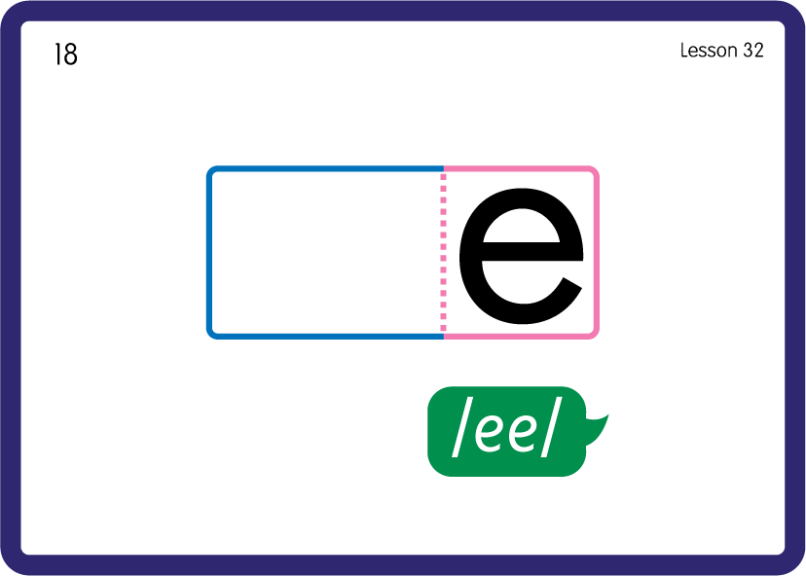



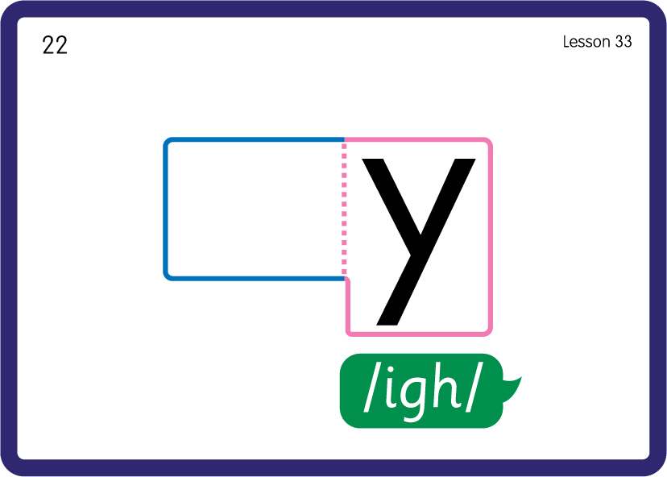
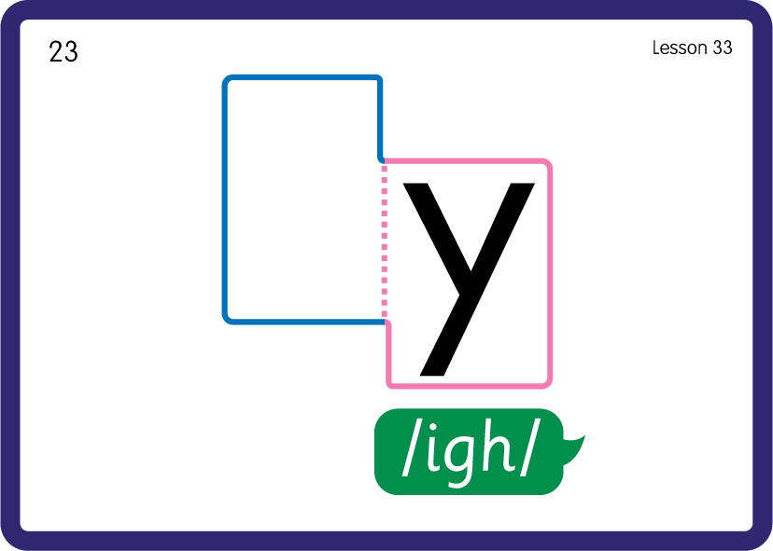
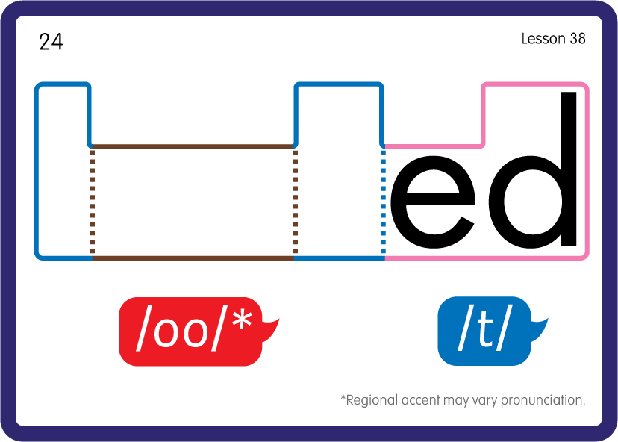







Practise Common Exception Words
USING JN687
FRONT

Slide 12












Practise High Frequency Words
USING JN688
FRONT

Slide 13
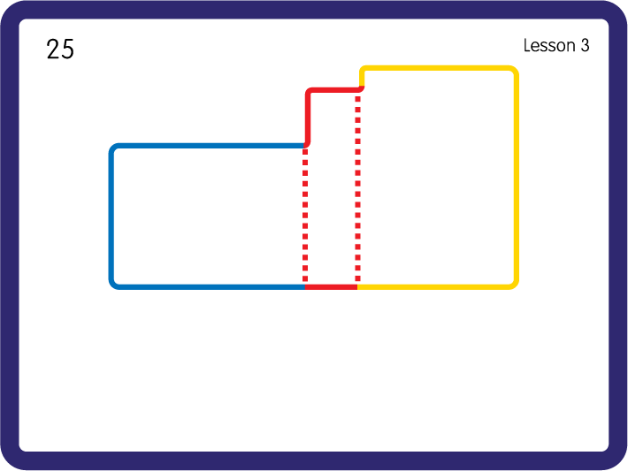
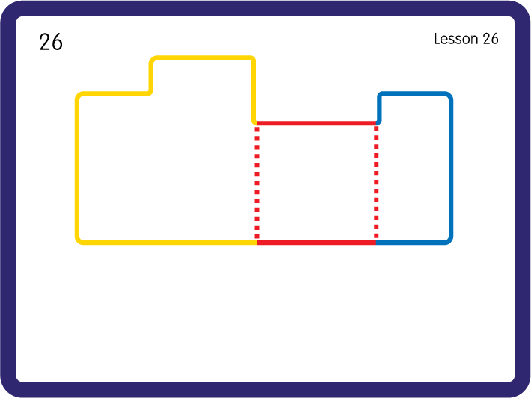
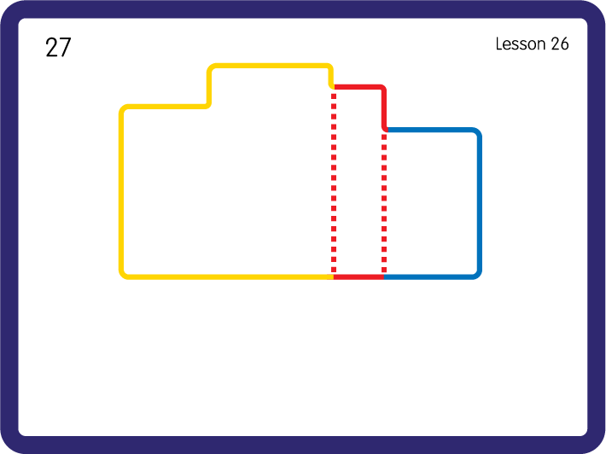
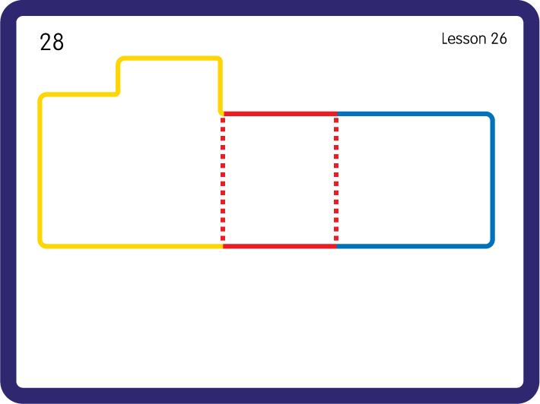
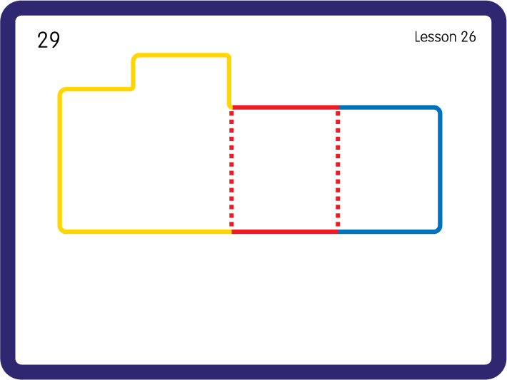
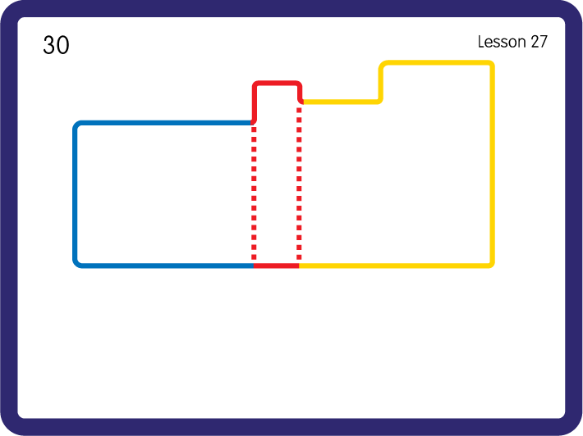
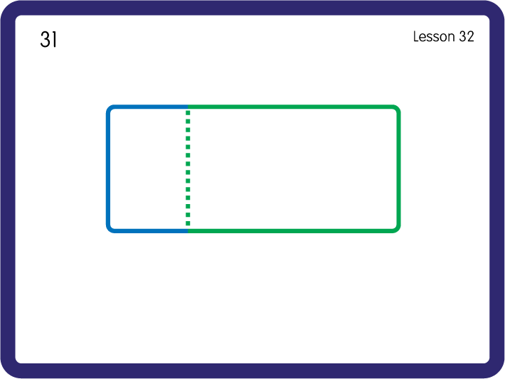
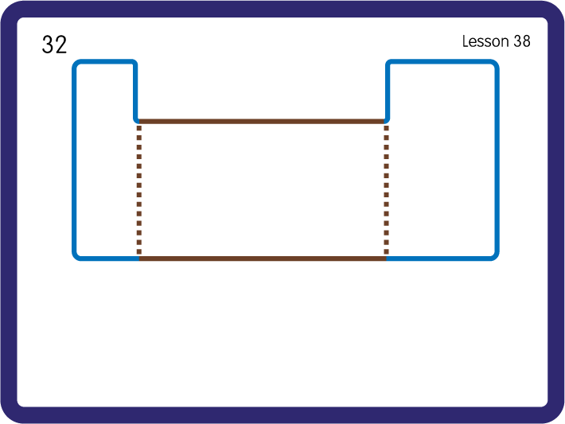
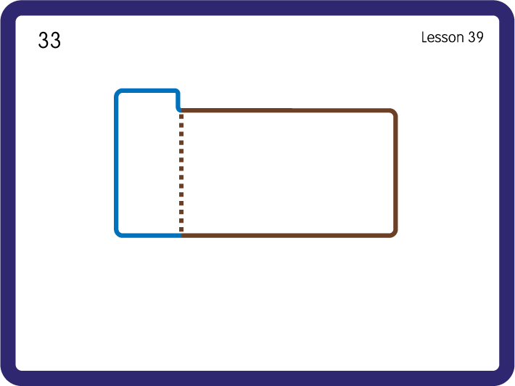
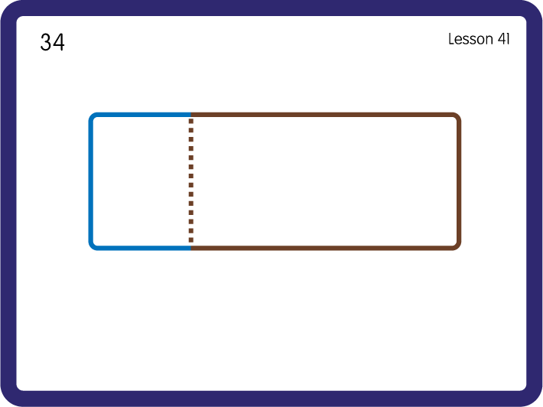
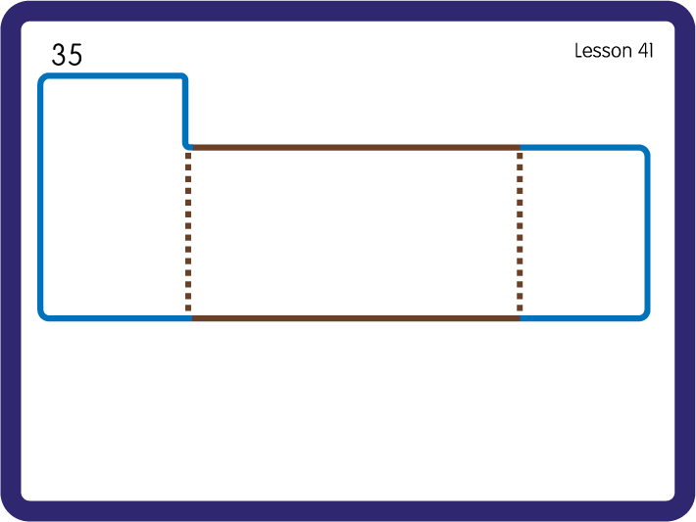
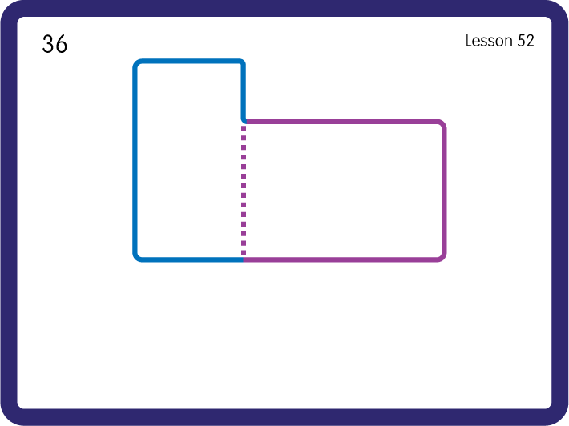
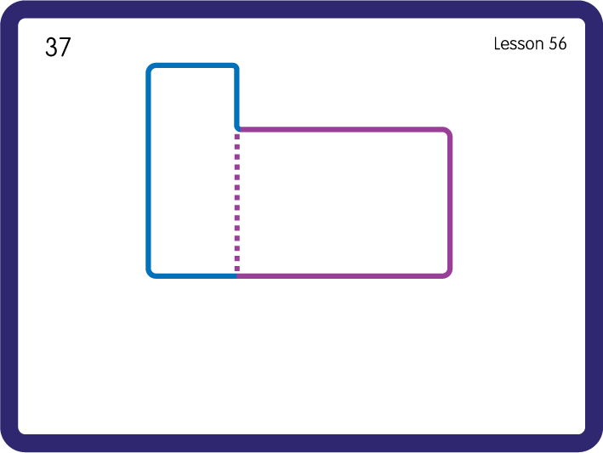
Practise High Frequency Words
USING JN688
FRONT

Slide 14
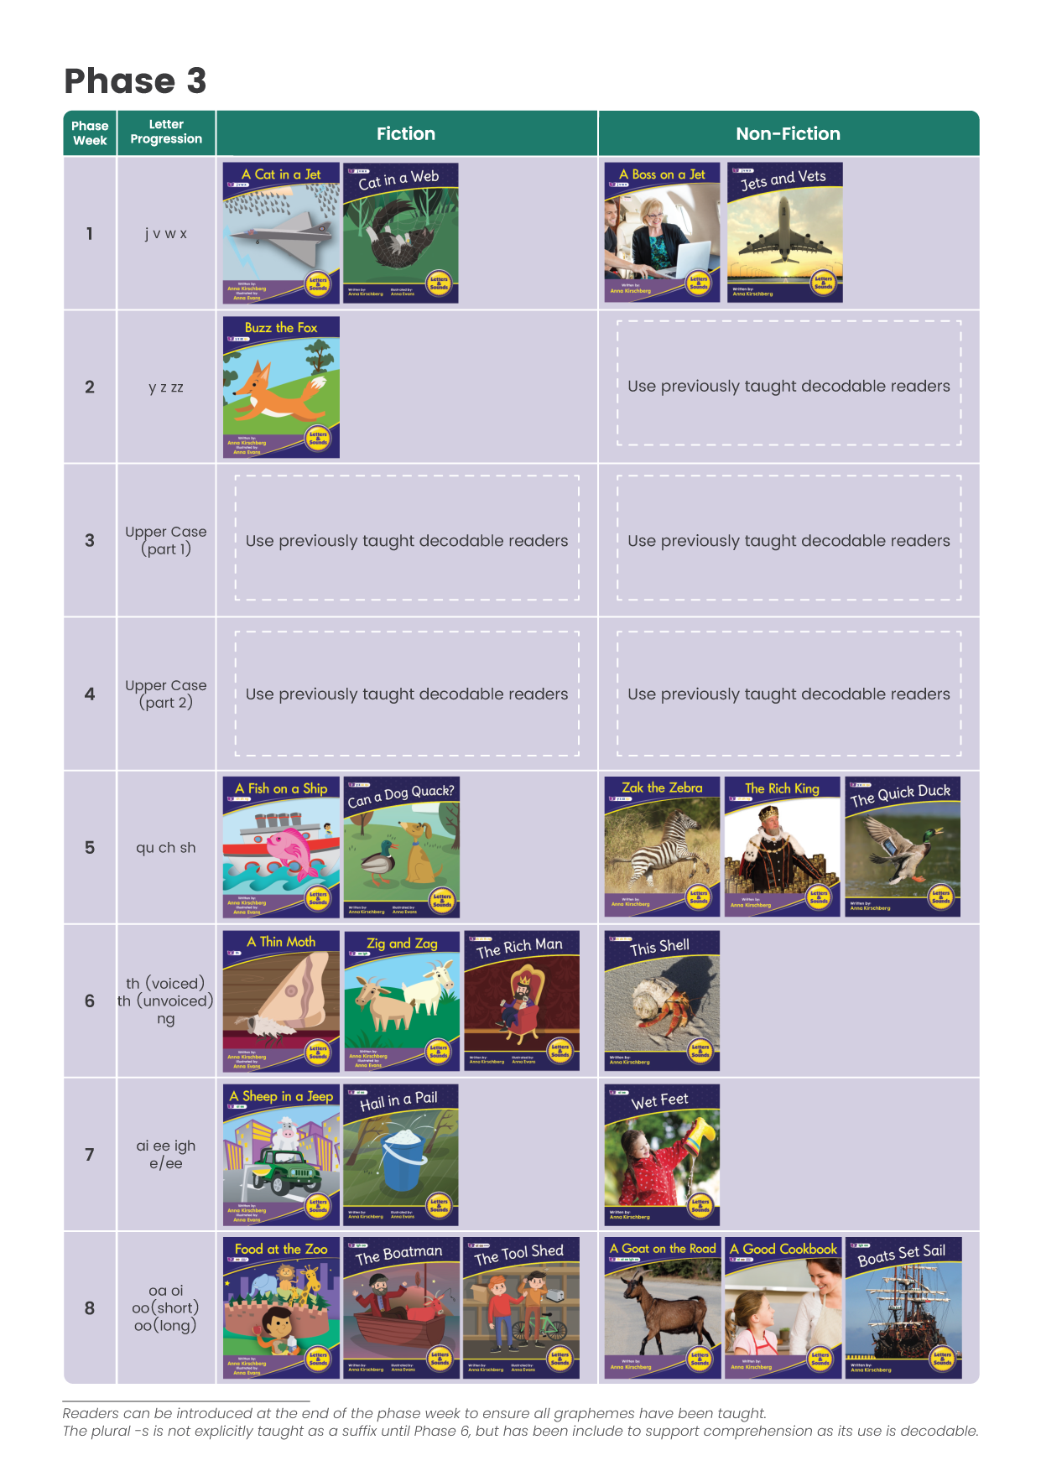


























click to view online book tracker
Set 1 Non-Fiction Books 1 - 12 JL388
Set 2 Non-Fiction Books 1 - 12 BB113

Slide 15
























click to view online book tracker
Set 1 Fiction Books 1 - 12 JL382
Set 2 Fiction Books 1 - 12 BB107

