Slide 1



j | v | w | x | y | z | zz | qu | ch
sh | th | ng | ai | ee | igh | oa | oi | oo
ow | ar | air | ear | er | ur | or | ure
Letter Sound 'z'
Lesson 7

Slide 2

Learn and practise letter / sound z.
Recall all GPCs learned so far using flashcards.
Review Phase 2 Common Exception Words as I is no go to into the put his has of pull full.
Phonemic Awareness Cards
Grapheme to Phoneme Cards
Phoneme Frame Cards
Alien Word Cards
JNL691
JNL686
JNL689
JNL692

Slide 3























Recall all GPCs learned so far using flashcards.

Slide 4





Recall all GPCs learned so far using flashcards.

Slide 5














Review Phase 2 Common Exception Words as I is no go to into the put his has of pull full.

Slide 6
Hear Phonemes
USING JNL691
FRONT

Slide 7
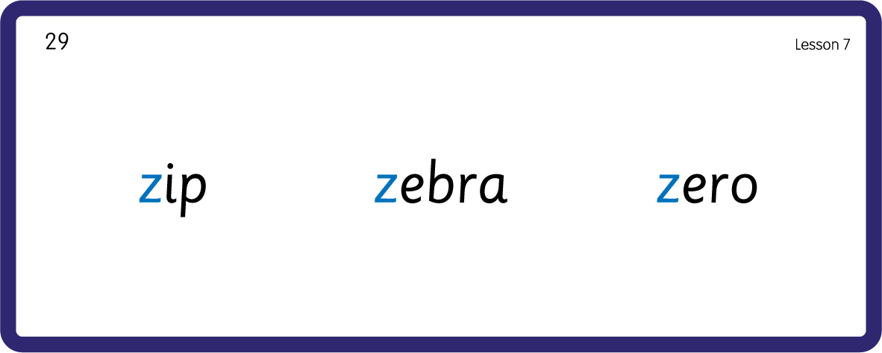
Hear Phonemes
USING JNL691
BACK

Slide 8
Teach Grapheme Caption
USING JL686
FRONT

Slide 9
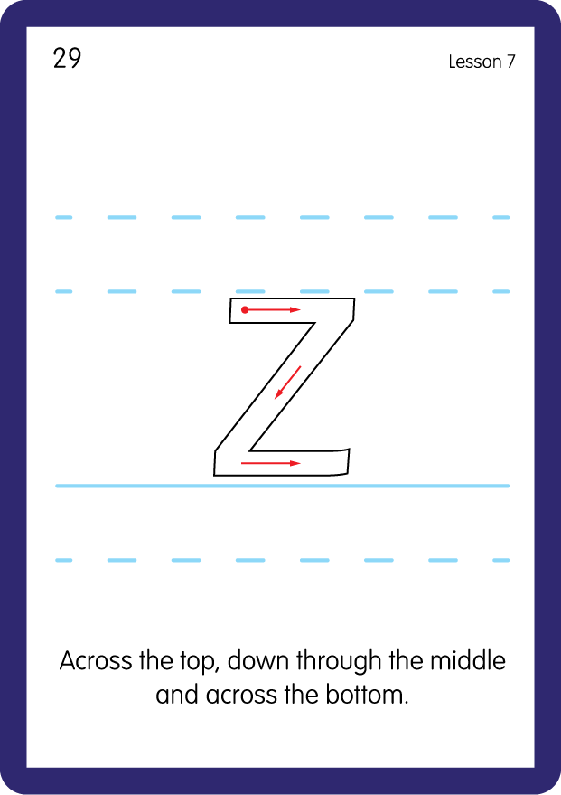
Teach Lowercase Formation
USING JNL686
BACK

Slide 10

Explain Decoding

Slide 11
Model Blending Phonemes
z
a
p
USING SOUND BUTTONS
Sound Buttons
Vowel
Consonant
Consonant Digraph
Long Vowel Sound
R-controlled Digraph
Split Digraph
Syllable / Silent Letter

Slide 12
Model Blending Phonemes
z
i
p
USING SOUND BUTTONS
Sound Buttons
Vowel
Consonant
Consonant Digraph
Long Vowel Sound
R-controlled Digraph
Split Digraph
Syllable / Silent Letter

Slide 13

Explain Encoding

Slide 14
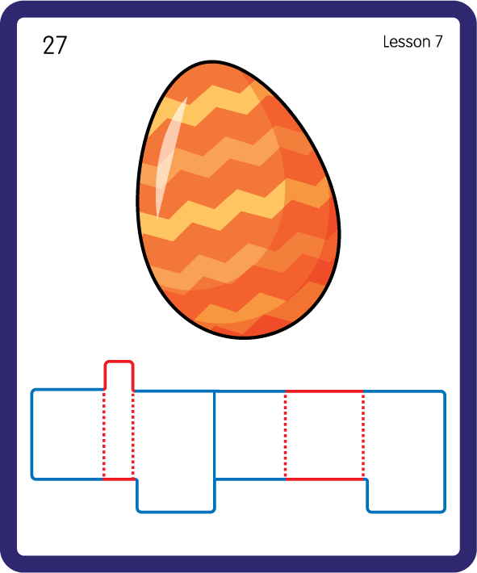
Build a Decodable Word
USING JNL689
BACK

Slide 15
Build a Decodable Word
USING JNL689
FRONT

Slide 16

Practise with Alien Words
USING JNL692
BACK

Slide 17
Practise with Alien Words
USING JNL692
FRONT

Slide 18

Practise Building Words
PRACTISE – 10MINS
p
a
i
z
g
g
z
USING MAGNETIC LETTERS AND A WHITEBOARD

Slide 19
Practise Building Words
PRACTISE – 10MINS
p
a
i
z
g
g
z
zip zigzag
USING MAGNETIC LETTERS AND A WHITEBOARD

Slide 20

Draw ‘z’ in a variety of sizes and media, for example using chalk to draw on the ground.
Make grapheme with playdough.
Explore words in environment for decoding.
z

