Slide 1



j | v | w | x | y | z | zz | qu | ch
sh | th | ng | ai | ee | igh | oa | oi | oo
ow | ar | air | ear | er | ur | or | ure
Review y z zz
Lesson 9

Slide 2



Learn and practise letter sounds y z zz.
Recall all GPCs learned so far using flashcards.
Review Phase 2 Common Exception Words as I is no go to into the put his has of pull full.
Phonemic Awareness Cards
Grapheme to Phoneme Cards
Phoneme Frame Cards
Alien Word Cards
JNL691
JNL686
JNL689
JNL692

Slide 3























Recall all GPCs learned so far using flashcards.

Slide 4




Recall all GPCs learned so far using flashcards.

Slide 5














Review Phase 2 Common Exception Words as I is no go to into the put his has of pull full.

Slide 6


Hear Phonemes
USING JNL691
FRONT

Slide 7
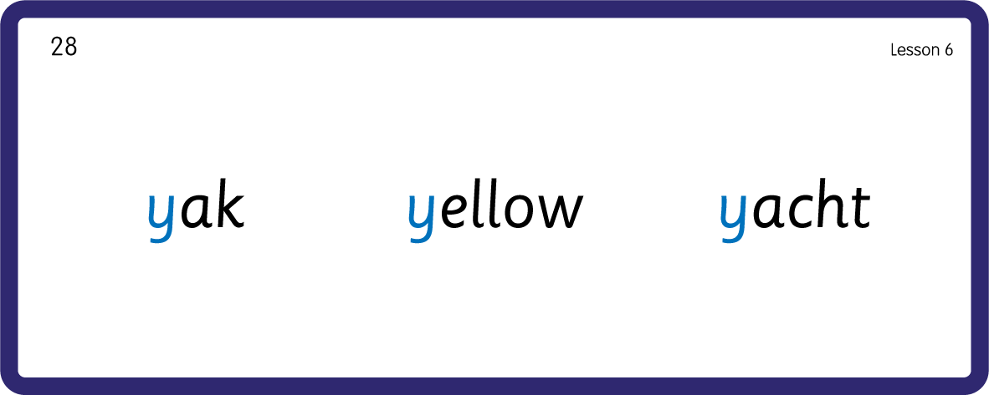
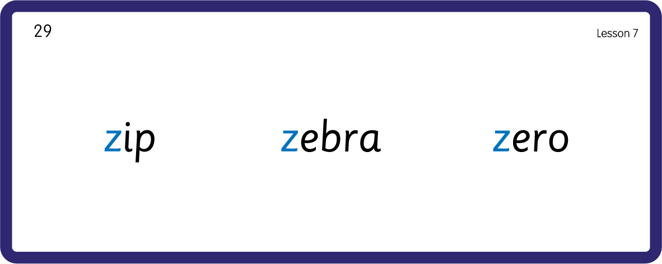
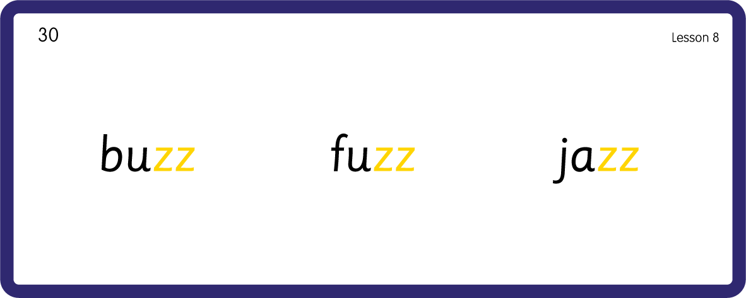
Hear Phonemes
USING JNL691
BACK

Slide 8
Review Grapheme Caption
USING JNL686
FRONT

Slide 9
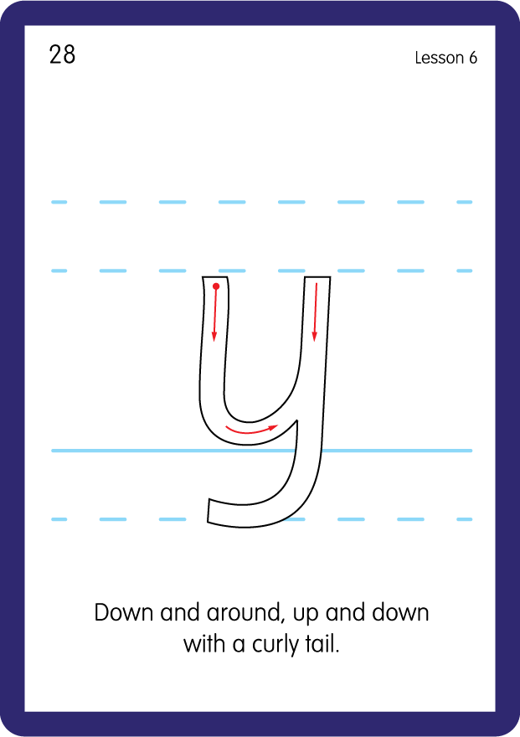
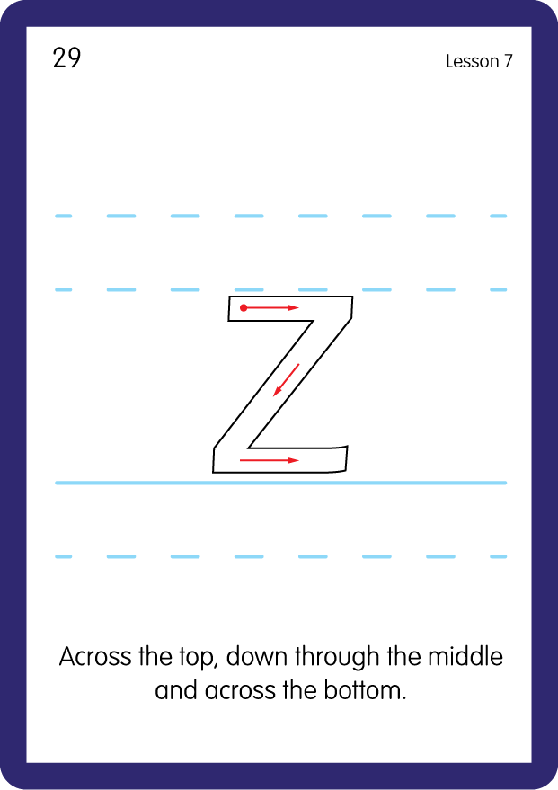
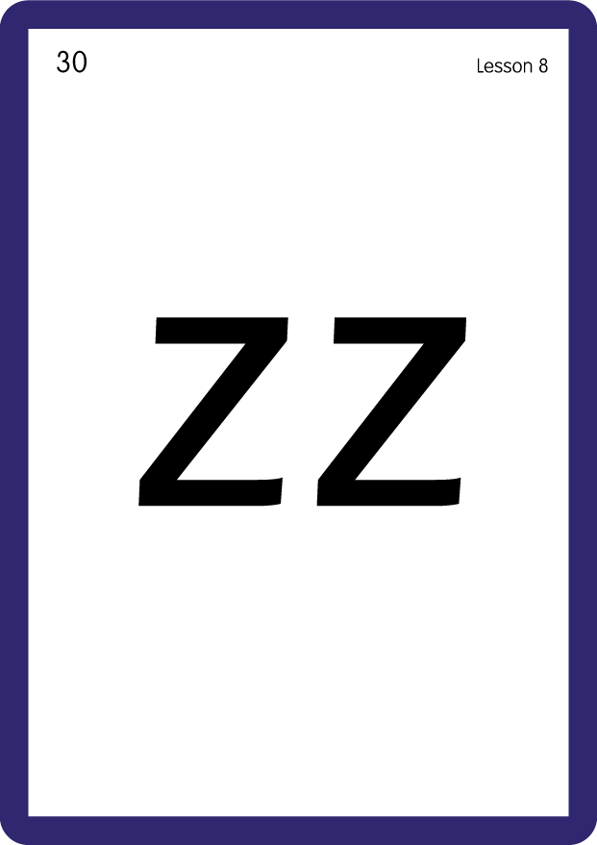
Review Lowercase Formation
USING JNL686
BACK

Slide 10
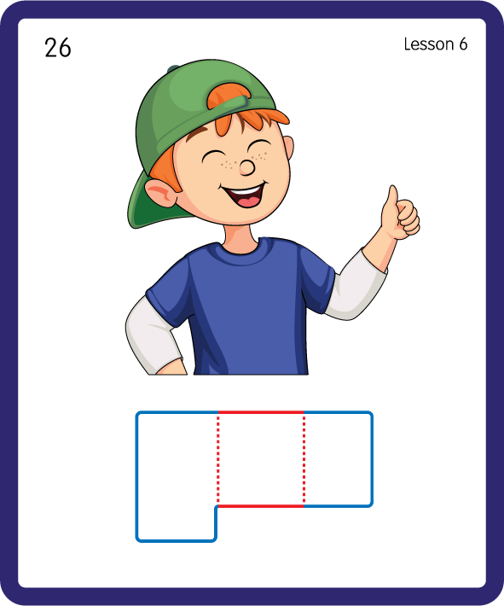
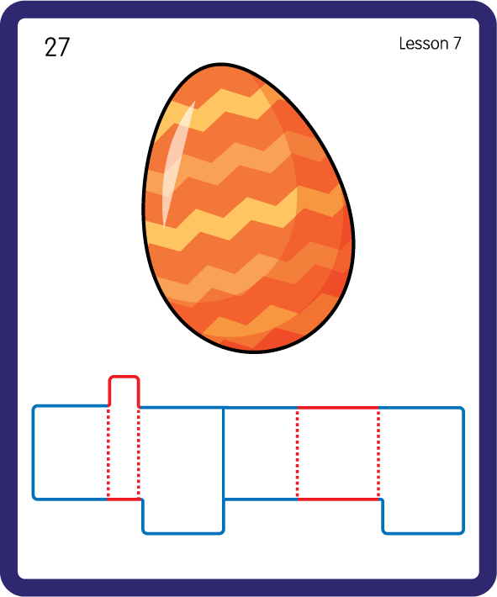
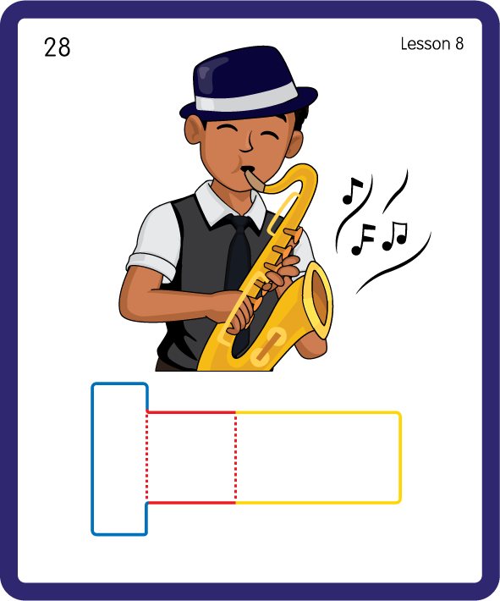
Build a Decodable Word
USING JNL689
BACK

Slide 11


Build a Decodable Word
USING JNL689
FRONT

Slide 12



Practise with Alien Words
USING JNL692
BACK

Slide 13


Practise with Alien Words
USING JNL692
FRONT

