Slide 1



CVCC (nd mp nt, nk ft st, lt lk sk) |  |  |  | CCVC (fr br, cr tr, gr dr pr)
CCVC (pl bl gl, sl fl cl, st sp sn, sm sw) |  |  |  | CCVCC (short vowel)
CVCC CCVC CCVCC (long vowel) |  |  |  | CCCVC CVCCC
CVCC ('nd' 'mp' 'nt')
Lesson 1

Slide 2


Learn and practise CVCC words containing nd mp nt.
Recall all GPCs learned so far using flashcards.
Review Alphabet Song.
Phonemic Awareness Cards
Phoneme Frame Cards
Alien Word Cards
Common Exception Word Cards
High Frequency Word Cards
JN691
JN689
JN692
JN687
JN688

Slide 3























Recall all GPCs learned so far using flashcards.

Slide 4





























Recall all GPCs learned so far using flashcards.

Slide 5














Review Phase 2 Common Exception Words as I is no go to into the put his has of pull full.

Slide 6




























Review Phase 3 Common Exception Words push they me we be he she my by looked you are there here were all sure.

Slide 7

Review Alphabet Song
a, b, c, d, e, f, g (pause)
h, i, j, k, l, m, n (pause)
o, p, q (pause) r, s, t (pause)
u v w (pause) x y z (pause)
Now I know my abc's, Next time won't you sing with me.

Slide 8
Hear Phonemes
USING JN691
FRONT

Slide 9
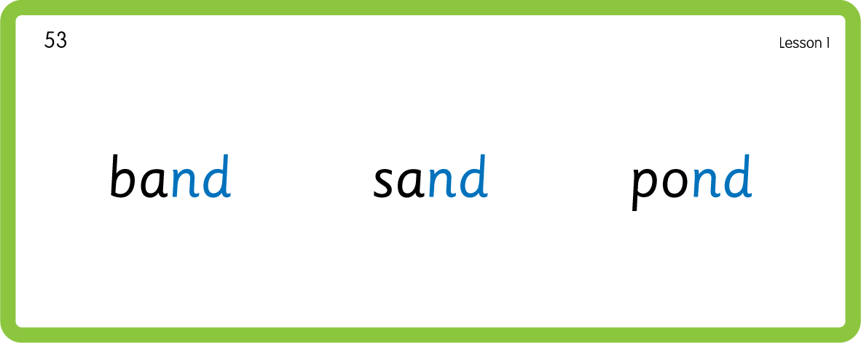
Hear Phonemes
USING JN691
BACK

Slide 10

Explain Decoding

Slide 11
Model Blending Phonemes
h
a
n
d
USING SOUND BUTTONS
Sound Buttons
Vowel
Consonant
Consonant Digraph
Multi Sound
Long Vowel Sound
R-controlled Digraph
Split Digraph
Syllable / Silent Letter

Slide 12
Model Blending Phonemes
l
i
m
p
USING SOUND BUTTONS
Sound Buttons
Vowel
Consonant
Consonant Digraph
Multi Sound
Long Vowel Sound
R-controlled Digraph
Split Digraph
Syllable / Silent Letter

Slide 13

Explain Encoding

Slide 14
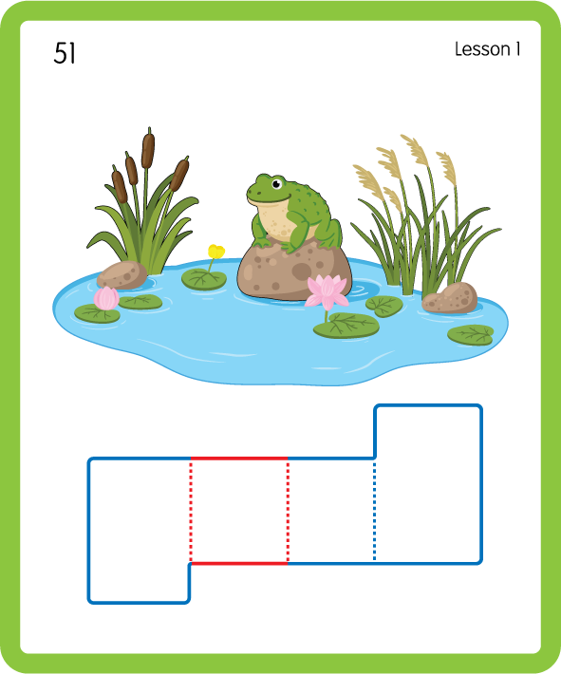
Build a Decodable Word
USING JL689
BACK

Slide 15
Build a Decodable Word
USING JL689
FRONT

Slide 16
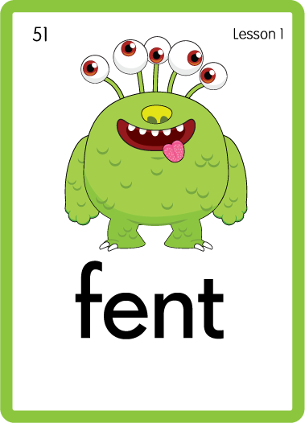
Practise with Alien Words
USING JN692
BACK

Slide 17
Practise with Alien Words
USING JN692
FRONT

Slide 18
Practise Common Exception Words
USING JN687
FRONT

Slide 19
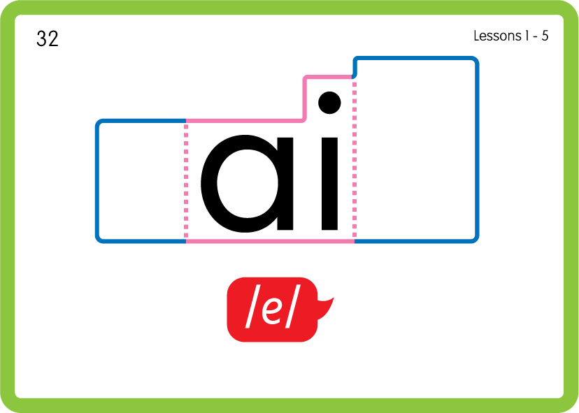
Practise Common Exception Words
USING JN687
BACK

Slide 20

Practise Common Exception Words
USING JN687
FRONT

Slide 21
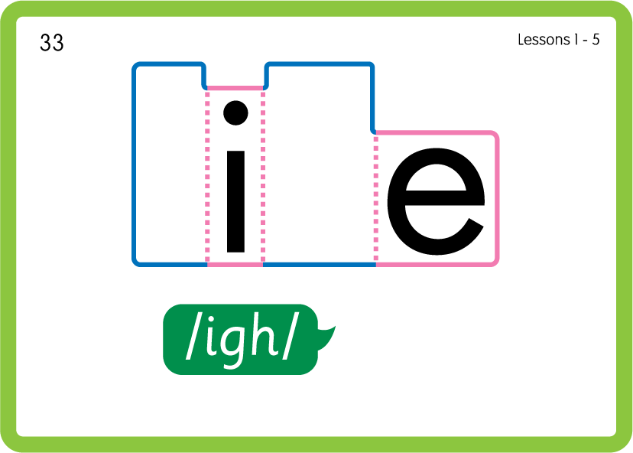
Practise Common Exception Words
USING JN687
BACK

Slide 22
Practise High Frequency Words
USING JN688
FRONT

Slide 23
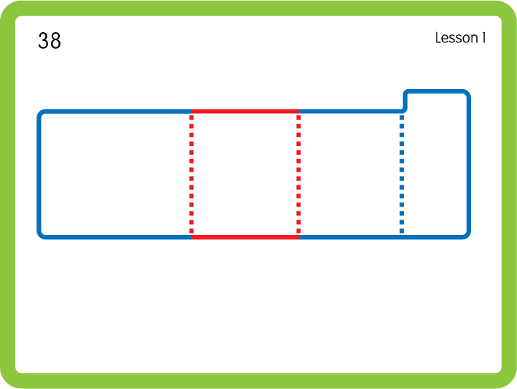
Practise High Frequency Words
USING JN688
BACK

Slide 24

PRACTISE – 10MINS
p
o
n
d
f
c
a
m
l
t
t
e
r
b
Practise Building Words
USING MAGNETIC LETTERS AND A WHITEBOARD

Slide 25
PRACTISE – 10MINS
p
o
n
d
f
c
a
m
l
t
t
e
r
b
pond fond camp lamp tent rent bent
Practise Building Words
USING MAGNETIC LETTERS AND A WHITEBOARD

