Slide 1




CVCC (nd mp nt, nk ft st, lt lk sk) |  |  |  | CCVC (fr br, cr tr, gr dr pr)
CCVC (pl bl gl, sl fl cl, st sp sn, sm sw) |  |  |  | CCVCC (short vowel)
CVCC CCVC CCVCC (long vowel) |  |  |  | CCCVC CVCCC
Review Common Exception Words
Lesson 15

Slide 2



Learn and practise Common Exception Words.
Recall all GPCs learned so far using flashcards.
Common Exception Word Cards
Phase 2
Common Exception Word Cards
Phase 3
Common Exception Word Cards
Phase 4
High Frequency Word Cards
JN687
JN687
JN687
JN688

Slide 3























Recall all GPCs learned so far using flashcards.

Slide 4

Review Alphabet Song
a, b, c, d, e, f, g (pause)
h, i, j, k, l, m, n (pause)
o, p, q (pause) r, s, t (pause)
u v w (pause) x y z (pause)
Now I know my abc's, Next time won't you sing with me.

Slide 5





























Recall all GPCs learned so far using flashcards.

Slide 6













Review Phase 2 Common Exception Words as I is no go to into the put his has of pull full.

Slide 7



























Review Phase 3 Common Exception Words push they me we be he she my by looked you are there here were all sure.

Slide 8


Review Phase 4 Common Exception Words said like out have some come.

Slide 9
Practise Common Exception Words
USING JL687
FRONT

Slide 10
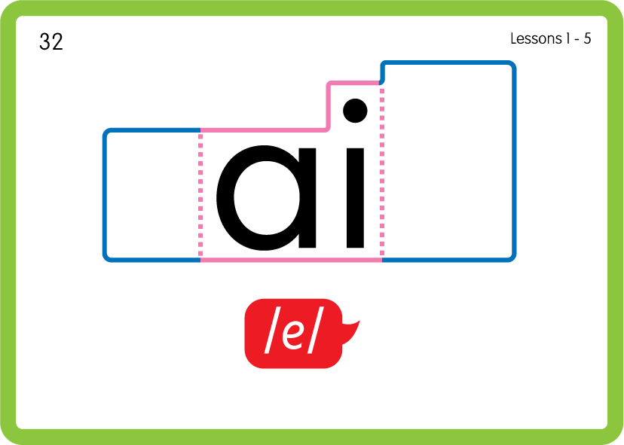

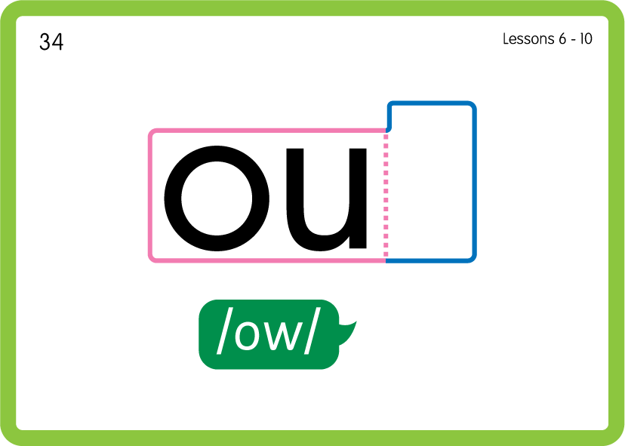
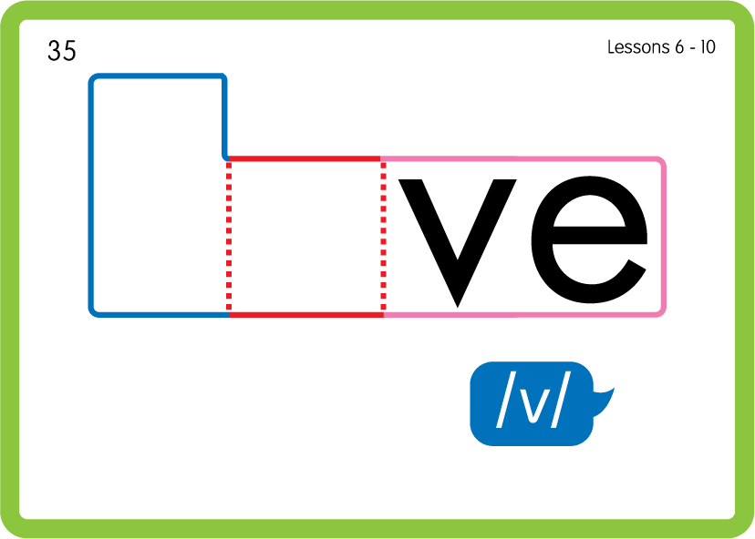
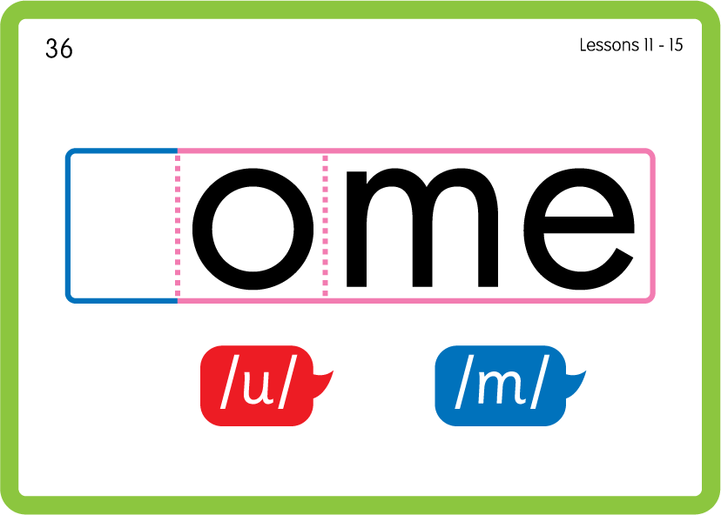
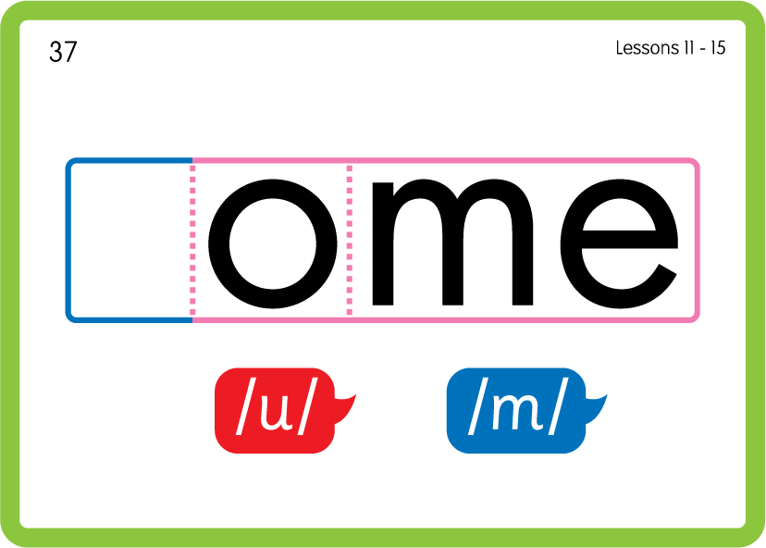
Practise Common Exception Words
USING JN687
BACK

Slide 11



Practise High Frequency Words
USING JN688
FRONT

Slide 12
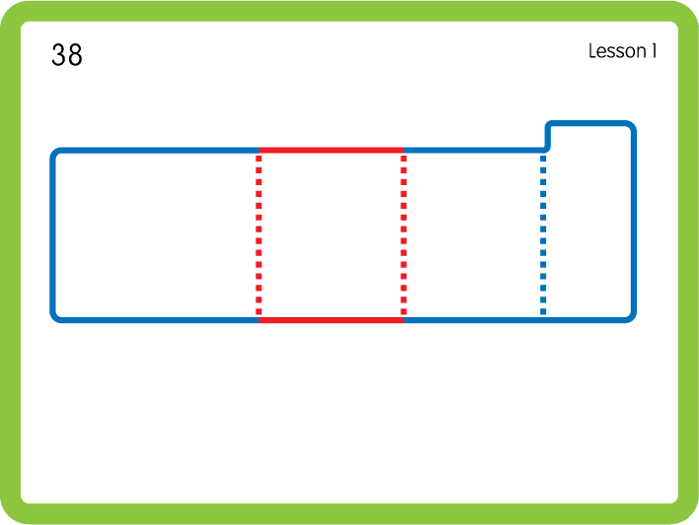
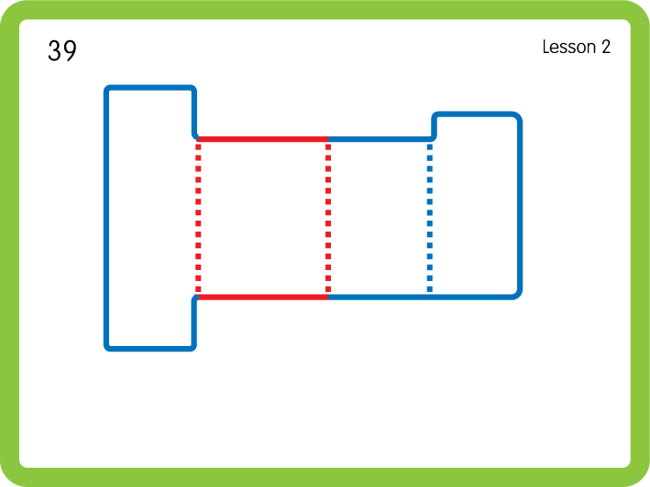
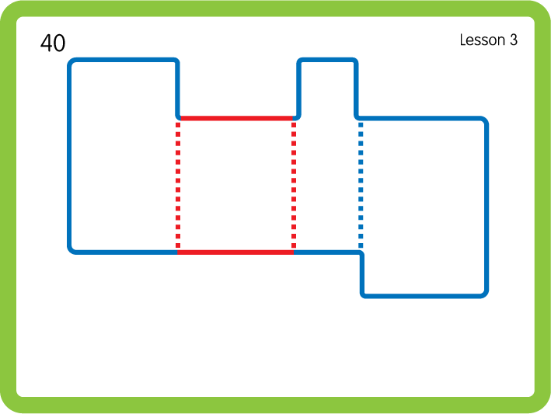
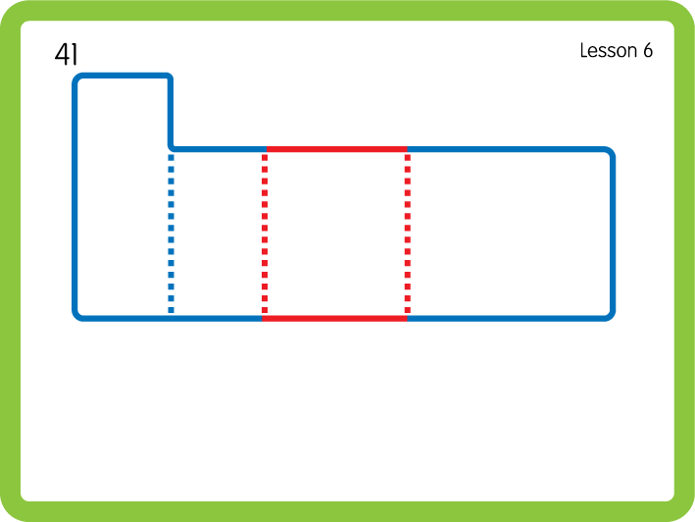
Practise High Frequency Words
USING JN688
BACK

Slide 13

