Slide 1


CVCC (nd mp nt, nk ft st, lt lk sk) |  |  |  | CCVC (fr br, cr tr, gr dr pr)
CCVC (pl bl gl, sl fl cl, st sp sn, sm sw) |  |  |  | CCVCC (short vowel)
CVCC CCVC CCVCC (long vowel) |  |  |  | CCCVC CVCCC
Two Syllable Words
Lesson 29

Slide 2

Learn and practise two syllable words containing adjacent consonants.
Recall all GPCs learned so far using flashcards.
Review Phase 3 Common Exception Words push they me we be he she my by looked you are there here were all sure.
Phoneme Frame Cards
Alien Word Cards
Common Exception Word Cards
JN689
JN692
JN687

Slide 3























Recall all GPCs learned so far using flashcards.

Slide 4





























Recall all GPCs learned so far using flashcards.

Slide 5














Review Phase 2 Common Exception Words as I is no go to into the put his has of pull full.

Slide 6




























Review Phase 3 Common Exception Words push they me we be he she my by looked you are there here were all sure.

Slide 7











Review Phase 4 Common Exception Words said like out have some come what was so old do little.

Slide 8

Review Alphabet Song
a, b, c, d, e, f, g (pause)
h, i, j, k, l, m, n (pause)
o, p, q (pause) r, s, t (pause)
u v w (pause) x y z (pause)
Now I know my abc's, Next time won't you sing with me.

Slide 9

Explain Decoding

Slide 10
Model Blending Phonemes
d
r
i
f
t
w
oo
d
USING SOUND BUTTONS
Sound Buttons
Vowel
Consonant
Consonant Digraph
Multi Sound
Long Vowel Sound
R-controlled Digraph
Split Digraph
Syllable / Silent Letter

Slide 11
Model Blending Phonemes
p
o
n
d
w
ee
d
USING SOUND BUTTONS
Sound Buttons
Vowel
Consonant
Consonant Digraph
Multi Sound
Long Vowel Sound
R-controlled Digraph
Split Digraph
Syllable / Silent Letter

Slide 12

Explain Encoding

Slide 13
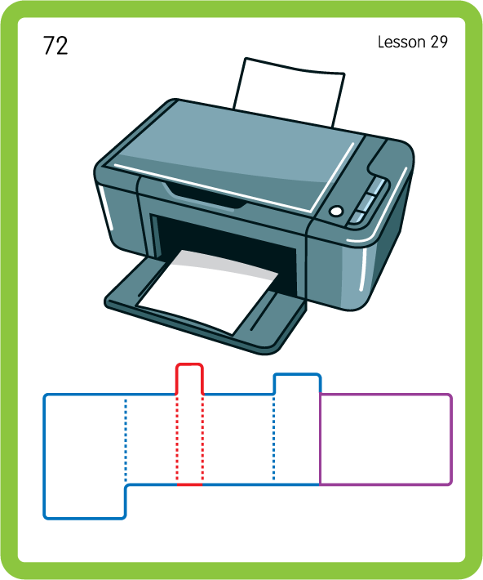
Build a Decodable Word
USING JN689
BACK

Slide 14
Build a Decodable Word
USING JN689
FRONT

Slide 15

Practise with Alien Words
USING JN692
BACK

Slide 16
Practise with Alien Words
USING JL692
FRONT

Slide 17
Practise Common Exception Words
USING JN687
FRONT

Slide 18
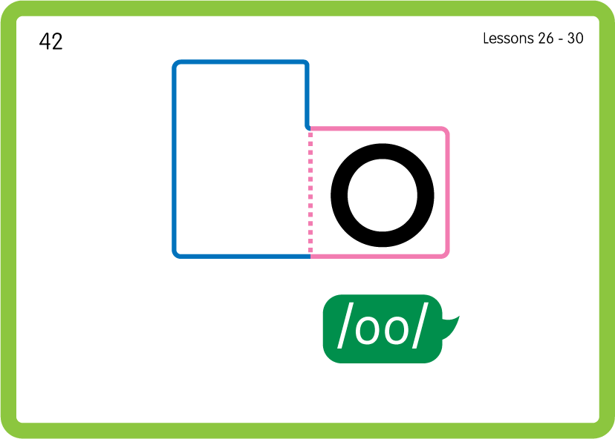
Practise Common Exception Words
USING JN687
BACK

Slide 19
Practise Common Exception Words
USING JN687
FRONT

Slide 20
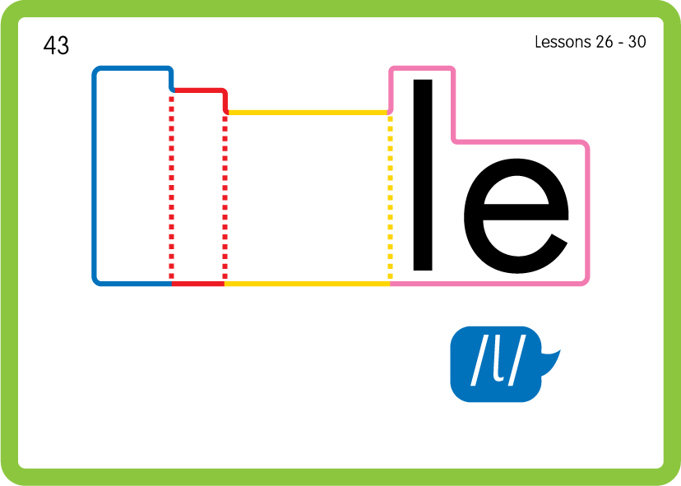
Practise Common Exception Words
USING JN687
BACK

Slide 21
Practise Building Words
d
r
i
f
t
w
oo
d
l
oa
ng
h
e
p
er
o
n
ee
USING MAGNETIC LETTERS AND A WHITEBOARD

Slide 22
Practise Building Words
d
r
i
f
t
w
oo
d
l
oa
ng
h
e
p
er
o
n
ee
driftwood floating helper pondweed printer
USING MAGNETIC LETTERS AND A WHITEBOARD

