Slide 1


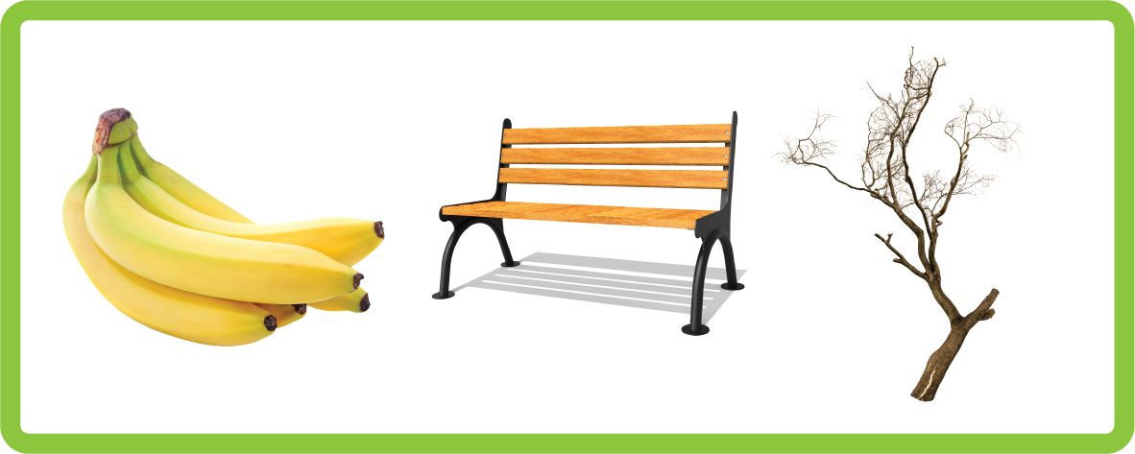
CVCC (nd mp nt, nk ft st, lt lk sk) |  |  |  | CCVC (fr br, cr tr, gr dr pr)
CCVC (pl bl gl, sl fl cl, st sp sn, sm sw) |  |  |  | CCVCC (short vowel)
CVCC CCVC CCVCC (long vowel) |  |  |  | CCCVC CVCCC
CCCVC CVCCC ('nch')
Lesson 34

Slide 2

Learn and practise 3 letter adjacent consonants.
Recall all GPCs learned so far using flashcards.
Review Alphabet Song.
Phonemic Awareness Cards
Phoneme Frame Cards
Alien Word Cards
Common Exception Word Cards
JN691
JN689
JN692
JN687

Slide 3























Recall all GPCs learned so far using flashcards.

Slide 4





























Recall all GPCs learned so far using flashcards.

Slide 5














Review Phase 2 Common Exception Words as I is no go to into the put his has of pull full.

Slide 6




























Review Phase 3 Common Exception Words push they me we be he she my by looked you are there here were all sure.

Slide 7












Review Phase 4 Common Exception Words said like out have some come what was so old do little one.

Slide 8

Review Alphabet Song
a, b, c, d, e, f, g (pause)
h, i, j, k, l, m, n (pause)
o, p, q (pause) r, s, t (pause)
u v w (pause) x y z (pause)
Now I know my abc's, Next time won't you sing with me.

Slide 9
Hear Phonemes
USING JN691
FRONT

Slide 10
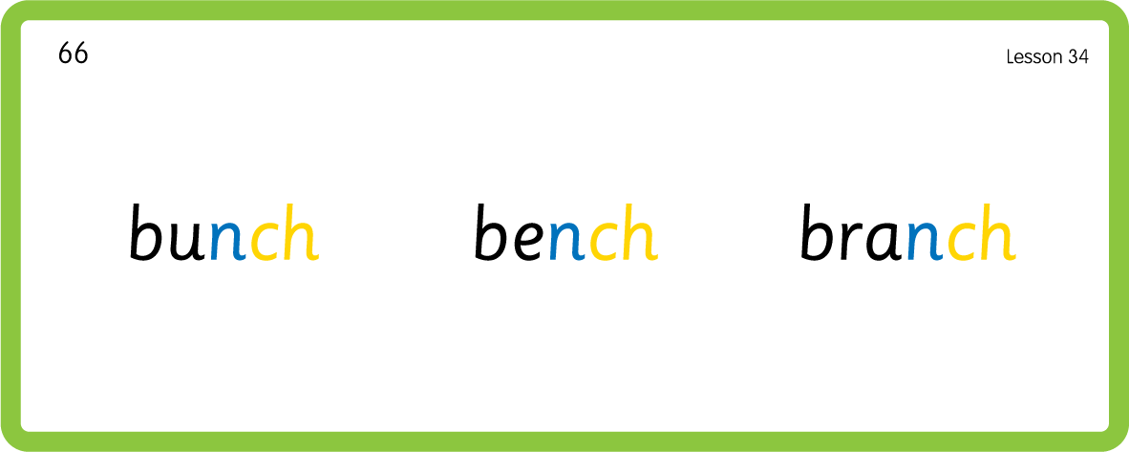
Hear Phonemes
USING JN691
BACK

Slide 11

Explain Decoding

Slide 12
Model Blending Phonemes
b
e
n
ch
USING SOUND BUTTONS
Sound Buttons
Vowel
Consonant
Consonant Digraph
Multi Sound
Long Vowel Sound
R-controlled Digraph
Split Digraph
Syllable / Silent Letter

Slide 13
Model Blending Phonemes
p
i
n
ch
USING SOUND BUTTONS
Sound Buttons
Vowel
Consonant
Consonant Digraph
Multi Sound
Long Vowel Sound
R-controlled Digraph
Split Digraph
Syllable / Silent Letter

Slide 14

Explain Encoding

Slide 15
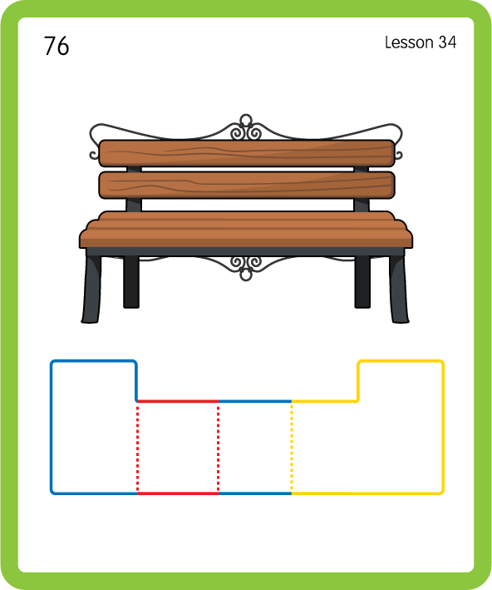
Build a Decodable Word
USING JN689
BACK

Slide 16
Build a Decodable Word
USING JN689
FRONT

Slide 17

Practise with Alien Words
USING JN692
BACK

Slide 18
Practise with Alien Words
USING JN692
FRONT

Slide 19
Practise Common Exception Words
USING JN687
FRONT

Slide 20
Practise Common Exception Words
USING JN687
BACK

Slide 21

Practise Building Words
PRACTISE – 10MINS
l
u
n
ch
b
e
p
i
c
a
t
m
r
s
USING MAGNETIC LETTERS AND A WHITEBOARD

Slide 22
Practise Building Words
PRACTISE – 10MINS
l
u
n
ch
b
e
p
i
c
a
t
m
r
s
lunch bench bunch pinch branch stench crunch
USING MAGNETIC LETTERS AND A WHITEBOARD

