Slide 1
CVCC (nd mp nt, nk ft st, lt lk sk) |  |  |  | CCVC (fr br, cr tr, gr dr pr)
CCVC (pl bl gl, sl fl cl, st sp sn, sm sw) |  |  |  | CCVCC (short vowel)
CVCC CCVC CCVCC (long vowel) |  |  |  | CCCVC CVCCC
CCVC (long vowel)
Lesson 9

Slide 2


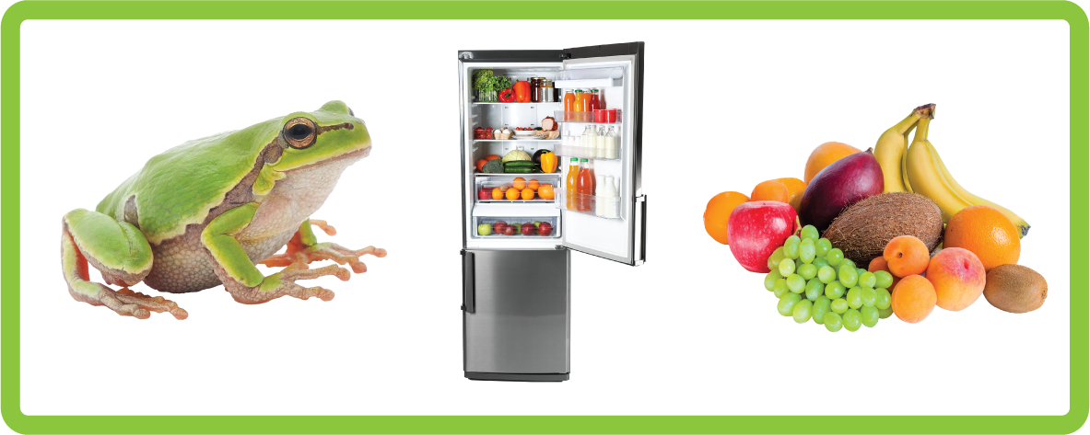


Learn and practise CCVC words.
Recall all GPCs learned so far using flashcards.
Review Alphabet Song.
Phonemic Awareness Cards
Phoneme Frame Cards
Alien Word Cards
Common Exception Word Cards
High Frequency Word Cards
JN691
JN689
JN692
JN687
JN688

Slide 3























Recall all GPCs learned so far using flashcards.

Slide 4





























Recall all GPCs learned so far using flashcards.

Slide 5














Review Phase 2 Common Exception Words as I is no go to into the put his has of pull full.

Slide 6




























Review Phase 3 Common Exception Words push they me we be he she my by looked you are there here were all sure.

Slide 7



Review Phase 4 Common Exception Words said like out have.

Slide 8

Review Alphabet Song
a, b, c, d, e, f, g (pause)
h, i, j, k, l, m, n (pause)
o, p, q (pause) r, s, t (pause)
u v w (pause) x y z (pause)
Now I know my abc's, Next time won't you sing with me.

Slide 9
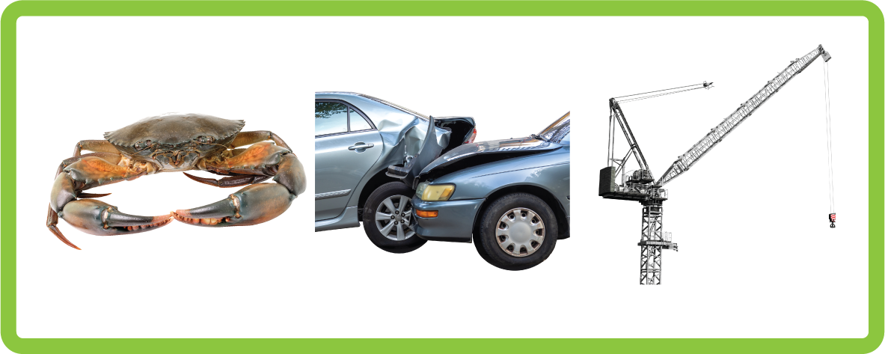

Hear Phonemes
USING JN691
FRONT

Slide 10



Hear Phonemes
USING JN691
BACK

Slide 11

Explain Decoding

Slide 12
Model Blending Phonemes
g
r
ee
n
USING SOUND BUTTONS

Slide 13
Model Blending Phonemes
t
r
ai
n
USING SOUND BUTTONS

Slide 14

Explain Encoding

Slide 15
t
r
u
ck
g
n
ai
Practise Building Words
USING A PHONEME FRAME
Notes:
truck grain

Slide 16
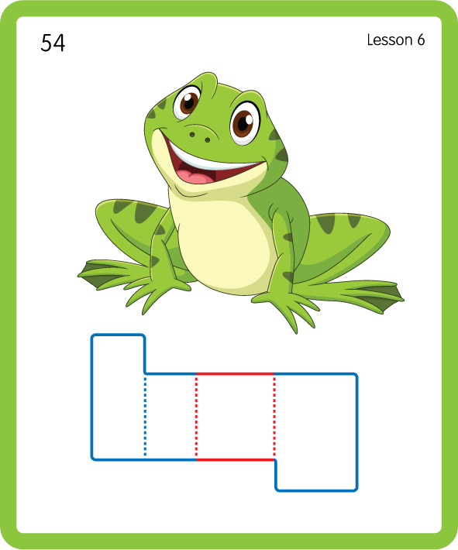
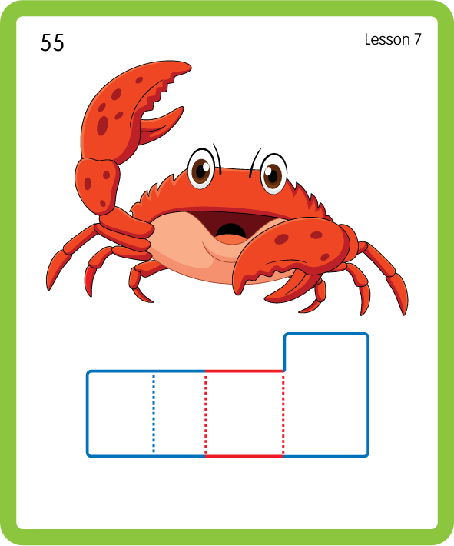
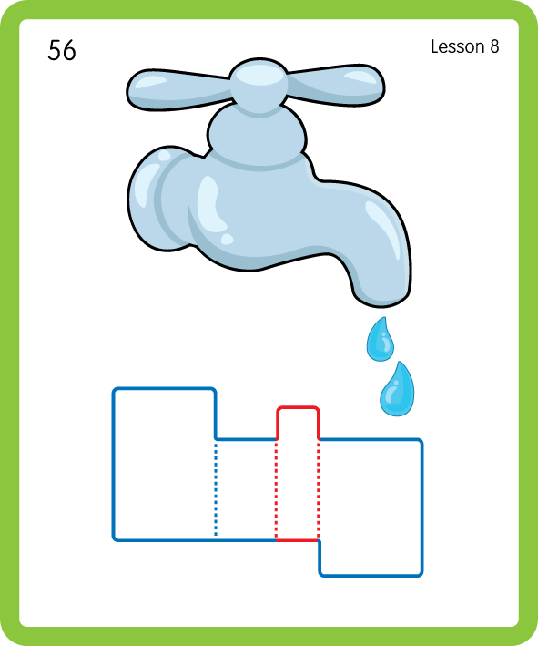
Build a Decodable Word
USING JN689
BACK

Slide 17


Build a Decodable Word
USING JN689
FRONT

Slide 18
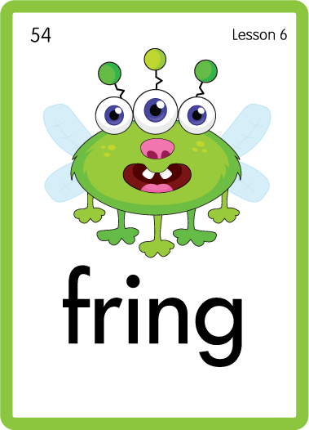


Practise with Alien Words
USING JN692
BACK

Slide 19


Practise with Alien Words
USING JN692
FRONT

Slide 20
Practise Common Exception Words
USING JN687
FRONT

Slide 21
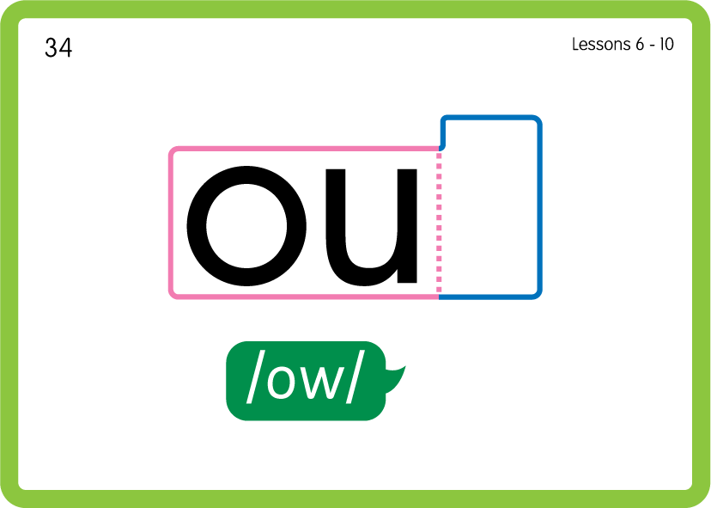
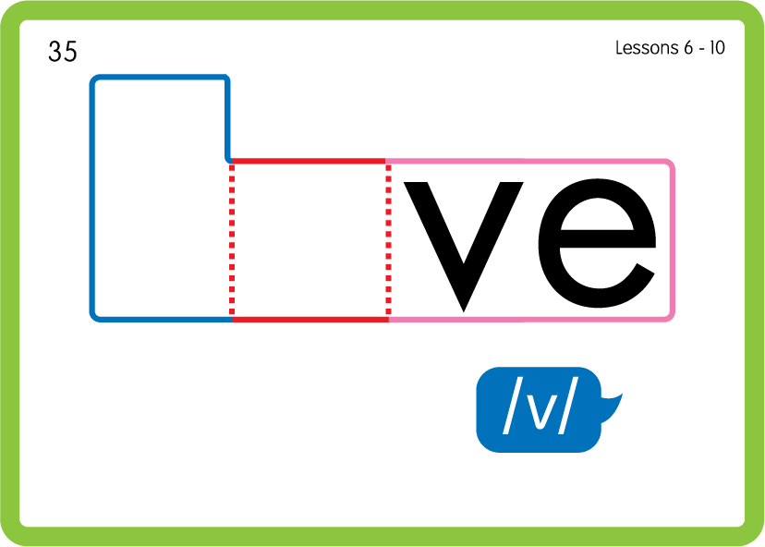
Practise Common Exception Words
USING JN687
BACK

Slide 22
Practise High Frequency Words
USING JN688
FRONT

Slide 23
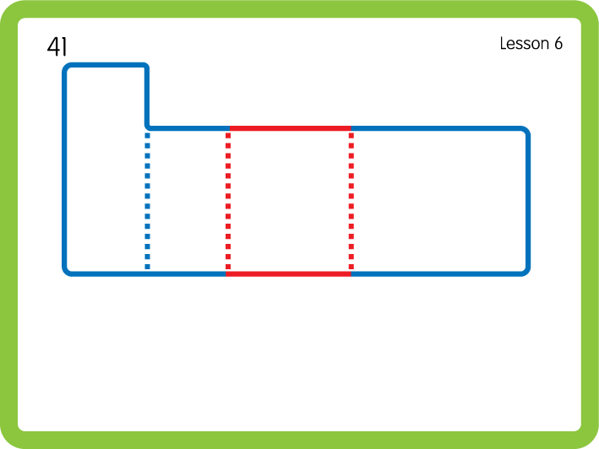
Practise High Frequency Words
USING JN688
FRONT

Slide 24

