Slide 1

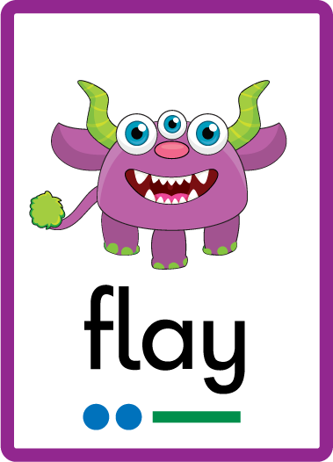
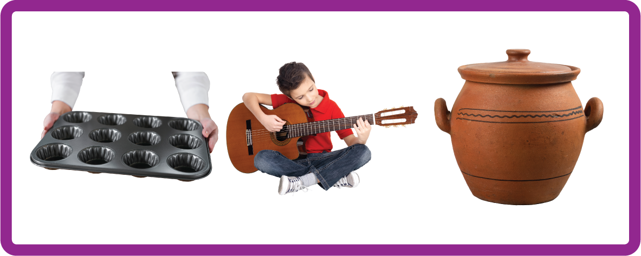
ay | ou | ie | ea | oy | ir | ue | aw
wh | ph | ew | oe | au | ey | a-e | e-e
i-e | o-e | u-e
Digraph 'ay'
Lesson 1

Slide 2
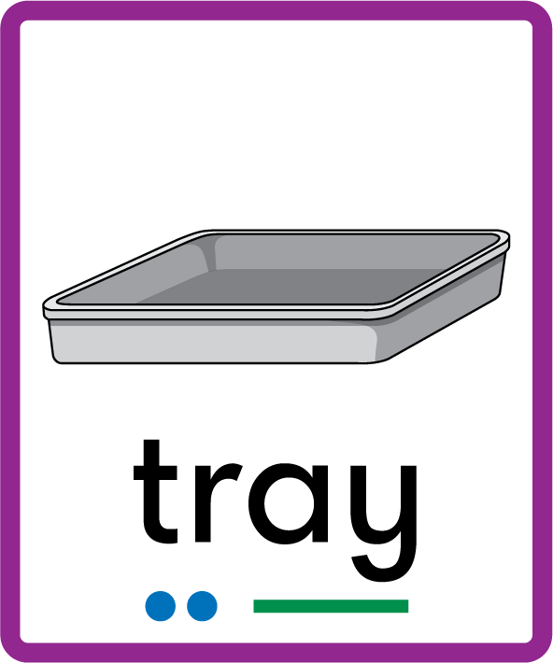


Learn and practise digraph ay.
Recall all GPCs learned so far using flashcards.
Recall Phase 2 Common Exception Words as I is no go to into the put his has of pull full.
Phonemic Awareness Cards
Grapheme to Phoneme Cards
Phoneme Frame Cards
Alien Word Cards
Common Exception Word Cards
High Frequency Word Cards
JN691
JN686
JN689
JN692
JN687
JN688

Slide 3


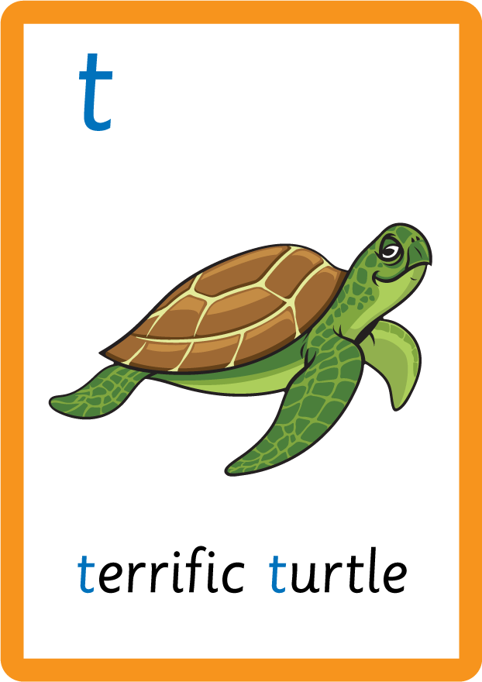




















Recall all GPCs learned so far using flashcards.

Slide 4


















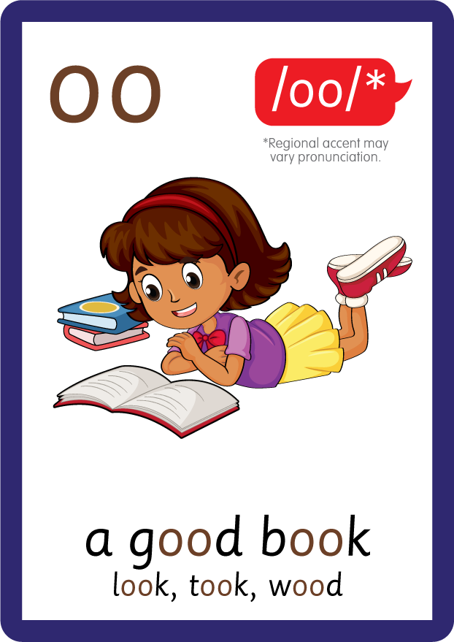









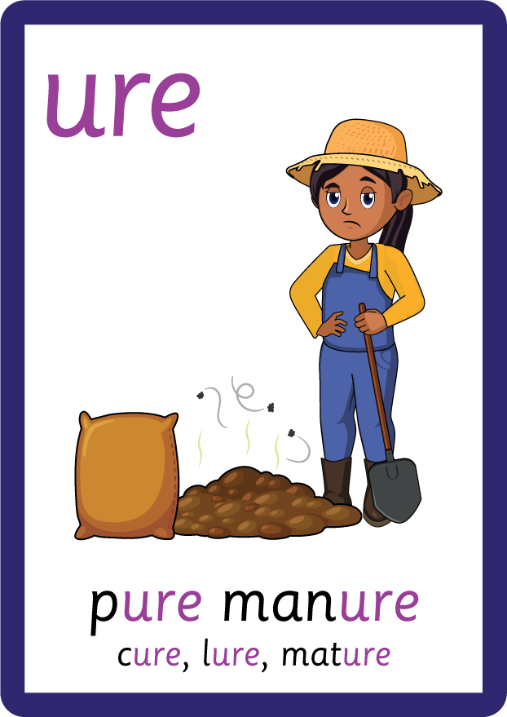
Recall all GPCs learned so far using flashcards.

Slide 5






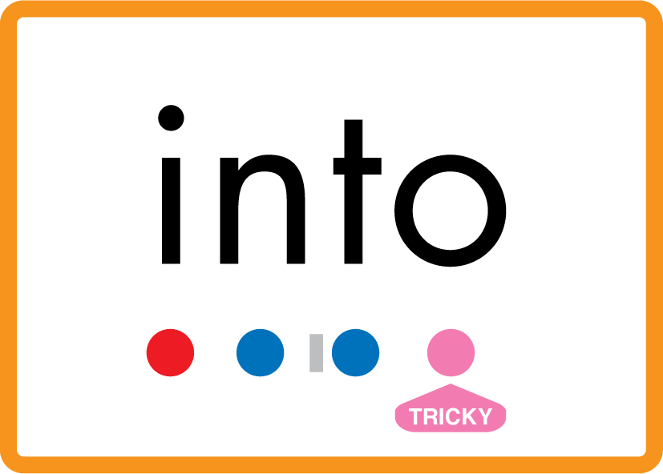


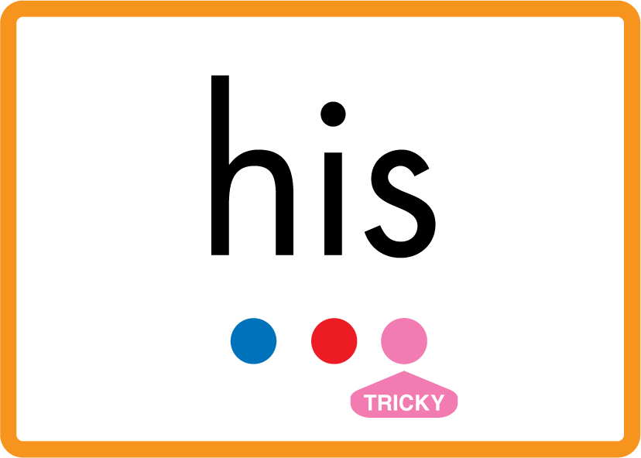



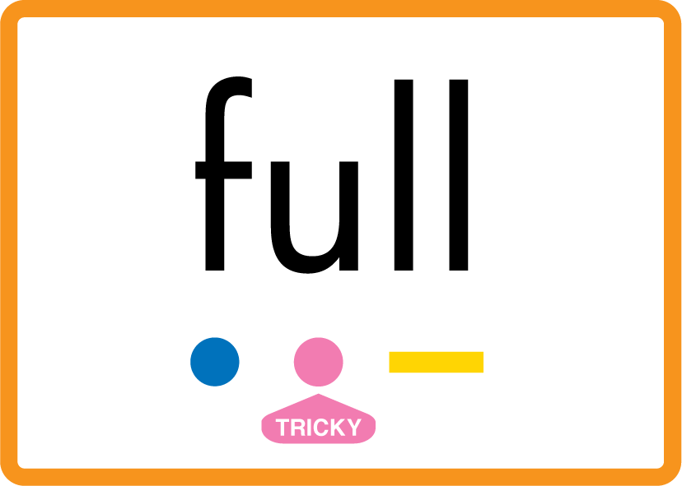
Review Phase 2 Common Exception Words as I is no go to into the put his has of pull full.

Slide 6
Hear Phonemes
USING JN691
FRONT

Slide 7
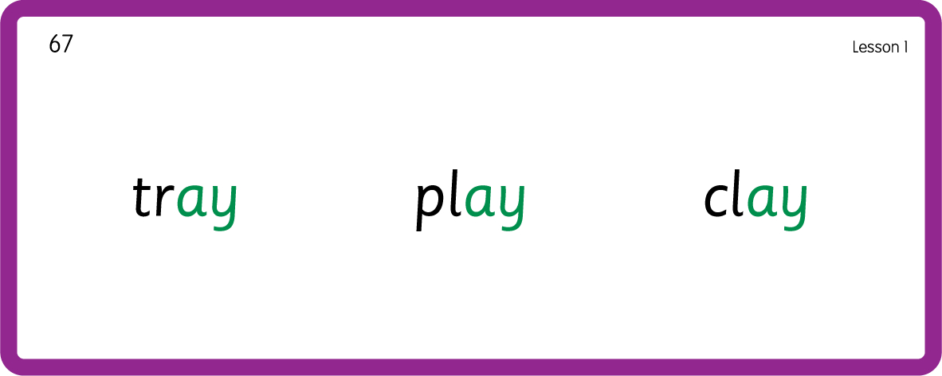
Hear Phonemes
USING JN691
BACK

Slide 8
Teach Grapheme Caption
USING JN686
FRONT

Slide 9
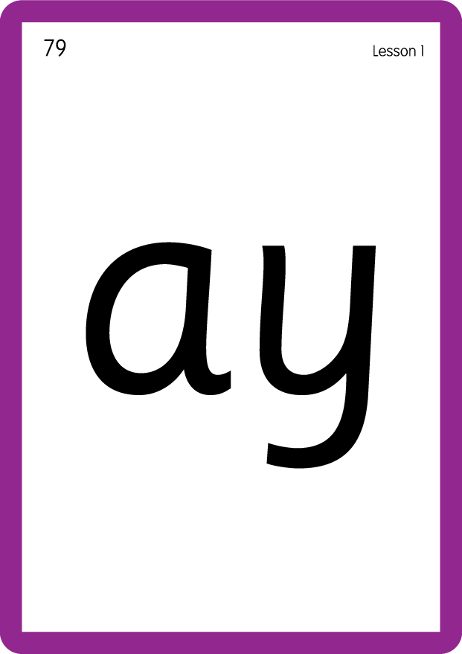
Teach Lowercase Formation
USING JN686
BACK

Slide 10

Explain Decoding

Slide 11
Model Blending Phonemes
m
ay
USING SOUND BUTTONS
Sound Buttons
Vowel
Consonant
Consonant Digraph
Long Vowel Sound
R-controlled Digraph
Split Digraph
Syllable / Silent Letter

Slide 12
Model Blending Phonemes
s
ay
USING SOUND BUTTONS
Sound Buttons
Vowel
Consonant
Consonant Digraph
Long Vowel Sound
R-controlled Digraph
Split Digraph
Syllable / Silent Letter

Slide 13
Model Blending Phonemes
p
l
ay
USING SOUND BUTTONS
Sound Buttons
Vowel
Consonant
Consonant Digraph
Long Vowel Sound
R-controlled Digraph
Split Digraph
Syllable / Silent Letter

Slide 14

Explain Encoding

Slide 15
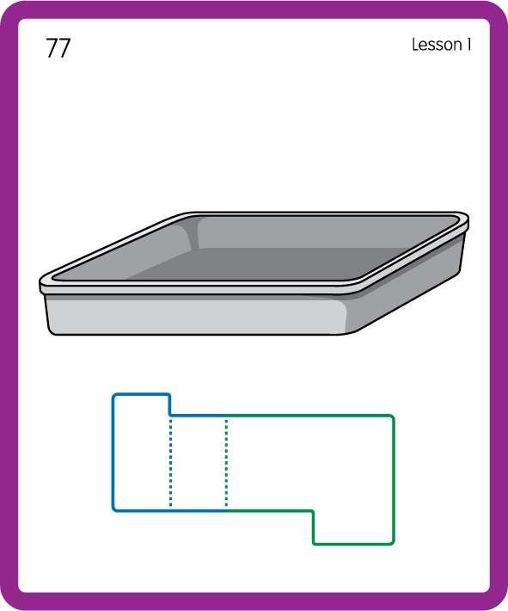
Build a Decodable Word
USING JN689
BACK

Slide 16
Build a Decodable Word
USING JN689
FRONT

Slide 17
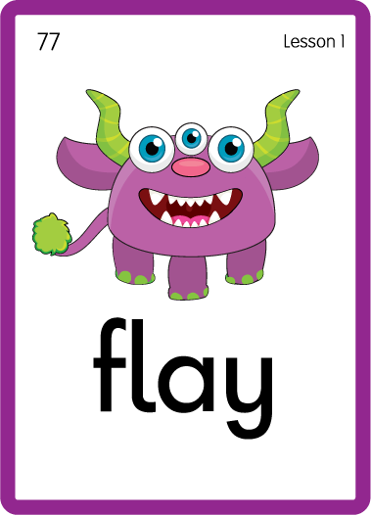
Practise with Alien Words
USING JN692
BACK

Slide 18
Practise with Alien Words
USING JN692
FRONT

Slide 19
Practice Common Exception Words
USING JN687
FRONT

Slide 20
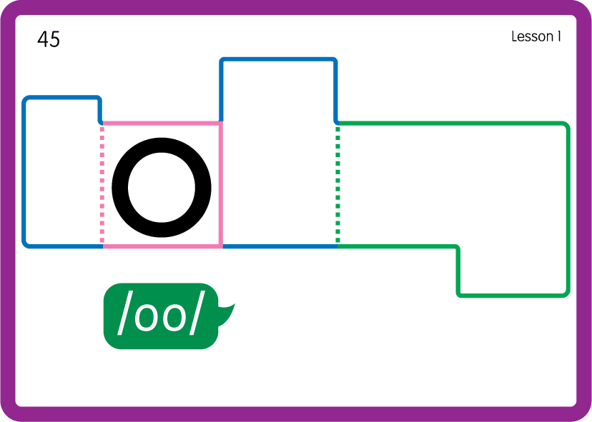
Practice Common Exception Words
USING JN687
FRONT

Slide 21
Practise High Frequency Words
USING JN688
FRONT

Slide 22
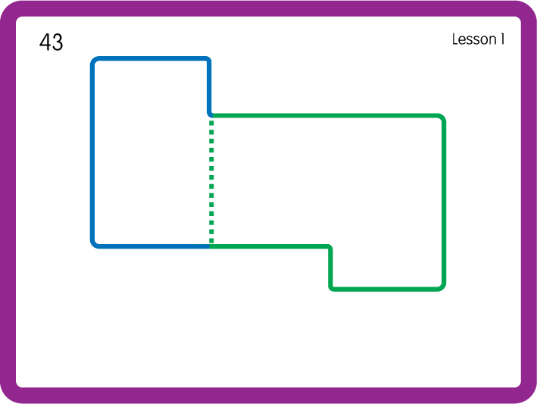
Practise High Frequency Words
USING JN688
BACK

Slide 23

Practise Building Words
PRACTISE – 10MINS
m
s
p
l
c
t
r
ay
USING MAGNETIC LETTERS AND A WHITEBOARD

Slide 24
Practise Building Words
PRACTISE – 10MINS
m
s
p
l
c
t
r
ay
may say play clay tray stray
USING MAGNETIC LETTERS AND A WHITEBOARD

