Slide 1




ay | ou | ie | ea | oy | ir | ue | aw
wh | ph | ew | oe | au | ey | a-e | e-e
i-e | o-e | u-e
Vowel Digraph 'ou' (/ow/)
Lesson 2

Slide 2


Learn and practise vowel digraph ou (/ow/).
Recall all GPCs learned so far using flashcards.
Recall Phase 3 Common Exception Words push they me we be he she my by looked you are there here were all sure.
Phonemic Awareness Cards
Grapheme to Phoneme Cards
Phoneme Frame Cards
Alien Word Cards
Common Exception Word Cards
High Frequency Word Cards
JN691
JN686
JN689
JN692
JN687
JN688

Slide 3























Recall all GPCs learned so far using flashcards.

Slide 4





























Recall all GPCs learned so far using flashcards.

Slide 5

Recall all GPCs learned so far using flashcards.

Slide 6














Review Phase 2 Common Exception Words as I is no go to into the put his has of pull full.

Slide 7




























Review Phase 3 Common Exception Words push they me we be he she my by looked you are there here were all sure.

Slide 8













Review Phase 4 Common Exception Words said like out have some come what was so old do little one.

Slide 9
Hear Phonemes
USING JN691
FRONT

Slide 10
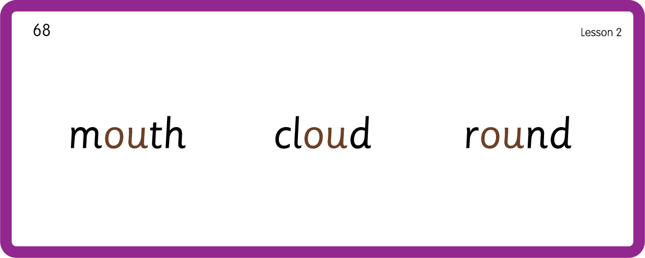
Hear Phonemes
USING JN691
BACK

Slide 11
Teach Grapheme Caption
USING JN686
FRONT

Slide 12
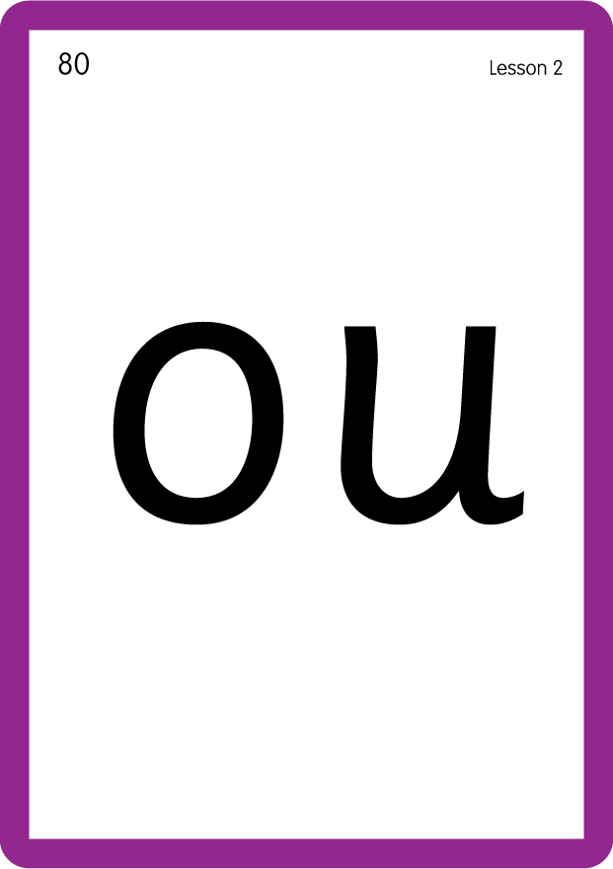
Teach Lowercase Formation
USING JN686
BACK

Slide 13

Explain Decoding

Slide 14
Model Blending Phonemes
ou
t
USING SOUND BUTTONS
Sound Buttons
Vowel
Consonant
Consonant Digraph
Long Vowel Sound
R-controlled Digraph
Split Digraph
Syllable / Silent Letter

Slide 15
Model Blending Phonemes
s
c
ou
t
USING SOUND BUTTONS
Sound Buttons
Vowel
Consonant
Consonant Digraph
Long Vowel Sound
R-controlled Digraph
Split Digraph
Syllable / Silent Letter

Slide 16
Model Blending Phonemes
p
r
ou
d
USING SOUND BUTTONS
Sound Buttons
Vowel
Consonant
Consonant Digraph
Long Vowel Sound
R-controlled Digraph
Split Digraph
Syllable / Silent Letter

Slide 17

Explain Encoding

Slide 18
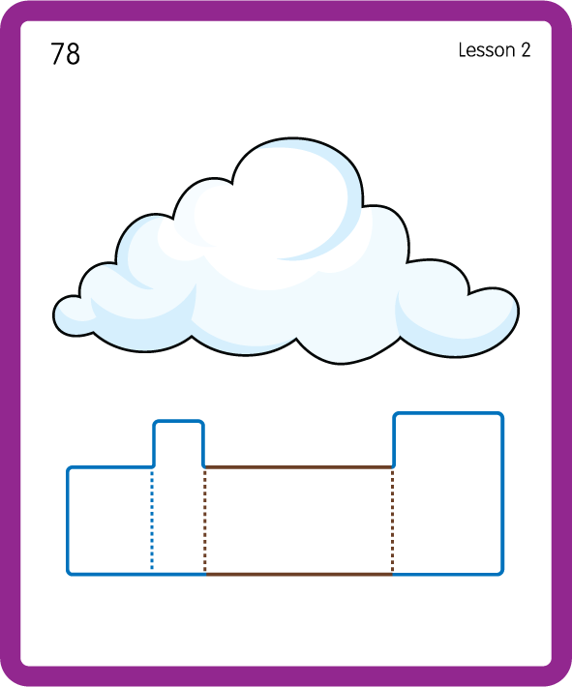
Build a Decodable Word
USING JN689
BACK

Slide 19
Build a Decodable Word
USING JN689
FRONT

Slide 20

Practise with Alien Words
USING JN692
BACK

Slide 21
Practise with Alien Words
USING JN692
FRONT

Slide 22
Practise Common Exception Words
USING JN687
FRONT

Slide 23
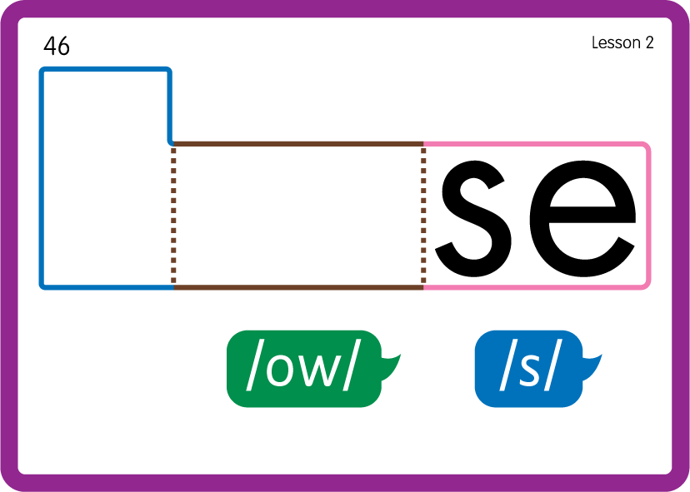
Practise Common Exception Words
USING JN687
BACK

Slide 24

Practise Common Exception Words
USING JN687
BACK

Slide 25
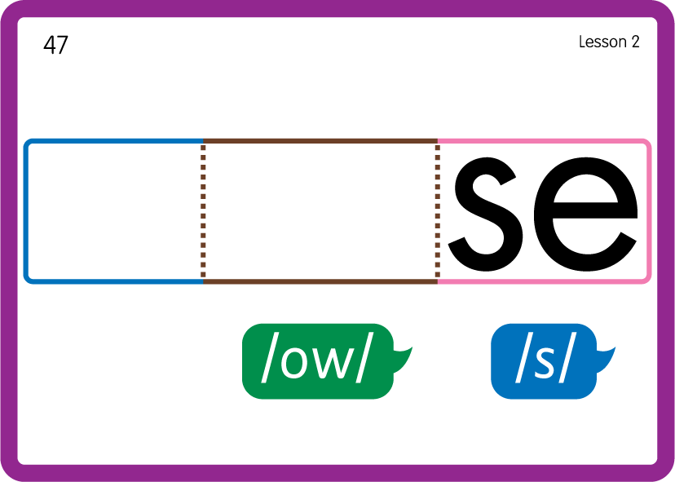
Practise Common Exception Words
USING JN687
BACK

Slide 26

Practise Common Exception Words
USING JN687
BACK

Slide 27
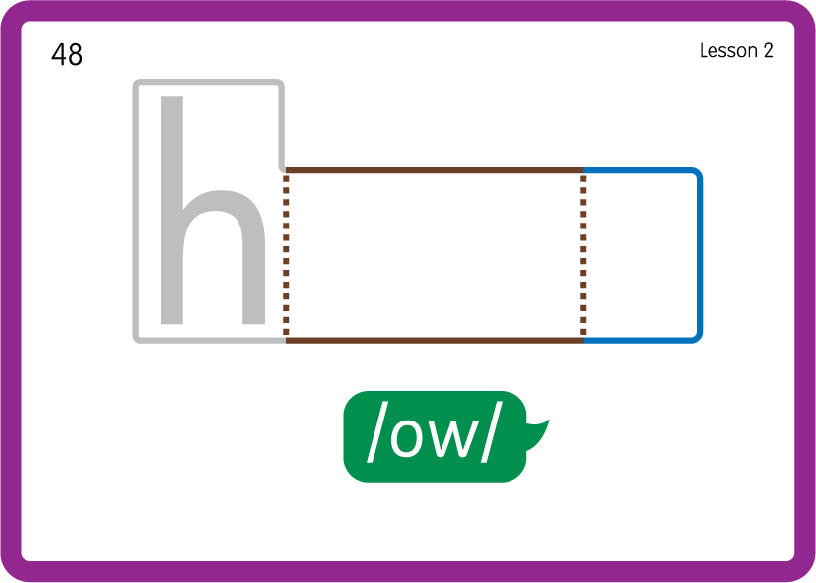
Practise Common Exception Words
USING JN687
BACK

Slide 28
Practise High Frequency Words
USING JN688
FRONT

Slide 29
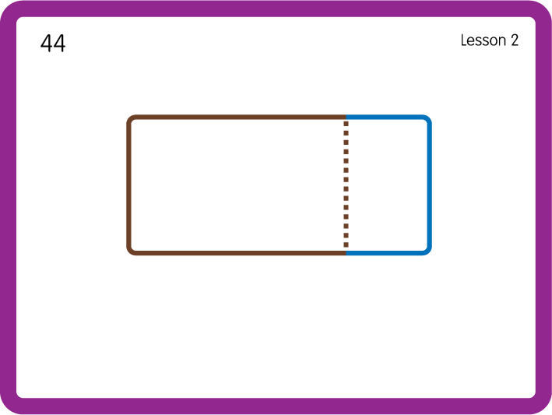
Practise High Frequency Words
USING JN688
BACK

Slide 30

Practise Building Words
PRACTISE – 10MINS
s
c
l
p
f
n
r
d
t
ou
USING MAGNETIC LETTERS AND A WHITEBOARD

Slide 31
Practise Building Words
PRACTISE – 10MINS
s
c
l
p
f
n
r
d
t
ou
out scout cloud proud found round sprout
USING MAGNETIC LETTERS AND A WHITEBOARD

