Slide 1



ay | ou | ie | ea | oy | ir | ue | aw
wh | ph | ew | oe | au | ey | a-e | e-e
i-e | o-e | u-e
Review a-e e-e i-e
Lesson 24

Slide 2


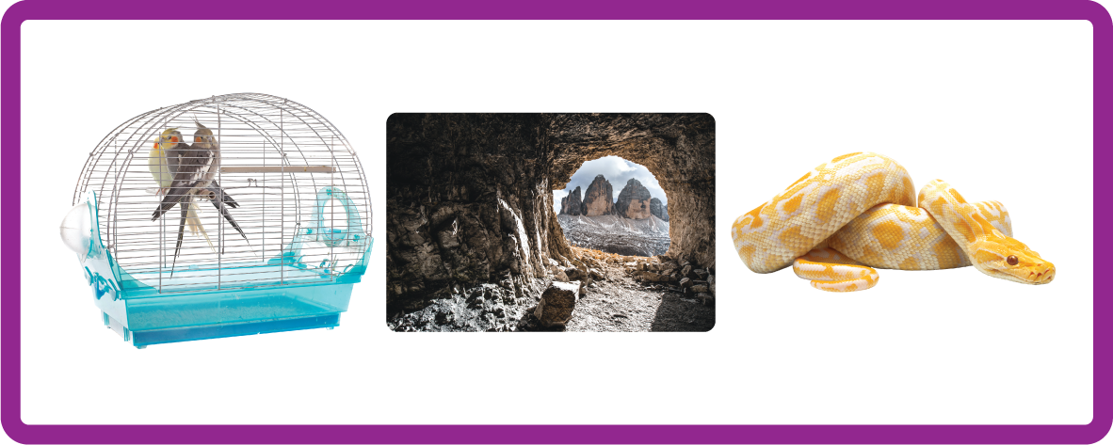

Review and practise a-e e-e i-e.
Recall all GPCs learned so far using flashcards.
Recall Phase 4 Common Exception Words said like out have some come was what so old do little one.
Phonemic Awareness Cards
Grapheme to Phoneme Cards
Phoneme Frame Cards
Alien Word Cards
High Frequency Word Cards
JN691
JN686
JN689
JN692
JN688

Slide 3
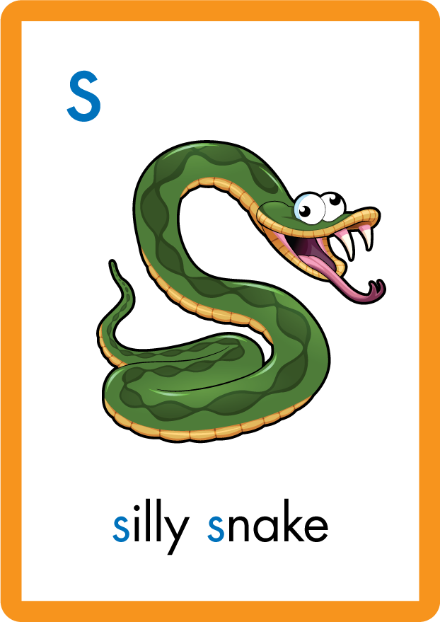







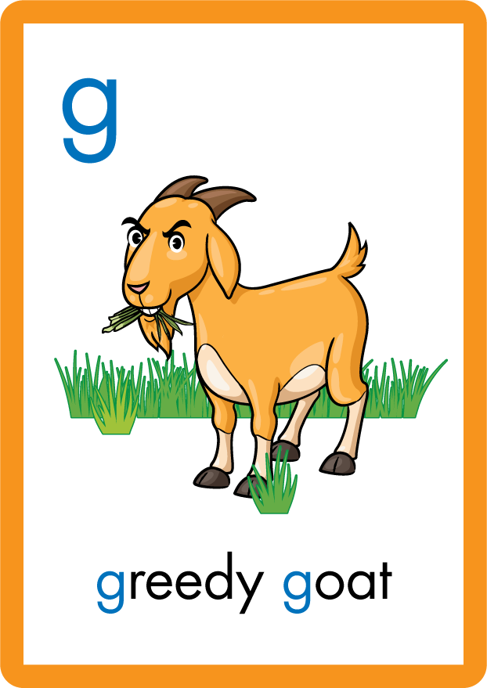




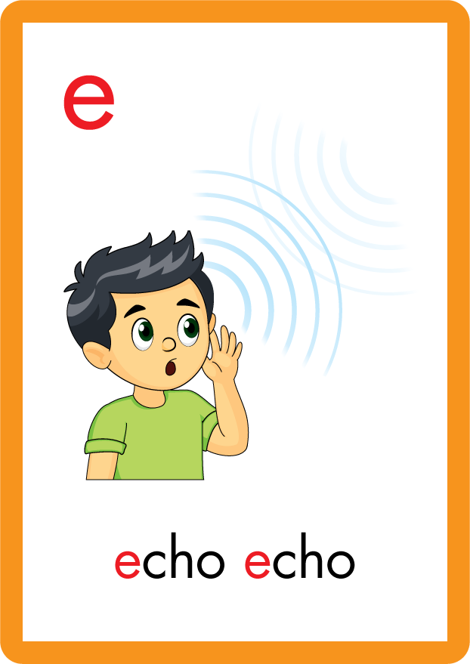







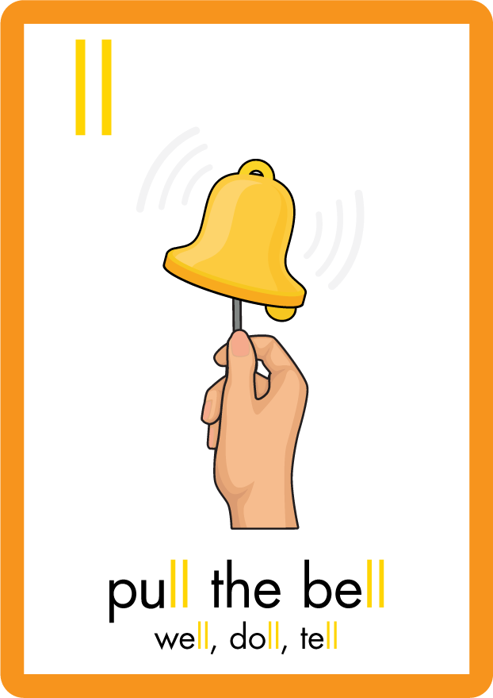

Recall all GPCs learned so far using flashcards.

Slide 4





























Recall all GPCs learned so far using flashcards.

Slide 5
















Recall all GPCs learned so far using flashcards.

Slide 6














Review Phase 2 Common Exception Words as I is no go to into the put his has of pull full.

Slide 7




























Review Phase 3 Common Exception Words push they me we be he she my by looked you are there here were all sure.

Slide 8













Review Phase 4 Common Exception Words said like out have some come what was so old do little one.

Slide 9












Review Phase 5 Common Exception Words today house mouse hour because Mr Mrs Ms where should could would.

Slide 10


Hear Phonemes
USING JN691
FRONT

Slide 11
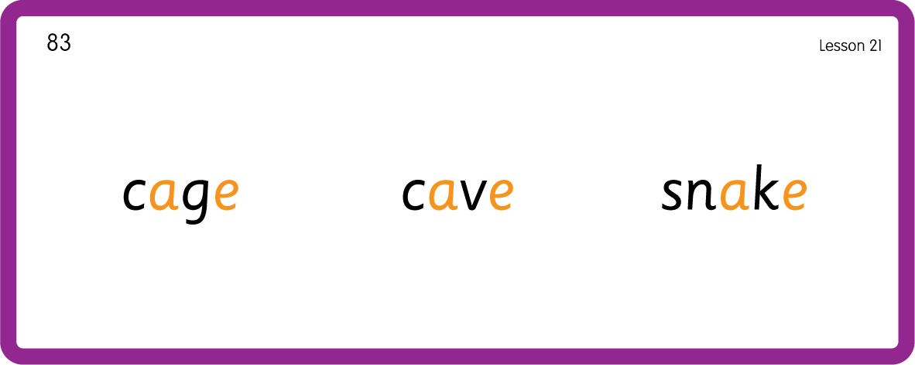

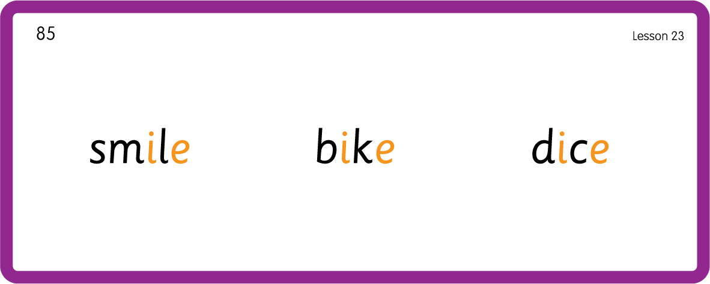
Hear Phonemes
USING JN691
BACK

Slide 12
Review Grapheme Caption
USING JN686
FRONT

Slide 13
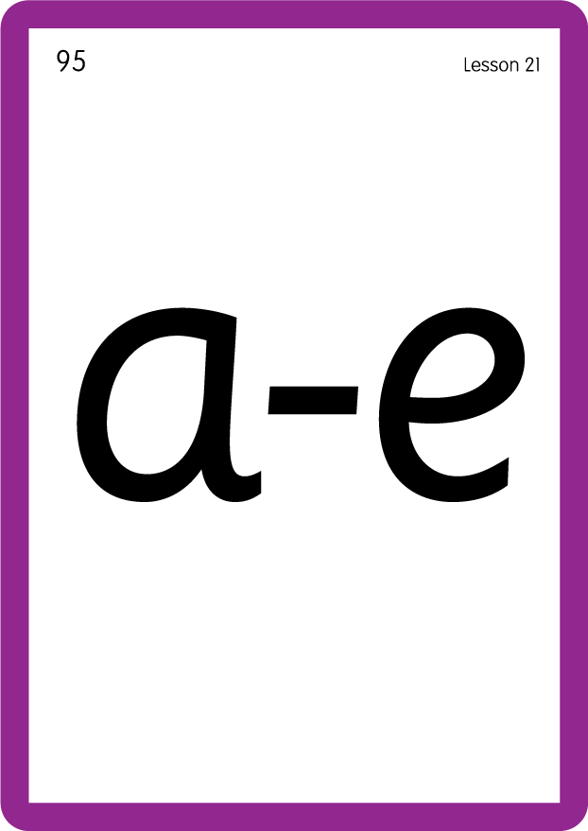


Review Lowercase Formation
USING JN686
BACK

Slide 14
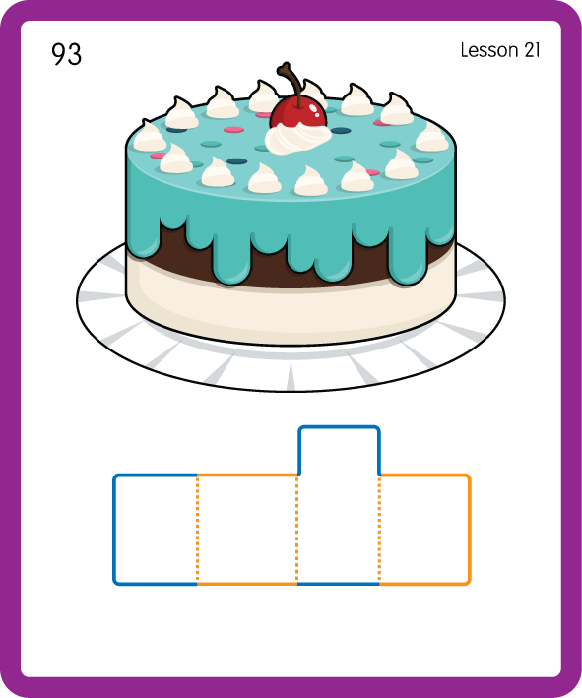
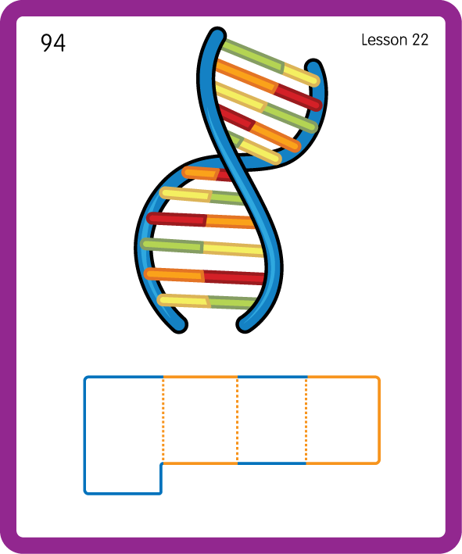
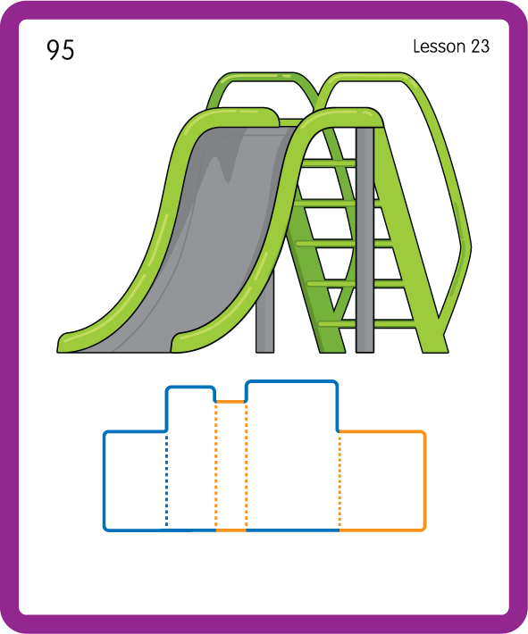
Build a Decodable Word
USING JN689
BACK

Slide 15


Build a Decodable Word
USING JN689
FRONT

Slide 16



Practise with Alien Words
USING JN692
BACK

Slide 17


Practise with Alien Words
USING JN692
FRONT

Slide 18



Practise High Frequency Words
USING JN688
FRONT

Slide 19
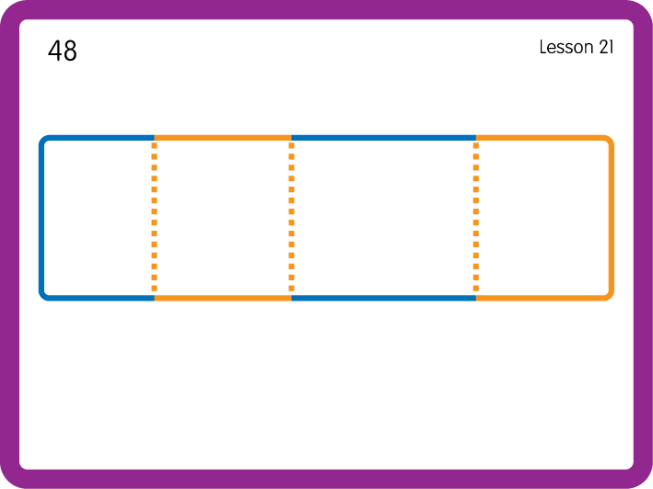
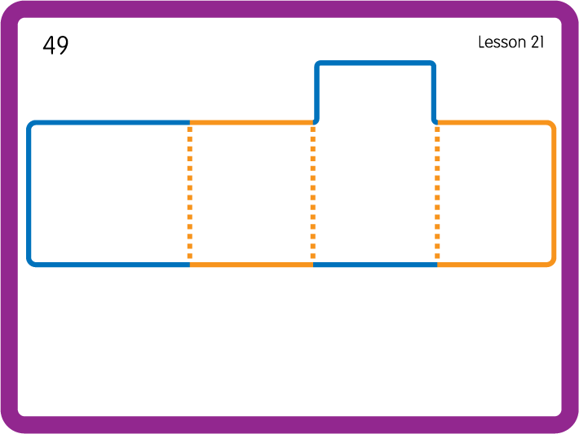
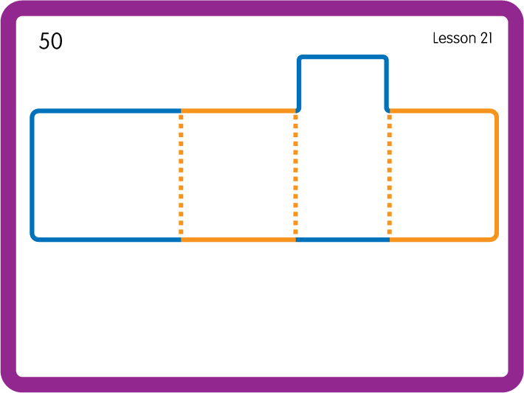
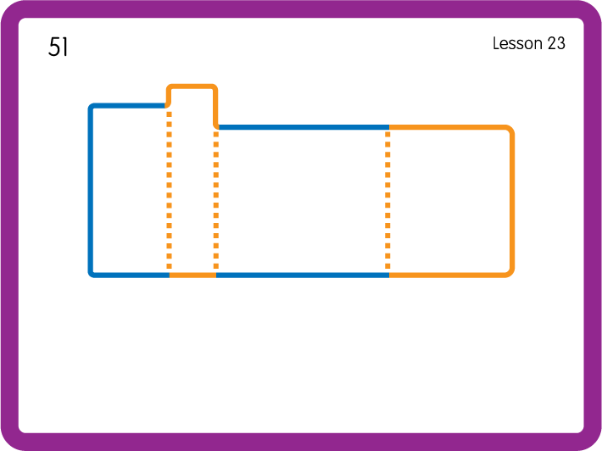
Practise High Frequency Words
USING JN688
BACK

Slide 20

