Slide 1




ay | ou | ie | ea | oy | ir | ue | aw
wh | ph | ew | oe | au | ey | a-e | e-e
i-e | o-e | u-e
Common Exception Words
Lesson 25

Slide 2




Learn and practise Common Exception Words.
Recall all GPCs learned so far using flashcards.
Review all Phase 4 & Phase 5 Common Exception Words:
said like out have some come was what so old do little one
today house mouse hour because Mr Mrs Ms where
Common Exception Word Cards
Phase 2
Common Exception Word Cards
Phase 3
Common Exception Word Cards
Phase 4
Common Exception Word Cards
Phase 5
High Frequency Word Cards
JN687
JN687
JN687
JN687
JN688

Slide 3























Recall all GPCs learned so far using flashcards.

Slide 4





























Recall all GPCs learned so far using flashcards.

Slide 5





































Recall all GPCs learned so far using flashcards.

Slide 6













Review Phase 2 Common Exception Words as I is no go to into the put his has of pull full.

Slide 7



























Review Phase 3 Common Exception Words push they me we be he she my by looked you are there here were all sure.

Slide 8












Review Phase 4 Common Exception Words said like out have some come what was so old do little one.

Slide 9








Review Phase 5 Common Exception Words today house mouse hour because Mr Mrs Ms where should could would.

Slide 10
Practise Common Exception Words
USING JN687
FRONT

Slide 11
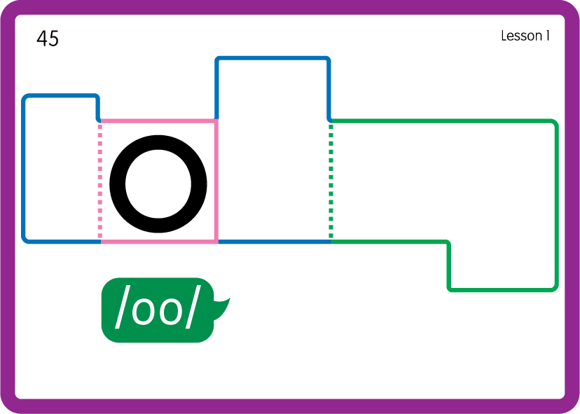
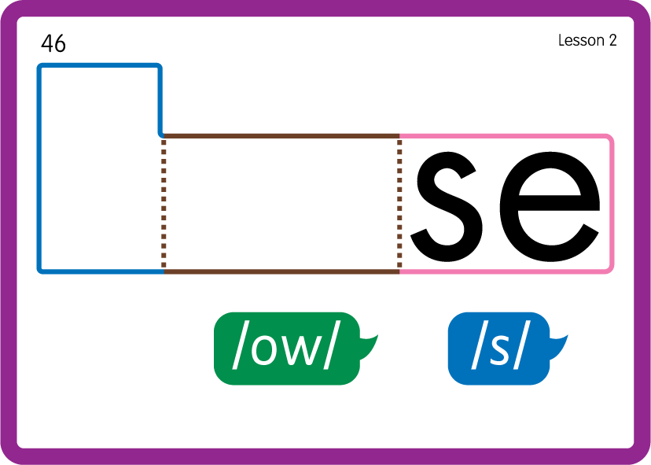
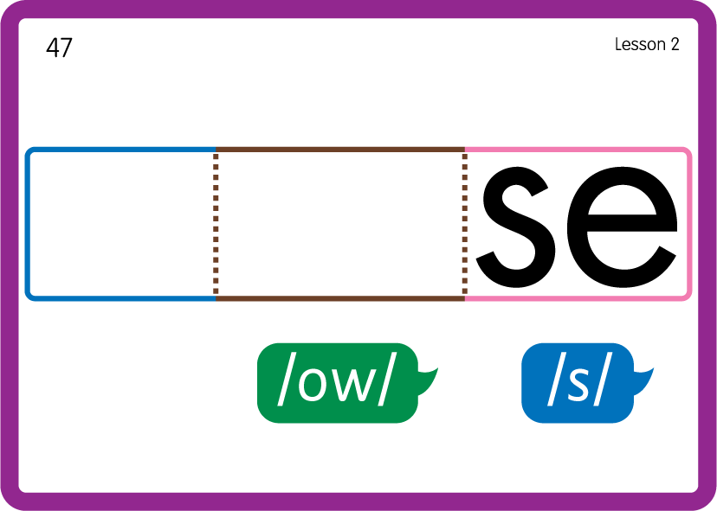
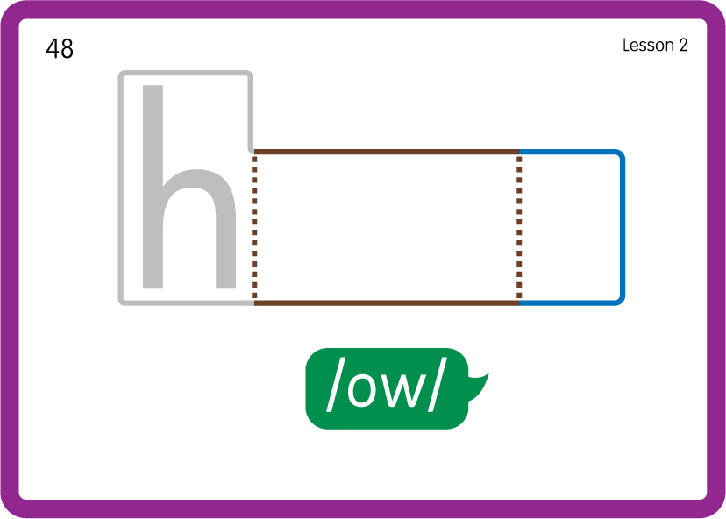
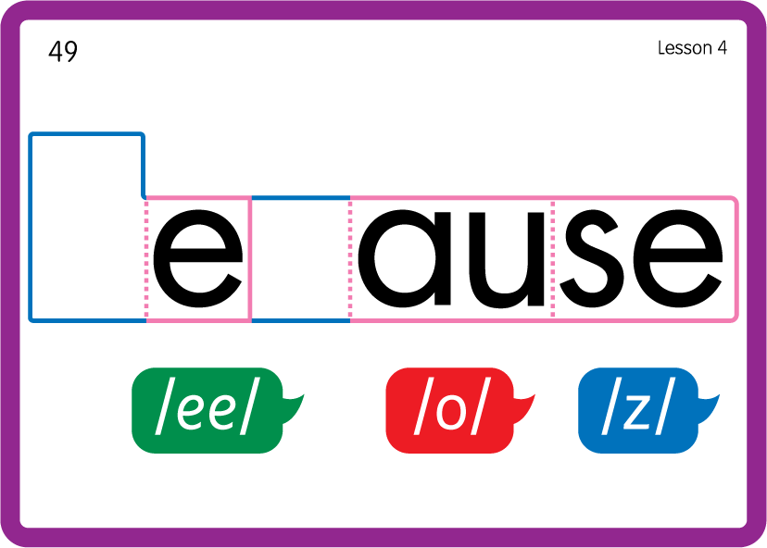






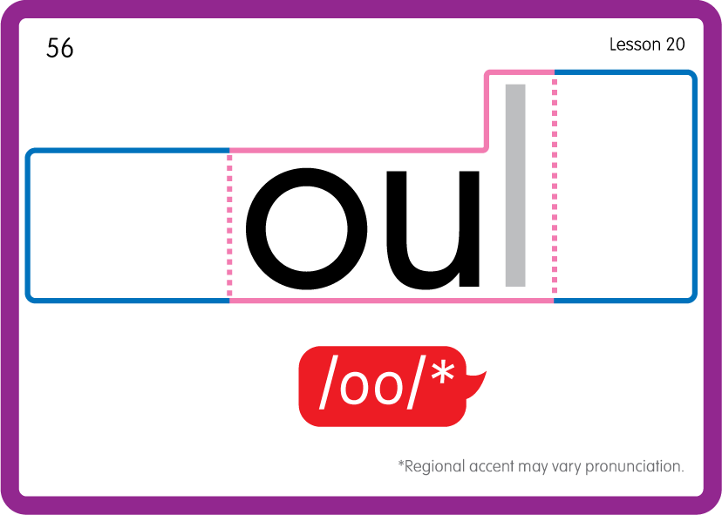
Practise Common Exception Words
USING JN687
BACK

Slide 12








Practise High Frequency Words
USING JN688
FRONT

Slide 13
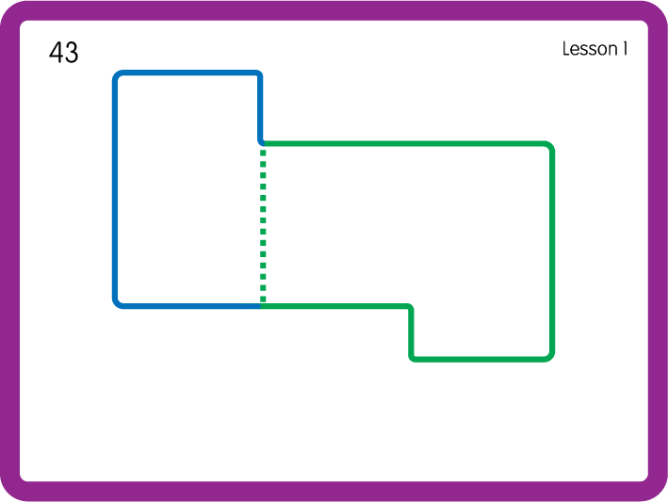
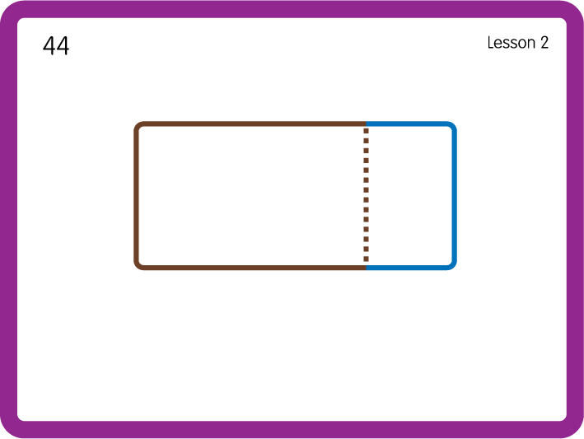
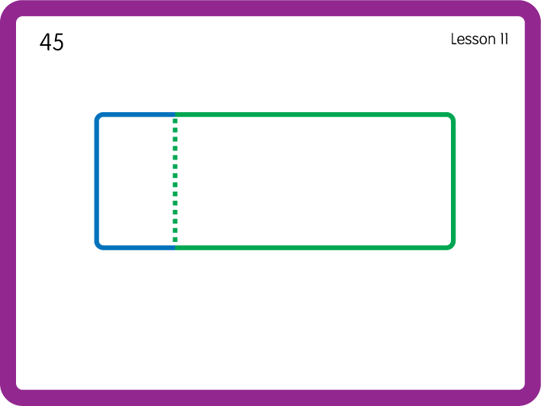
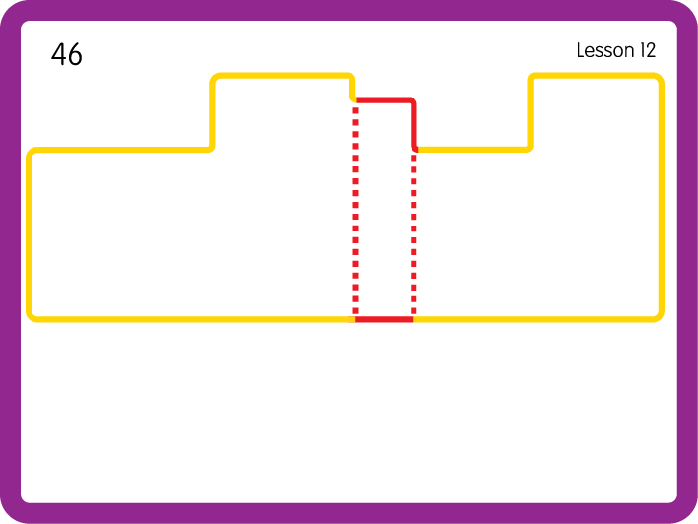
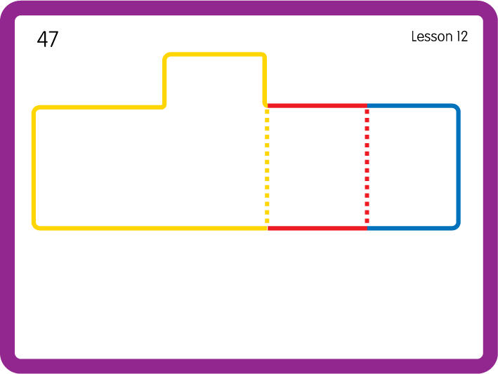
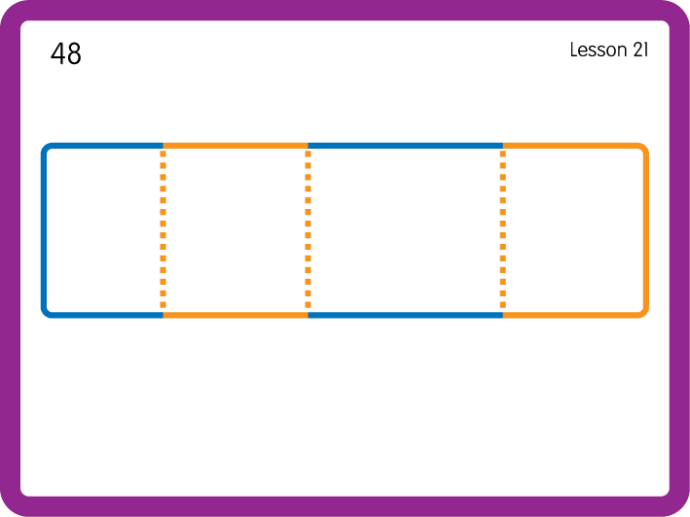
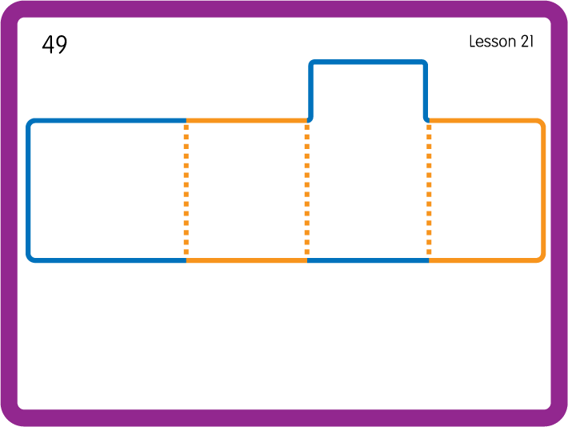
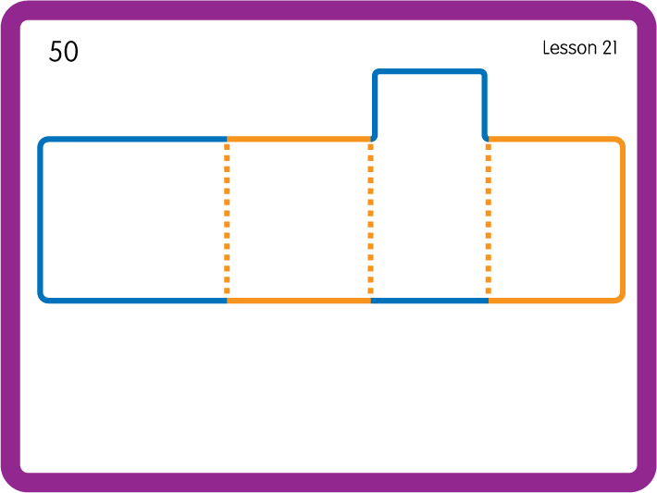
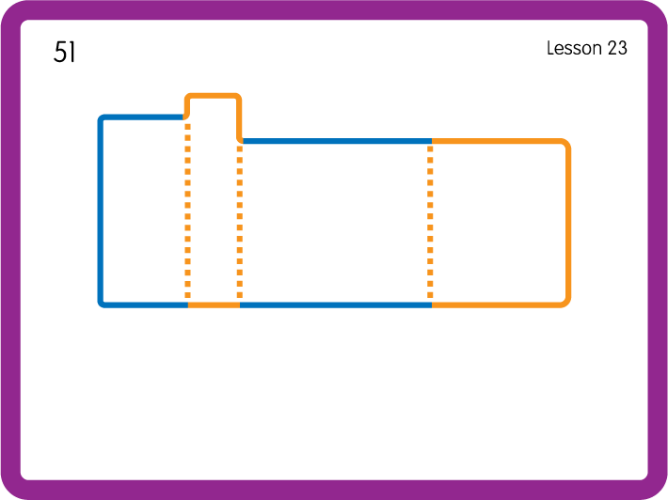
Practise High Frequency Words
USING JN688
BACK

