Slide 1



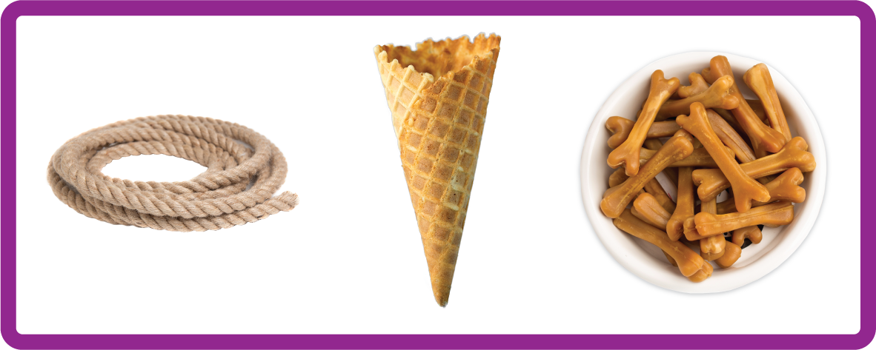
ay | ou | ie | ea | oy | ir | ue | aw
wh | ph | ew | oe | au | ey | a-e | e-e
i-e | o-e | u-e
Split Digraph 'o-e'
Lesson 26

Slide 2

Learn and practise split digraph o-e.
Recall all GPCs learned so far using flashcards.
Recall Phase 2 Common Exception Words as I is no go to into the put his has of pull full.
Phonemic Awareness Cards
Grapheme to Phoneme Cards
Phoneme Frame Cards
Alien Word Cards
Common Exception Word Cards
JN691
JN686
JN689
JN692
JN687

Slide 3























Recall all GPCs learned so far using flashcards.

Slide 4





























Recall all GPCs learned so far using flashcards.

Slide 5





































Recall all GPCs learned so far using flashcards.

Slide 6














Review Phase 2 Common Exception Words as I is no go to into the put his has of pull full.

Slide 7




























Review Phase 3 Common Exception Words push they me we be he she my by looked you are there here were all.

Slide 8













Review Phase 4 Common Exception Words said like out have some come what was so old do little one.

Slide 9












Review Phase 5 Common Exception Words today house mouse hour because Mr Mrs Ms where should could would.

Slide 10
Hear Phonemes
USING JN691
FRONT

Slide 11
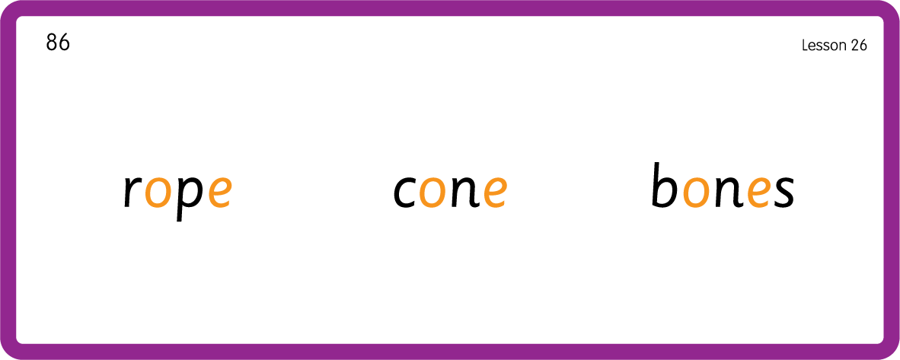
Hear Phonemes
USING JN691
BACK

Slide 12
Teach Grapheme Caption
USING JN686
FRONT

Slide 13

Teach Lowercase Formation
USING JN686
BACK

Slide 14

Explain Decoding

Slide 15
Model Blending Phonemes
h
o
m
e
USING SOUND BUTTONS
Sound Buttons
Vowel
Consonant
Consonant Digraph
Multi Sound
Long Vowel Sound
R-controlled Digraph
Split Digraph
Syllable / Silent Letter

Slide 16
Model Blending Phonemes
c
o
n
e
USING SOUND BUTTONS
Sound Buttons
Vowel
Consonant
Consonant Digraph
Multi Sound
Long Vowel Sound
R-controlled Digraph
Split Digraph
Syllable / Silent Letter

Slide 17
Model Blending Phonemes
n
o
t
e
USING SOUND BUTTONS
Sound Buttons
Vowel
Consonant
Consonant Digraph
Multi Sound
Long Vowel Sound
R-controlled Digraph
Split Digraph
Syllable / Silent Letter

Slide 18

Explain Encoding

Slide 19
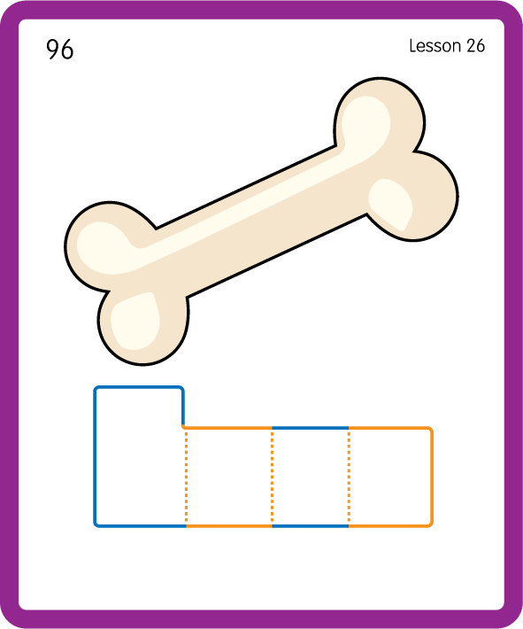
Build a Decodable Word
USING JN689
BACK

Slide 20
Build a Decodable Word
USING JN689
FRONT

Slide 21

Practise with Alien Words
USING JN692
BACK

Slide 22
Practise with Alien Words
USING JN692
FRONT

Slide 23
Practise Common Exception Words
USING JN687
FRONT

Slide 24
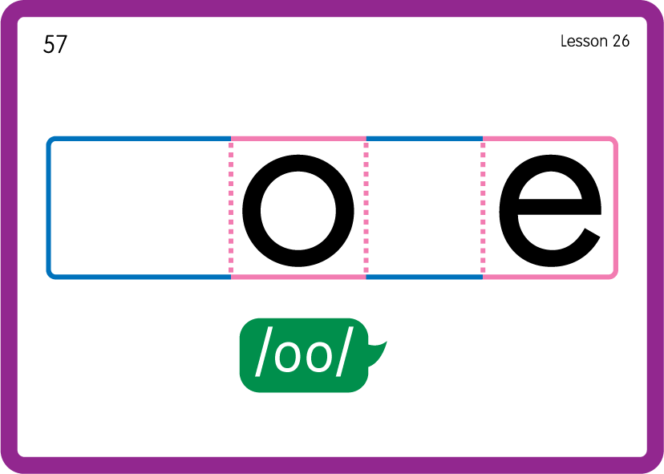
Practise Common Exception Words
USING JN687
BACK

Slide 25

Practise Building Words
PRACTICE – 10MINS
h
m
b
n
t
l
c
th
s
w
k
a
o-e
USING MAGNETIC LETTERS AND A WHITEBOARD

Slide 26
Practise Building Words
PRACTICE – 10MINS
h
m
b
n
t
l
c
th
s
w
k
a
o-e
home bone note cone alone those woke stone
USING MAGNETIC LETTERS AND A WHITEBOARD

