Slide 1




ay | ou | ie | ea | oy | ir | ue | aw
wh | ph | ew | oe | au | ey | a-e | e-e
i-e | o-e | u-e
Common Exception Words
Lesson 30

Slide 2




Learn and practise Common Exception Words.
Recall all GPCs learned so far using flashcards.
Review all Phase 4 & Phase 5 Common Exception Words:
said like out have some come was what so old do little one
today house mouse hour because Mr Mrs Ms where should could would move use
Common Exception Word Cards
Phase 2
Common Exception Word Cards
Phase 3
Common Exception Word Cards
Phase 4
Common Exception Word Cards
Phase 5
High Frequency Word Cards
JN687
JN687
JN687
JN687
JN688

Slide 3























Recall all GPCs learned so far using flashcards.

Slide 4





























Recall all GPCs learned so far using flashcards.

Slide 5









































Recall all GPCs learned so far using flashcards.

Slide 6













Review Phase 2 Common Exception Words as I is no go to into the put his has of pull full.

Slide 7



























Review Phase 3 Common Exception Words push they me we be he she my by looked you are there here were all sure

Slide 8












Review Phase 4 Common Exception Words said like out have some come what was so old do little one.

Slide 9










Review Phase 5 Common Exception Words today house mouse hour because Mr Mrs Ms where should could would move use.

Slide 10
Practise Common Exception Words
USING JL687
FRONT

Slide 11
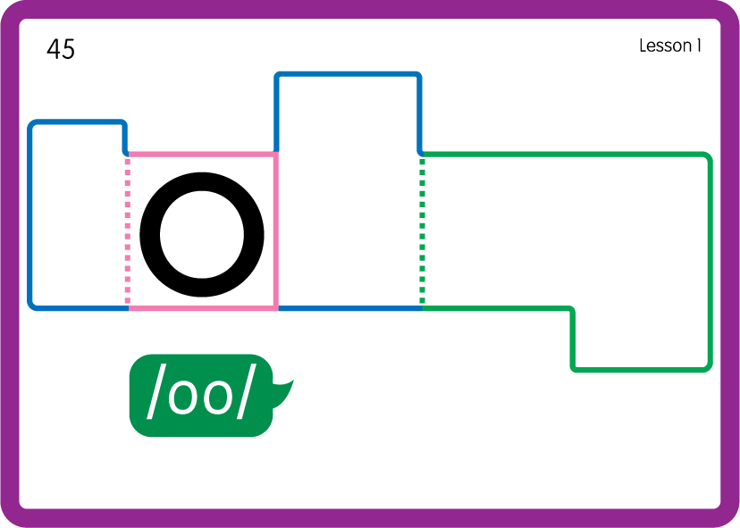
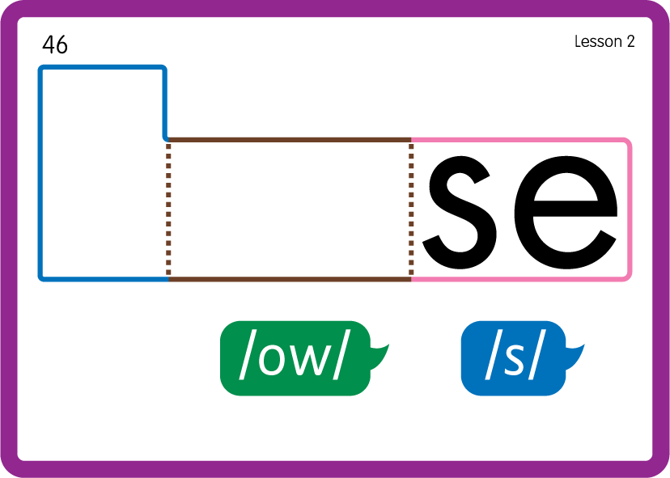
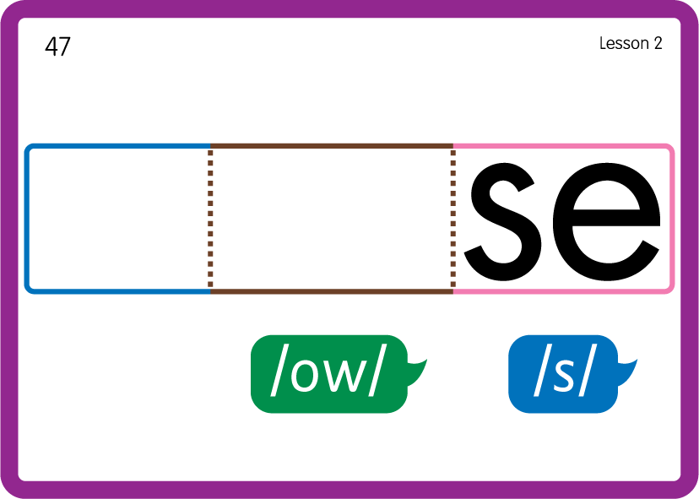
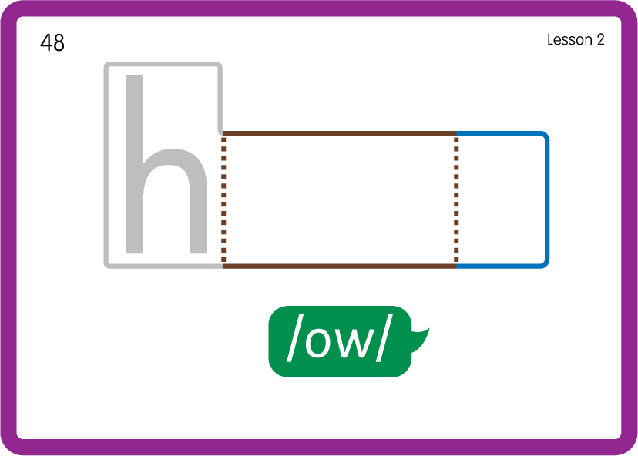
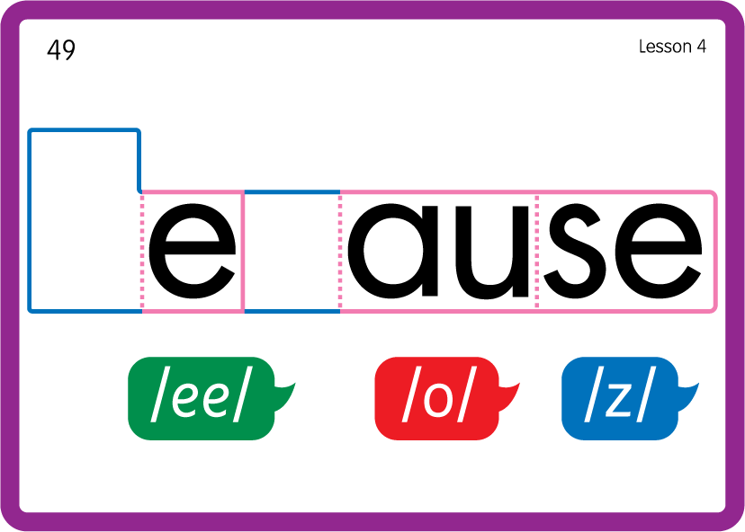
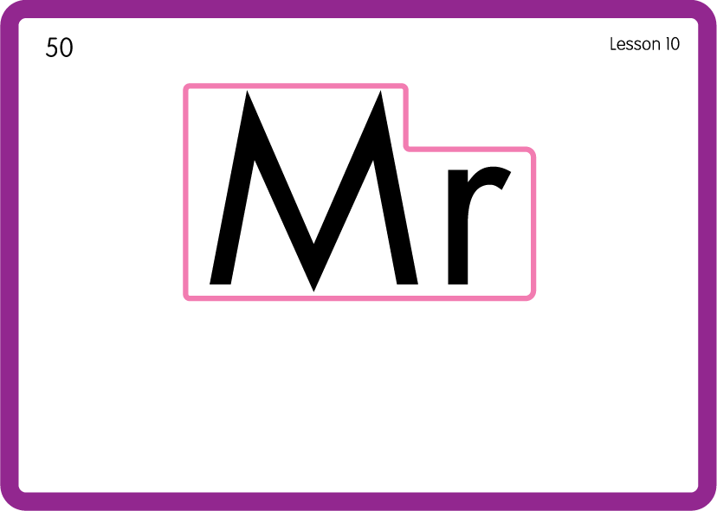


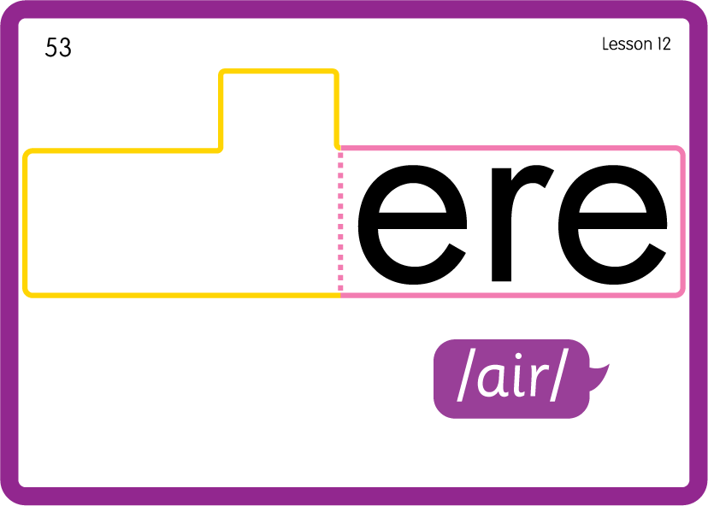
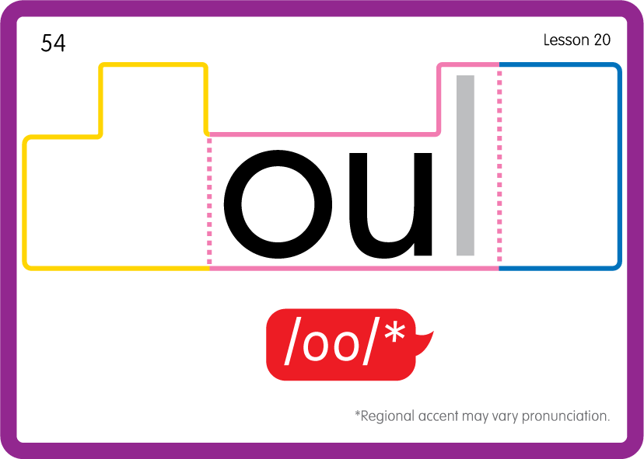
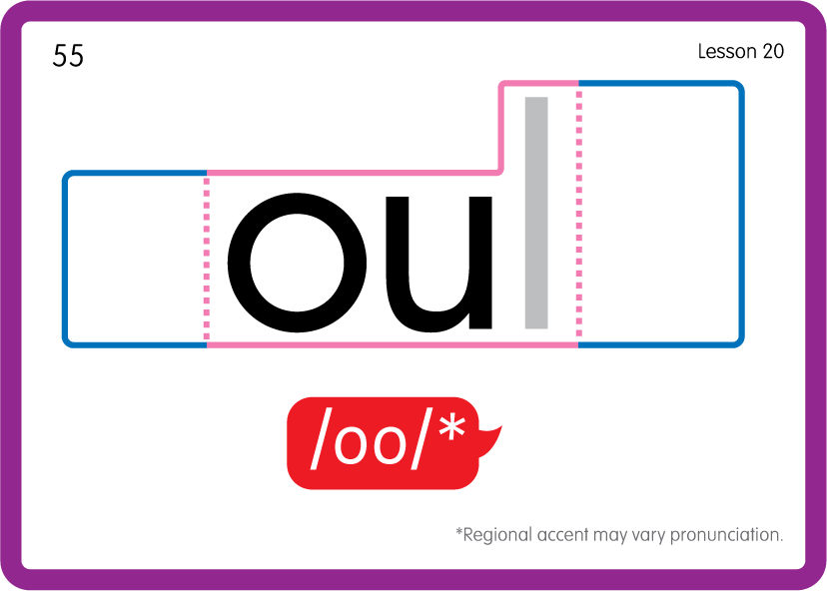
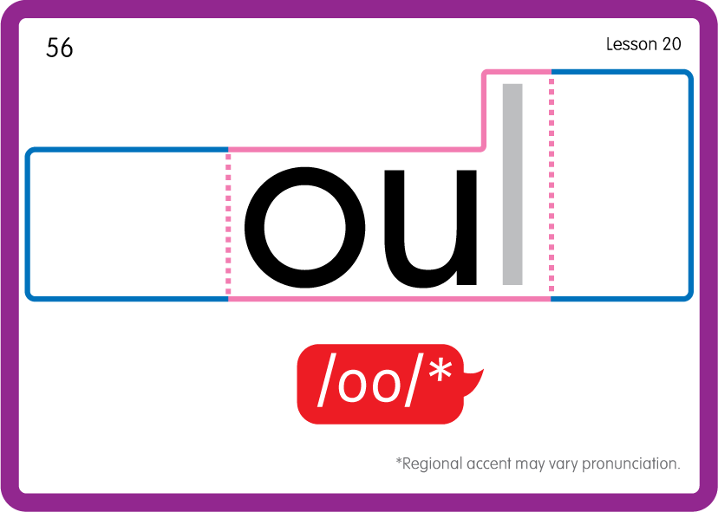
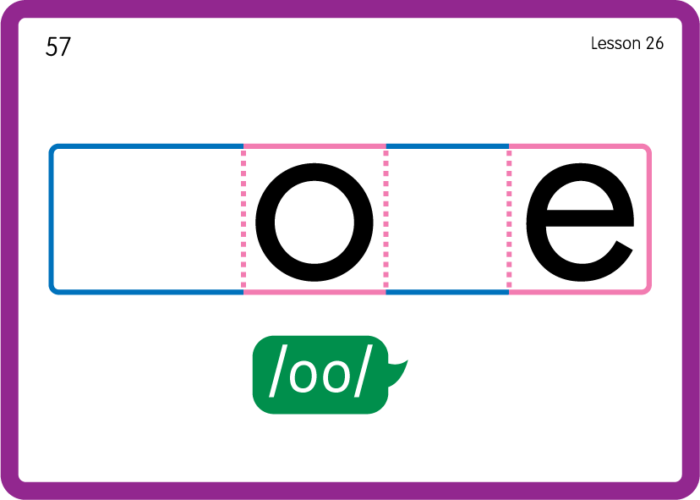
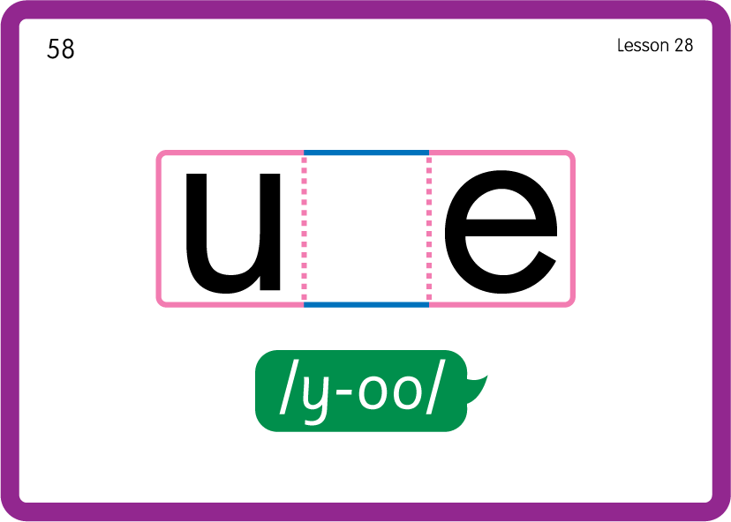
Practise Common Exception Words
USING JL687
BACK

Slide 12

Teach Common Exception Words
USING JN687
FRONT

Slide 13
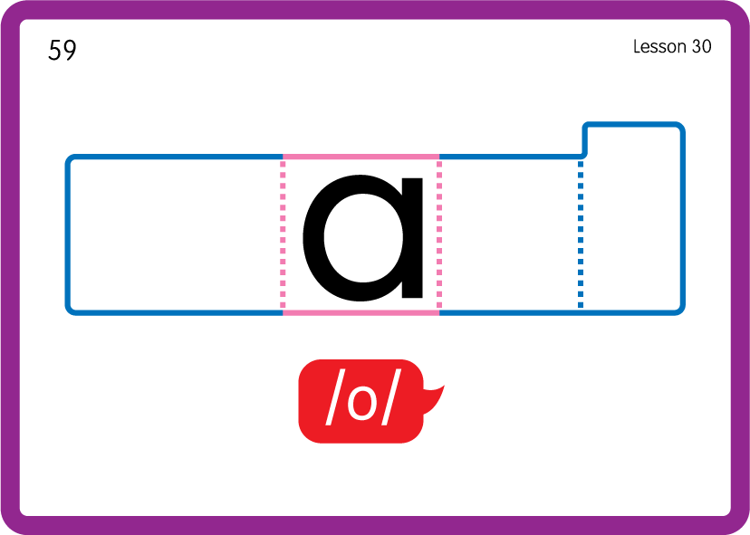
Teach Common Exception Words
USING JN687
BACK

Slide 14








Practise High Frequency Words
USING JN688
FRONT

Slide 15
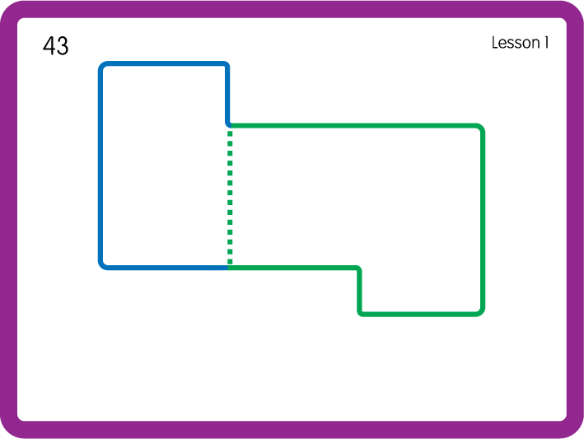
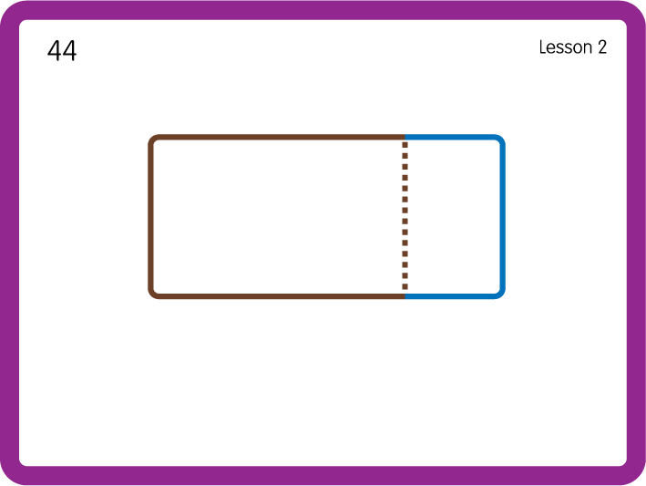
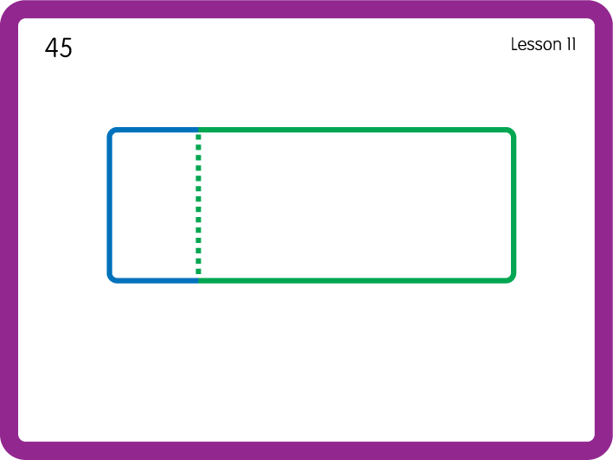
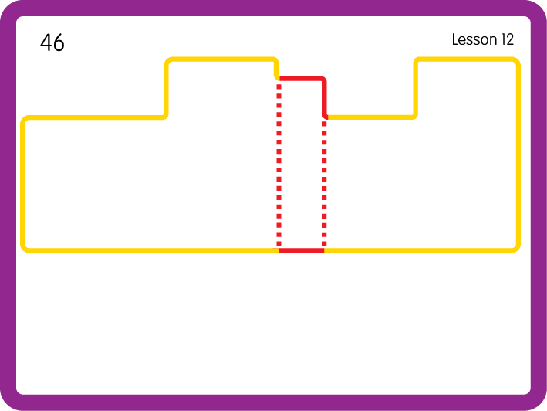
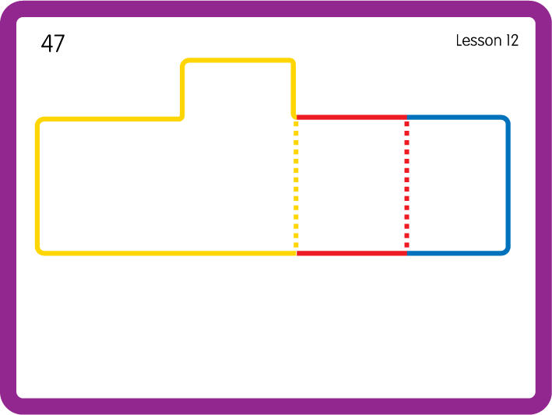
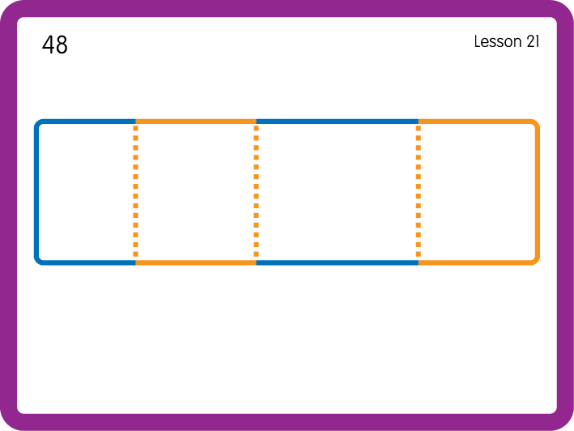
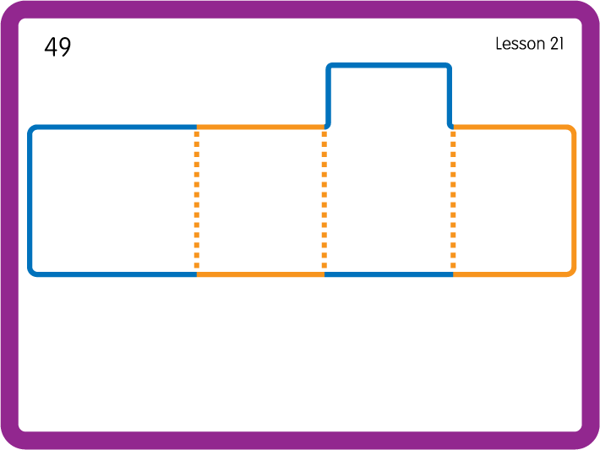
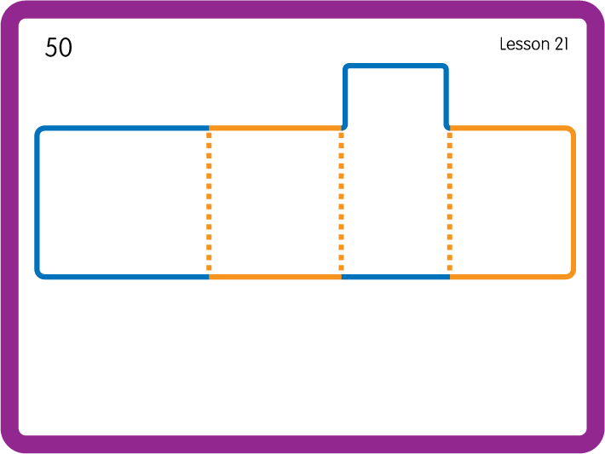
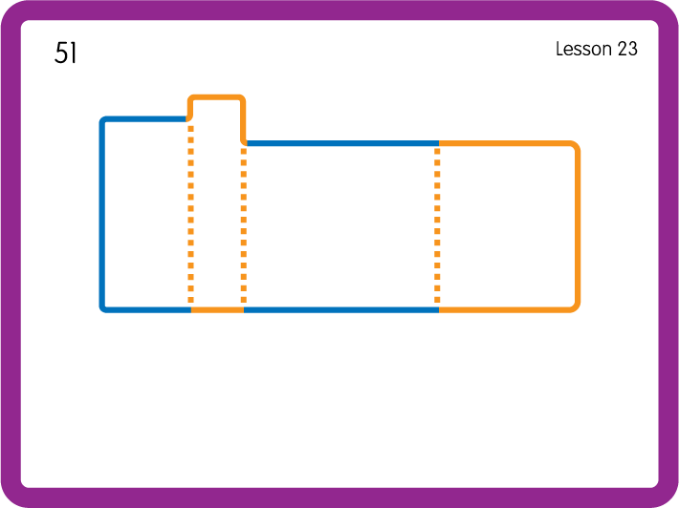
Practise High Frequency Words
USING JN688
BACK

Slide 16
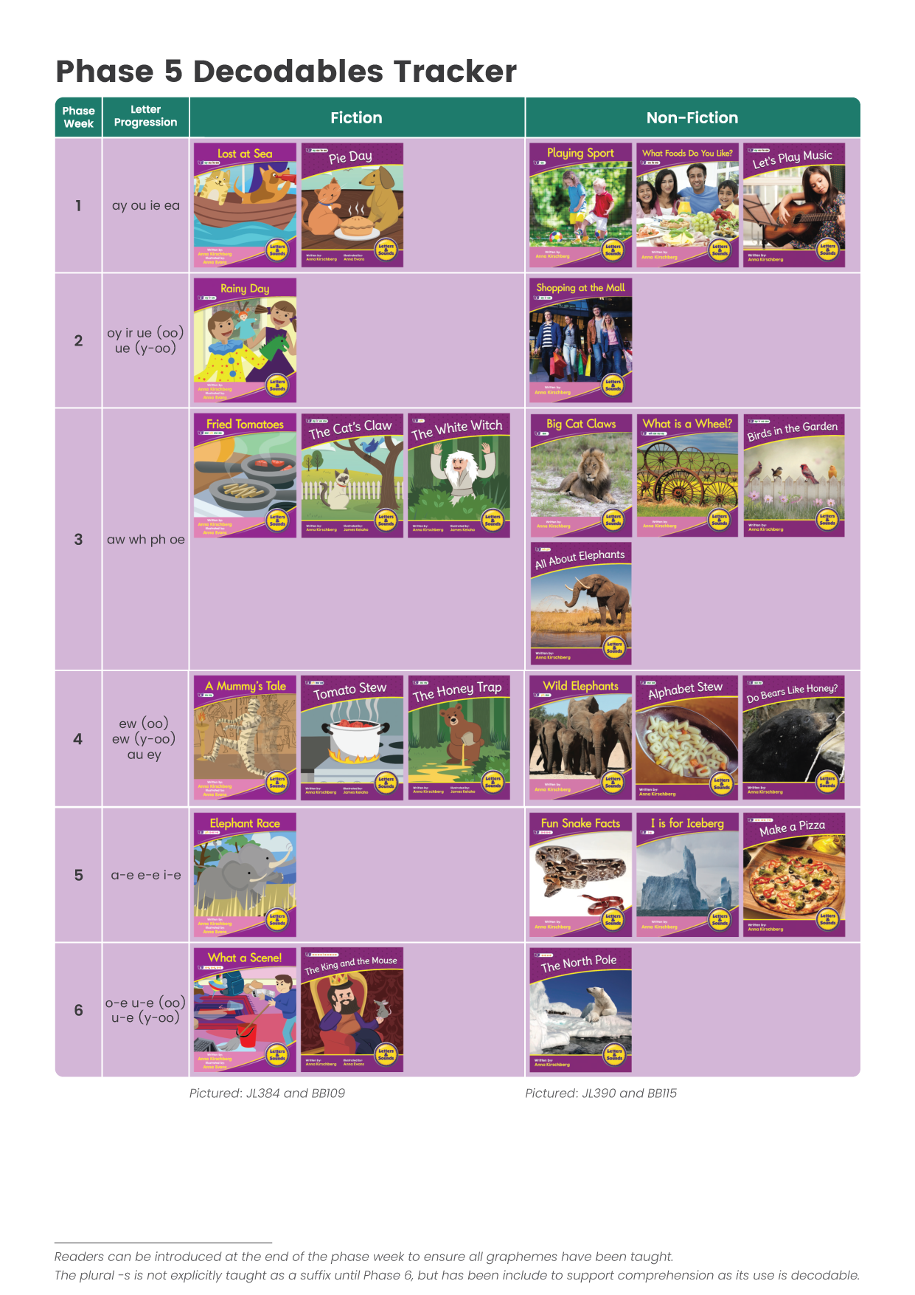







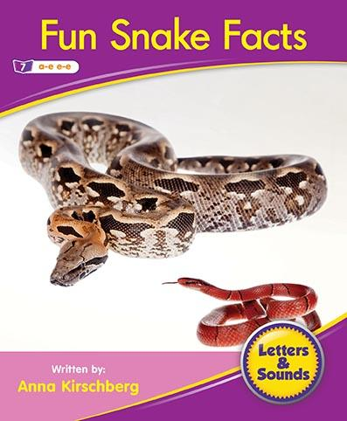

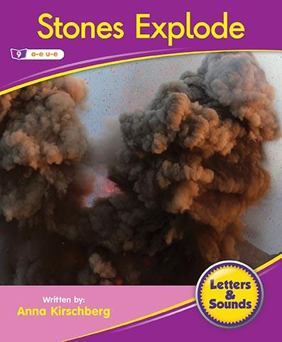

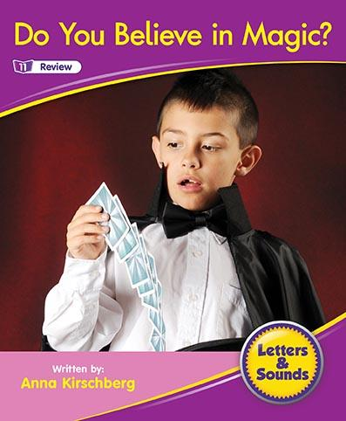


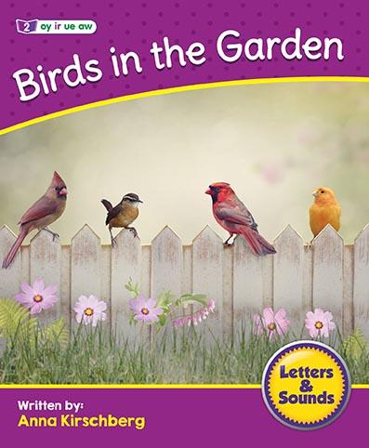

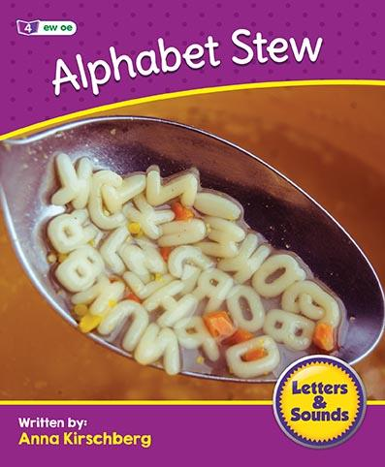
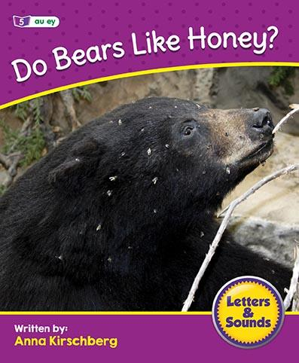
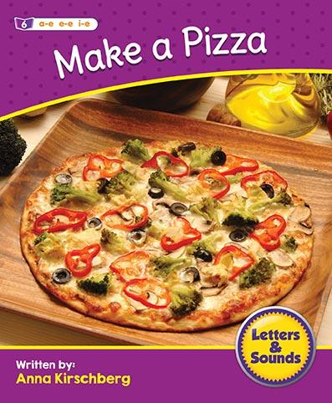



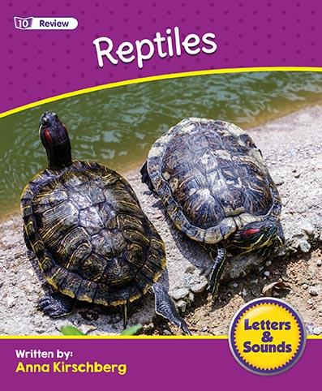


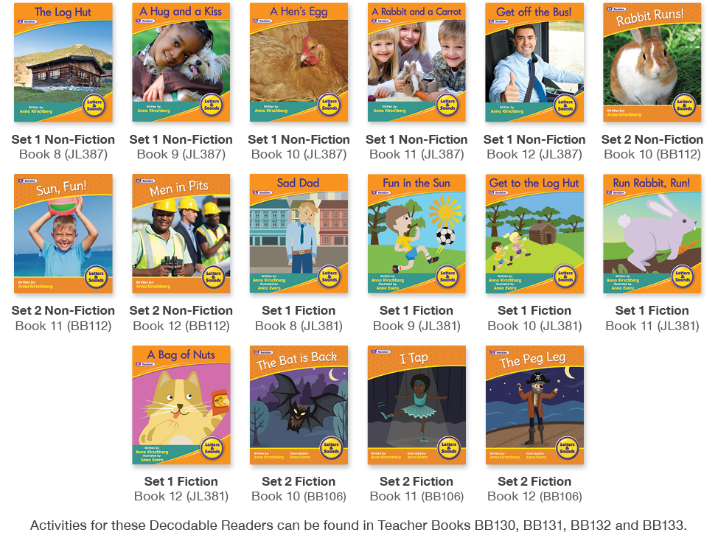
click to view online book tracker
Set 1 Non-Fiction Books 1 - 12 JL390
Set 2 Non-Fiction Books 1 - 12 BB115

Slide 17



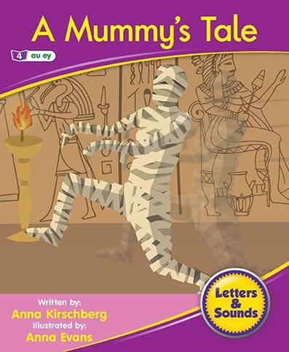

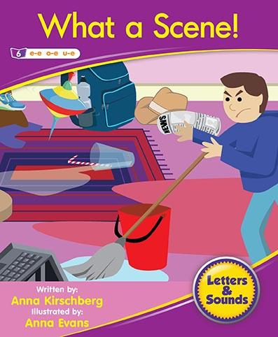
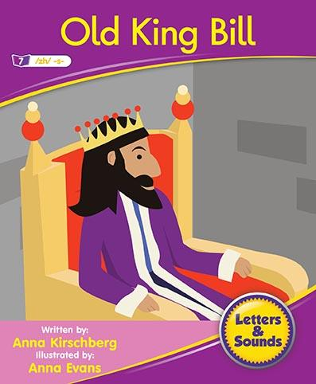





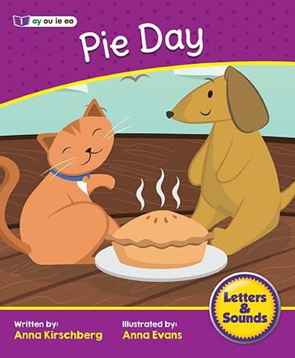


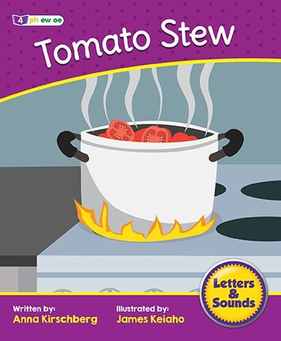

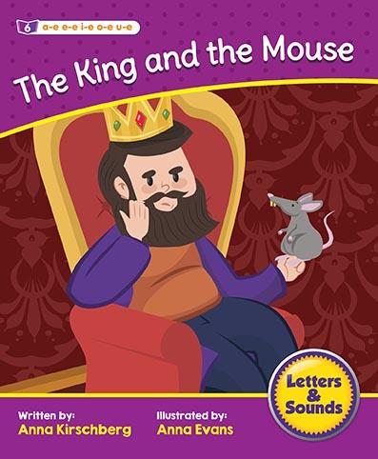



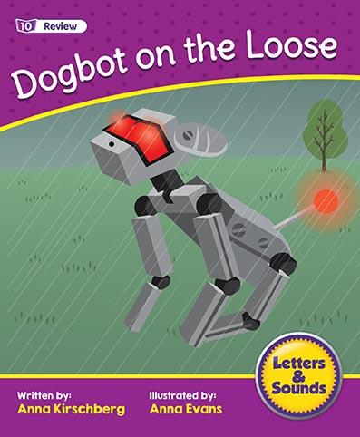


click to view online book tracker
Set 1 Fiction Books 1 - 12 JL384
Set 2 Fiction Books 1 - 12 BB109

