Slide 1




ay | ou | ie | ea | oy | ir | ue | aw
wh | ph | ew | oe | au | ey | a-e | e-e
i-e | o-e | u-e
Review ay ou ie ea
Lesson 5

Slide 2
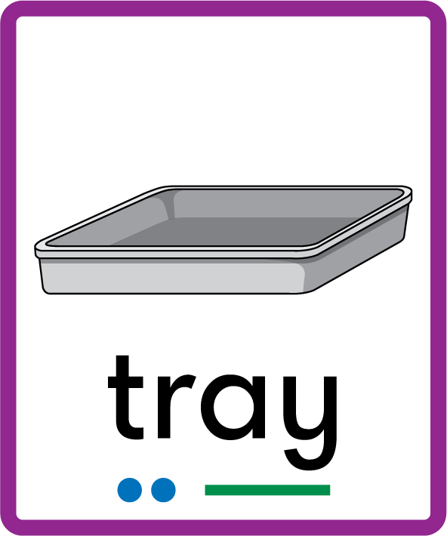

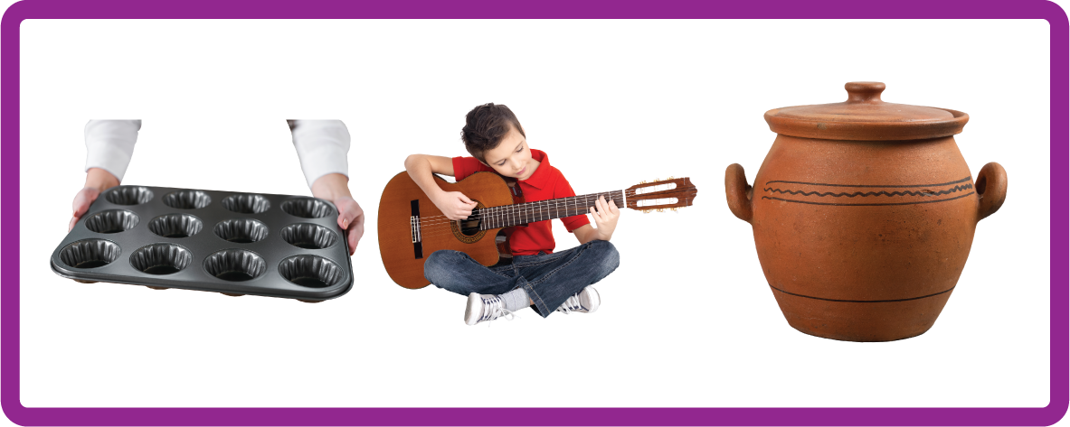


Learn and practise Common Exception Words and review ay ou ie ea.
Recall all GPCs learned so far using flashcards.
Review all Phase 4 Common Exception Words said like out have some come was what so old do little one.
Phonemic Awareness Cards
Grapheme to Phoneme Cards
Phoneme Frame Cards
Alien Word Cards
Common Exception Word Cards
High Frequency Word Cards
JN691
JN686
JN689
JN692
JN687
JN688

Slide 3























Recall all GPCs learned so far using flashcards.

Slide 4





























Recall all GPCs learned so far using flashcards.

Slide 5
Recall all GPCs learned so far using flashcards.

Slide 6














Review Phase 2 Common Exception Words as I is no go to into the put his has of pull full.

Slide 7




























Review Phase 3 Common Exception Words push they me we be he she my by looked you are there here were all sure.

Slide 8













Review Phase 4 Common Exception Words said like out have some come what was so old do little one.

Slide 9




Review Phase 5 Common Exception Words today house mouse hour because.

Slide 10

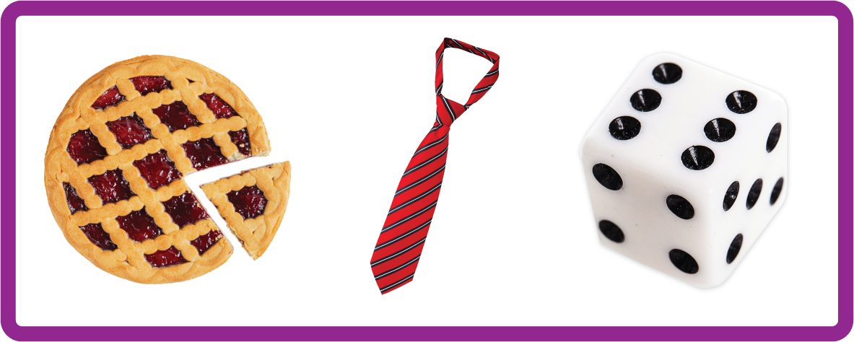

Hear Phonemes
USING JN691
FRONT

Slide 11
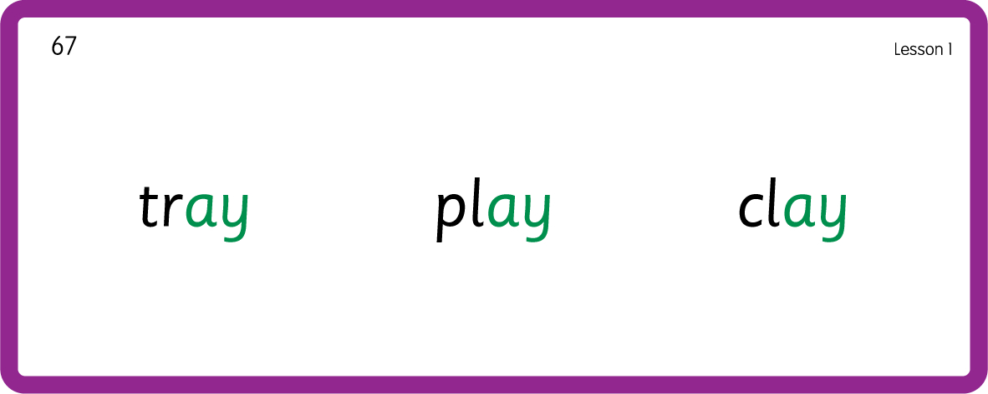
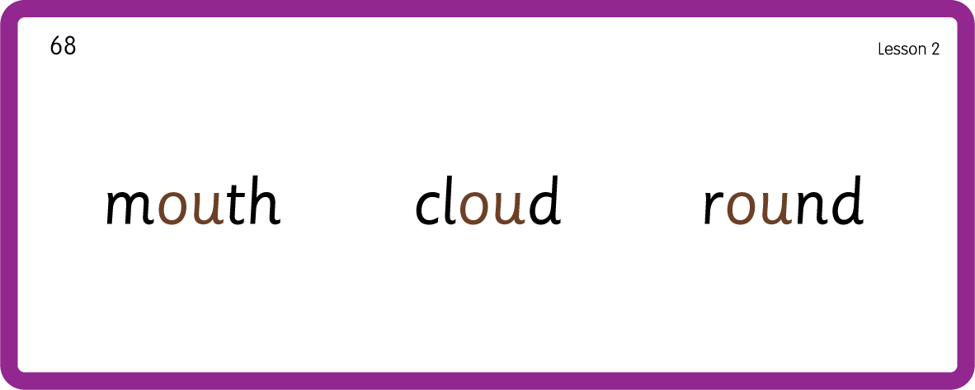
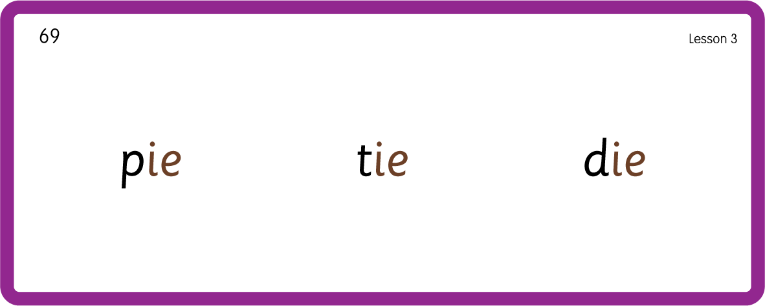
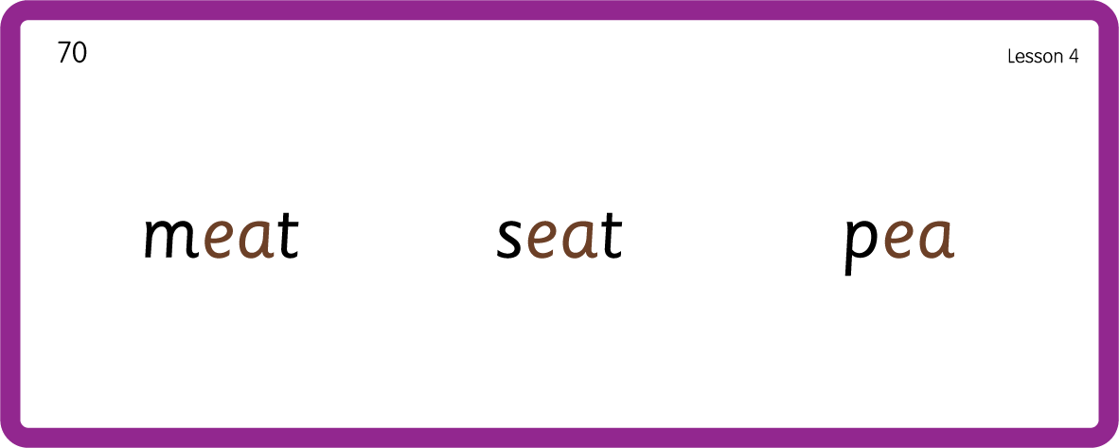
Hear Phonemes
USING JN691
BACK

Slide 12
Review Grapheme Caption
USING JN686
FRONT

Slide 13
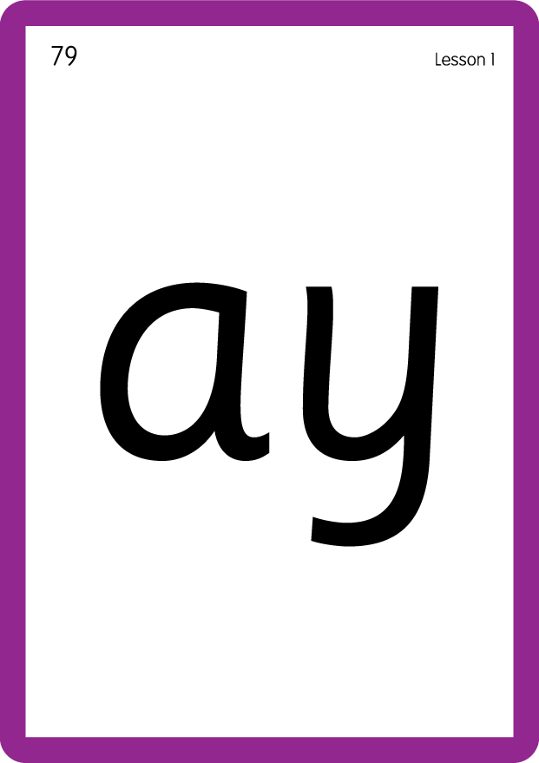


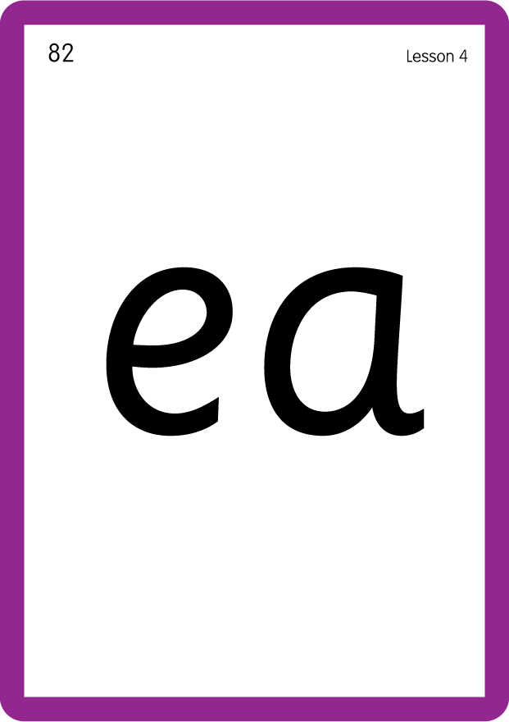
Review Lowercase Formation
USING JN686
BACK

Slide 14
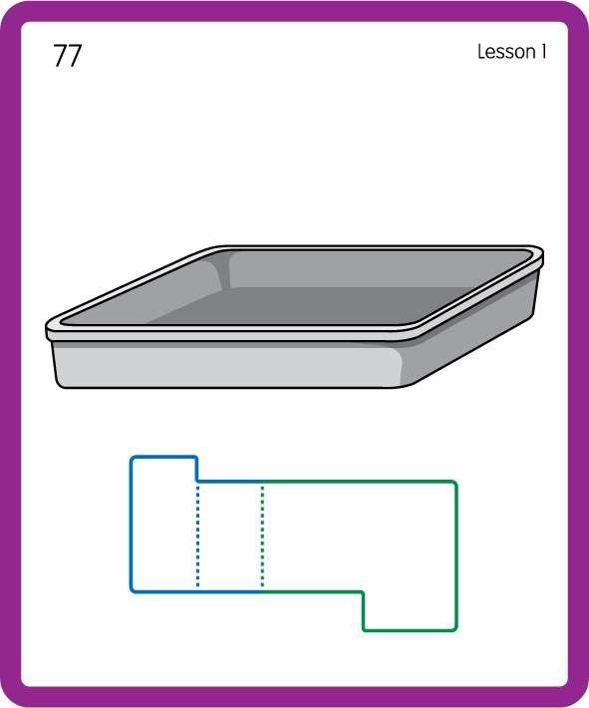
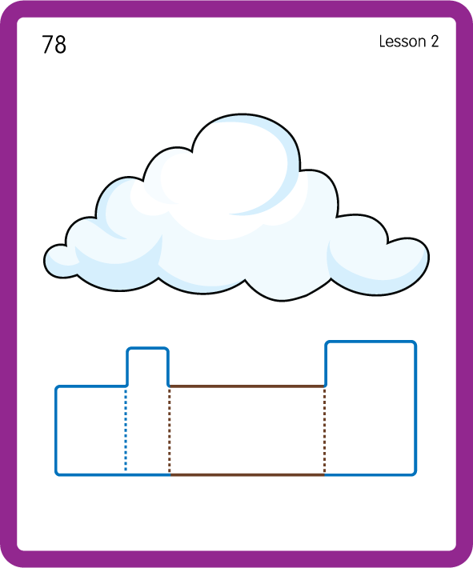
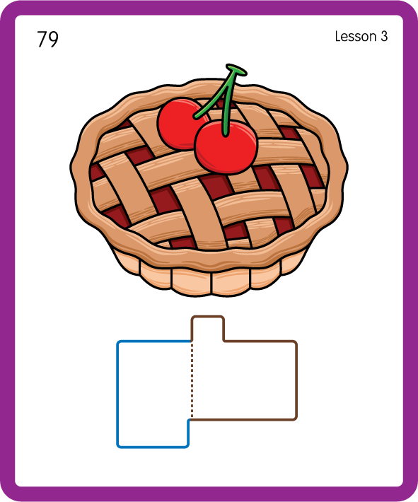
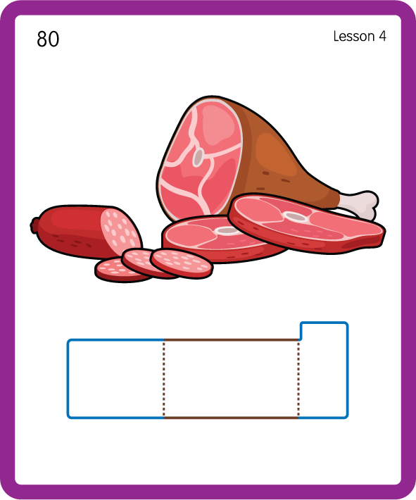
Build a Decodable Word
USING JN689
BACK

Slide 15



Build a Decodable Word
USING JN689
FRONT

Slide 16
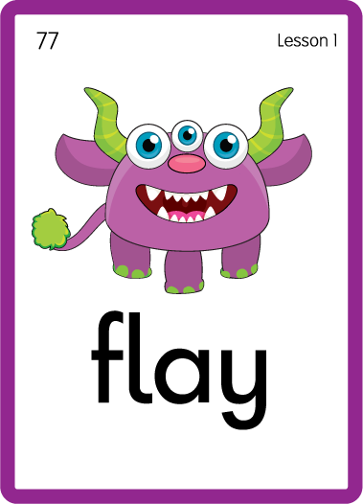

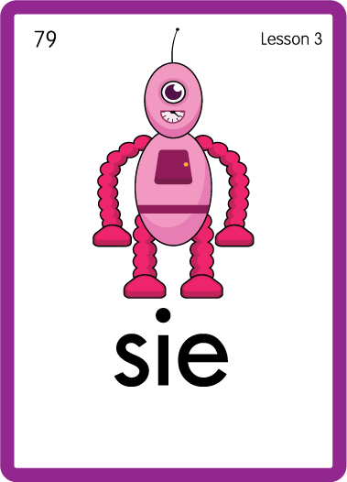

Practise with Alien Words
USING JN692
BACK

Slide 17



Practise with Alien Words
USING JN692
FRONT

Slide 18
Practise Common Exception Words
USING JN687
FRONT

Slide 19
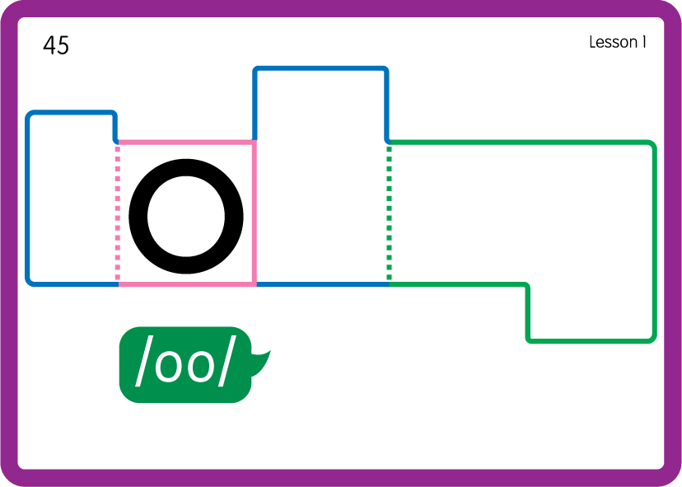
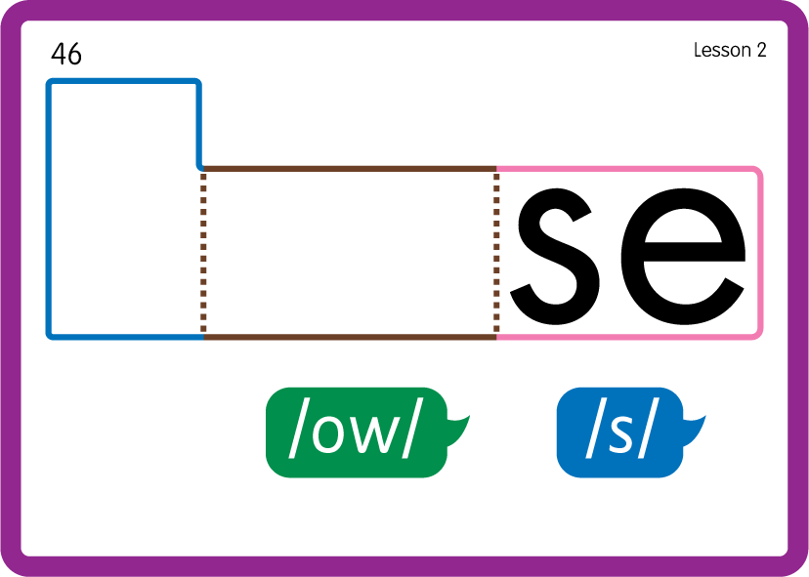
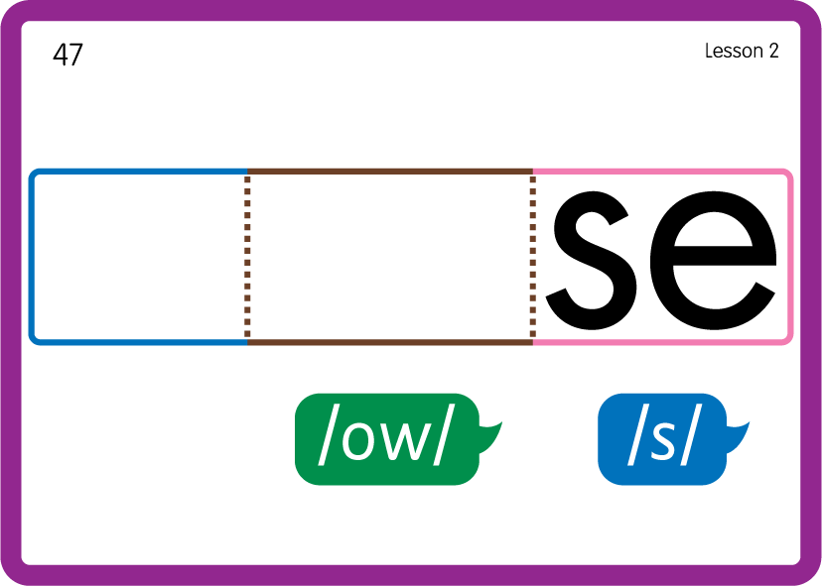
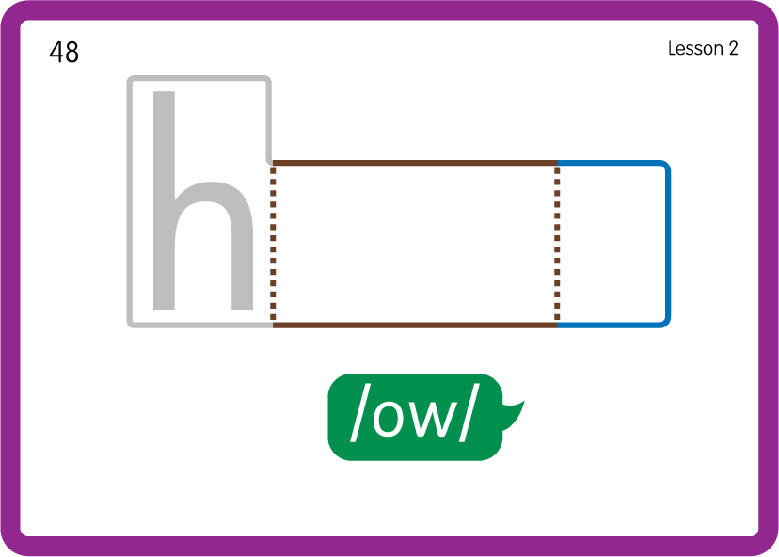
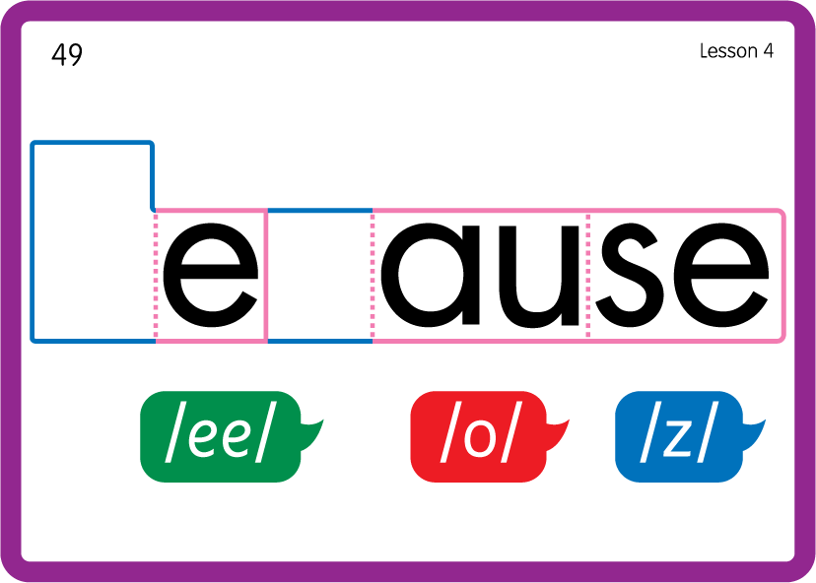
Practise Common Exception Words
USING JN687
BACK

Slide 20

Practise High Frequency Words
USING JN688
FRONT

Slide 21
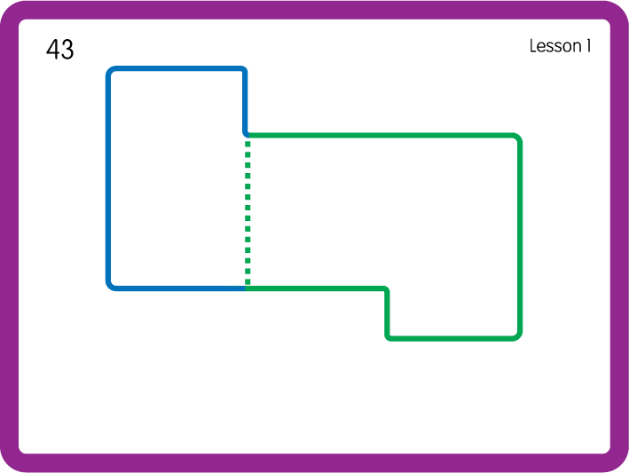
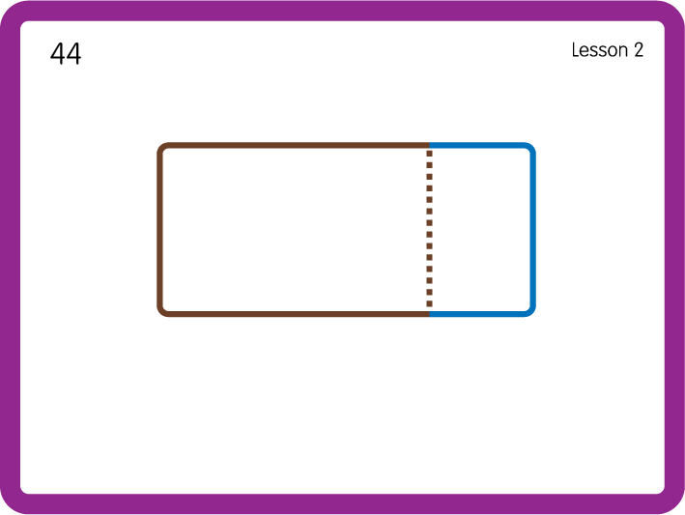
Practise High Frequency Words
USING JN688
BACK

Slide 22

