Slide 1

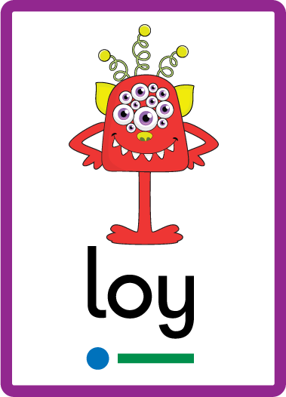
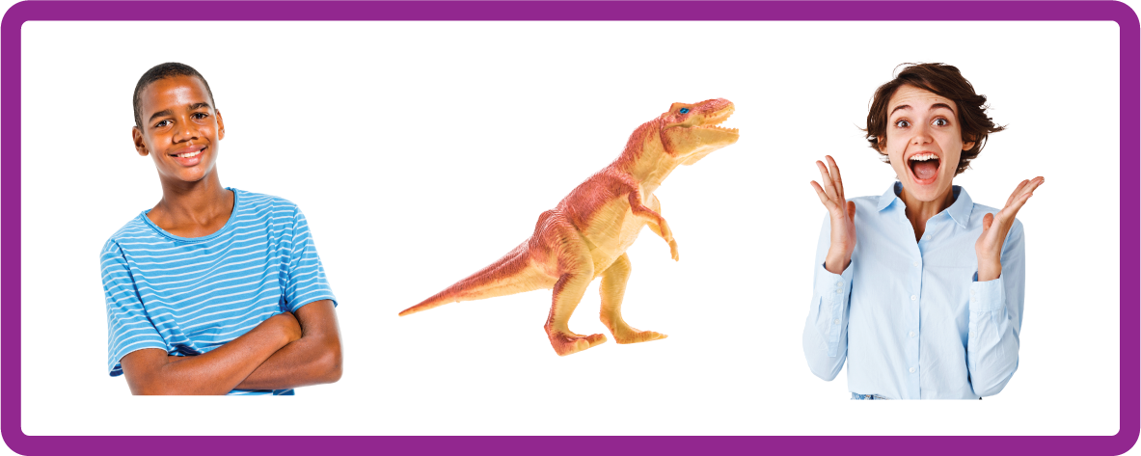
ay | ou | ie | ea | oy | ir | ue | aw
wh | ph | ew | oe | au | ey | a-e | e-e
i-e | o-e | u-e
Digraph 'oy'
Lesson 6

Slide 2
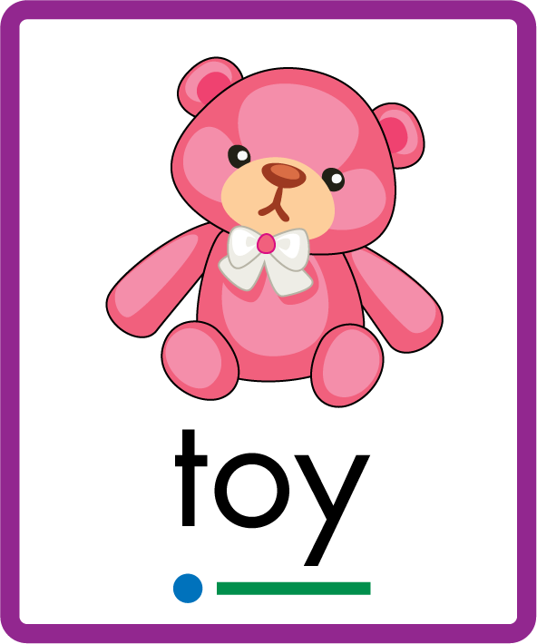
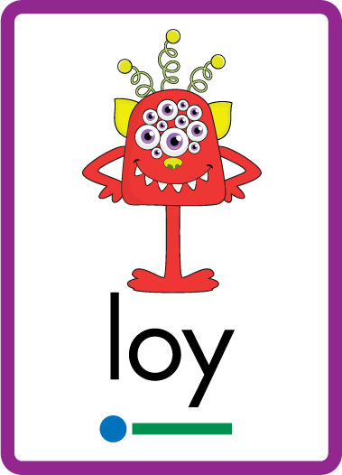
Learn and practise digraph oy.
Recall all GPCs learned so far using flashcards.
Recall Phase 2 Common Exception Words as I is no go to into the put his has of pull full.
Phonemic Awareness Cards
Grapheme to Phoneme Cards
Phoneme Frame Cards
Alien Word Cards
JN691
JN686
JN689
JN692

Slide 3


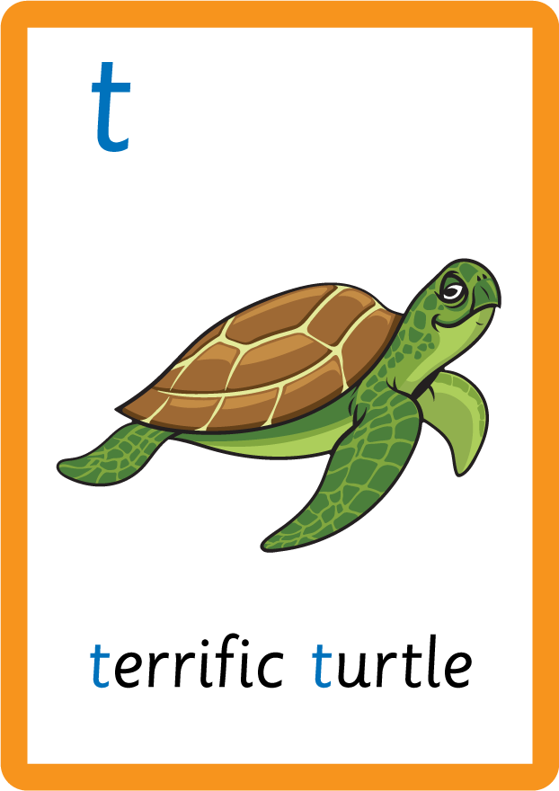

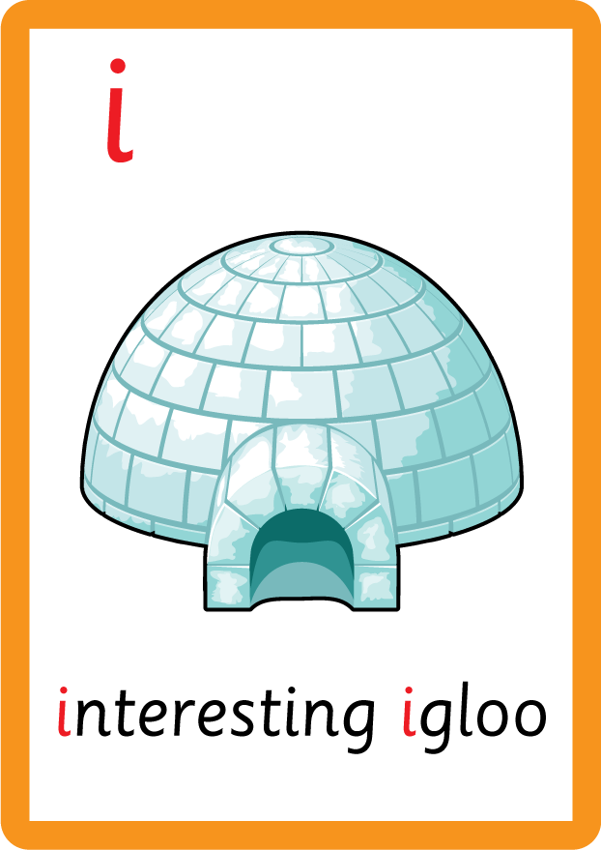

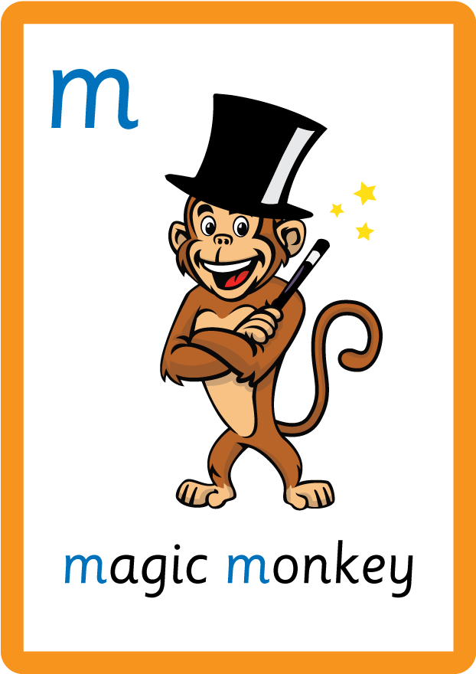
















Recall all GPCs learned so far using flashcards.

Slide 4




























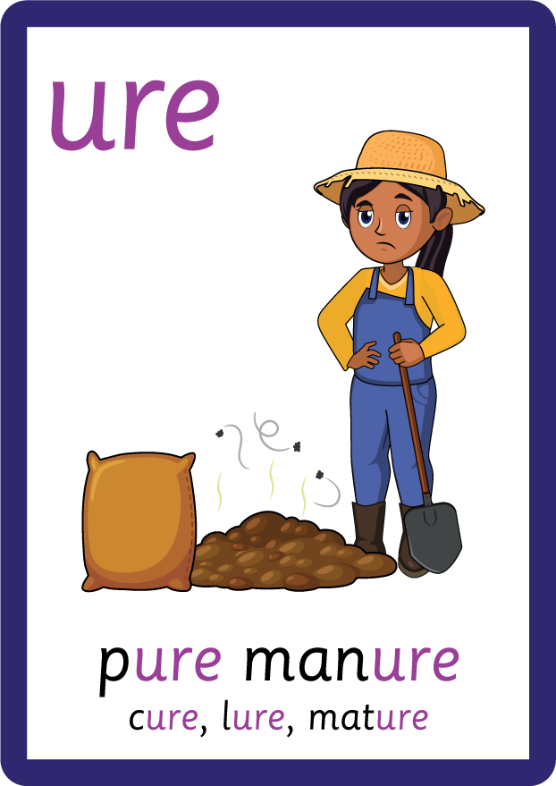
Recall all GPCs learned so far using flashcards.

Slide 5

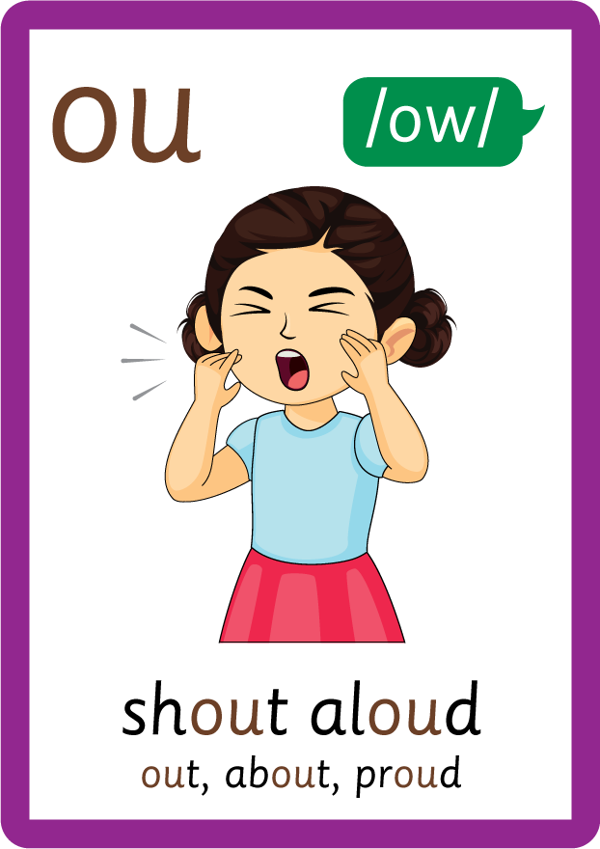


Recall all GPCs learned so far using flashcards.

Slide 6






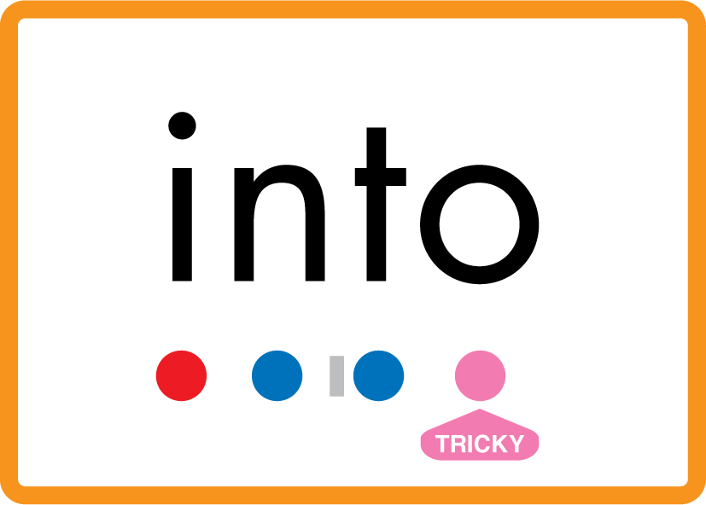


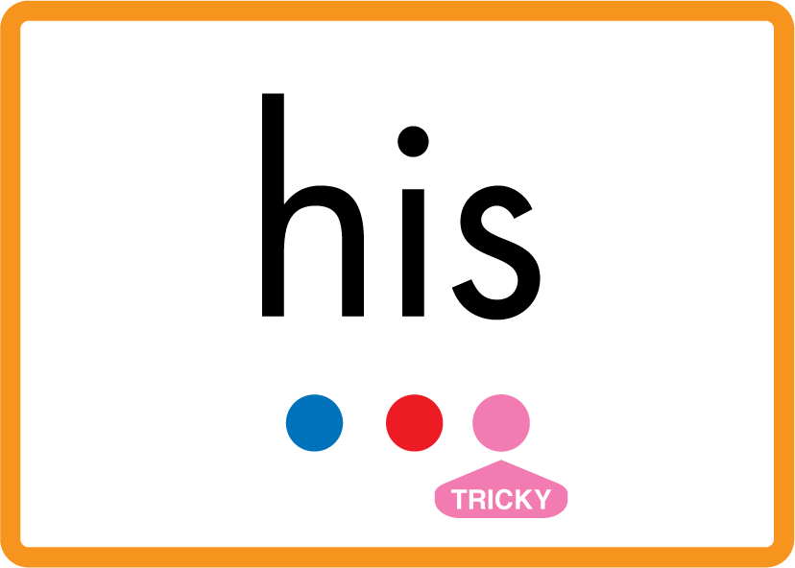




Review Phase 2 Common Exception Words as I is no go to into the put his has of pull full.

Slide 7
Hear Phonemes
USING JN691
FRONT

Slide 8
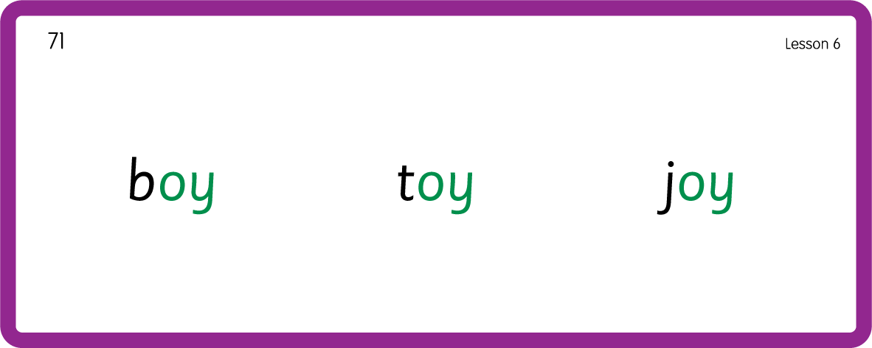
Hear Phonemes
USING JN691
BACK

Slide 9
Teach Grapheme Caption
USING JN686
FRONT

Slide 10
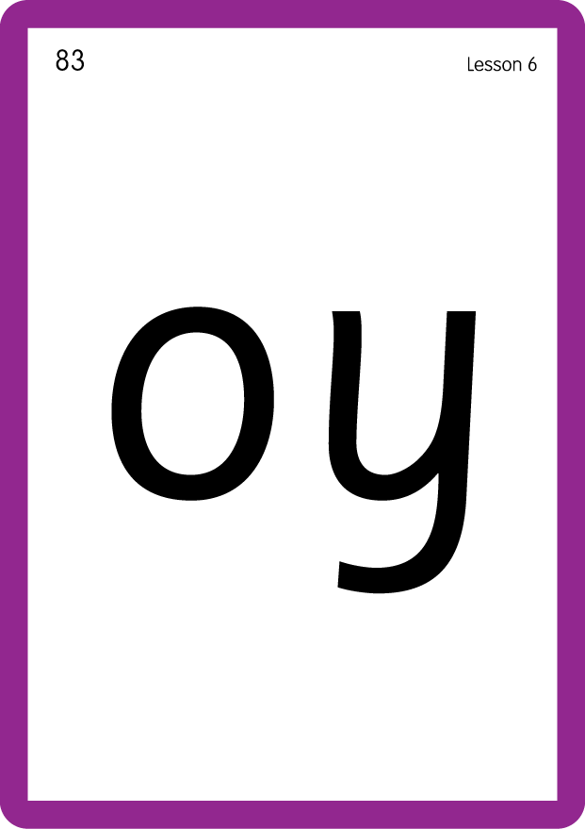
Teach Lowercase Formation
USING JN686
BACK

Slide 11

Explain Decoding

Slide 12
Model Blending Phonemes
t
oy
USING SOUND BUTTONS
Sound Buttons
Vowel
Consonant
Consonant Digraph
Long Vowel Sound
R-controlled Digraph
Split Digraph
Syllable / Silent Letter

Slide 13
Model Blending Phonemes
j
oy
USING SOUND BUTTONS
Sound Buttons
Vowel
Consonant
Consonant Digraph
Long Vowel Sound
R-controlled Digraph
Split Digraph
Syllable / Silent Letter

Slide 14

Explain Encoding

Slide 15
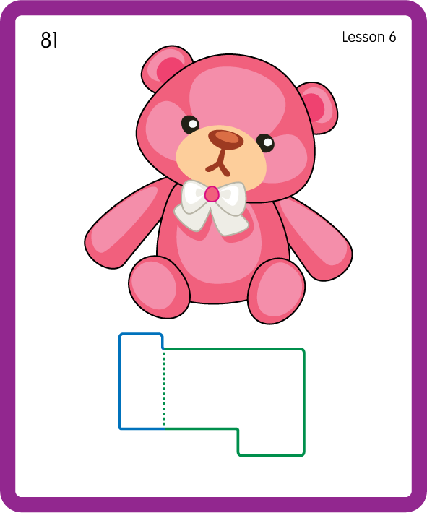
Build a Decodable Word
USING JN689
BACK

Slide 16
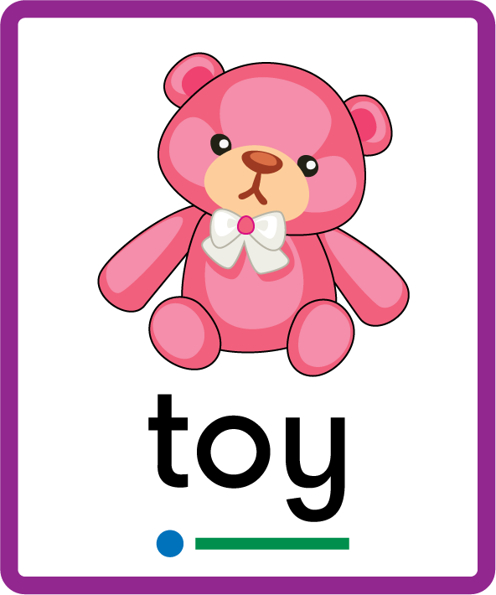
Build a Decodable Word
USING JN689
FRONT

Slide 17
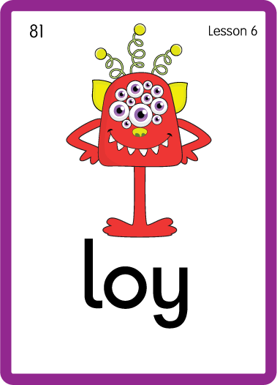
Practise with Alien Words
USING JN692
BACK

Slide 18
Practise with Alien Words
USING JN692
FRONT

Slide 19

Practise Building Words
PRACTISE – 10MINS
t
j
b
s
t
er
e
n
d
r
a
l
oy
USING MAGNETIC LETTERS AND A WHITEBOARD

Slide 20
Practise Building Words
PRACTISE – 10MINS
t
j
b
s
t
er
e
n
d
r
a
l
oy
toy joy boy oyster enjoy destroy royal
USING MAGNETIC LETTERS AND A WHITEBOARD

