Slide 1
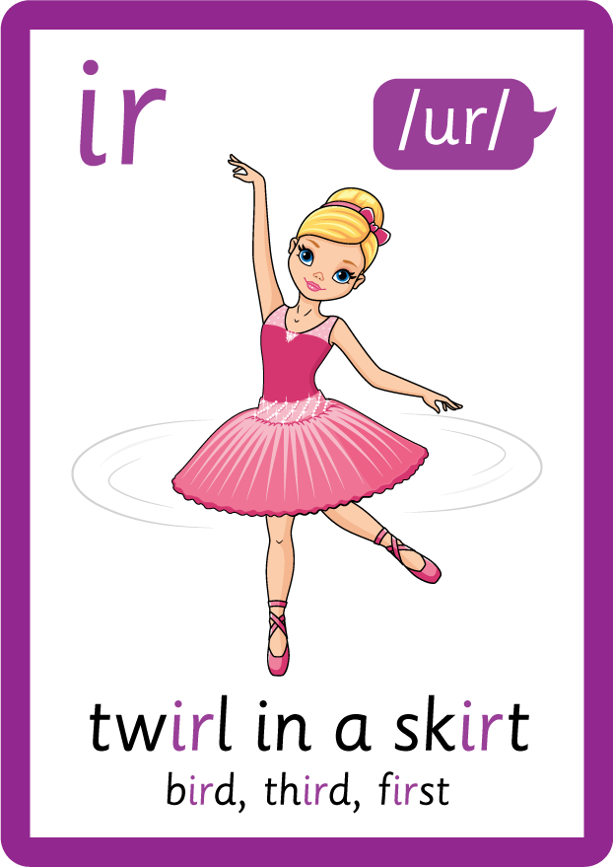
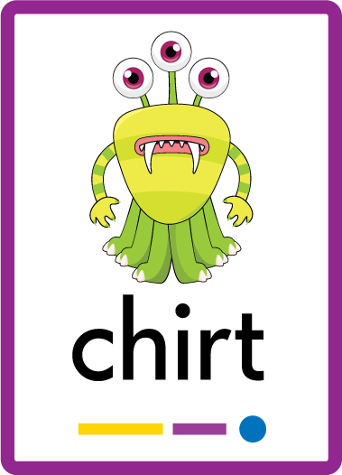
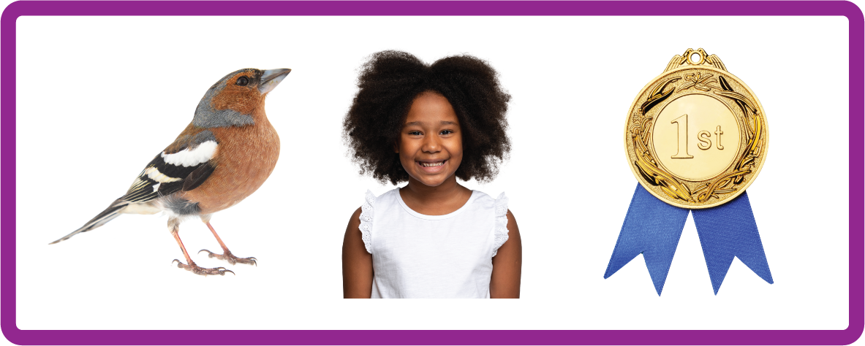
ay | ou | ie | ea | oy | ir | ue | aw
wh | ph | ew | oe | au | ey | a-e | e-e
i-e | o-e | u-e
Digraph 'ir'
Lesson 7

Slide 2
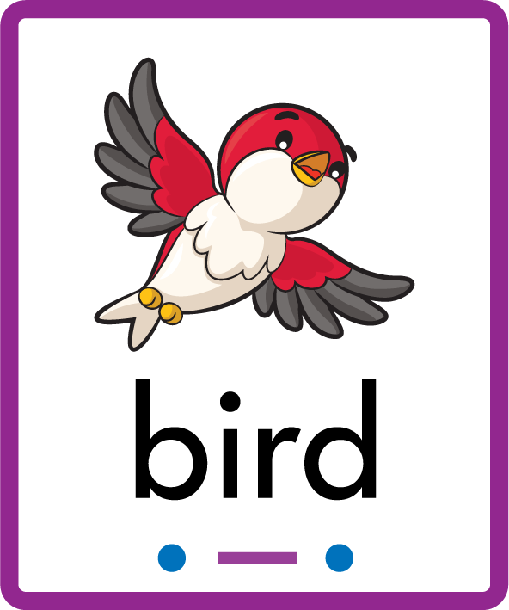
Learn and practise digraph ir.
Recall all GPCs learned so far using flashcards.
Recall Phase 3 Common Exception Words push they me we be he she my by looked you are there here were all sure.
Phonemic Awareness Cards
Grapheme to Phoneme Cards
Phoneme Frame Cards
Alien Word Cards
JN691
JN686
JN689
JN692

Slide 3


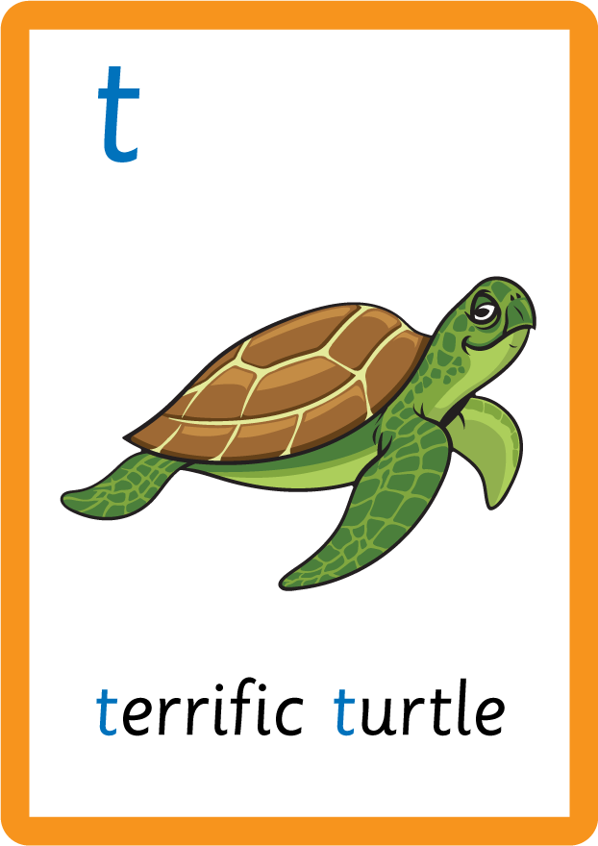




















Recall all GPCs learned so far using flashcards.

Slide 4


















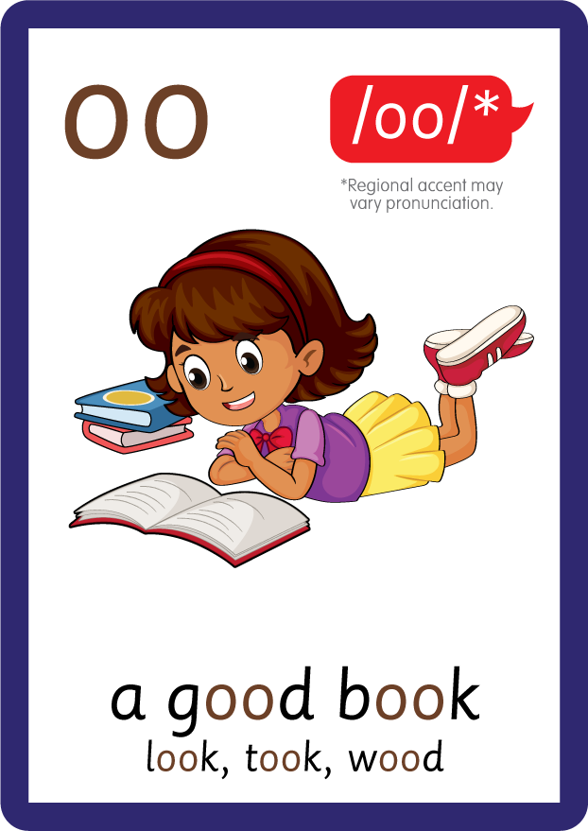









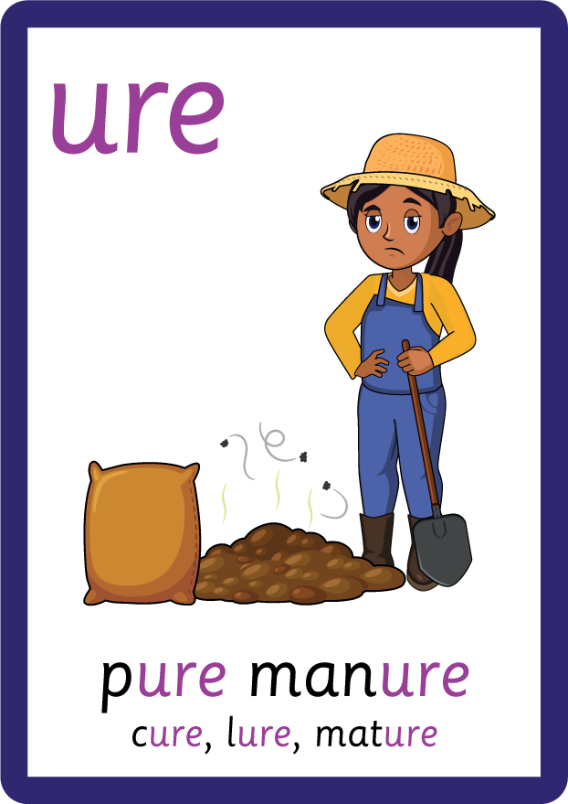
Recall all GPCs learned so far using flashcards.

Slide 5

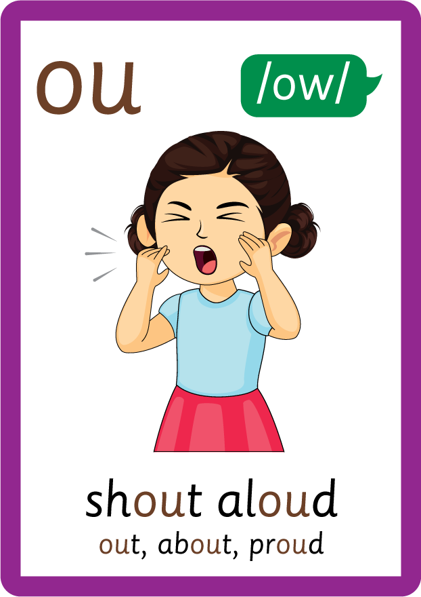


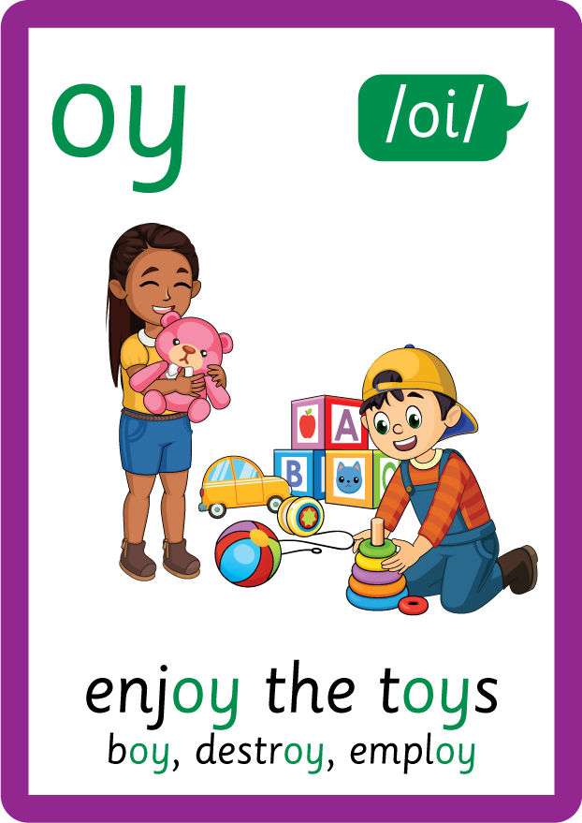
Recall all GPCs learned so far using flashcards.

Slide 6



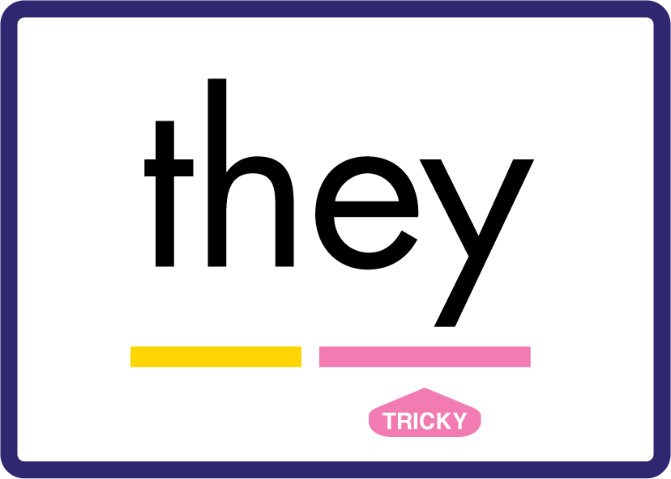


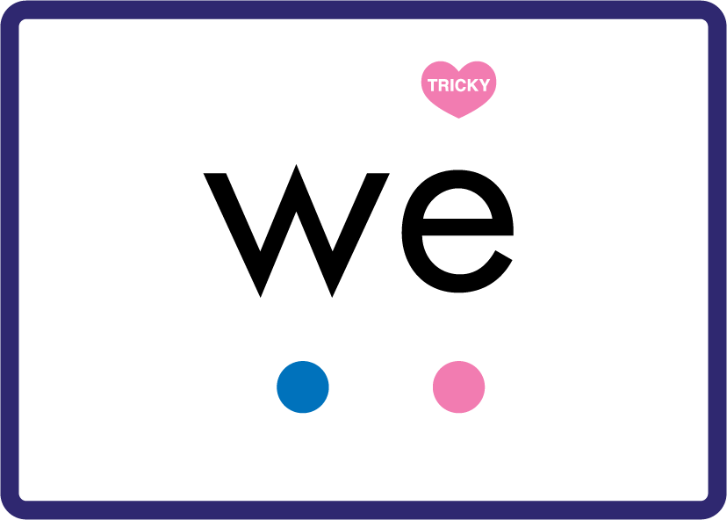
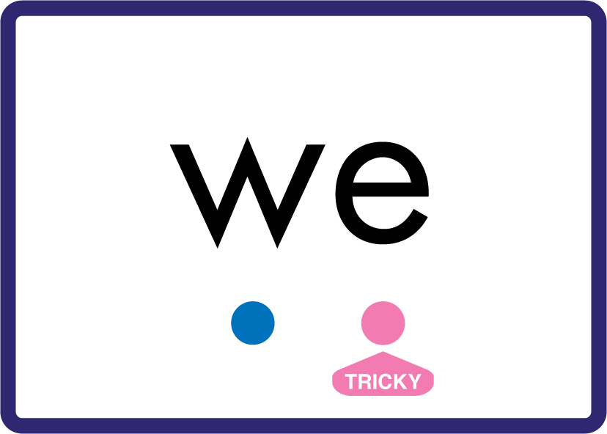
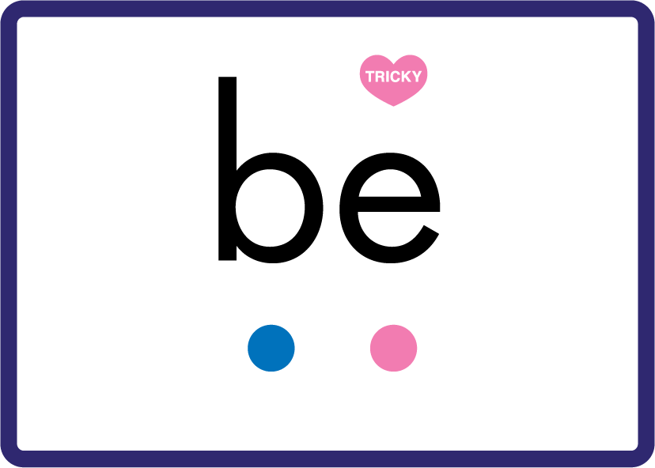

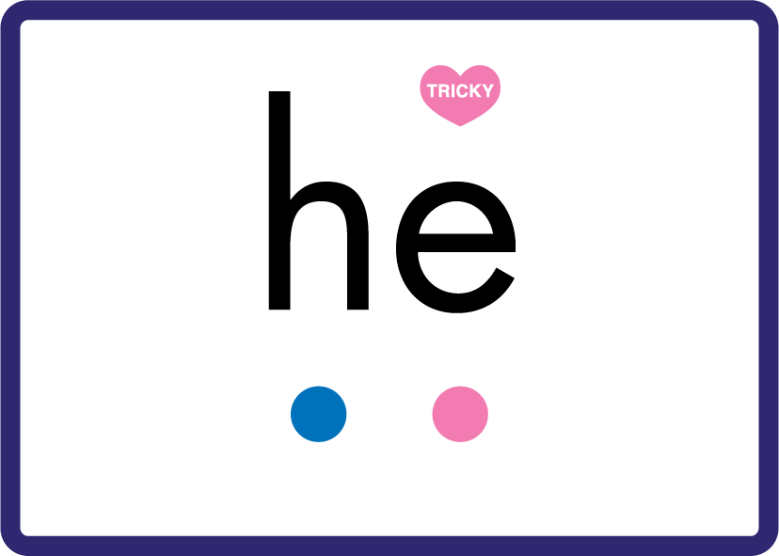



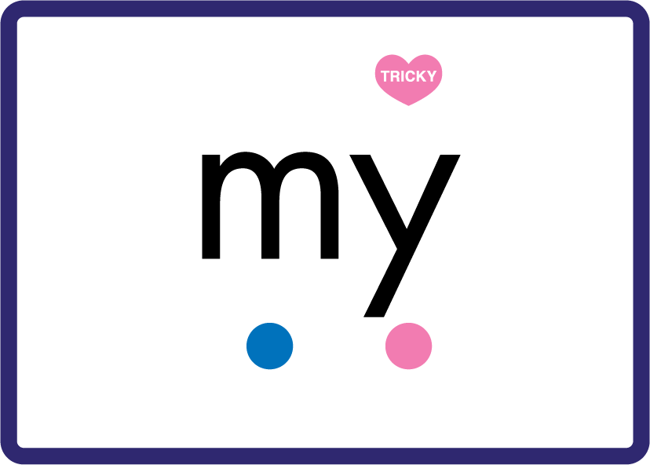

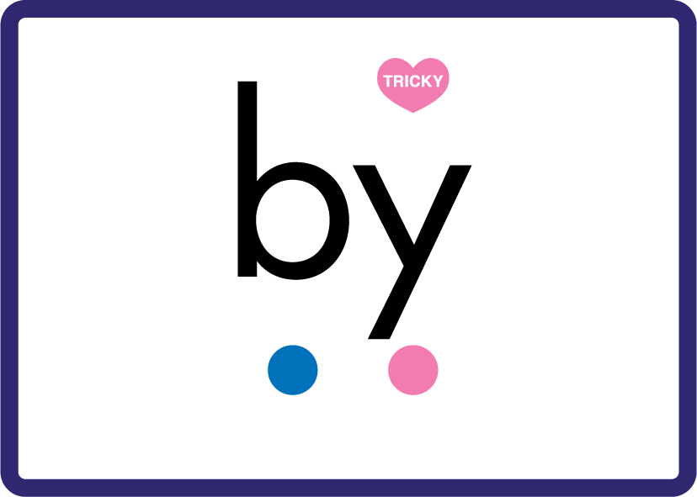




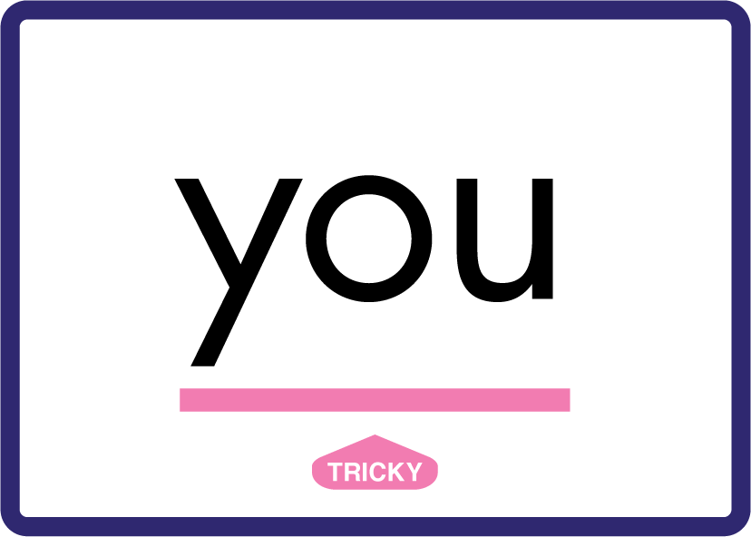






Review Phase 3 Common Exception Words push they me we be he she my by looked you are there here were all sure.

Slide 7
Hear Phonemes
USING JN691
FRONT

Slide 8
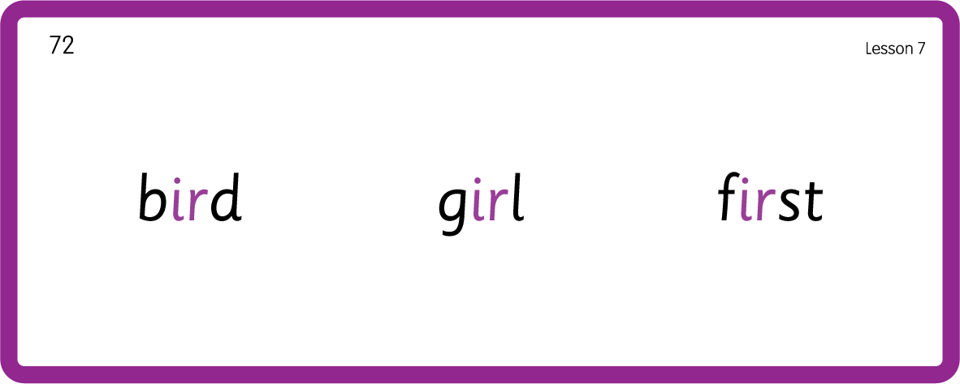
Hear Phonemes
USING JN691
BACK

Slide 9
Teach Grapheme Caption
USING JN686
FRONT

Slide 10
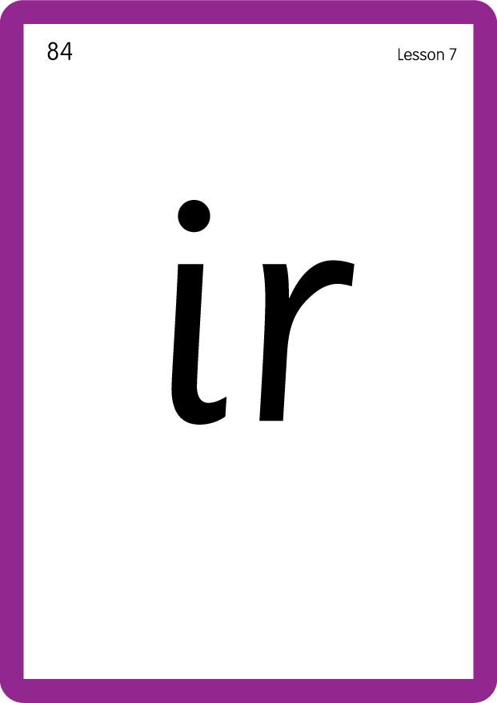
Teach Lowercase Formation
USING JN686
BACK

Slide 11

Explain Decoding

Slide 12
Model Blending Phonemes
s
ir
USING SOUND BUTTONS
Sound Buttons
Vowel
Consonant
Consonant Digraph
Long Vowel Sound
R-controlled Digraph
Split Digraph
Syllable / Silent Letter

Slide 13
Model Blending Phonemes
b
ir
d
USING SOUND BUTTONS
Sound Buttons
Vowel
Consonant
Consonant Digraph
Long Vowel Sound
R-controlled Digraph
Split Digraph
Syllable / Silent Letter

Slide 14
Model Blending Phonemes
d
ir
t
USING SOUND BUTTONS
Sound Buttons
Vowel
Consonant
Consonant Digraph
Long Vowel Sound
R-controlled Digraph
Split Digraph
Syllable / Silent Letter

Slide 15

Explain Encoding

Slide 16
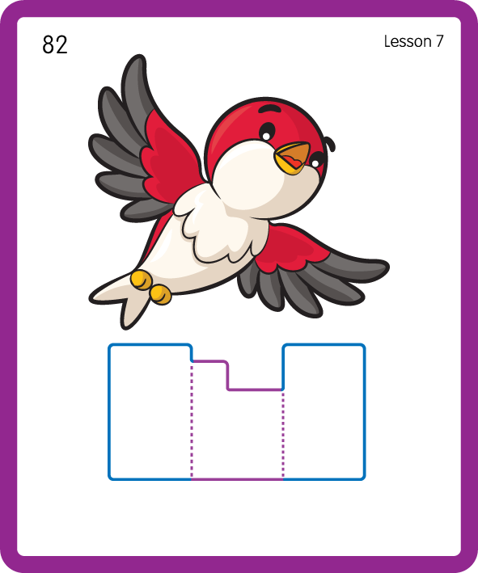
Build a Decodable Word
USING JN689
BACK

Slide 17
Build a Decodable Word
USING JN689
FRONT

Slide 18
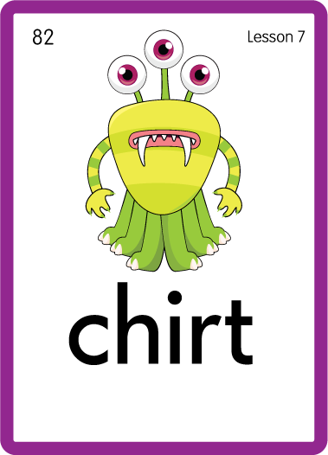
Practise with Alien Words
USING JN692
BACK

Slide 19
Practise with Alien Words
USING JN692
FRONT

Slide 20

Practise Building Words
PRACTISE – 10MINS
s
g
l
b
d
k
t
sh
th
f
ir
USING MAGNETIC LETTERS AND A WHITEBOARD

Slide 21
Practise Building Words
PRACTISE – 10MINS
s
g
l
b
d
k
t
sh
th
f
ir
sir girl bird dirt skirt shirt birth first third
USING MAGNETIC LETTERS AND A WHITEBOARD

