Slide 1


/ai/ | /ee/ | /igh/ | /oa/ | /oo/ | /y-oo/ | /r/
/n/ | /m/ | /ch/ | /k/ | /sh/ | /j/ | /v/
/u/ | /e/ | /i/ | /s/ | /zh/ | /z/ | /ar/
/or/ | /ur/ | /air/ | /ear/
Sound Family /ai/; ai / ay
Lesson 1

Slide 2


Learn and practise /ai/ sound family spelling patterns.
Recall all GPCs learned so far using flashcards.
Grapheme to Phoneme Cards
Phoneme Frame Cards
Alien Word Cards
JN686
JN689
JN692

Slide 3























Recall all GPCs learned so far using flashcards.

Slide 4




























Recall all GPCs learned so far using flashcards.

Slide 5








































Recall all GPCs learned so far using flashcards.

Slide 6














Review Phase 2 Common Exception Words as I is no go to into the put his has of pull full.

Slide 7




























Review Phase 3 Common Exception Words push they me we be he she my by looked you are there here were all sure.

Slide 8













Review Phase 4 Common Exception Words said like out have some come what was so old do little one.

Slide 9














Review Phase 5 Common Exception Words today house mouse hour because Mr Mrs Ms where should could would move use.

Slide 10
Review Grapheme Captions
rain
snail
train
Phase 3, Lesson 31
USING JN686
FRONT

Slide 11
Review Grapheme Captions
play
day
spray
Phase 5, Lesson 1
USING JN686
FRONT

Slide 12
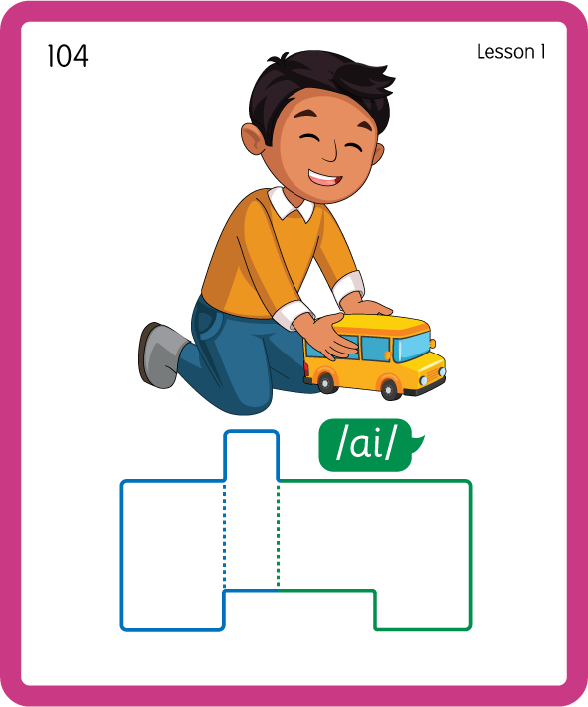
Build a Decodable Word
USING JN689
BACK

Slide 13
Build a Decodable Word
USING JN689
FRONT

Slide 14
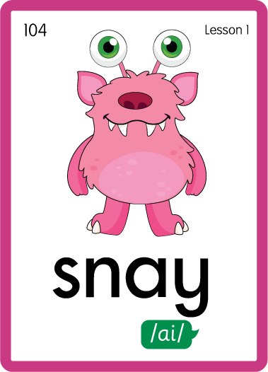
Practise with Alien Words
USING JN692
BACK

Slide 15
Practise with Alien Words
USING JN692
FRONT

Slide 16

Practise Building Words
PRACTISE – 10MINS
d
r
ai
n
p
l
s
t
g
t
b
ay
USING MAGNETIC LETTERS AND A WHITEBOARD

Slide 17
Practise Building Words
PRACTISE – 10MINS
d
r
ai
n
p
l
s
t
g
t
b
ay
drain pail stain grain strait bait ray play stay pay stray
USING MAGNETIC LETTERS AND A WHITEBOARD

