Slide 1


/ai/ | /ee/ | /igh/ | /oa/ | /oo/ | /y-oo/ | /r/
/n/ | /m/ | /ch/ | /k/ | /sh/ | /j/ | /v/
/u/ | /e/ | /i/ | /s/ | /zh/ | /z/ | /ar/
/or/ | /ur/ | /air/ | /ear/
Sound Family /igh/; i-e
Lesson 12

Slide 2



Learn and practise /igh/ sound family spelling patterns.
Recall all GPCs learned so far using flashcards.
Grapheme to Phoneme Cards
Phoneme Frame Cards
Alien Word Cards
Common Exception Word Cards
JN686
JN689
JN692
JN687

Slide 3























Recall all GPCs learned so far using flashcards.

Slide 4




























Recall all GPCs learned so far using flashcards.

Slide 5








































Recall all GPCs learned so far using flashcards.

Slide 6





Recall all GPCs learned so far using flashcards.

Slide 7














Review Phase 2 Common Exception Words as I is no go to into the put his has of pull full.

Slide 8




























Review Phase 3 Common Exception Words push they me we be he she my by looked you are there here were all sure.

Slide 9












Review Phase 4 Common Exception Words said like out have some come what was so old do little one.

Slide 10














Review Phase 5 Common Exception Words today house mouse hour because Mr Mrs Ms where should could would move use.

Slide 11

Review Phase 5.5 Common Exception Word people.

Slide 12
Review Grapheme Caption
right
fight
night
Phase 3, Lesson 33
USING JN686
FRONT

Slide 13
Review Grapheme Caption
bike
five
slime
Phase 5, Lesson 23
USING JN686
FRONT

Slide 14
Review Grapheme Caption
rice
slice
price
+
Phase 5, Lesson 23 + Phase 5, Lesson 29
USING JN686
FRONT

Slide 15
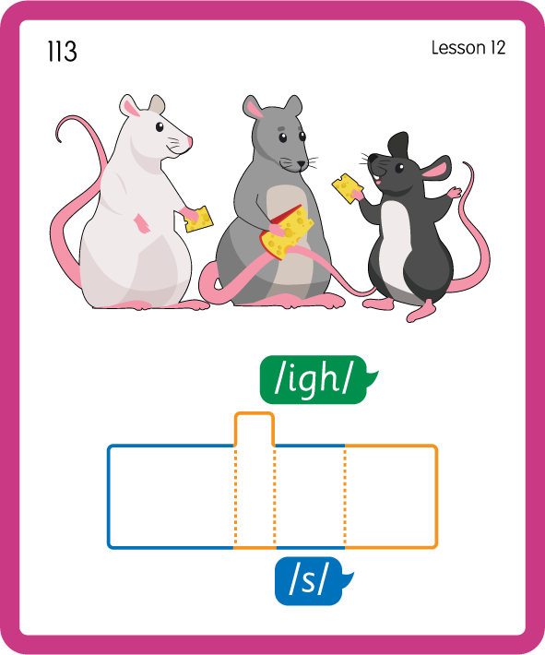
Build a Decodable Word
USING JN689
BACK

Slide 16
Build a Decodable Word
USING JN689
FRONT

Slide 17
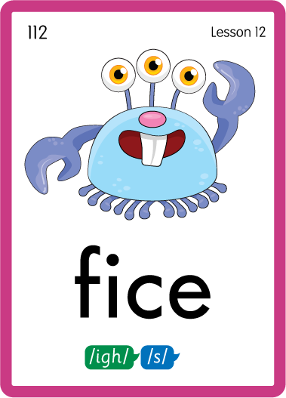
Practise with Alien Words
USING JL692
BACK

Slide 18
Practise with Alien Words
USING JN692
FRONT

Slide 19
Practise Common Exception Words
USING JN687
FRONT

Slide 20
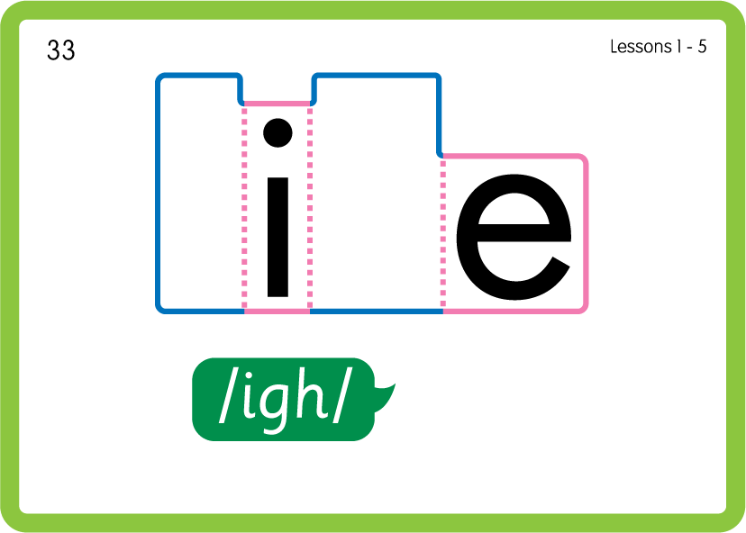
Practise Common Exception Words
USING JN687
BACK

Slide 21

Practise Building Words
PRACTISE – 10MINS
i-e
c
b
k
d
v
f
l
n
n
m
r
s
t
p
USING MAGNETIC LETTERS AND A WHITEBOARD
LAYOUT B

Slide 22
Practise Building Words
PRACTISE – 10MINS
i-e
c
b
k
d
v
f
l
n
n
m
r
s
t
p
ice bike dice stripe file fine nine mice rice vine
USING MAGNETIC LETTERS AND A WHITEBOARD
LAYOUT B

