Slide 1





/ai/ | /ee/ | /igh/ | /oa/ | /oo/ | /y-oo/ | /r/
/n/ | /m/ | /ch/ | /k/ | /sh/ | /j/ | /v/
/u/ | /e/ | /i/ | /s/ | /zh/ | /z/ | /ar/
/or/ | /ur/ | /air/ | /ear/
Review Sound Family /igh/
Lesson 15

Slide 2


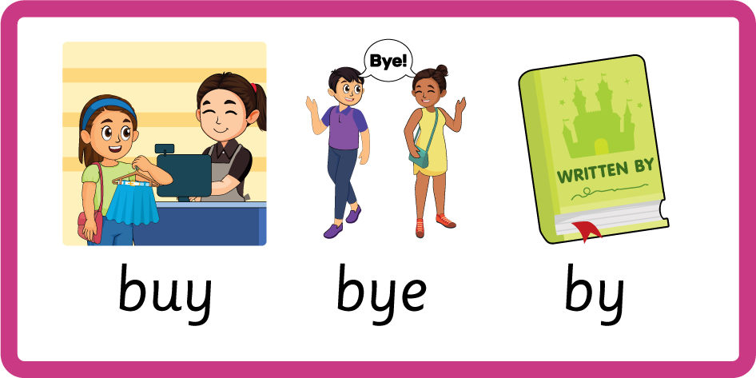

Learn and practise /igh/ sound family spelling patterns, including homophones and Common Exception Words.
Recall all GPCs learned so far using flashcards.
Homophone Cards
Grapheme to Phoneme Cards
Phoneme Frame Cards
Alien Word Cards
Common Exception Word Cards
JN693
JN686
JN689
JN692
JN687

Slide 3























Recall all GPCs learned so far using flashcards.

Slide 4




























Recall all GPCs learned so far using flashcards.

Slide 5







































Recall all GPCs learned so far using flashcards.

Slide 6





Recall all GPCs learned so far using flashcards.

Slide 7













Review Phase 2 Common Exception Words as I is no go to into the put his has of pull full.

Slide 8




























Review Phase 3 Common Exception Words push they me we be he she my by looked you are there here were all sure.

Slide 9













Review Phase 4 Common Exception Words said like out have some come what was so old do little one.

Slide 10














Review Phase 5 Common Exception Words today house mouse hour because Mr Mrs Ms where should could would move use.

Slide 11






Review Phase 5.5 Common Exception Words people wild child mind kind behind.

Slide 12



Teach Homophones within /igh/ family: buy / bye / by, I / eye, sight / site, die / dye.

Slide 13
Review Common Exception Words containing /igh/ sound I my by like wild child mind kind behind.

Slide 14

Introduce /igh/ sound in new Common Exception Word eye.

Slide 15
Review Grapheme Captions
USING JN686
FRONT

Slide 16





Review Grapheme Captions
USING JN686
BACK

Slide 17
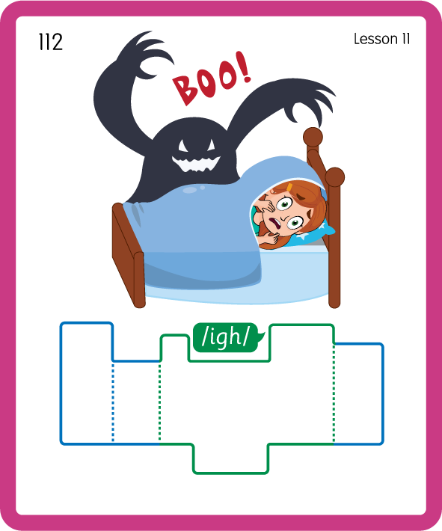
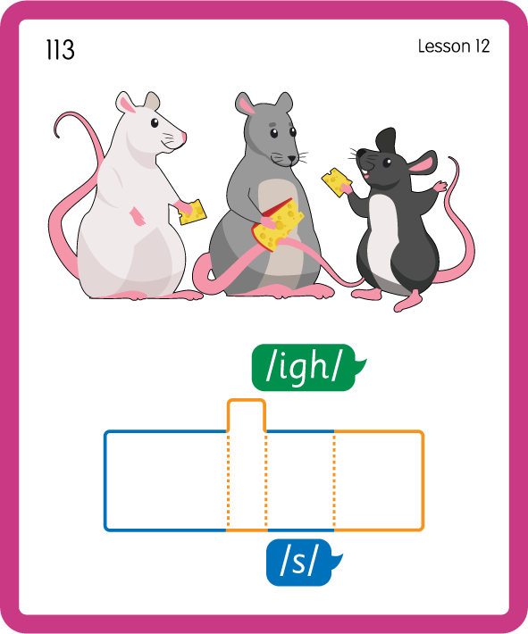
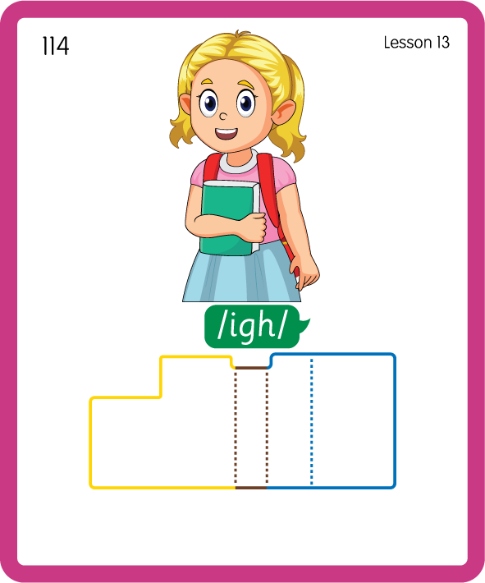
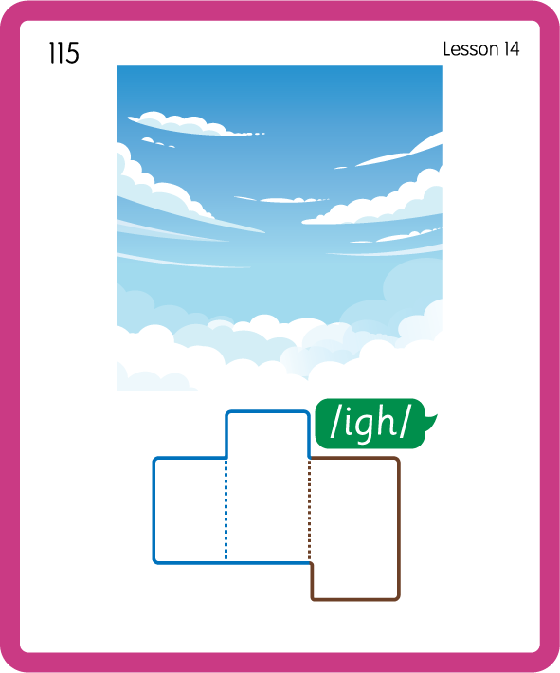
Build a Decodable Word
USING JN689
BACK

Slide 18



Build a Decodable Word
USING JN689
FRONT

Slide 19




Practise with Alien Words
USING JN692
BACK

Slide 20



Practise with Alien Words
USING JN692
FRONT

Slide 21
Practise Common Exception Words
USING JN687
FRONT

Slide 22
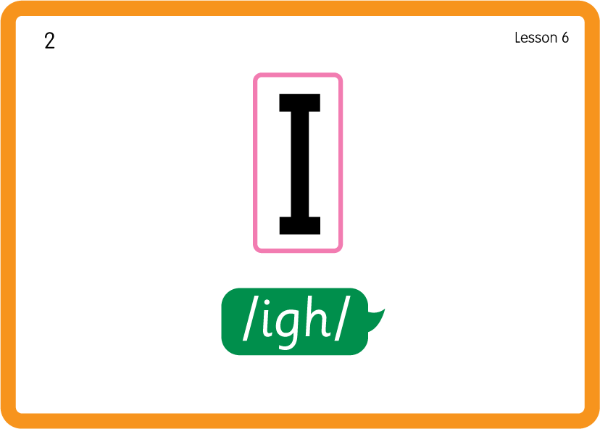
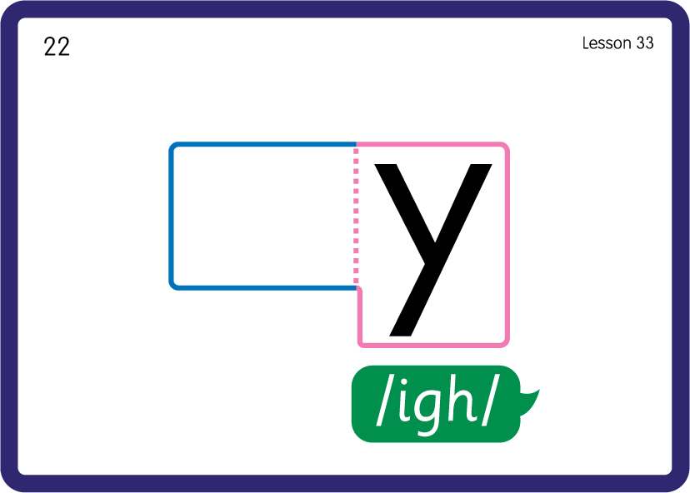
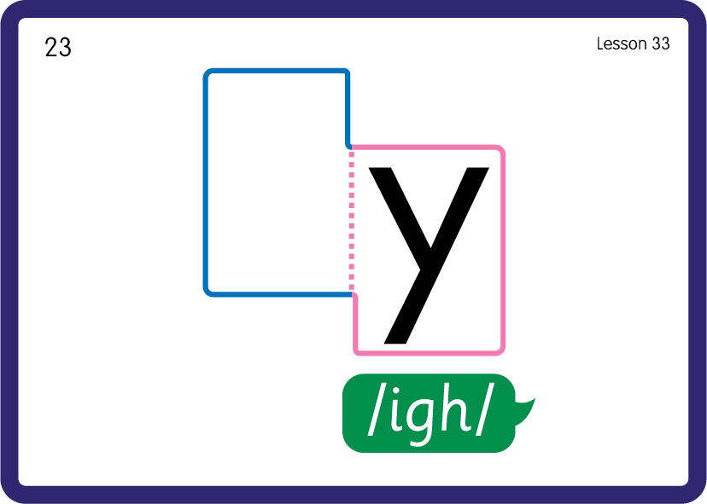

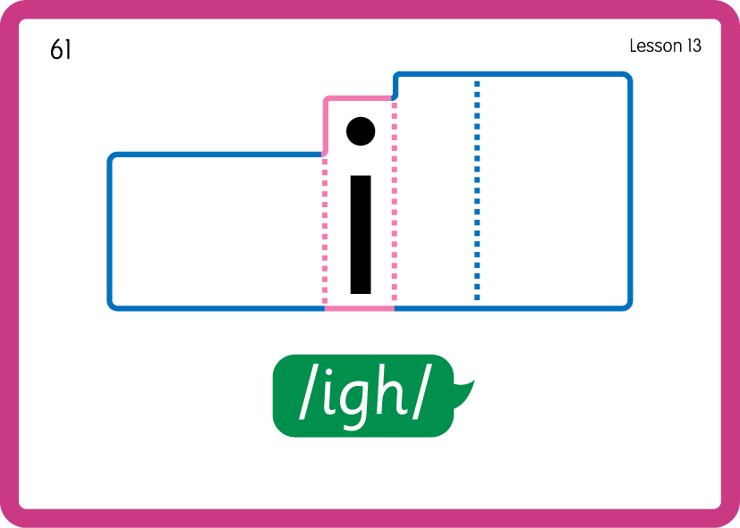
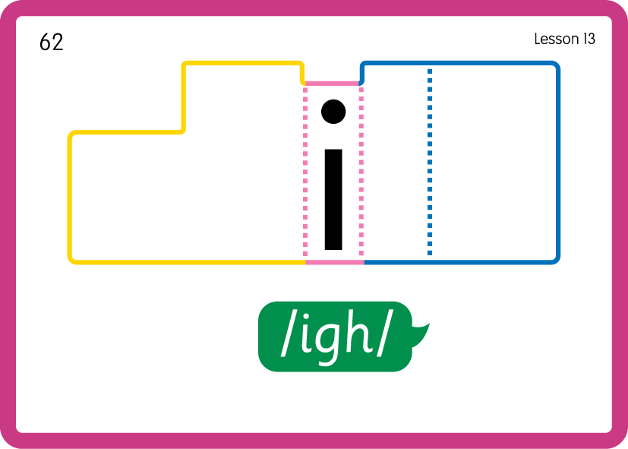
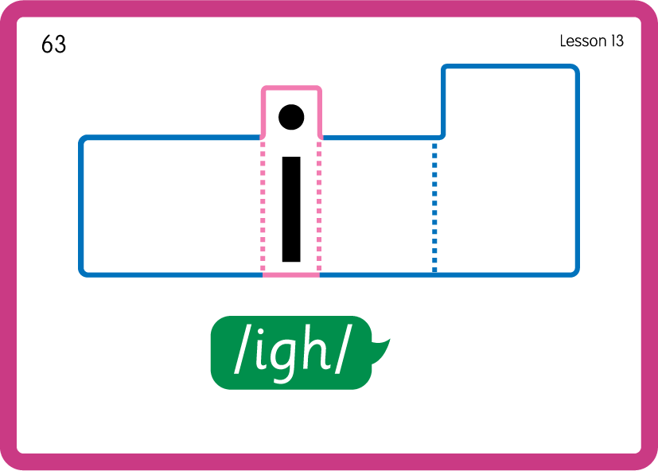
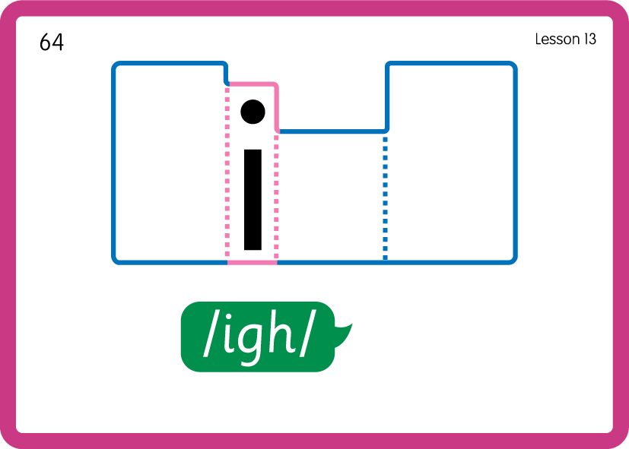
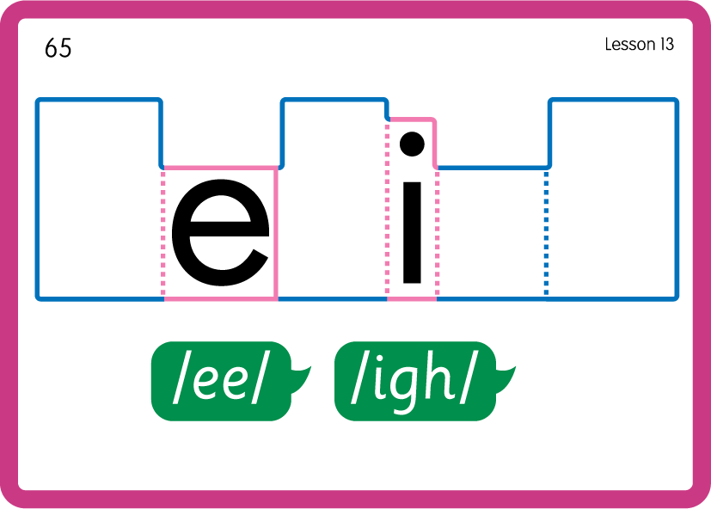

Practise Common Exception Words
USING JN687
BACK

Slide 23
Practise Common Exception Words
USING JN687
BACK

Slide 24

Practise Common Exception Words
USING JN687
BACK

Slide 25

