Slide 1


/ai/ | /ee/ | /igh/ | /oa/ | /oo/ | /y-oo/ | /r/
/n/ | /m/ | /ch/ | /k/ | /sh/ | /j/ | /v/
/u/ | /e/ | /i/ | /s/ | /zh/ | /z/ | /ar/
/or/ | /ur/ | /air/ | /ear/
Sound Family /oa/; oe o-e
Lesson 17

Slide 2


Learn and practise /oa/ sound family spelling patterns.
Recall all GPCs learned so far using flashcards.
Grapheme to Phoneme Cards
Phoneme Frame Cards
Alien Word Cards
JN686
JN689
JN692

Slide 3
Learn and practise /oa/ sound family spelling patterns.
Recall all GPCs learned so far using flashcards.
Grapheme to Phoneme Cards
Phoneme Frame Cards
Alien Word Cards
JN686
JN689
JN692

Slide 4























Recall all GPCs learned so far using flashcards.

Slide 5





























Recall all GPCs learned so far using flashcards.

Slide 6


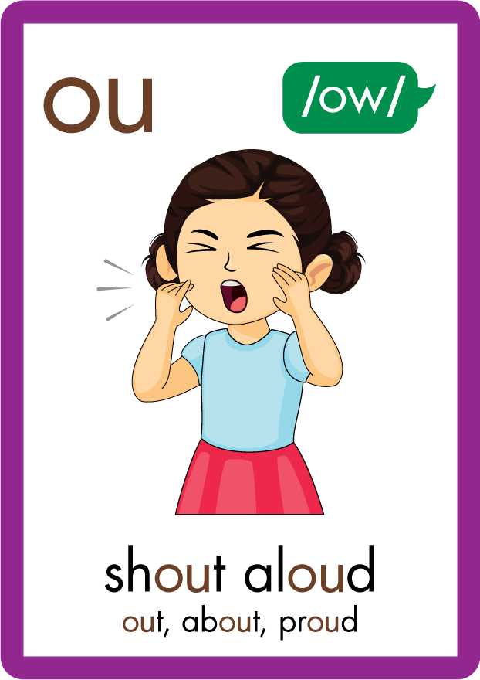
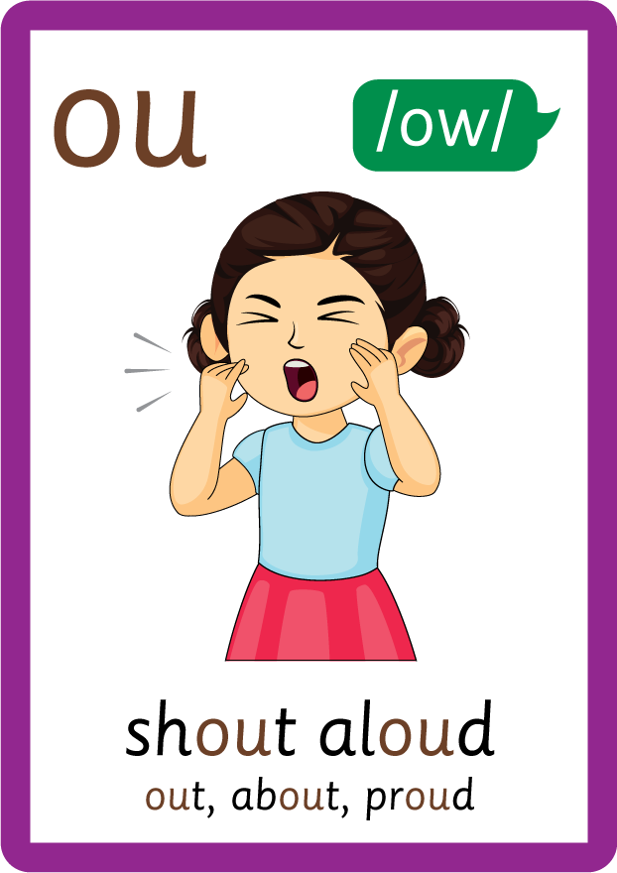



















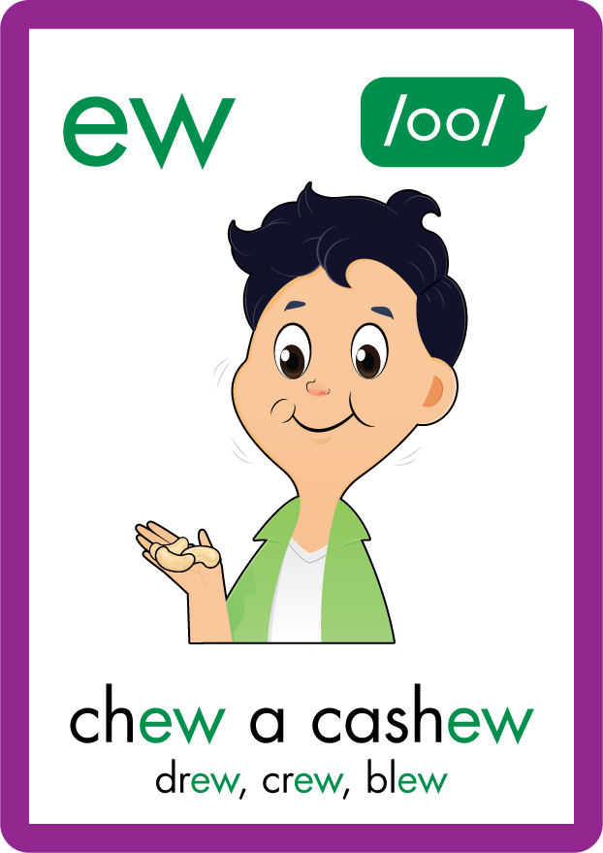















Recall all GPCs learned so far using flashcards.

Slide 7
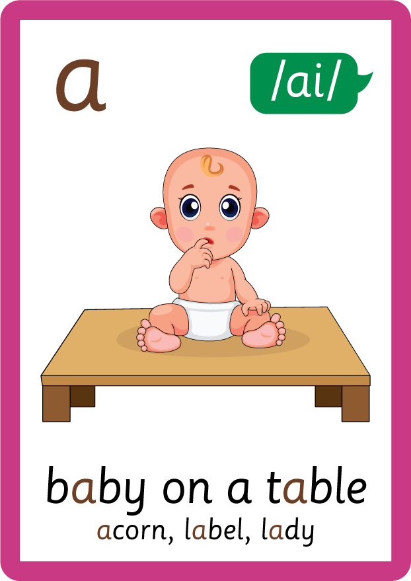






Recall all GPCs learned so far using flashcards.

Slide 8






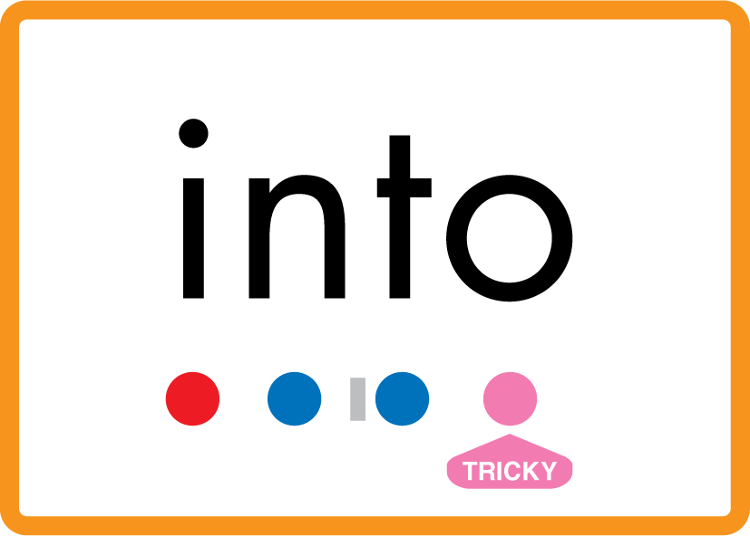







Review Phase 2 Common Exception Words as I is no go to into the put his has of pull full.

Slide 9







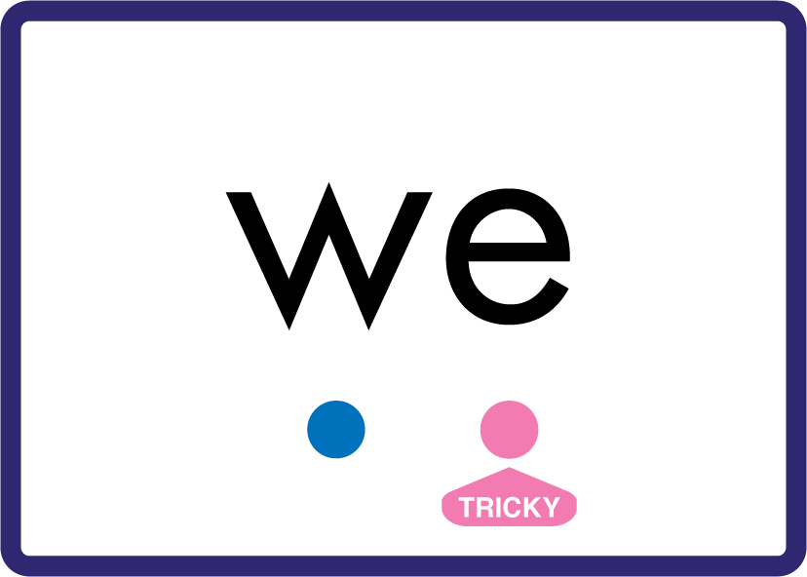




















Review Phase 3 Common Exception Words push they me we be he she my by looked you are there here were all sure.

Slide 10













Review Phase 4 Common Exception Words said like out have some come what was so old do little one.

Slide 11














Review Phase 5 Common Exception Words today house mouse hour because Mr Mrs Ms where should could would move use.

Slide 12



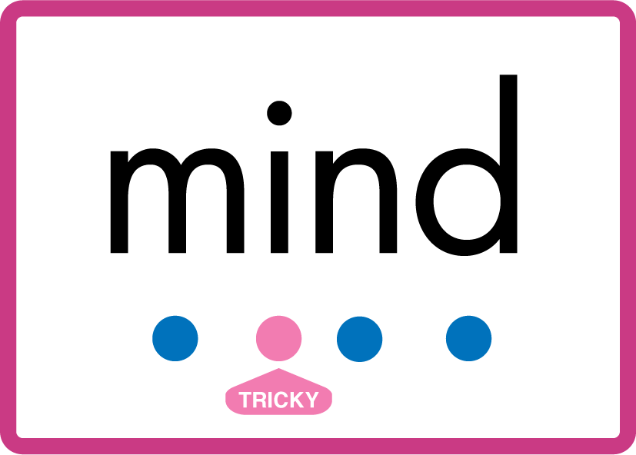


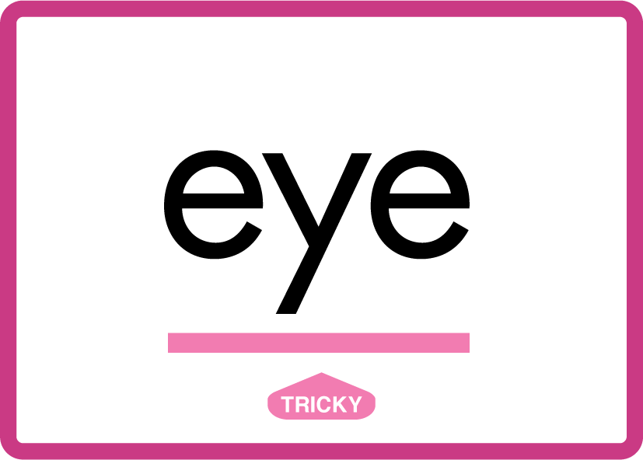
Review Phase 5.5 Common Exception Words people wild child mind kind behind eye.

Slide 13
Review Grapheme Caption
toes
doe
dominoes
Phase 5, Lesson 14
USING JN686
FRONT

Slide 14
Review Grapheme Caption
bone
rope
stone
Phase 5, Lesson 26
USING JN686
FRONT

Slide 15
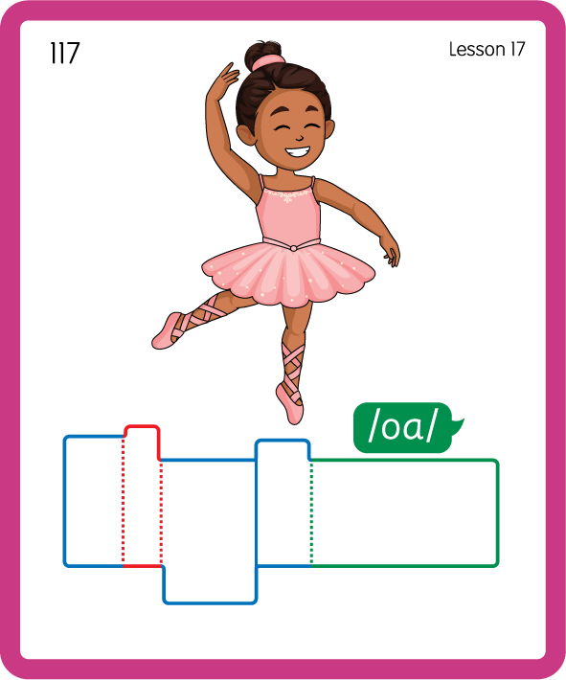
Build a Decodable Word
USING JN689
BACK

Slide 16
Build a Decodable Word
USING JN689
FRONT

Slide 17
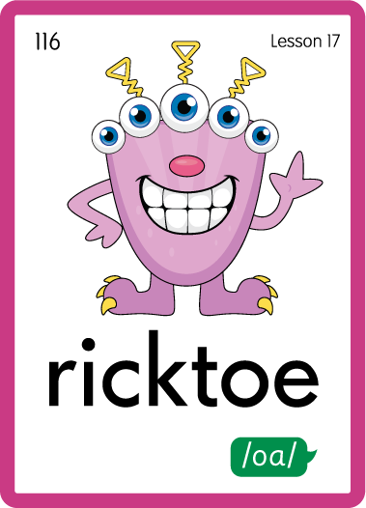
Practise with Alien Words
USING JN692
BACK

Slide 18
Practise with Alien Words
USING JN692
FRONT

Slide 19

Practise Building Words
PRACTISE – 10MINS
t
oe
f
d
h
o-e
m
p
j
k
s
r
c
n
l
USING MAGNETIC LETTERS AND A WHITEBOARD
LAYOUT B

Slide 20
Practise Building Words
PRACTISE – 10MINS
t
oe
f
d
h
o-e
m
p
j
k
s
r
c
n
l
toe foe doe home hope joke smoke rope cone slope
USING MAGNETIC LETTERS AND A WHITEBOARD
LAYOUT B

