Slide 1






/ai/ | /ee/ | /igh/ | /oa/ | /oo/ | /y-oo/ | /r/
/n/ | /m/ | /ch/ | /k/ | /sh/ | /j/ | /v/
/u/ | /e/ | /i/ | /s/ | /zh/ | /z/ | /ar/
/or/ | /ur/ | /air/ | /ear/
Review Sound Family /oa/
Lesson 20

Slide 2




Learn and practise /oa/ sound family spelling patterns, including homophones and Common Exception Words.
Recall all GPCs learned so far using flashcards.
Homophone Cards
Grapheme to Phoneme Cards
Phoneme Frame Cards
Alien Word Cards
Common Exception Words
JN693
JN686
JN689
JN692
JN687

Slide 3























Recall all GPCs learned so far using flashcards.

Slide 4



























Recall all GPCs learned so far using flashcards.

Slide 5







































Recall all GPCs learned so far using flashcards.

Slide 6







Recall all GPCs learned so far using flashcards.

Slide 7













Review Phase 2 Common Exception Words as I is no go to into the put his has of pull full.

Slide 8




























Review Phase 3 Common Exception Words push they me we be he she my by looked you are there here were all sure.

Slide 9













Review Phase 4 Common Exception Words said like out have some come what was so old do little one.

Slide 10














Review Phase 5 Common Exception Words today house mouse hour because Mr Mrs Ms where should could would move use.

Slide 11












Review Phase 5.5 Common Exception Words people wild child mind kind behind eye oh most only both though.

Slide 12
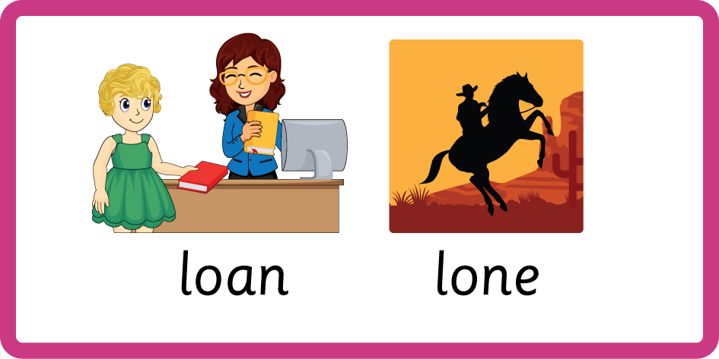
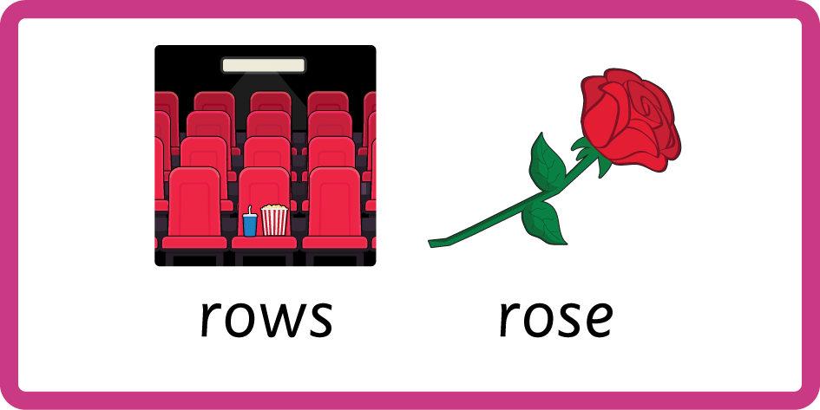

Teach Homophones within /oa/ family:
know / no, loan / lone, rows / rose, road / rode.

Slide 13
Review Common Exception Words containing /oa/ sound no go so oh most only both though.

Slide 14
Review Grapheme Captions
USING JN686
FRONT

Slide 15
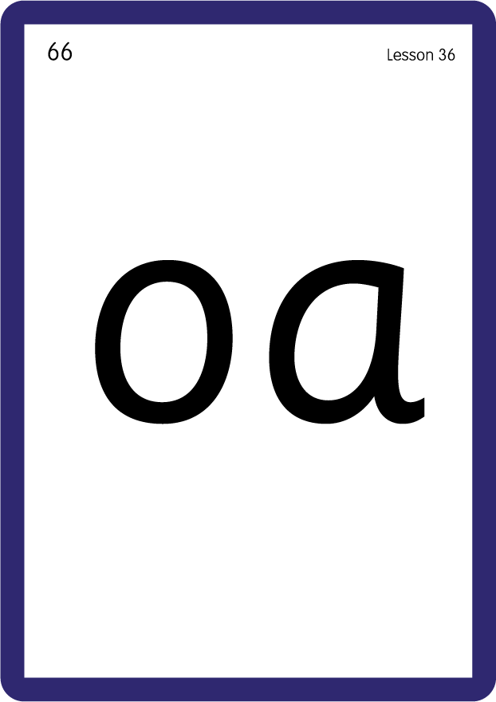





Review Grapheme Captions
USING JN686
BACK

Slide 16
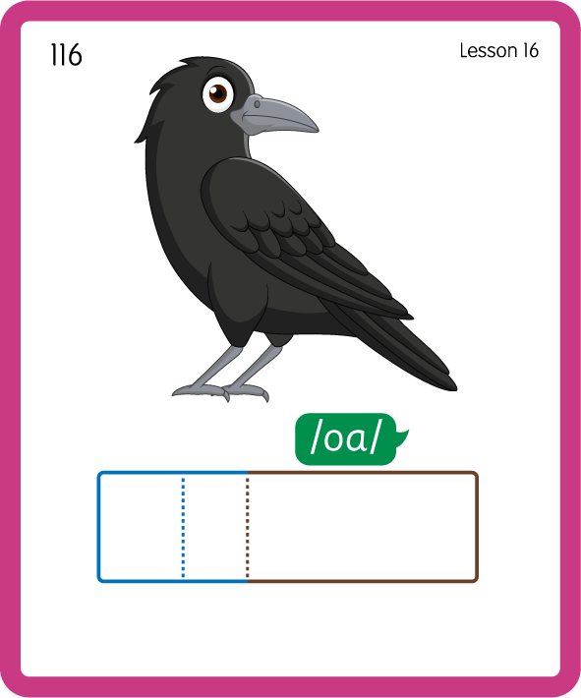
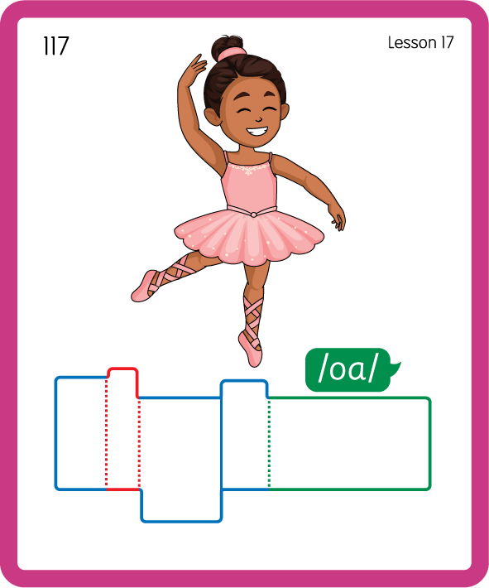
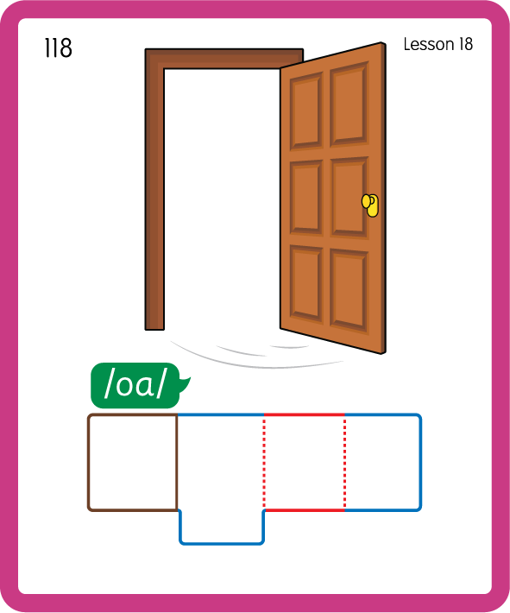
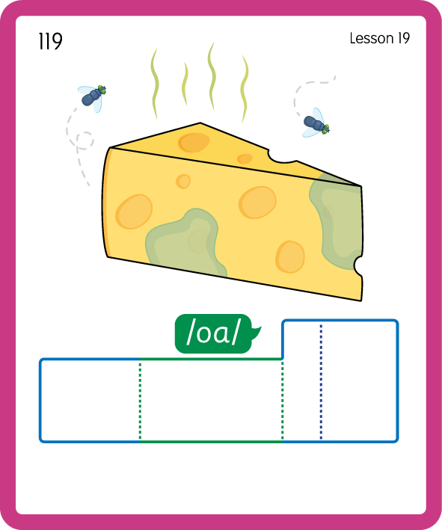
Build a Decodable Word
USING JN689
BACK

Slide 17



Build a Decodable Word
USING JN689
FRONT

Slide 18
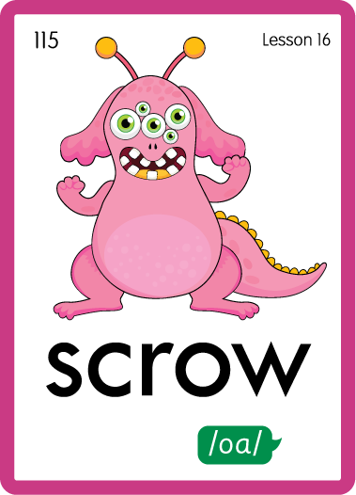

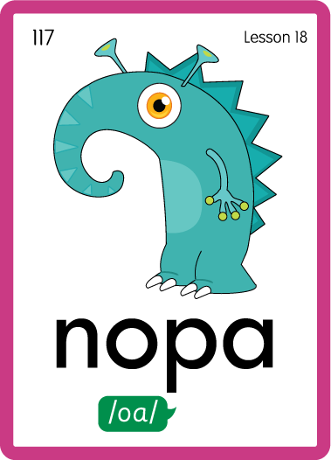
Practise with Alien Words
USING JN692
BACK

Slide 19


Practise with Alien Words
USING JN692
FRONT

Slide 20
Practise Common Exception Words
USING JN687
FRONT

Slide 21
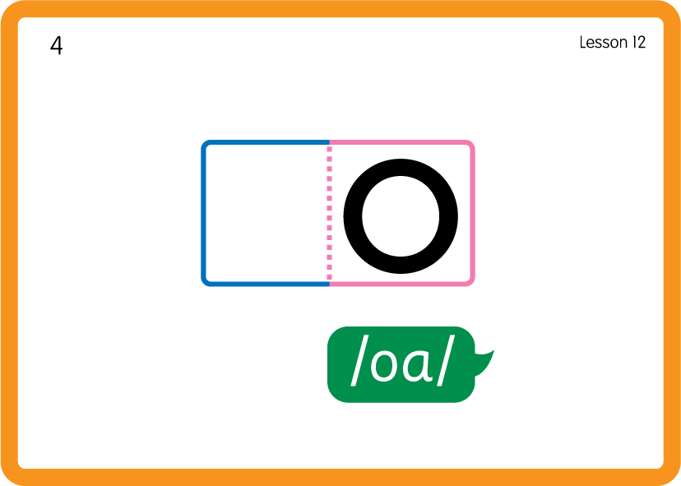
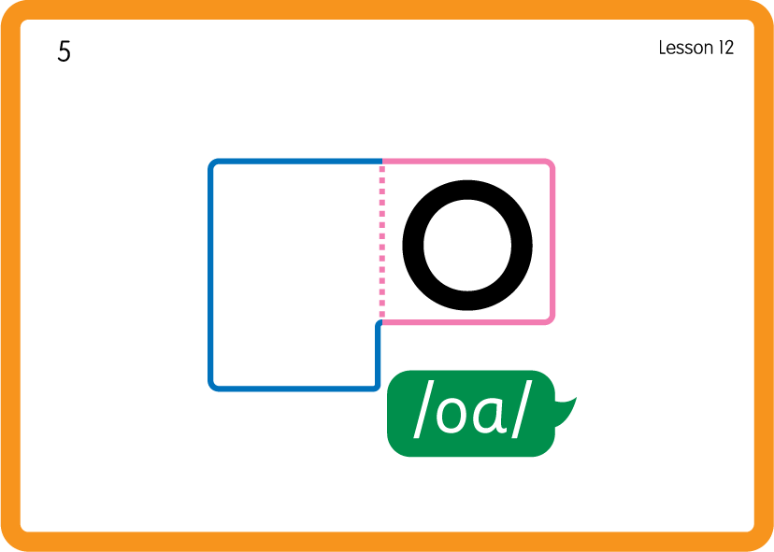
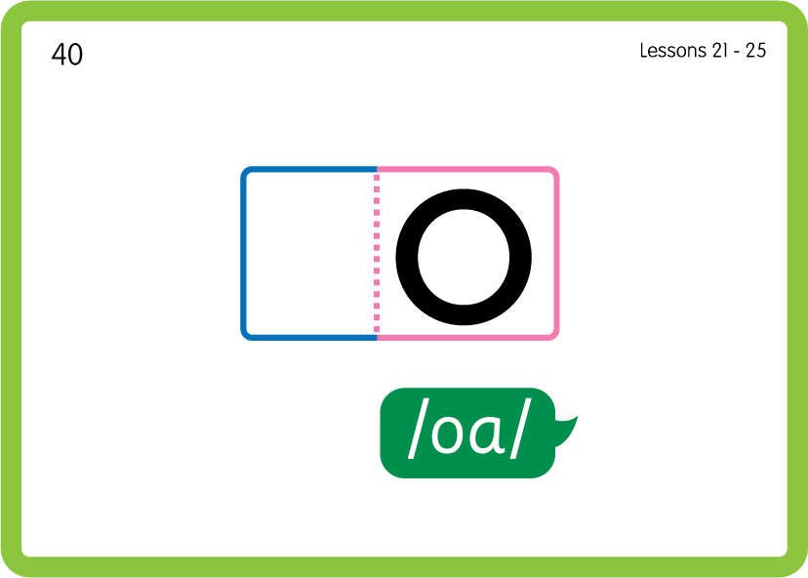

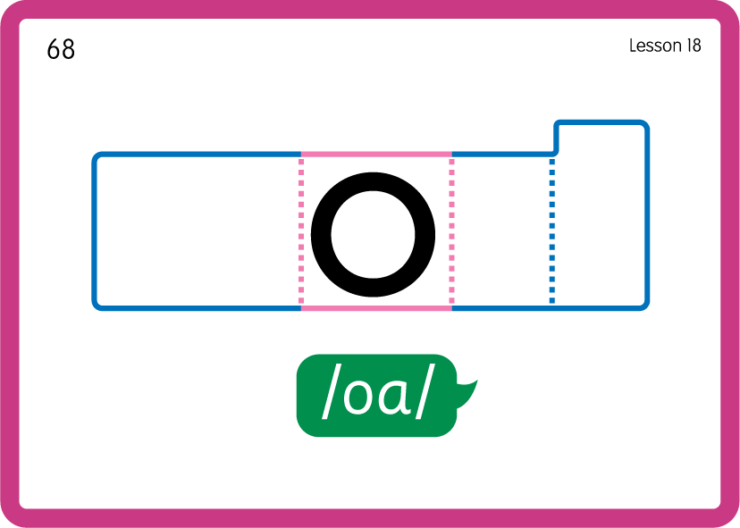
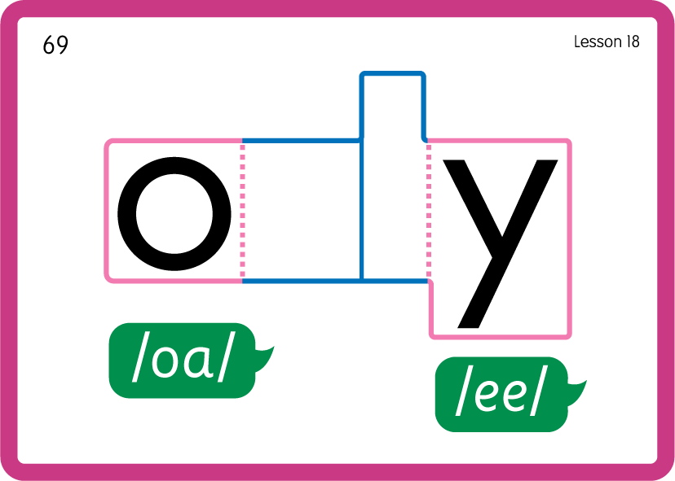
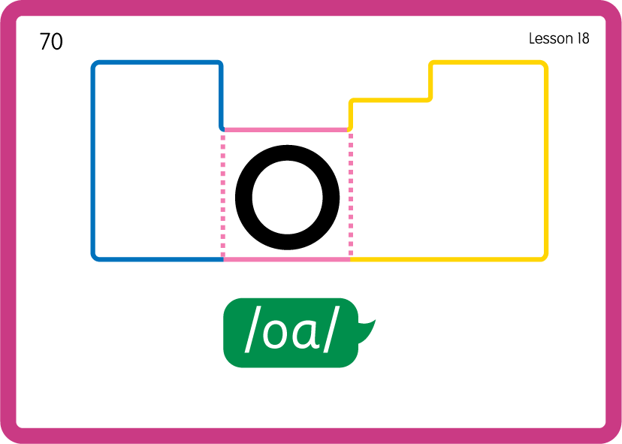
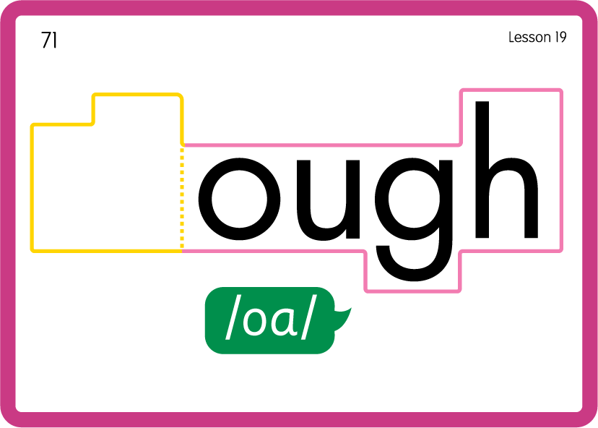
Practise Common Exception Words
USING JN687
BACK

Slide 22
Practise Common Exception Words
USING JN687
FRONT

Slide 23
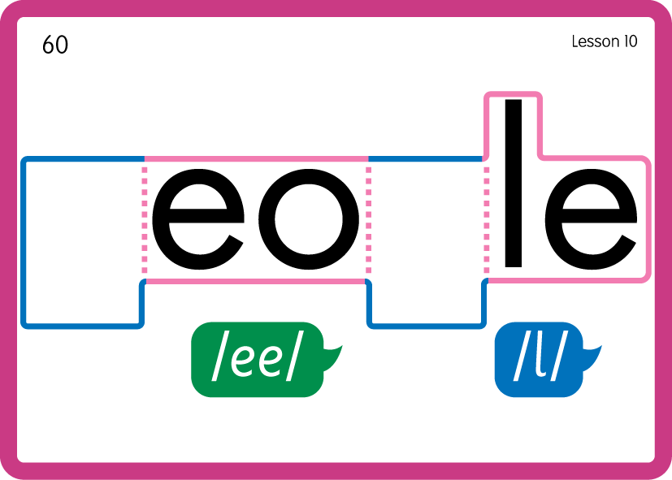
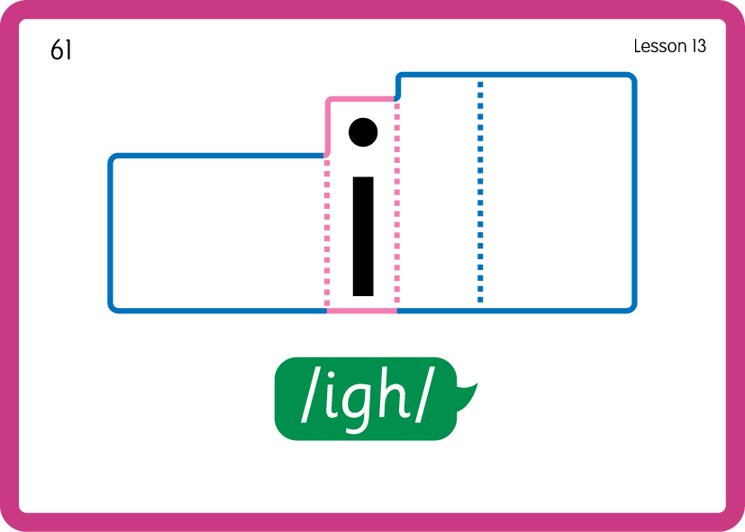
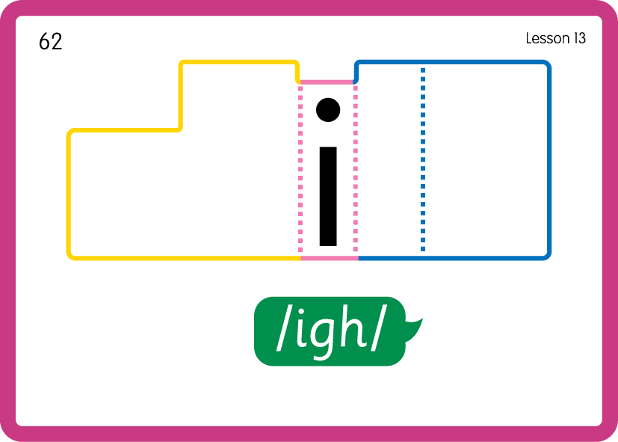
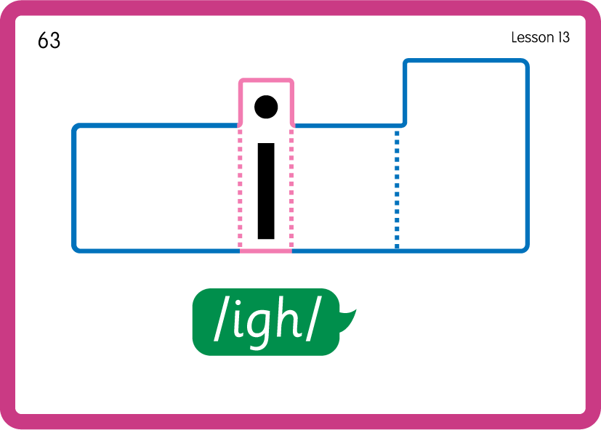
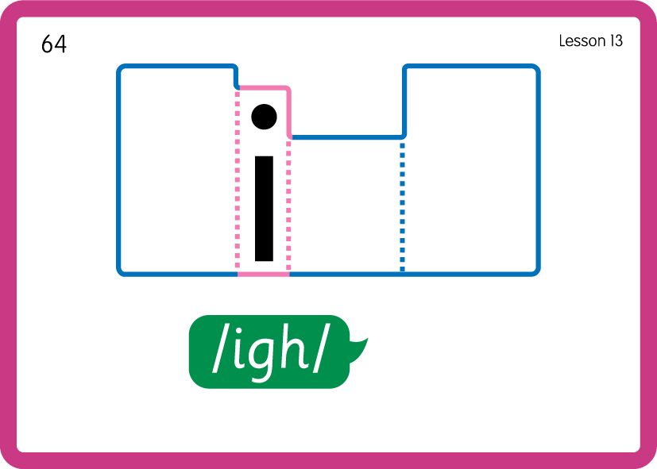
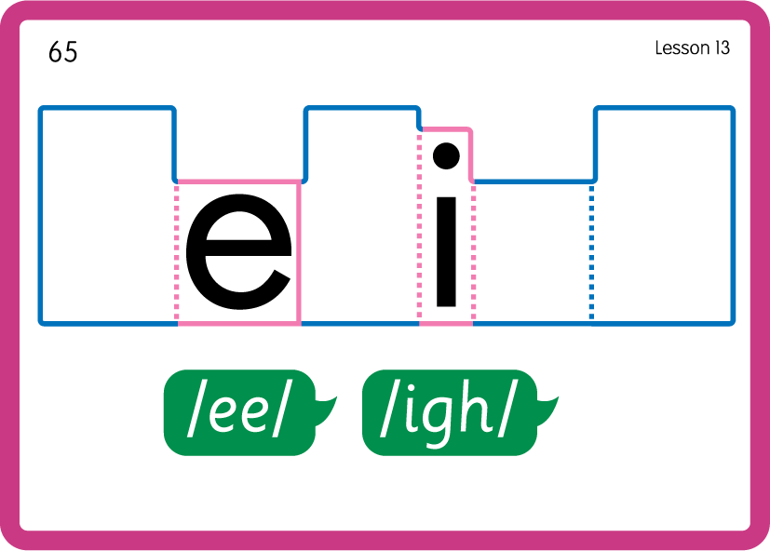

Practise Common Exception Words
USING JN687
BACK

Slide 24

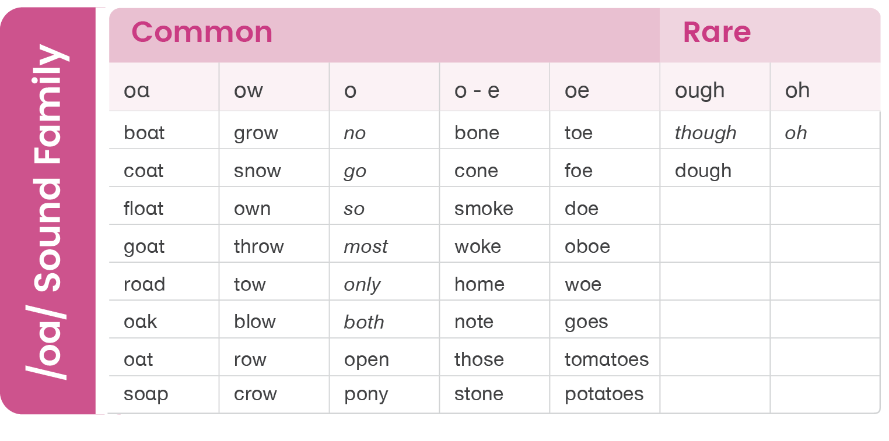

Slide 25
Sound Family /oo/; short vs long - Lesson 21

