Slide 1


/ai/ | /ee/ | /igh/ | /oa/ | /oo/ | /y-oo/ | /r/
/n/ | /m/ | /ch/ | /k/ | /sh/ | /j/ | /v/
/u/ | /e/ | /i/ | /s/ | /zh/ | /z/ | /ar/
/or/ | /ur/ | /air/ | /ear/
Sound Family /y-oo/; ue (/oo/ vs /y-oo/)
Lesson 26

Slide 2
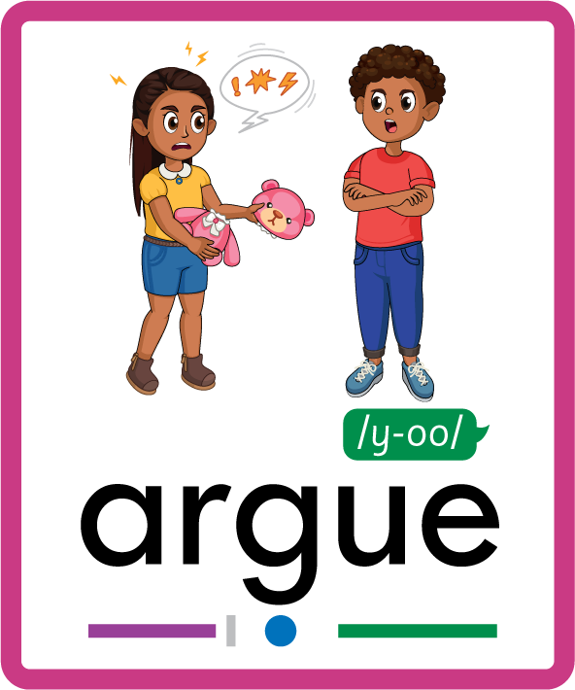
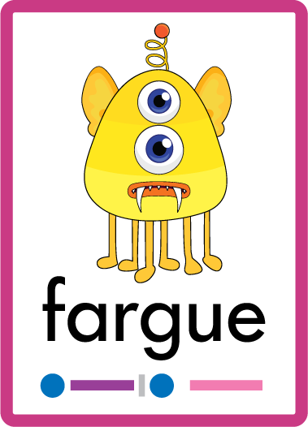
Learn and practise /y-oo/ sound family spelling patterns.
Recall all GPCs learned so far using flashcards.
Grapheme to Phoneme Cards
Phoneme Frame Cards
Alien Word Cards
JN686
JN689
JN692

Slide 3




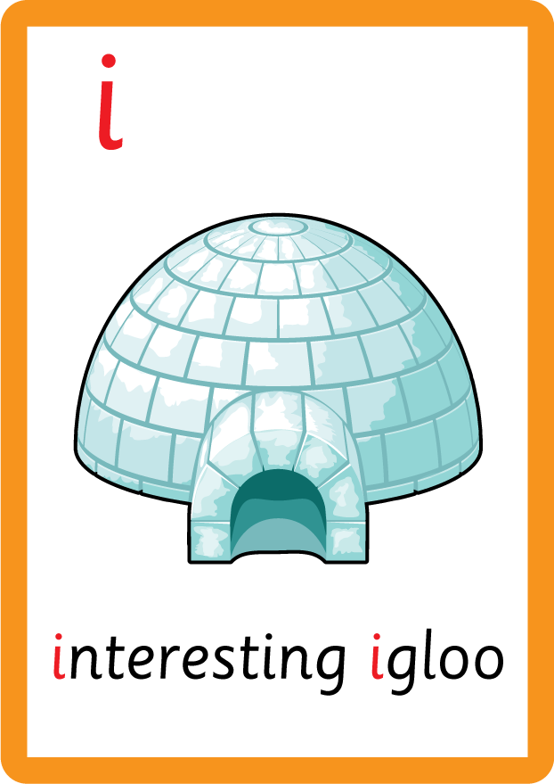


















Recall all GPCs learned so far using flashcards.

Slide 4





























Recall all GPCs learned so far using flashcards.

Slide 5


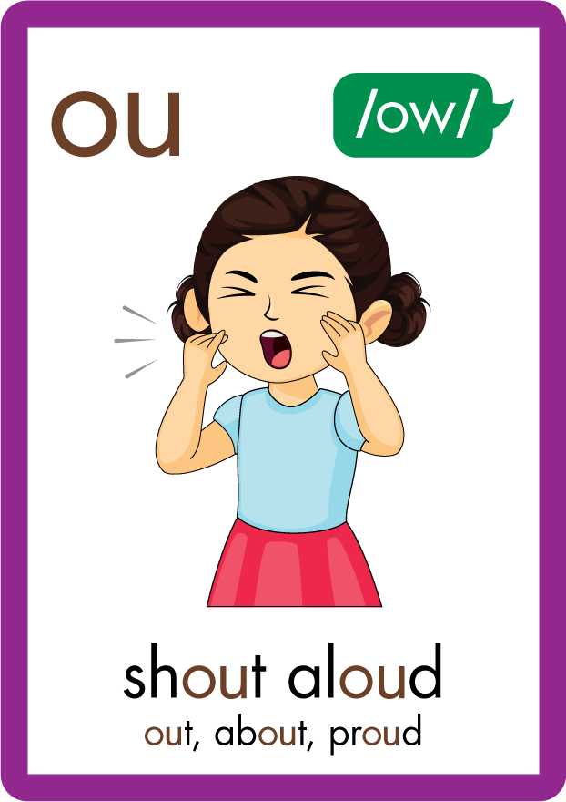
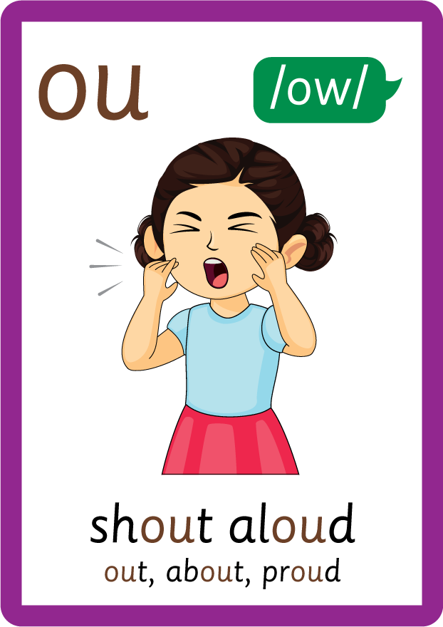






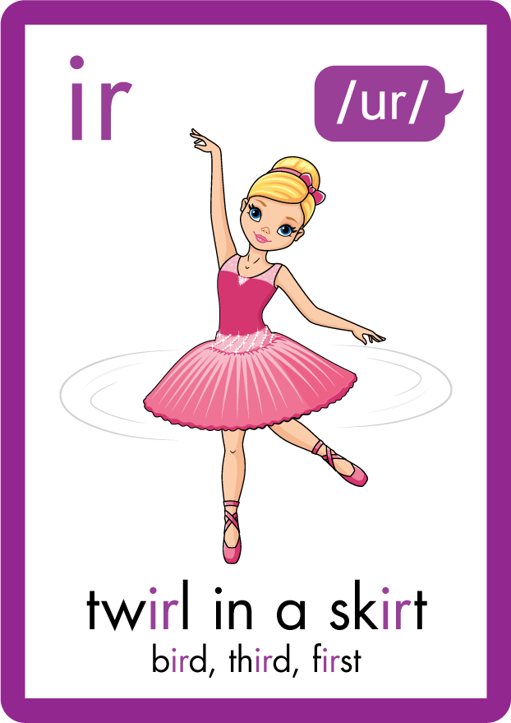
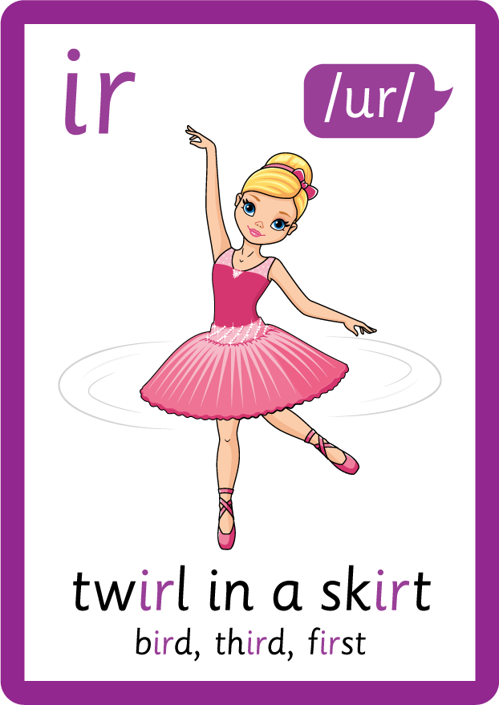






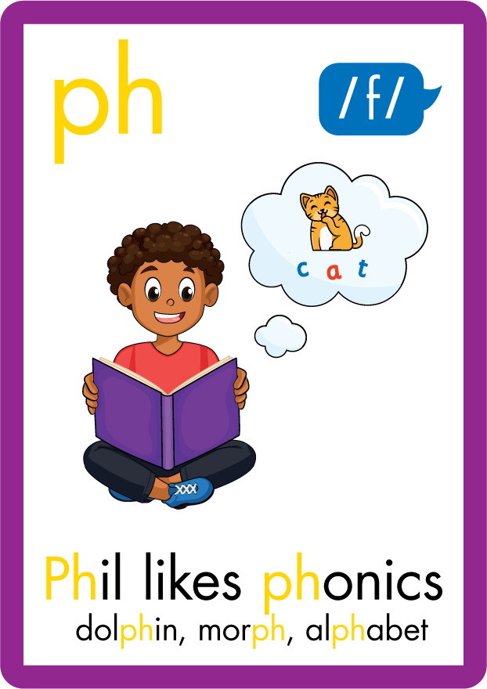



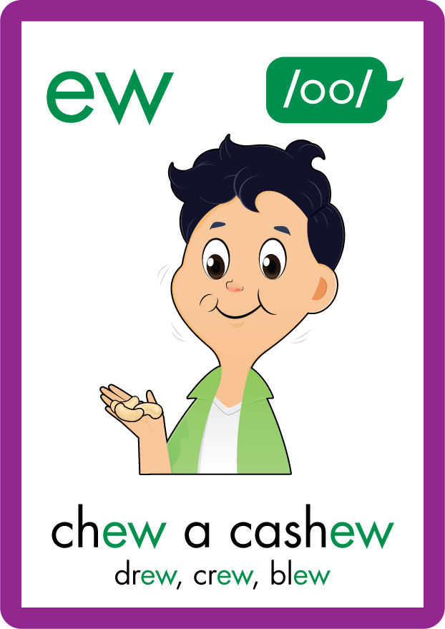









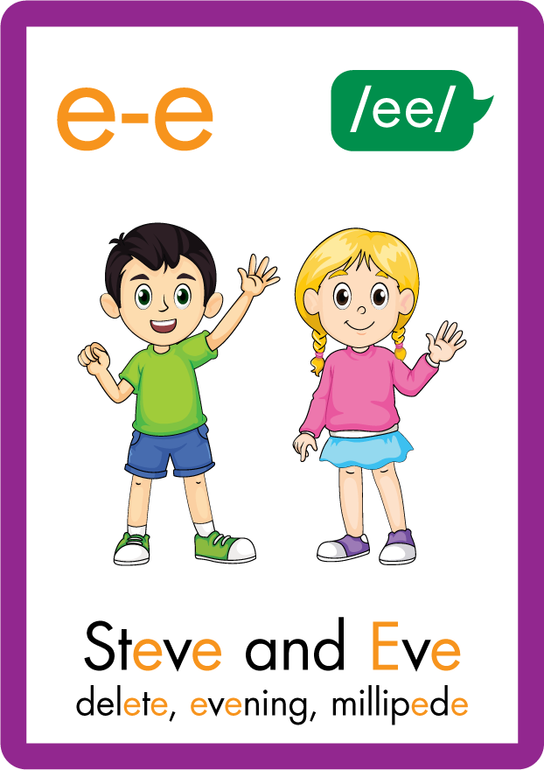





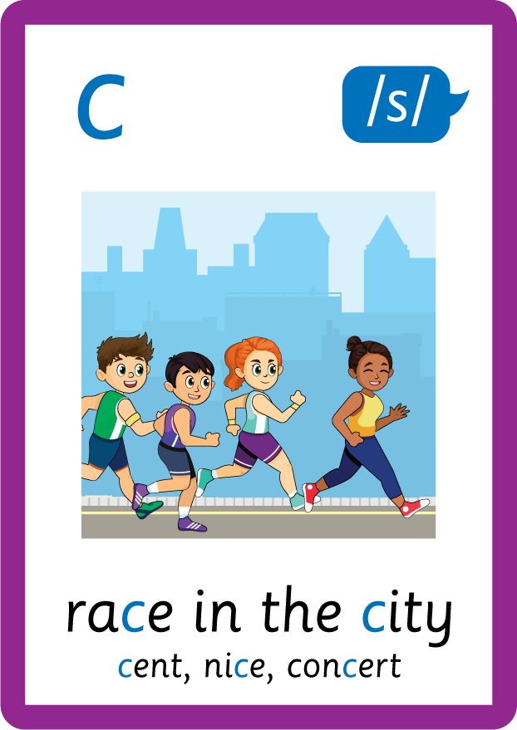
Recall all GPCs learned so far using flashcards.

Slide 6
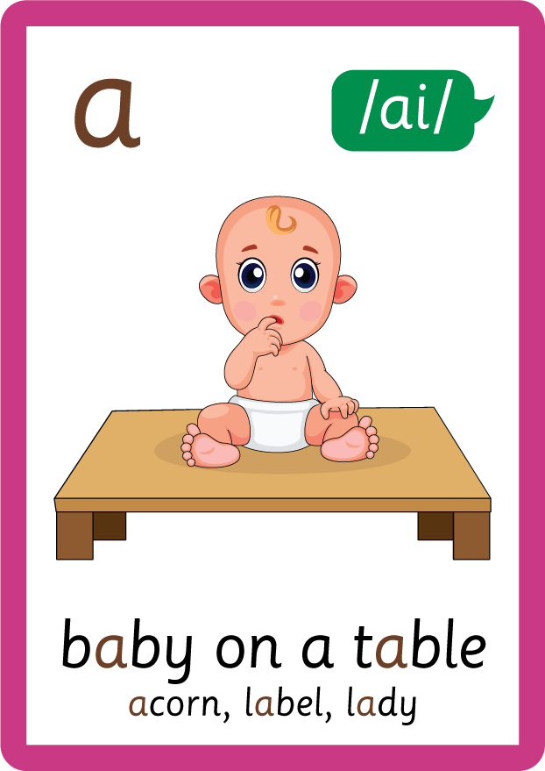



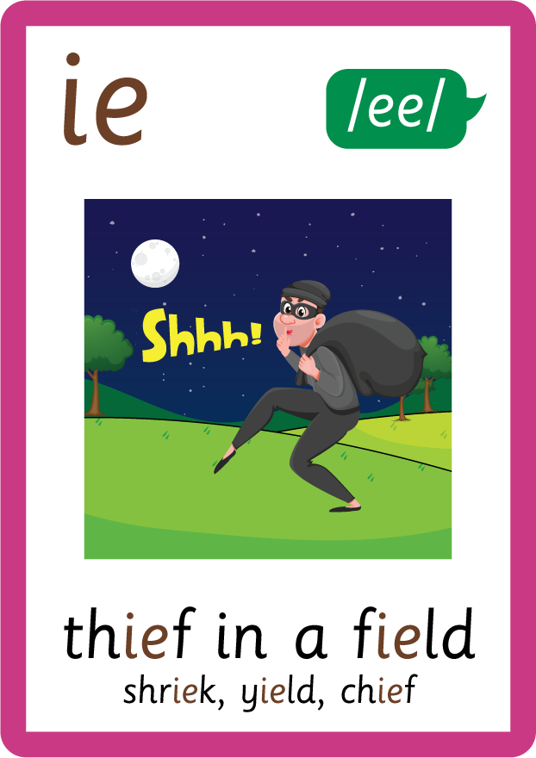
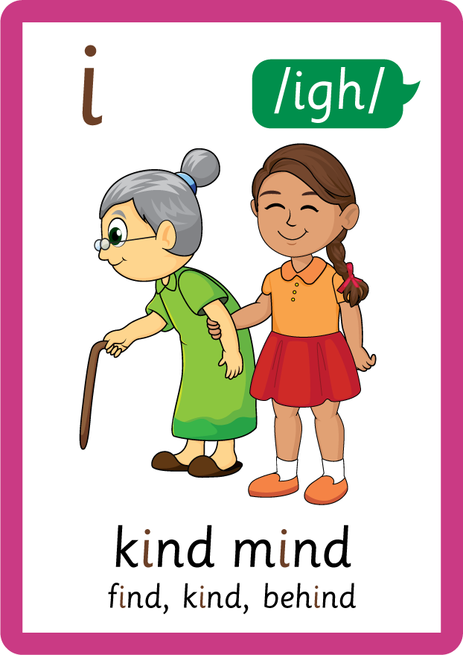




Recall all GPCs learned so far using flashcards.

Slide 7






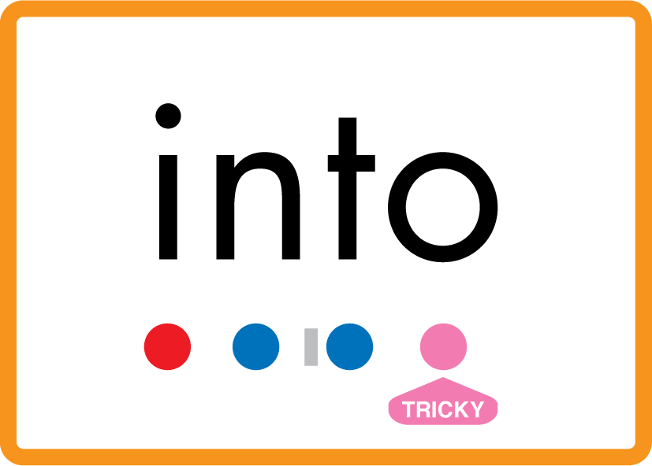
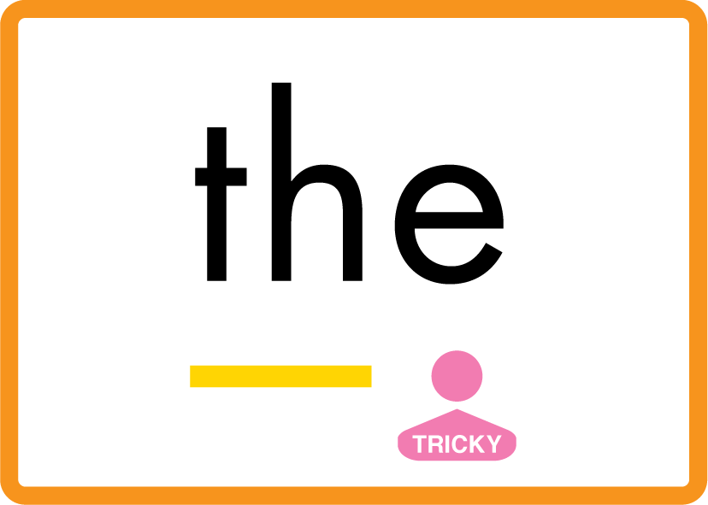

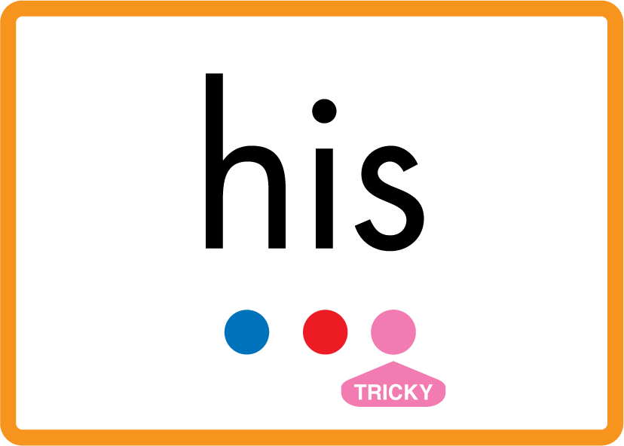


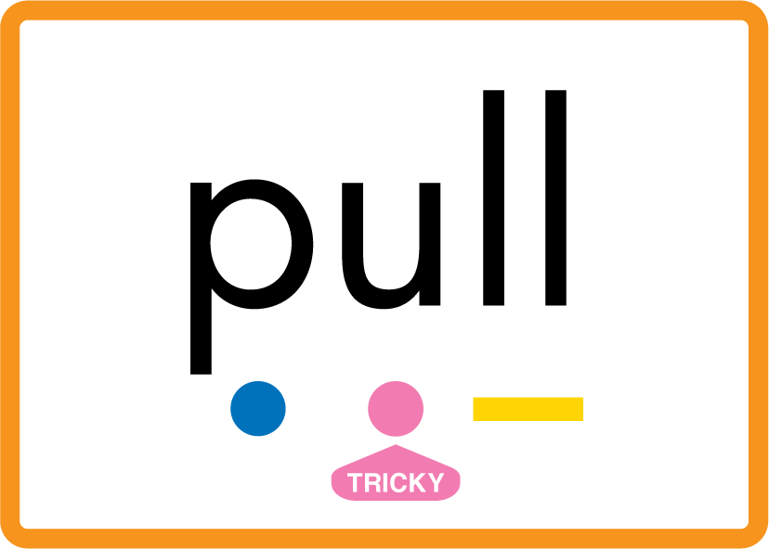
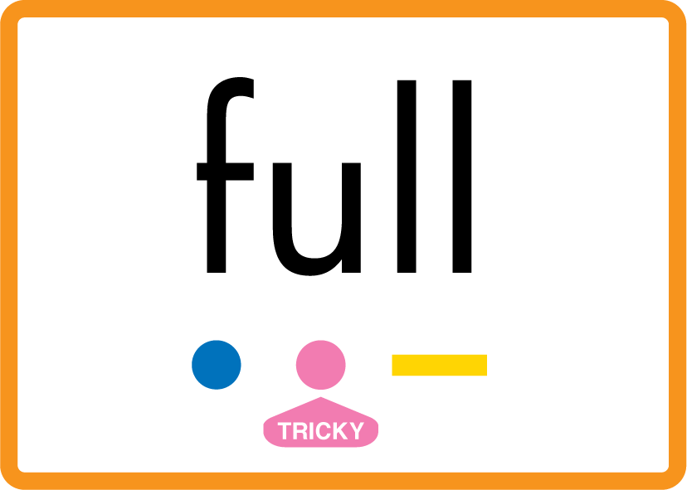
Review Phase 2 Common Exception Words as I is no go to into the put his has of pull full.

Slide 8


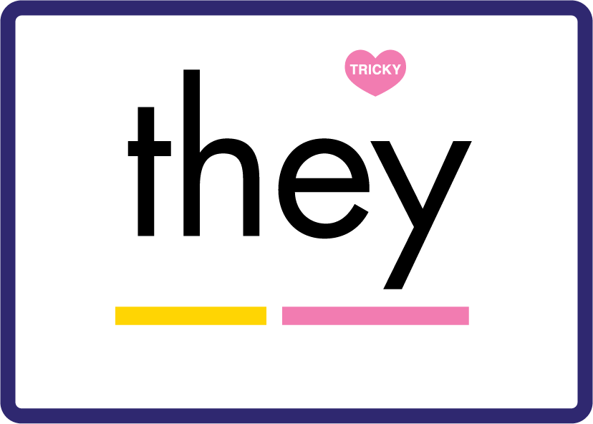
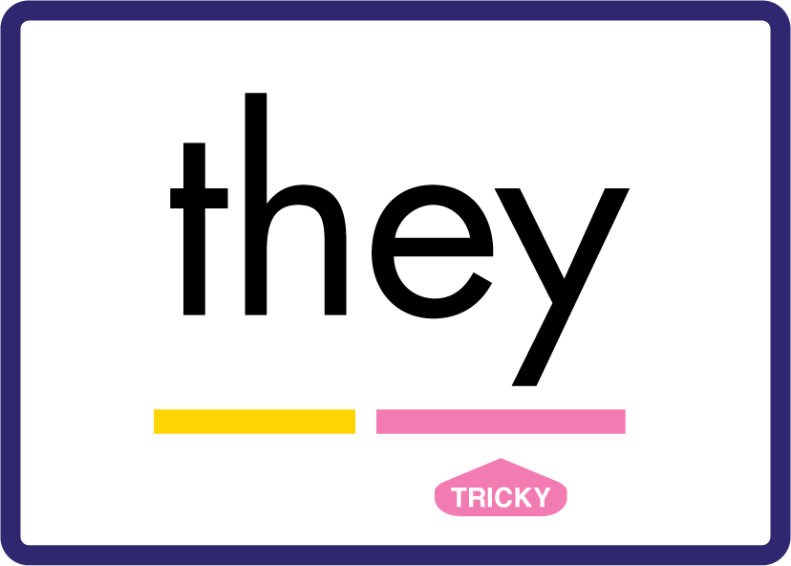


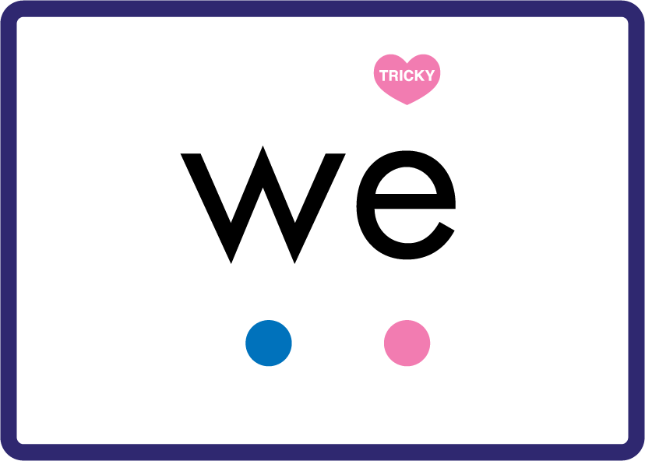
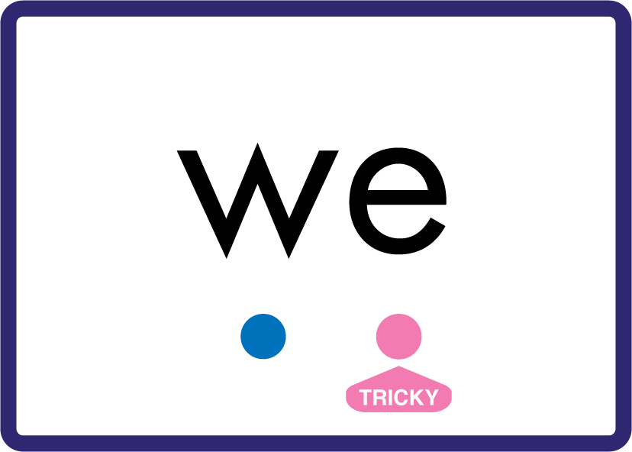
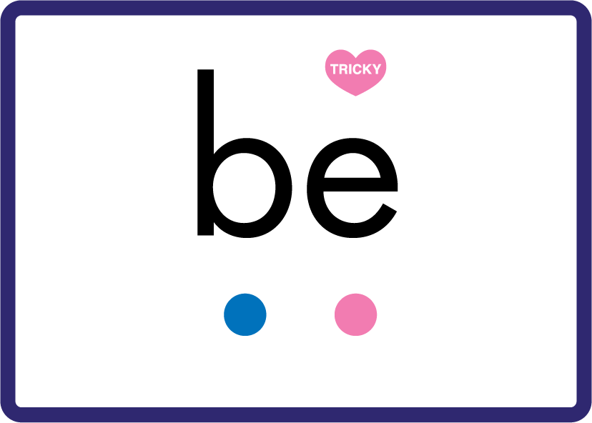

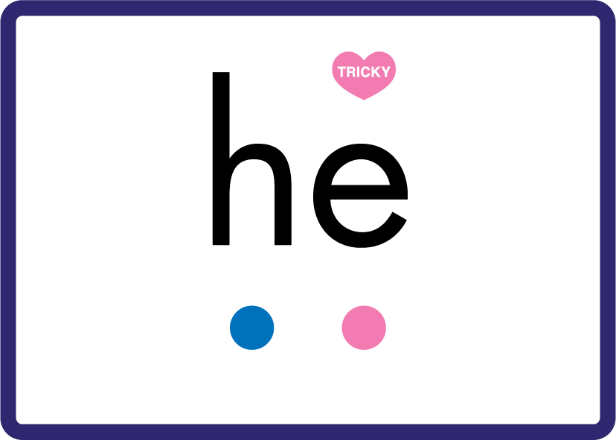

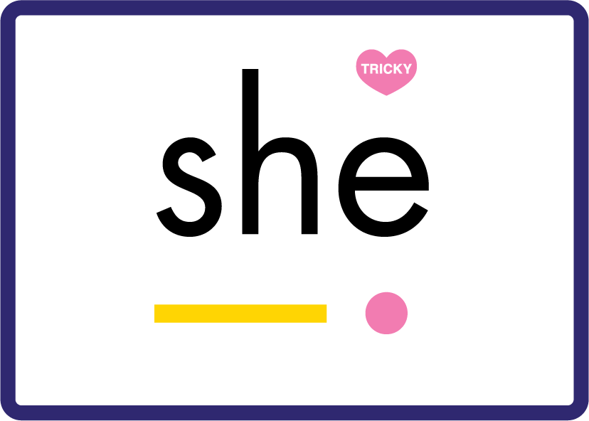
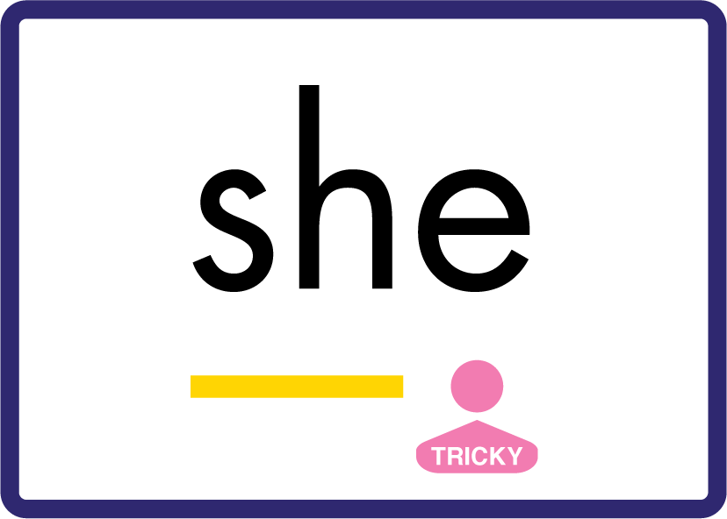
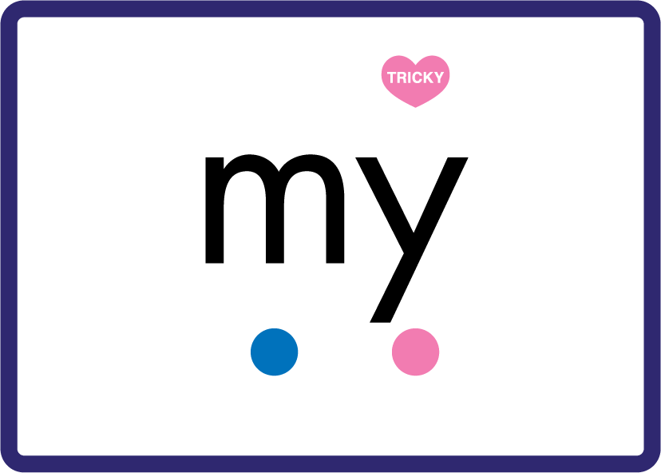

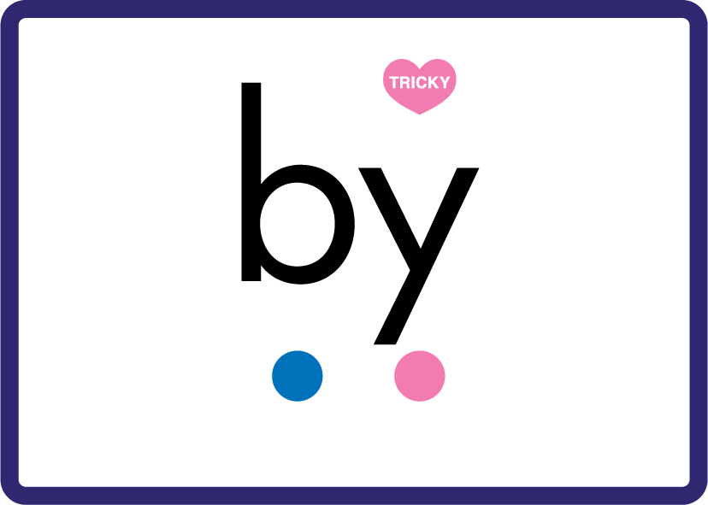



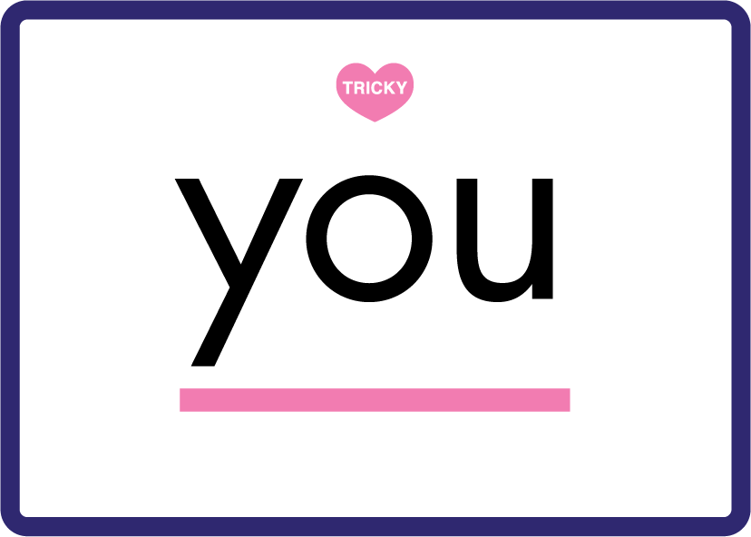
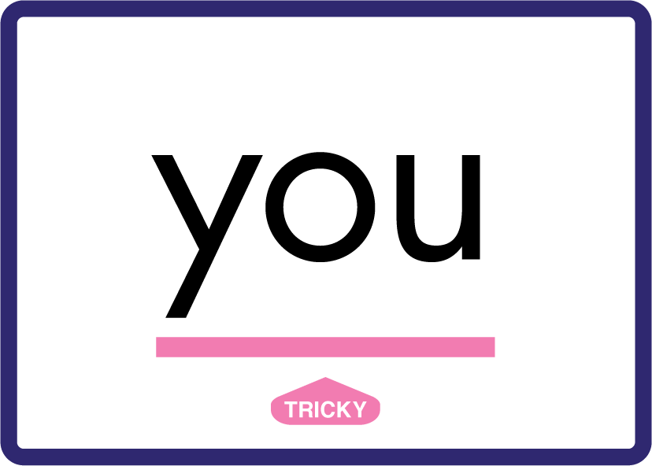






Review Phase 3 Common Exception Words push they me we be he she my by looked you are there here were all sure.

Slide 9







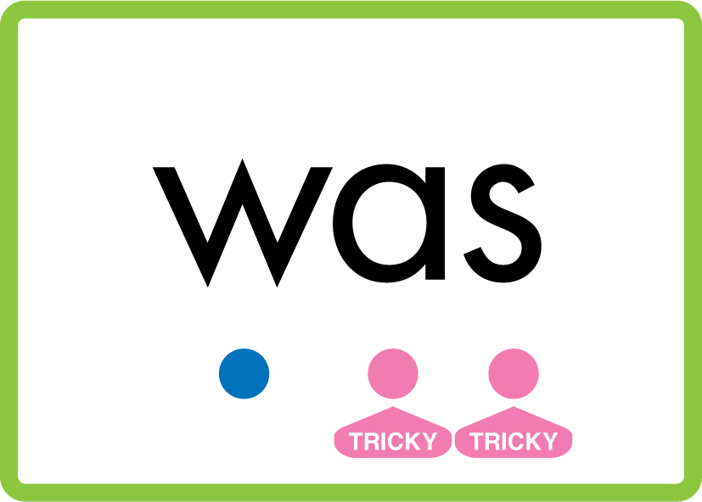

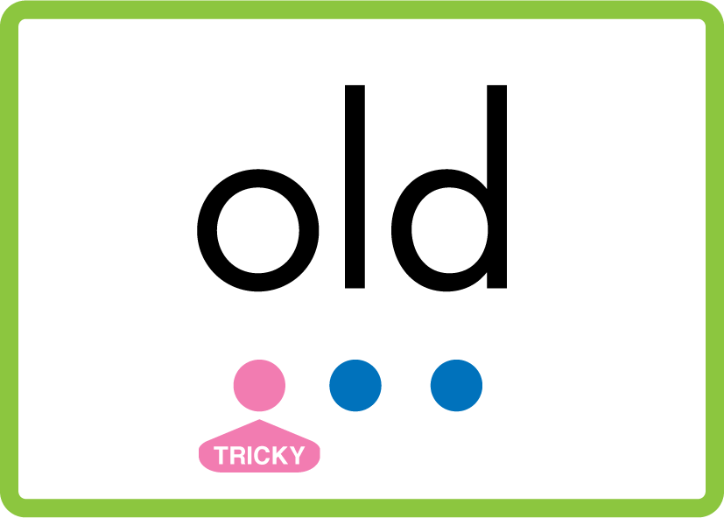
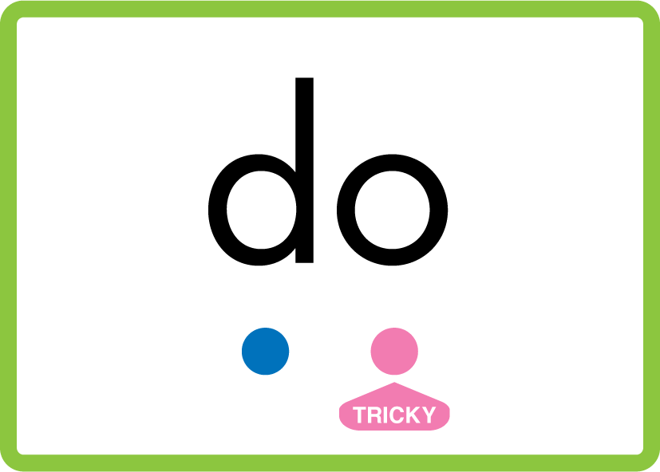


Review Phase 4 Common Exception Words said like out have some come what was so old do little one.

Slide 10

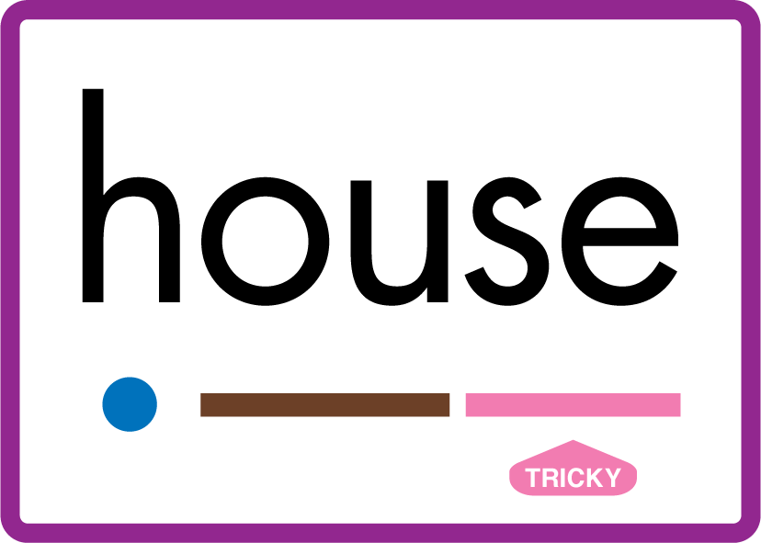
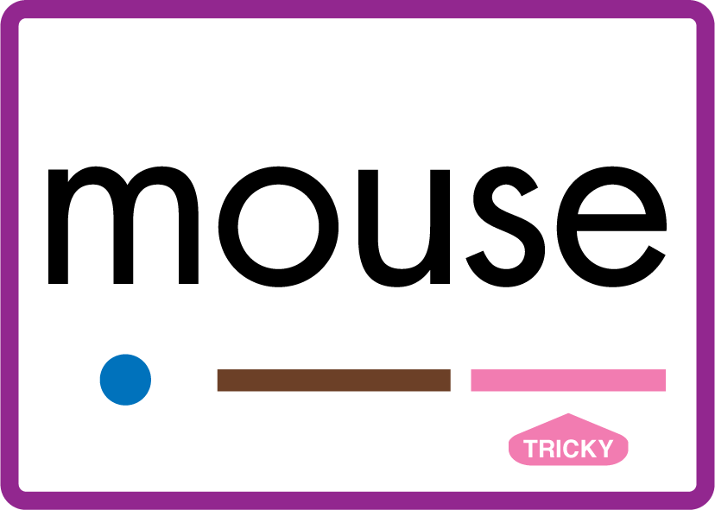
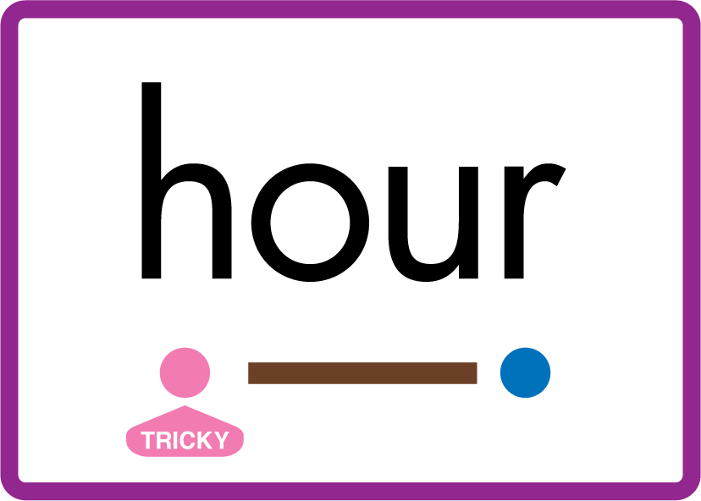










Review Phase 5 Common Exception Words today house mouse hour because Mr Mrs Ms where should could would move use.

Slide 11
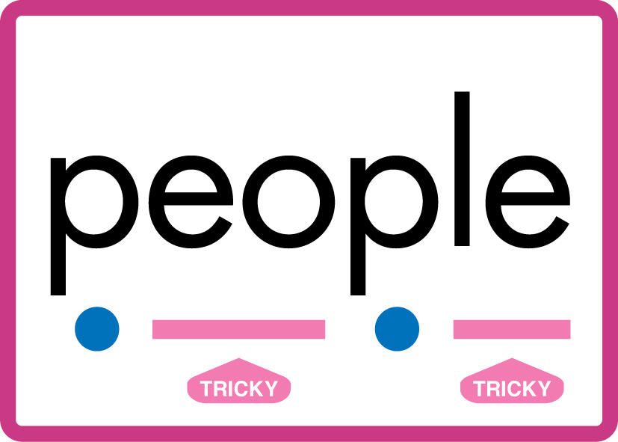


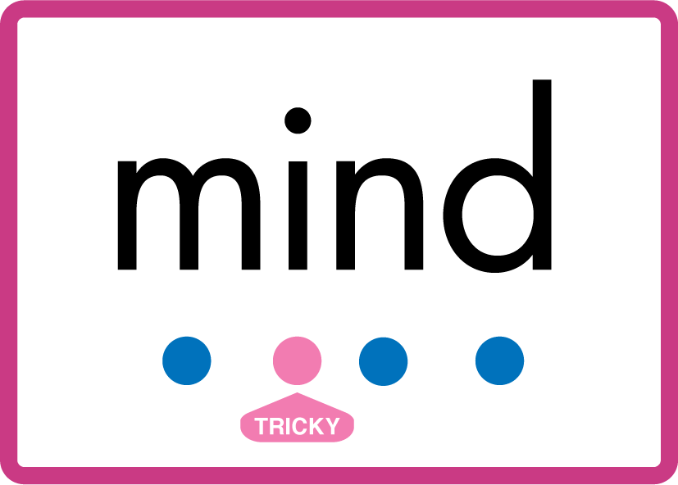


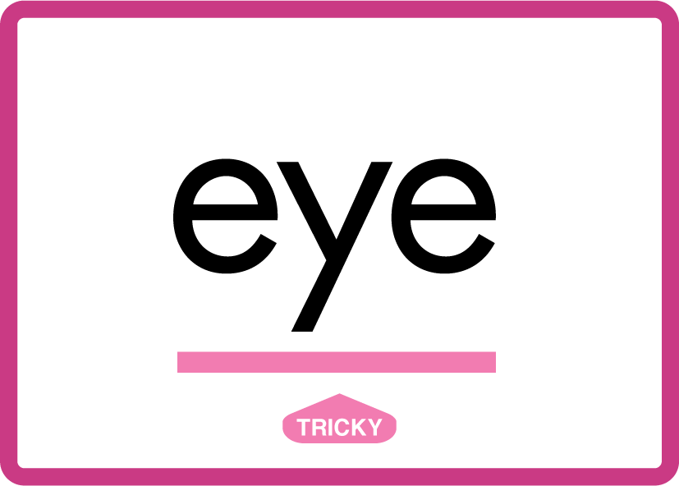




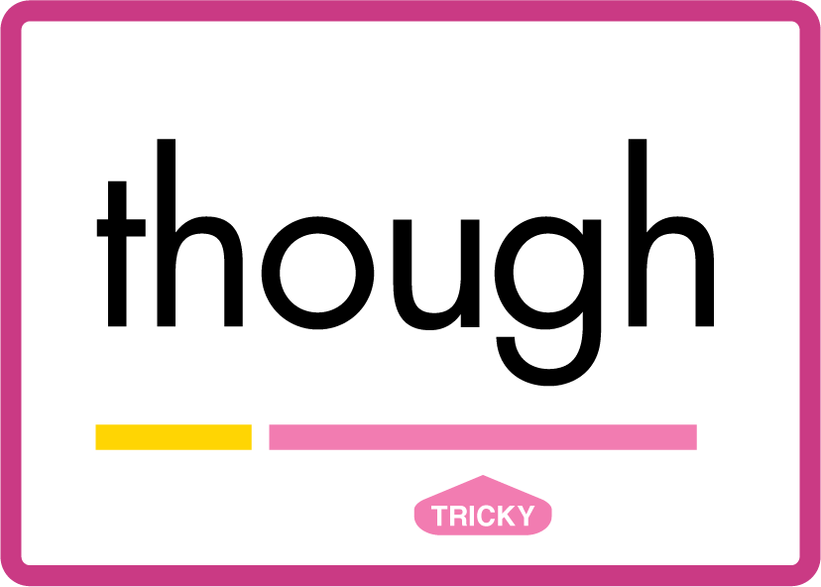
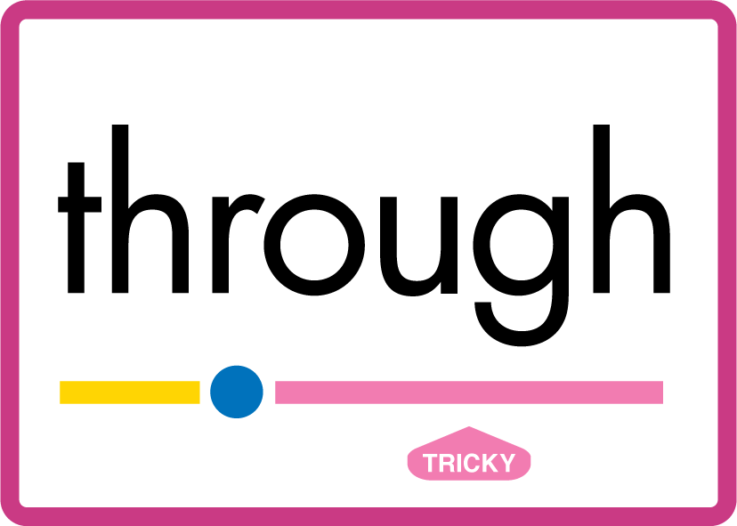
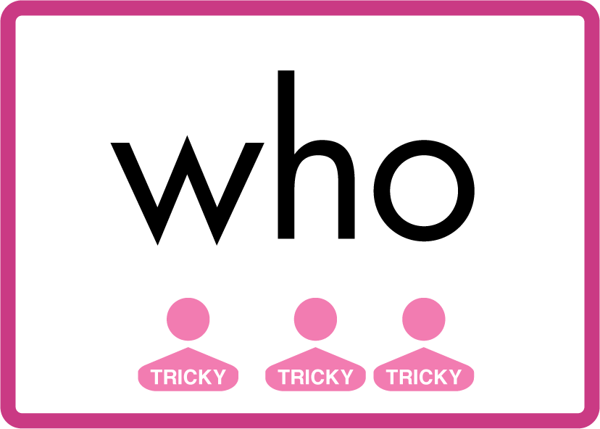
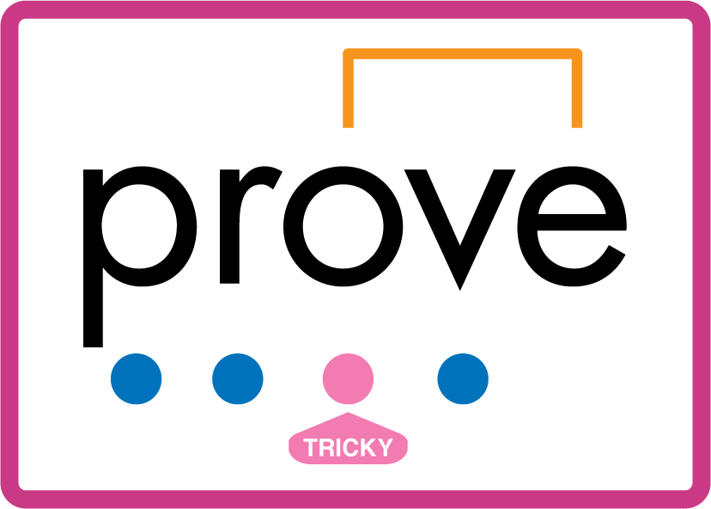
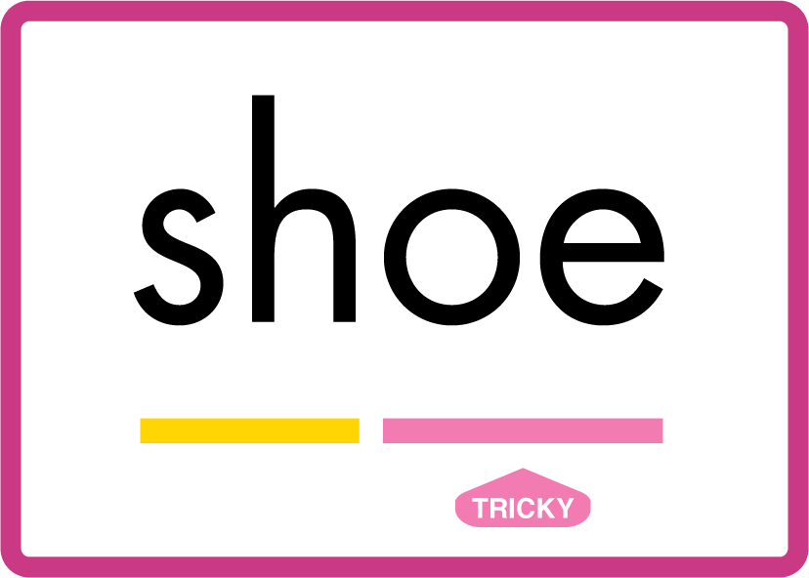
Review Phase 5.5 Common Exception Words people wild child mind kind behind eye oh most only both though through who prove shoe.

Slide 12
Review Grapheme Caption
glue
true
blue
Phase 5, Lesson 8
USING JN686
FRONT

Slide 13
Review Grapheme Caption
venue
fuel
continue
Phase 5, Lesson 9
USING JN686
FRONT

Slide 14
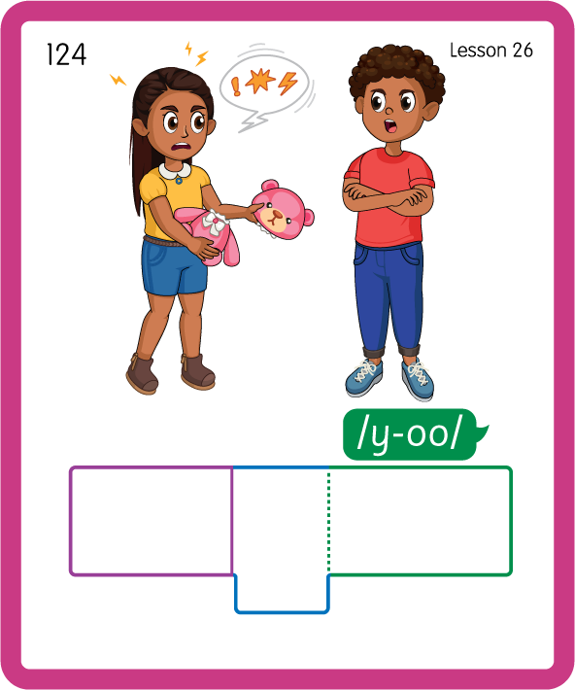
Build a Decodable Word
USING JN689
BACK

Slide 15
Build a Decodable Word
USING JN689
FRONT

Slide 16
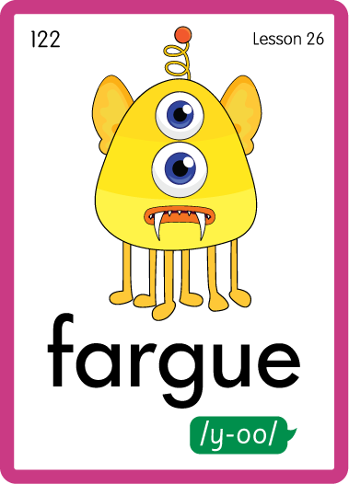
Practise with Alien Words
USING JN692
BACK

Slide 17
Practise with Alien Words
USING JN692
FRONT

Slide 18

Practise Building Words
PRACTISE – 10MINS
b
l
ue
t
r
g
d
r
e
s
c
ar
USING MAGNETIC LETTERS AND A WHITEBOARD
LAYOUT A

Slide 19
Practise Building Words
PRACTISE – 10MINS
b
l
ue
t
r
g
d
r
e
s
c
ar
blue true glue due rescue argue
USING MAGNETIC LETTERS AND A WHITEBOARD
LAYOUT A

