Slide 1

/ai/ | /ee/ | /igh/ | /oa/ | /oo/ | /y-oo/ | /r/
/n/ | /m/ | /ch/ | /k/ | /sh/ | /j/ | /v/
/u/ | /e/ | /i/ | /s/ | /zh/ | /z/ | /ar/
/or/ | /ur/ | /air/ | /ear/
Sound Family /y-oo/; u-e
Lesson 28

Slide 2
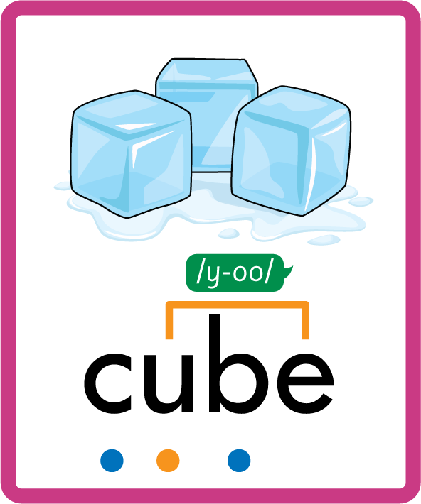


Learn and practise /y-oo/ sound family spelling patterns.
Recall all GPCs learned so far using flashcards.
Grapheme to Phoneme Cards
Phoneme Frame Cards
Alien Word Cards
Common Exception Word Cards
JN686
JN689
JN692
JN687

Slide 3























Recall all GPCs learned so far using flashcards.

Slide 4






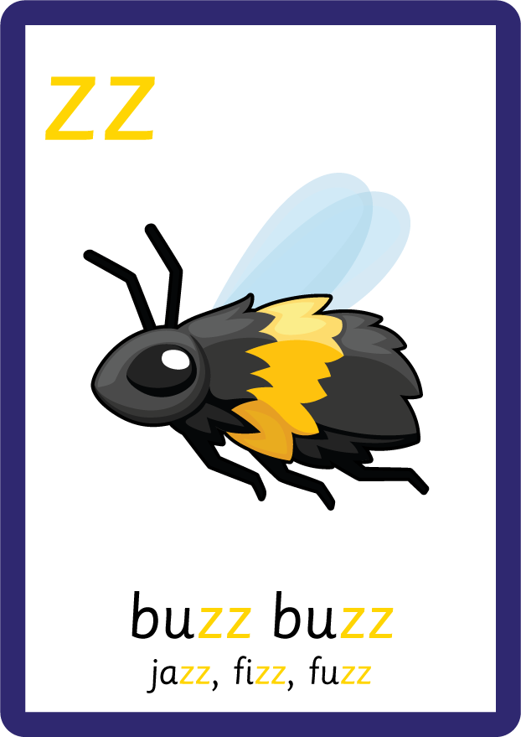






















Recall all GPCs learned so far using flashcards.

Slide 5








































Recall all GPCs learned so far using flashcards.

Slide 6










Recall all GPCs learned so far using flashcards.

Slide 7






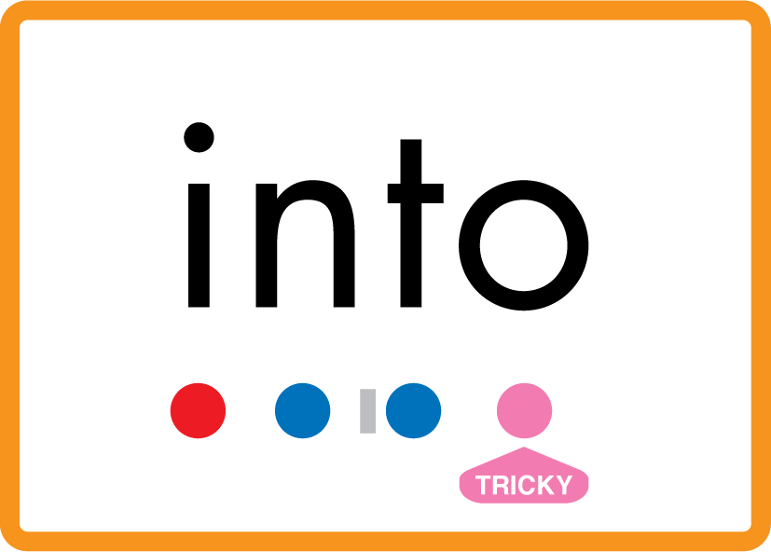







Review Phase 2 Common Exception Words as I is no go to into the put his has of pull full.

Slide 8







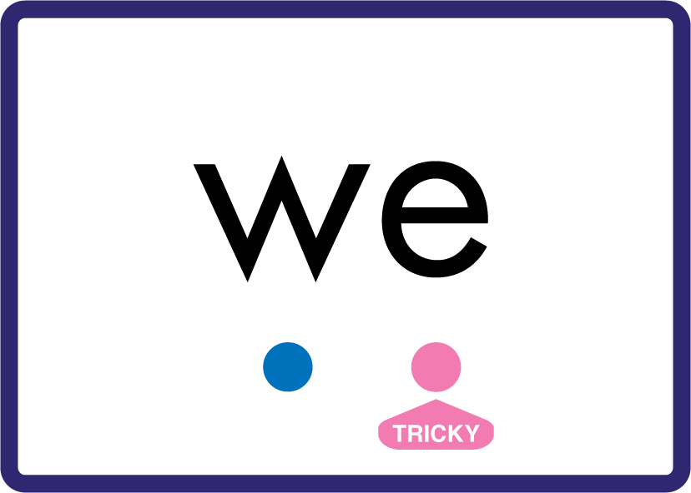
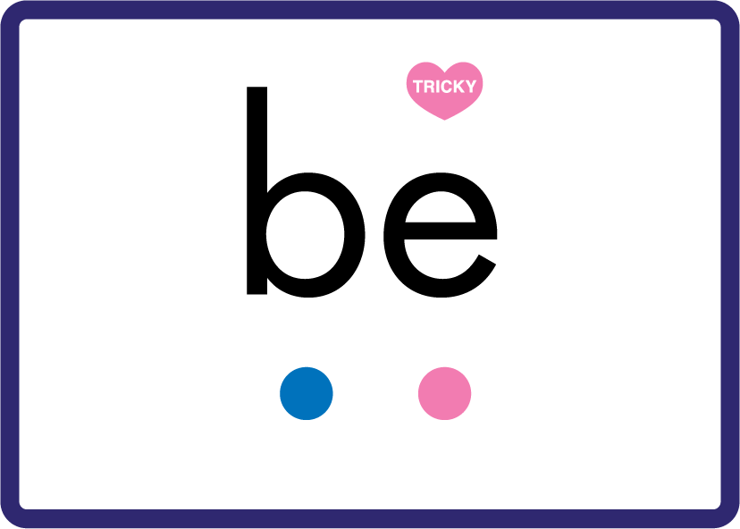





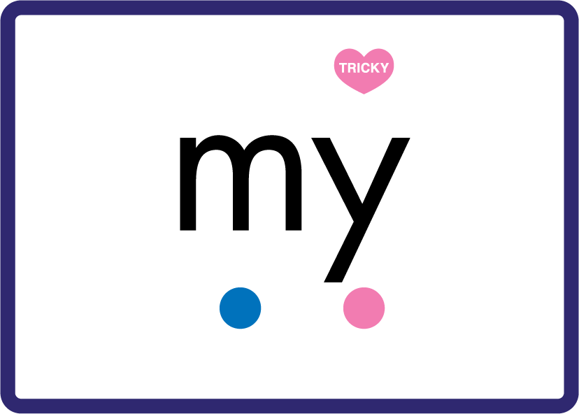

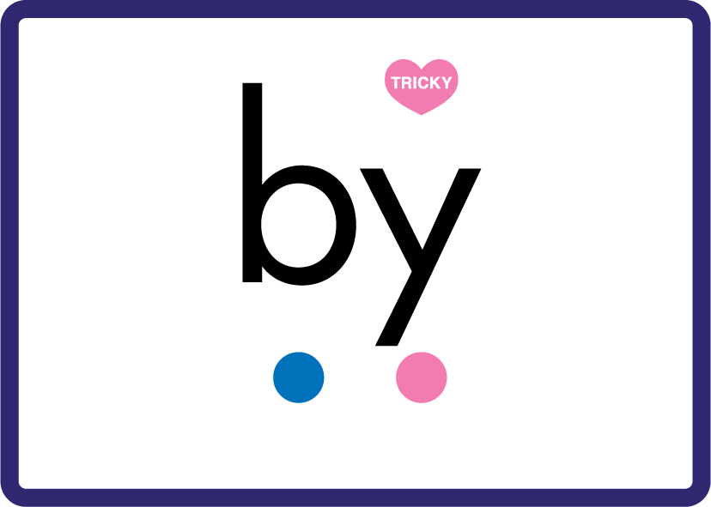




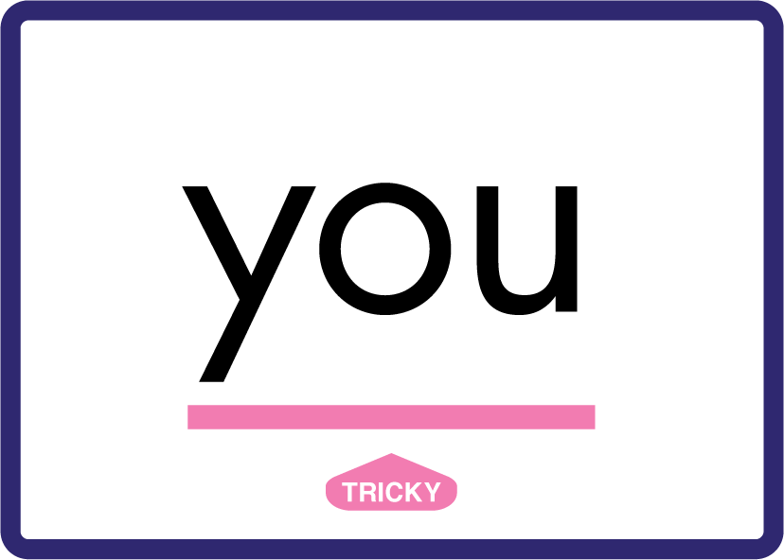






Review Phase 3 Common Exception Words push they me we be he she my by looked you are there here were all sure.

Slide 9













Review Phase 4 Common Exception Words said like out have some come what was so old do little one.

Slide 10













Review Phase 5 Common Exception Words today house mouse hour because Mr Mrs Ms where should could would move use.

Slide 11



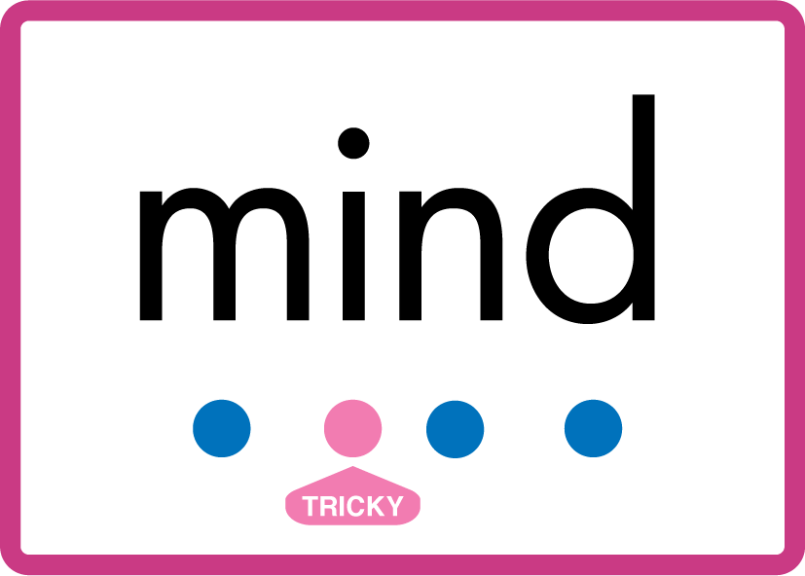


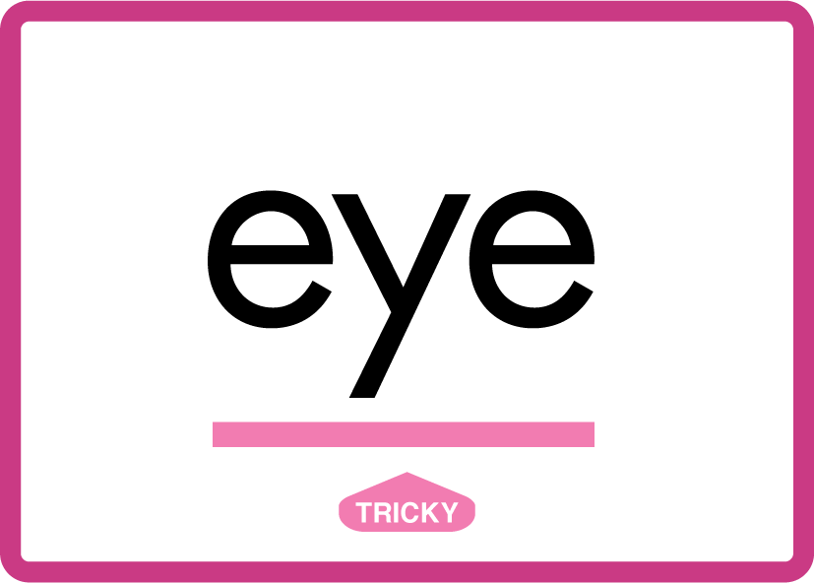








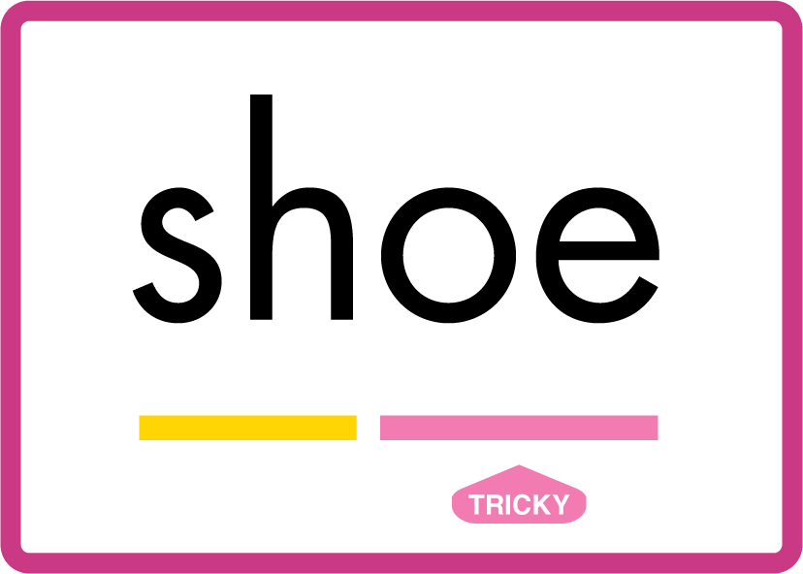
Review Phase 5.5 Common Exception Words people wild child mind kind behind eye oh most only both though through who prove shoe.

Slide 12
Review Grapheme Caption
confuse
huge
mute
Phase 5, Lesson 28
USING JN686
FRONT

Slide 13
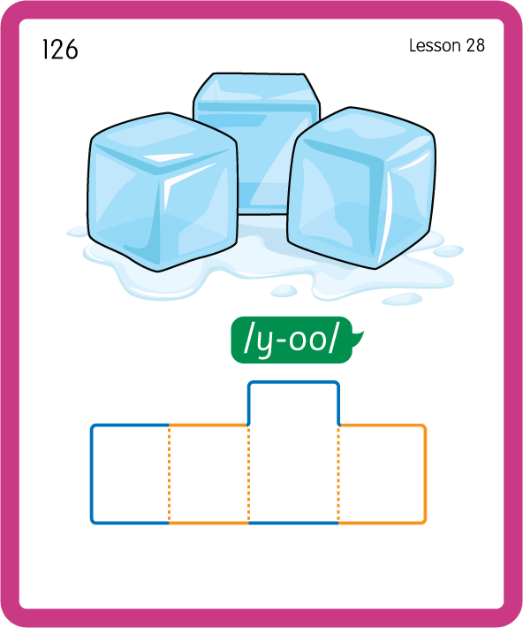
Build a Decodable Word
USING JN689
BACK

Slide 14
Build a Decodable Word
USING JN689
FRONT

Slide 15
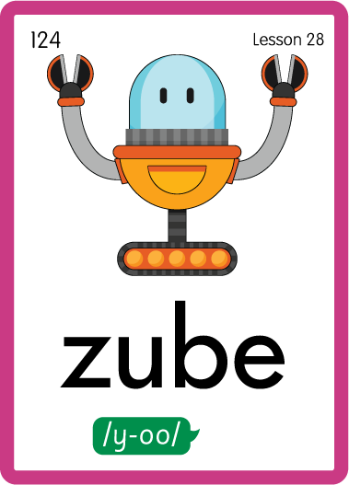
Practise with Alien Words
USING JN692
BACK

Slide 16
Practise with Alien Words
USING JN692
FRONT

Slide 17
Practise Common Exception Words
USING JN687
FRONT

Slide 18
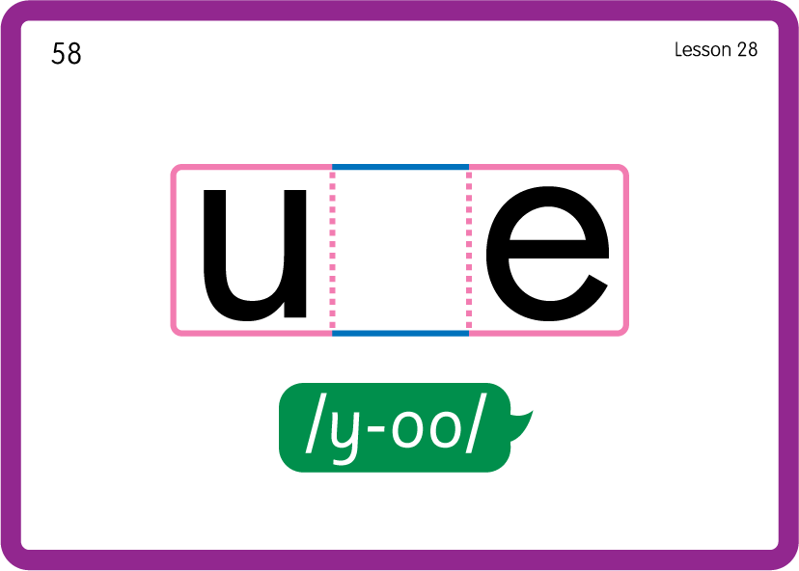
Practise Common Exception Words
USING JN687
BACK

Slide 19

Practise Building Words
PRACTISE – 10MINS
c
u-e
b
s
t
m
l
f
h
g
USING MAGNETIC LETTERS AND A WHITEBOARD
LAYOUT A

Slide 20
Practise Building Words
PRACTISE – 10MINS
c
u-e
b
s
t
m
l
f
h
g
cube use cute mule fume mute huge
USING MAGNETIC LETTERS AND A WHITEBOARD
LAYOUT A

