Slide 1

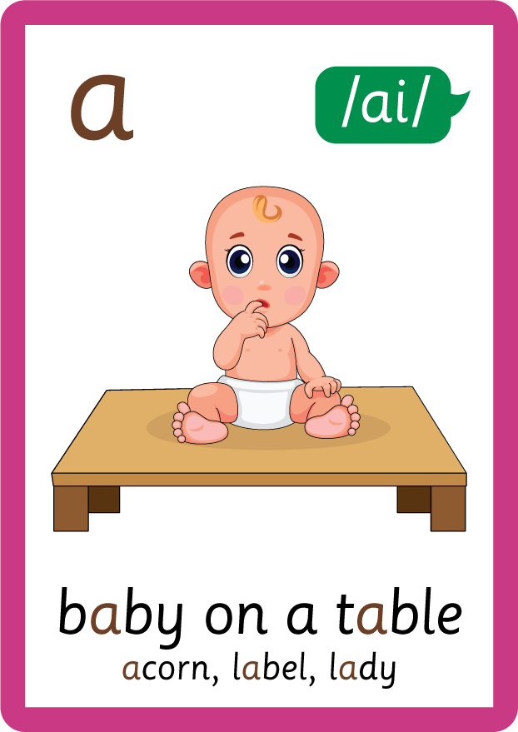
/ai/ | /ee/ | /igh/ | /oa/ | /oo/ | /y-oo/ | /r/
/n/ | /m/ | /ch/ | /k/ | /sh/ | /j/ | /v/
/u/ | /e/ | /i/ | /s/ | /zh/ | /z/ | /ar/
/or/ | /ur/ | /air/ | /ear/
Sound Family /ai/; a
Lesson 3

Slide 2
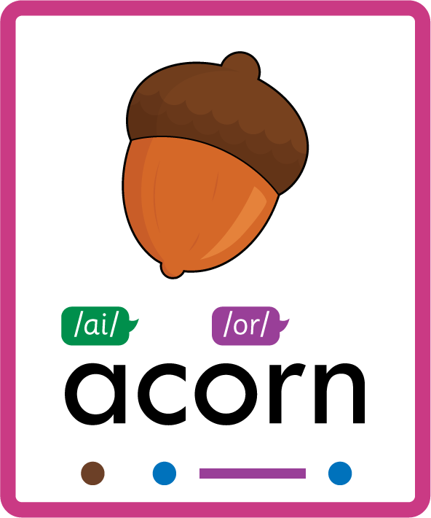

Learn and practise /ai/ sound family spelling patterns.
Recall all GPCs learned so far using flashcards.
Recall Phase 2 Common Exception Words as I is no go to into the put his has of pull full.
Grapheme to Phoneme Cards
Phoneme Frame Cards
Alien Word Cards
JN686
JN689
JN692

Slide 3






















Recall all GPCs learned so far using flashcards.

Slide 4





























Recall all GPCs learned so far using flashcards.

Slide 5


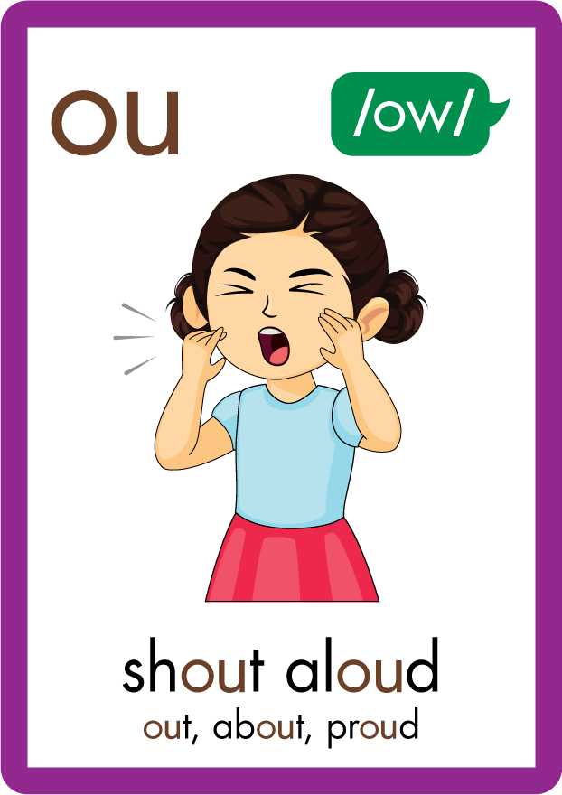
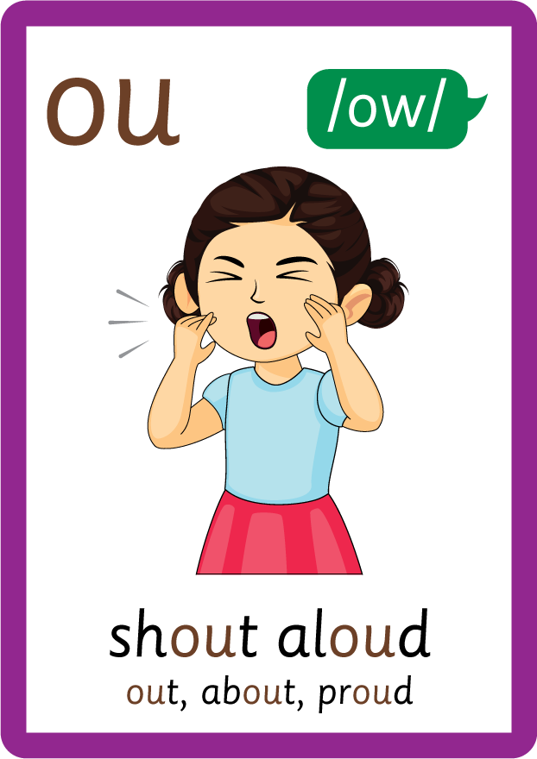




















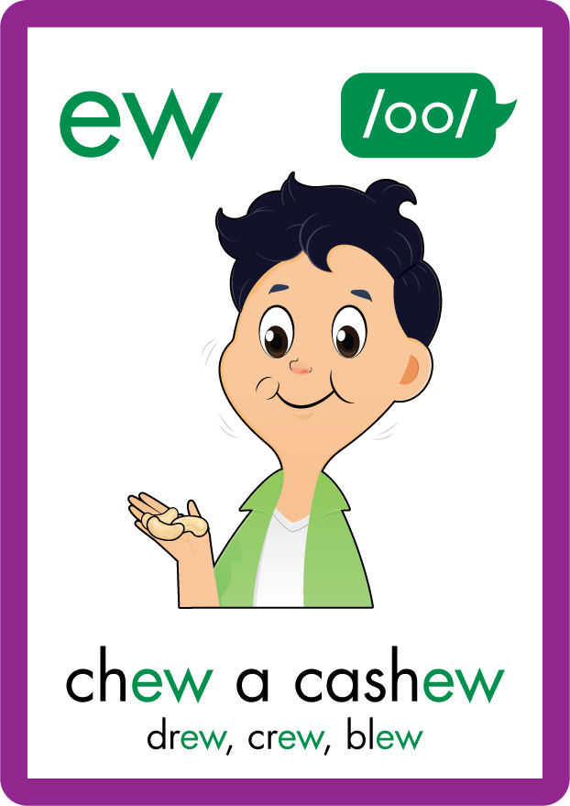
















Recall all GPCs learned so far using flashcards.

Slide 6






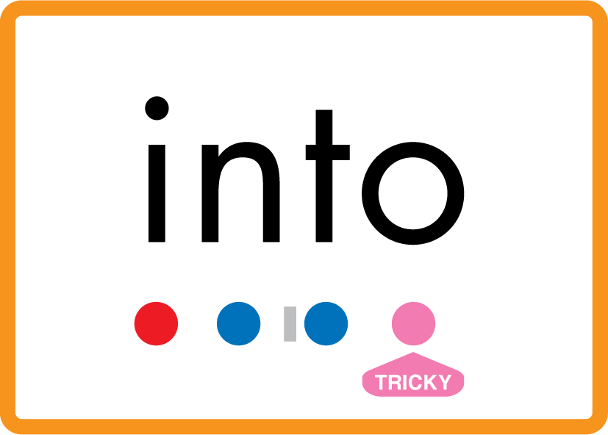







Review Phase 2 Common Exception Words as I is no go to into the put his has of pull full.

Slide 7







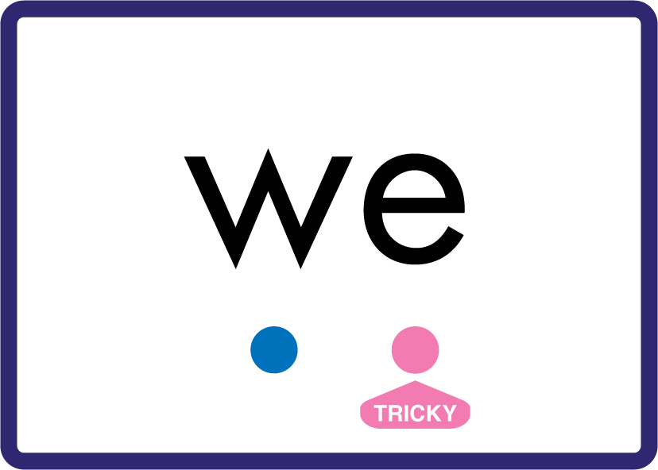
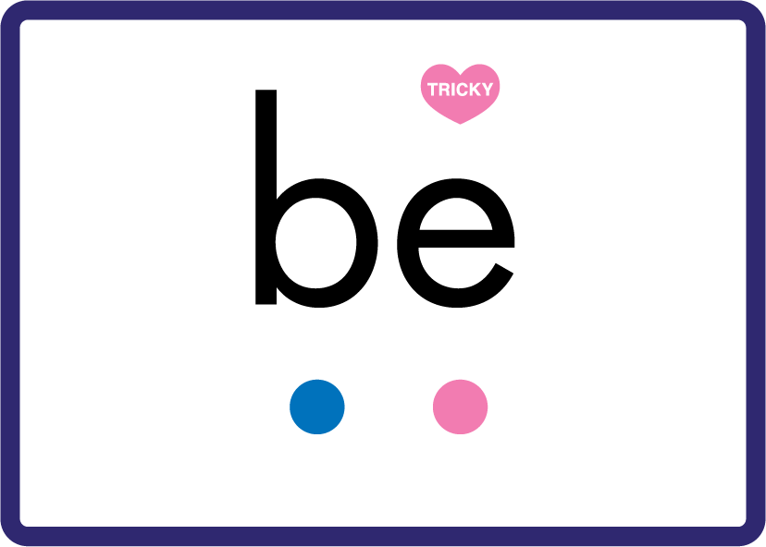





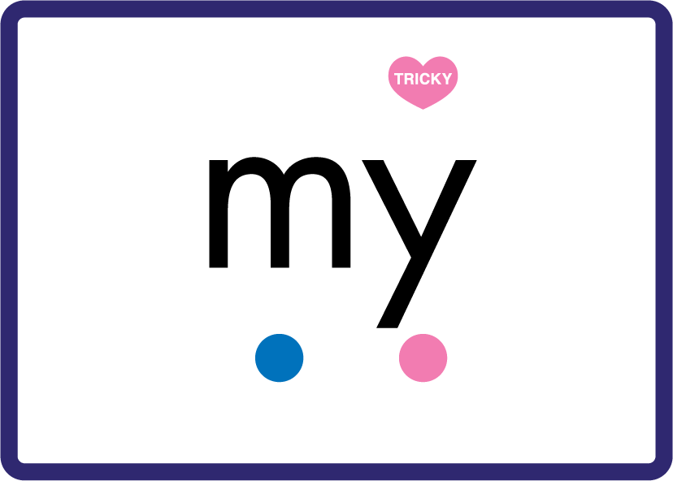













Review Phase 3 Common Exception Words push they me we be he she my by looked you are there here were all sure.

Slide 8













Review Phase 4 Common Exception Words said like out have some come what was so old do little one.

Slide 9














Review Phase 5 Common Exception Words today house mouse hour because Mr Mrs Ms where should could would move use.

Slide 10
Review Grapheme Caption
cat
fat
pat
Phase 2, Lesson 2
USING JN686
FRONT

Slide 11
Teach Grapheme Caption
apron
lady
basin
Phase 5.5, Lesson 3
USING JN686
FRONT

Slide 12

Explain Decoding

Slide 13
Model Blending Phonemes
p
a
p
er
USING SOUND BUTTONS
Sound Buttons
Vowel
Consonant
Consonant Digraph
Multi Sound
Long Vowel Sound
R-controlled Digraph
Split Digraph
Syllable / Silent Letter

Slide 14
Model Blending Phonemes
b
a
c
o
n
USING SOUND BUTTONS
Sound Buttons
Vowel
Consonant
Consonant Digraph
Multi Sound
Long Vowel Sound
R-controlled Digraph
Split Digraph
Syllable / Silent Letter

Slide 15

Explain Encoding

Slide 16
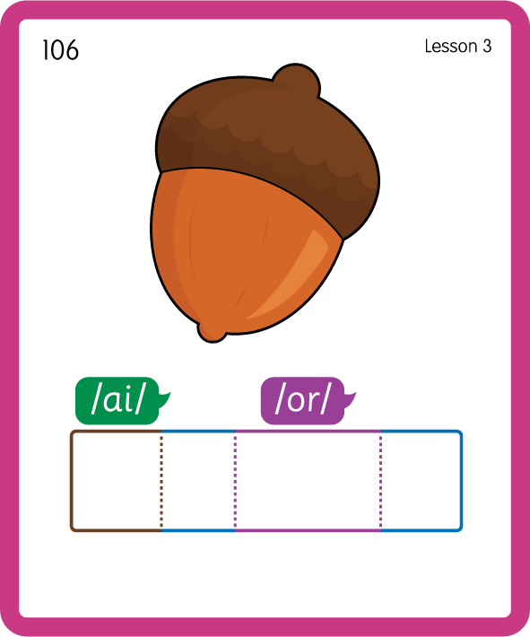
Build a Decodable Word
USING JN689
BACK

Slide 17
Build a Decodable Word
USING JN689
FRONT

Slide 18

Practise with Alien Words
USING JN692
BACK

Slide 19
Practise with Alien Words
USING JN692
FRONT

Slide 20

Practise Building Words
PRACTISE – 10MINS
b
a
b
s
i
n
p
p
er
c
o
r
z
y
l
d
USING MAGNETIC LETTERS AND A WHITEBOARD
LAYOUT B

Slide 21
Practise Building Words
PRACTISE – 10MINS
b
a
b
s
i
n
p
p
er
c
o
r
z
y
l
d
baby basin paper bacon basic crazy lady
USING MAGNETIC LETTERS AND A WHITEBOARD
LAYOUT B

