Slide 1


/ai/ | /ee/ | /igh/ | /oa/ | /oo/ | /y-oo/ | /r/
/n/ | /m/ | /ch/ | /k/ | /sh/ | /j/ | /v/
/u/ | /e/ | /i/ | /s/ | /zh/ | /z/ | /ar/
/or/ | /ur/ | /air/ | /ear/
Sound Family /n/; kn
Lesson 33

Slide 2


Learn and practise /n/ sound family spelling patterns.
Recall all GPCs learned so far using flashcards.
Grapheme to Phoneme Cards
Phoneme Frame Cards
Alien Word Cards
JN686
JL689
JN692

Slide 3






















Recall all GPCs learned so far using flashcards.

Slide 4





























Recall all GPCs learned so far using flashcards.

Slide 5









































Recall all GPCs learned so far using flashcards.

Slide 6
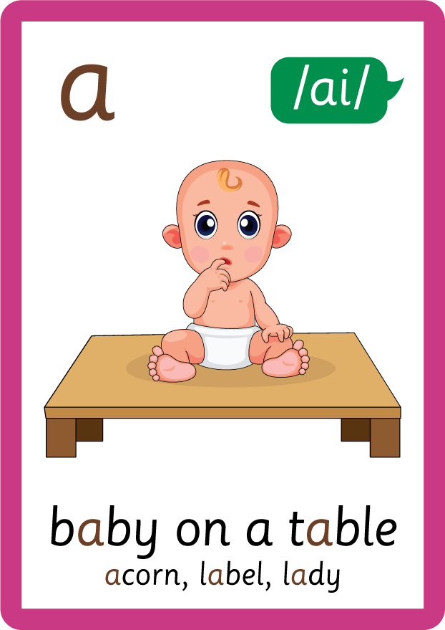












Recall all GPCs learned so far using flashcards.

Slide 7






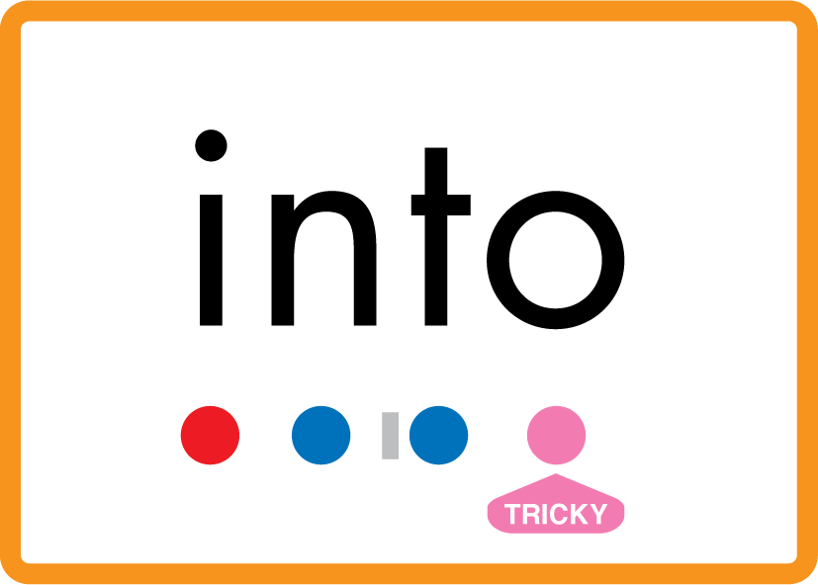







Review Phase 2 Common Exception Words as I is no go to into the put his has of pull full.

Slide 8



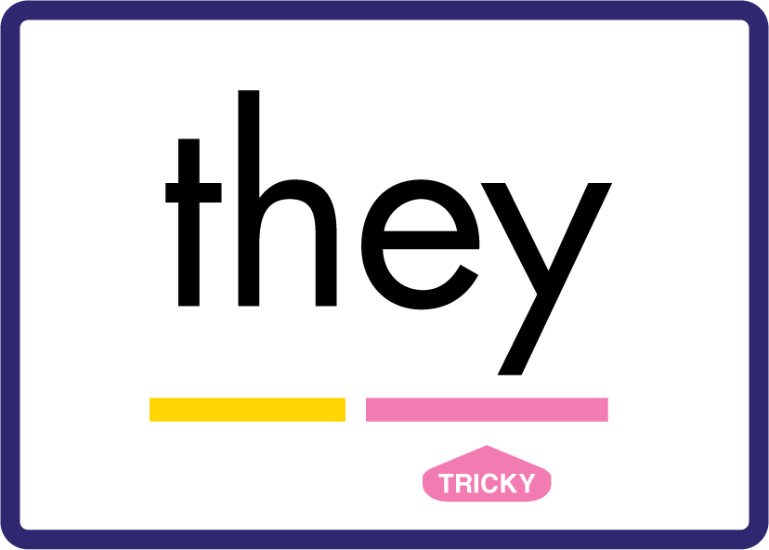




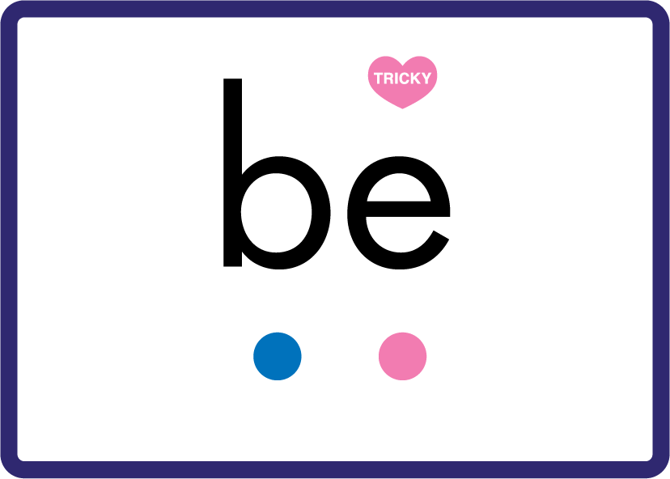





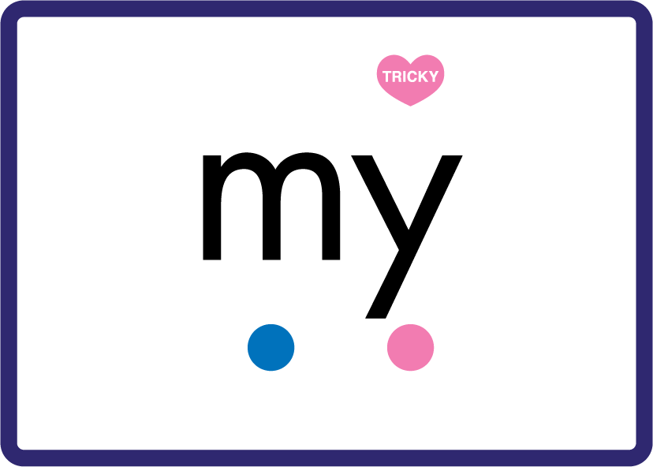

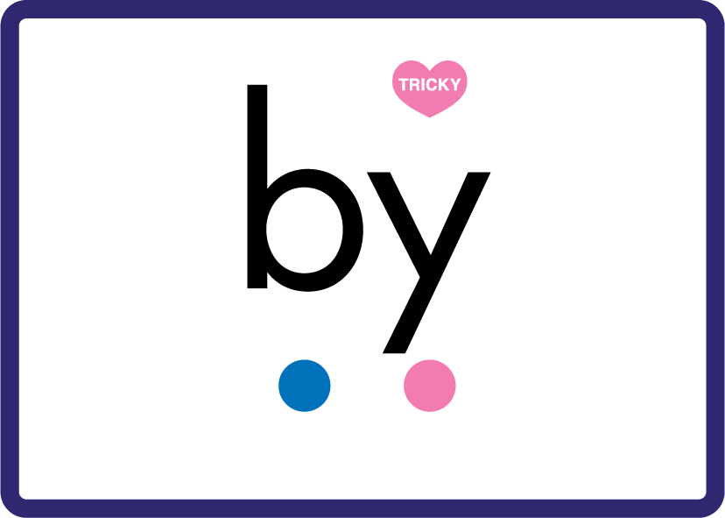




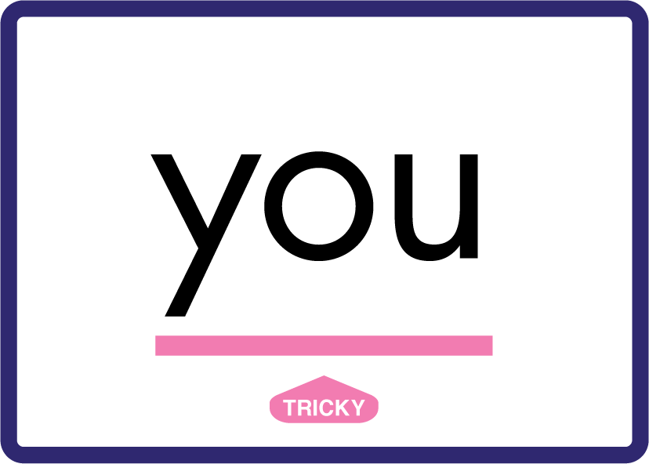






Review Phase 3 Common Exception Words push they me we be he she my by looked you are there here were all sure

Slide 9













Review Phase 4 Common Exception Words said like out have some come what was so old do little one.

Slide 10














Review Phase 5 Common Exception Words today house mouse hour because Mr Mrs Ms where should could would move use.

Slide 11



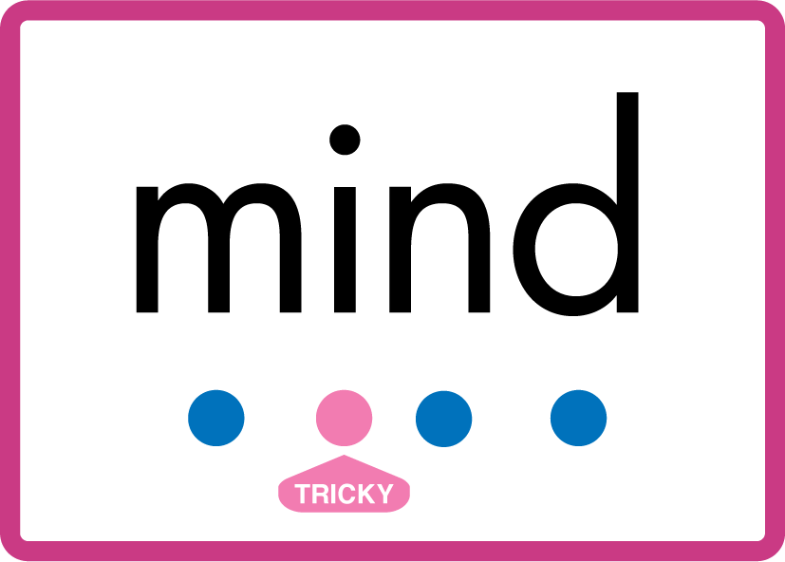


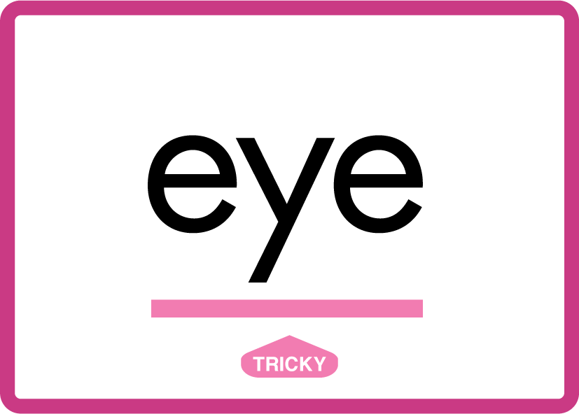








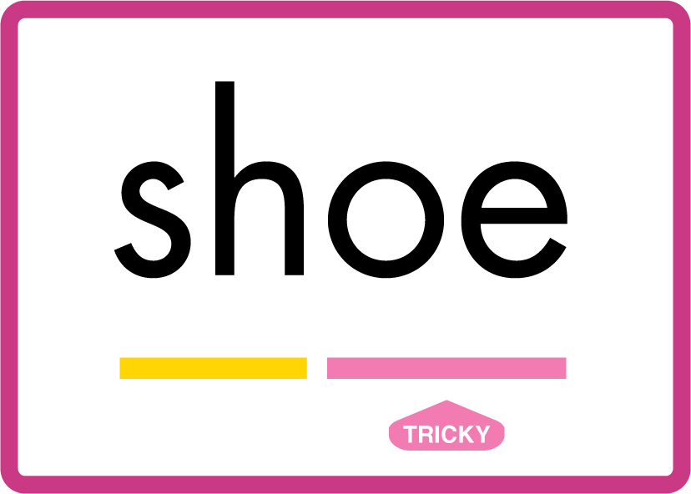

Review Phase 5.5 Common Exception Words people wild child mind kind behind eye oh most only both though through who prove shoe beautiful.

Slide 12
Review Grapheme Caption
net
span
need
Phase 2, Lesson 7
USING JN686
FRONT

Slide 13
Review Grapheme Caption
knight
knot
know
Phase 5.5, Lesson 33
USING JN686
FRONT

Slide 14

Explain Decoding

Slide 15
Model Blending Phonemes
kn
ee
USING SOUND BUTTONS
Sound Buttons
Vowel
Consonant
Consonant Digraph
Multi Sound
Long Vowel Sound
R-controlled Digraph
Split Digraph
Syllable / Silent Letter

Slide 16
Model Blending Phonemes
kn
i
f
e
USING SOUND BUTTONS
Sound Buttons
Vowel
Consonant
Consonant Digraph
Multi Sound
Long Vowel Sound
R-controlled Digraph
Split Digraph
Syllable / Silent Letter

Slide 17

Explain Encoding

Slide 18
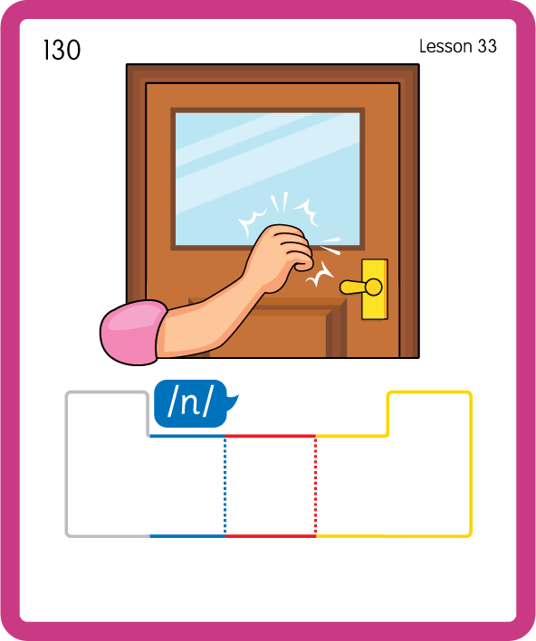
Build a Decodable Word
USING JL689
BACK

Slide 19
Build a Decodable Word
USING JN689
FRONT

Slide 20
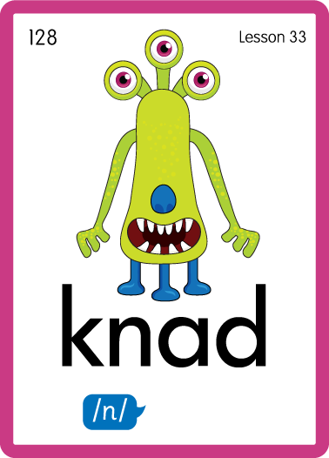
Practise with Alien Words
USING JN692
BACK

Slide 21
Practise with Alien Words
USING JN692
FRONT

Slide 22

Practise Building Words
PRACTISE – 10MINS
k
n
o
ck
ow
i
t
u
e
b
igh
USING MAGNETIC LETTERS AND A WHITEBOARD
LAYOUT A

Slide 23
Practise Building Words
PRACTISE – 10MINS
k
n
o
ck
ow
i
t
u
e
b
igh
knock know knit knuckle knob knight
USING MAGNETIC LETTERS AND A WHITEBOARD
LAYOUT A

