Slide 1


/ai/ | /ee/ | /igh/ | /oa/ | /oo/ | /y-oo/ | /r/
/n/ | /m/ | /ch/ | /k/ | /sh/ | /j/ | /v/
/u/ | /e/ | /i/ | /s/ | /zh/ | /z/ | /ar/
/or/ | /ur/ | /air/ | /ear/
Sound Family /k/; ch
Lesson 37

Slide 2
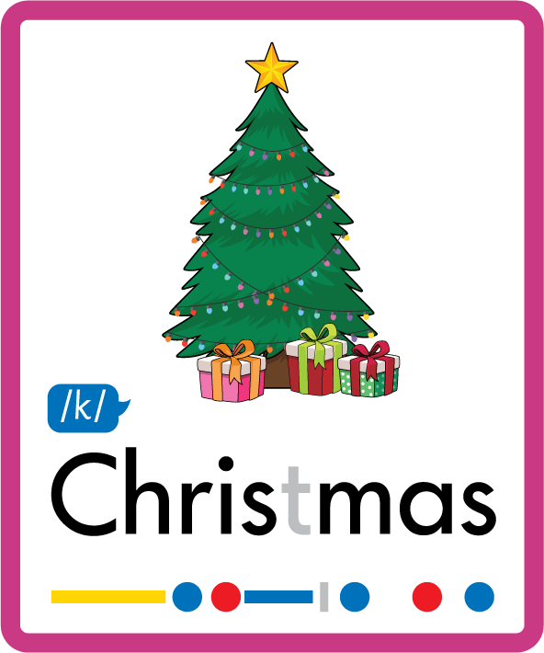

Learn and practise /k/ sound family spelling patterns.
Recall all GPCs learned so far using flashcards.
Grapheme to Phoneme Cards
Phoneme Frame Cards
Common Exception Word Cards
JN686
JN689
JN687

Slide 3






















Recall all GPCs learned so far using flashcards.

Slide 4





























Recall all GPCs learned so far using flashcards.

Slide 5









































Recall all GPCs learned so far using flashcards.

Slide 6
















Recall all GPCs learned so far using flashcards.

Slide 7














Review Phase 2 Common Exception Words as I is no go to into the put his has of pull full.

Slide 8




























Review Phase 3 Common Exception Words push they me we be he she my by looked you are there here were all sure.

Slide 9













Review Phase 4 Common Exception Words said like out have some come what was so old do little one.

Slide 10















Review Phase 5 Common Exception Words today house mouse hour because Mr Mrs Ms where should could would move use want.

Slide 11


















Review Phase 5.5 Common Exception Words people wild child mind kind behind eye oh most only both though through who prove shoe beautiful climb.

Slide 12
Review Grapheme Caption
kite
king
kick
Phase 2, Lesson 14
USING JN686
FRONT

Slide 13
Teach Grapheme Caption
school
anchor
stomach
Phase 5.5, Lesson 37
USING JN686
FRONT

Slide 14

Explain Decoding

Slide 15
Model Blending Phonemes
ch
e
m
i
s
t
USING SOUND BUTTONS
Sound Buttons
Vowel
Consonant
Consonant Digraph
Multi Sound
Long Vowel Sound
R-controlled Digraph
Split Digraph
Syllable / Silent Letter

Slide 16
Model Blending Phonemes
ch
or
u
s
USING SOUND BUTTONS
Sound Buttons
Vowel
Consonant
Consonant Digraph
Multi Sound
Long Vowel Sound
R-controlled Digraph
Split Digraph
Syllable / Silent Letter

Slide 17

Explain Encoding

Slide 18
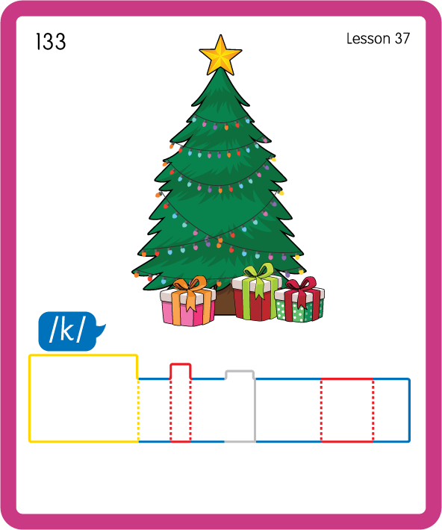
Build a Decodable Word
USING JN689
BACK

Slide 19
Build a Decodable Word
USING JN689
FRONT

Slide 20
Practise Common Exception Words
USING JN687
FRONT

Slide 21
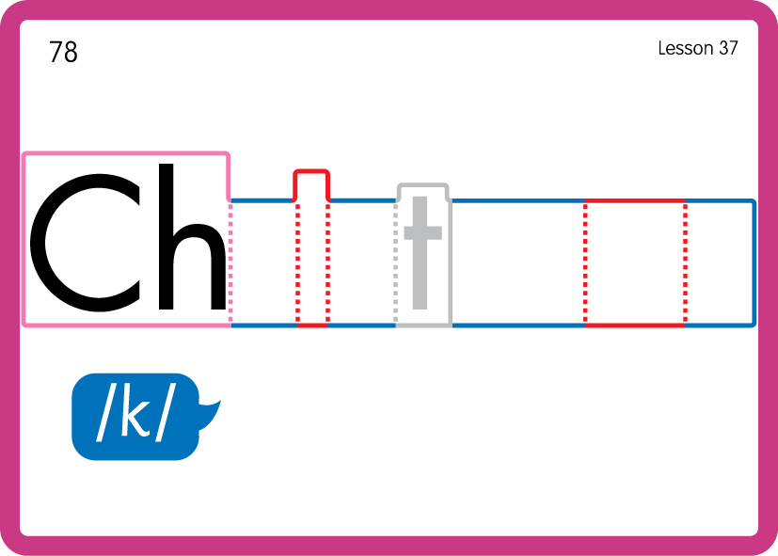
Practise Common Exception Words
USING JN687
BACK

Slide 22

Practise Common Exception Words
USING JN687
FRONT

Slide 23
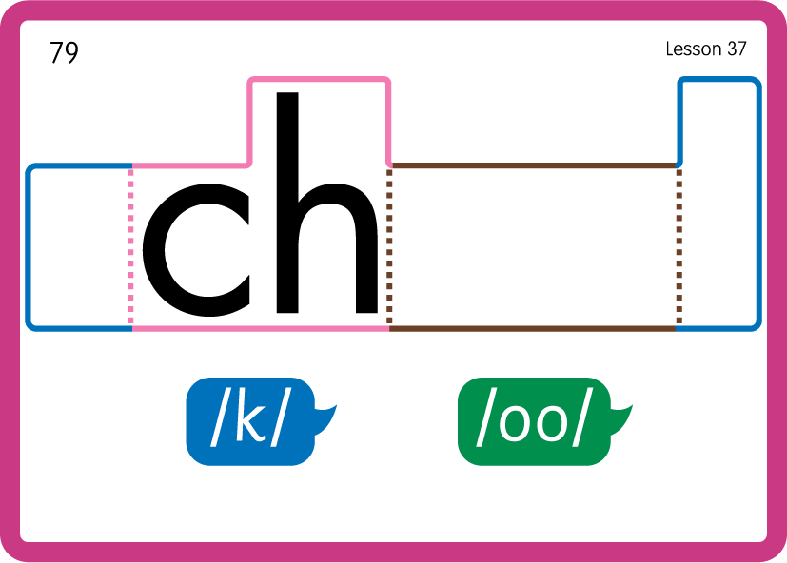
Practise Common Exception Words
USING JN687
BACK

Slide 24

Practise Building Words
PRACTISE – 10MINS
ch
e
m
i
c
a
l
or
u
s
r
a
t
er
o
o-e
USING MAGNETIC LETTERS AND A WHITEBOARD
LAYOUT B

Slide 25
Practise Building Words
PRACTISE – 10MINS
ch
e
m
i
c
a
l
or
u
s
r
a
t
er
o
o-e
chemical chorus character chaos chrome
USING MAGNETIC LETTERS AND A WHITEBOARD
LAYOUT B

