Slide 1


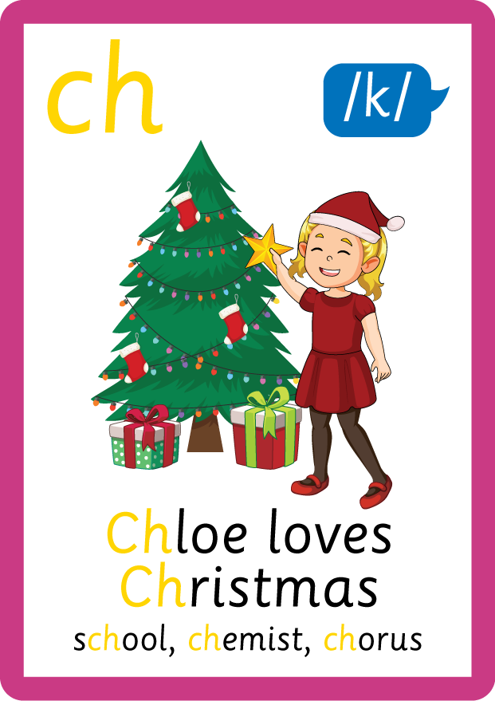

/ai/ | /ee/ | /igh/ | /oa/ | /oo/ | /y-oo/ | /r/
/n/ | /m/ | /ch/ | /k/ | /sh/ | /j/ | /v/
/u/ | /e/ | /i/ | /s/ | /zh/ | /z/ | /ar/
/or/ | /ur/ | /air/ | /ear/
Compare c; /k/ and /s/
Lesson 38

Slide 2
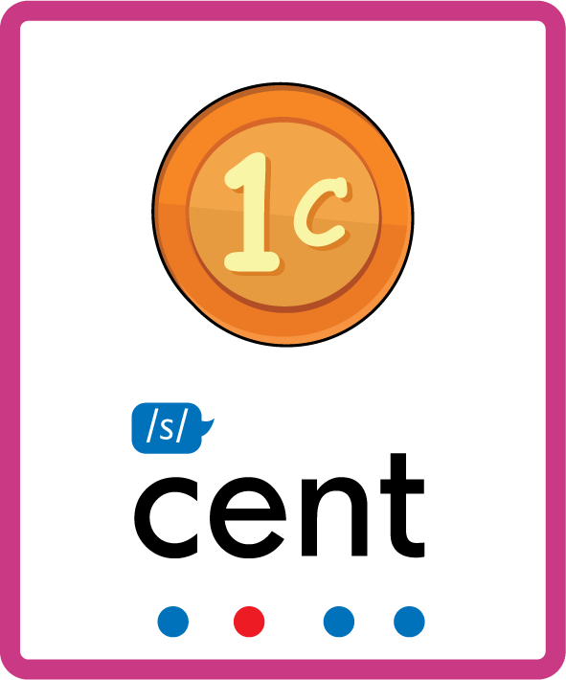

Compare alternative phonemes /k/ and /s/ for grapheme 'c'.
Recall all GPCs learned so far using flashcards.
Grapheme to Phoneme Cards
Phoneme Frame Cards
Common Exception Word Cards
JN686
JN689
JN687

Slide 3





















Recall all GPCs learned so far using flashcards.

Slide 4





























Recall all GPCs learned so far using flashcards.

Slide 5








































Recall all GPCs learned so far using flashcards.

Slide 6
















Recall all GPCs learned so far using flashcards.

Slide 7














Review Phase 2 Common Exception Words as I is no go to into the put his has of pull full.

Slide 8




























Review Phase 3 Common Exception Words push they me we be he she my by looked you are there here were all sure.

Slide 9













Review Phase 4 Common Exception Words said like out have some come what was so old do little one.

Slide 10















Review Phase 5 Common Exception Words today house mouse hour because Mr Mrs Ms where should could would move use want.

Slide 11



















Review Phase 5.5 Common Exception Words people wild child mind kind behind eye oh most only both though through who prove shoe beautiful climb Christmas school.

Slide 12
Review Grapheme Caption
USING JN686
FRONT

Slide 13
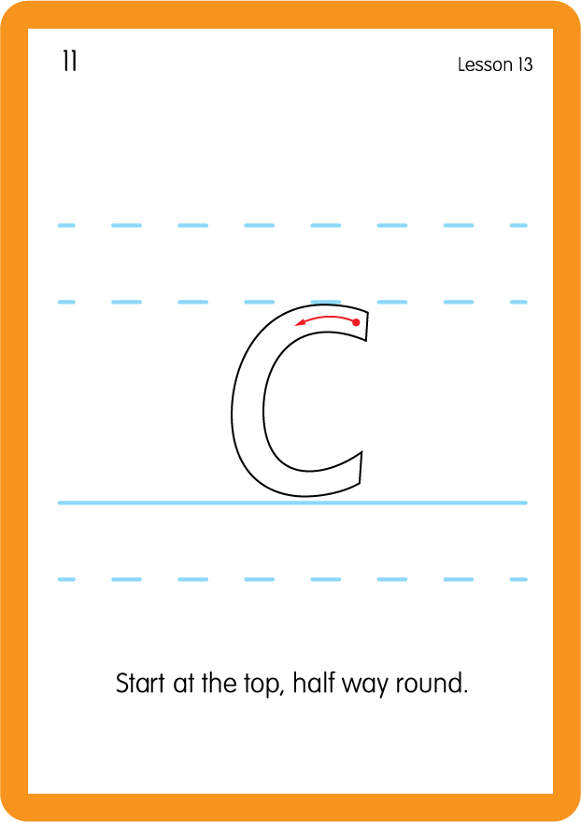

Review Grapheme Caption
USING JN686
FRONT

Slide 14
Review Grapheme Caption
USING JN686
FRONT

Slide 15
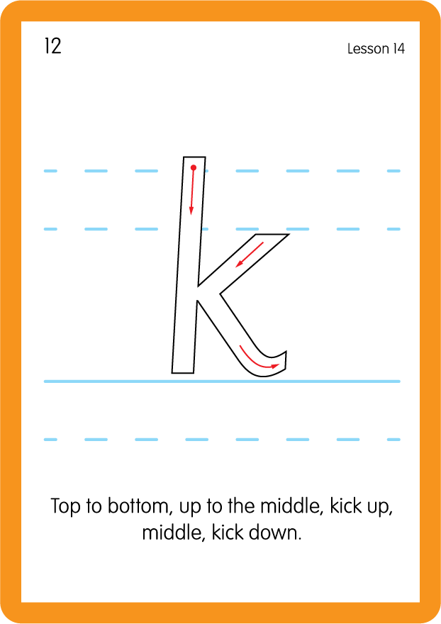

Review Grapheme Caption
USING JN686
FRONT

Slide 16
Discuss the Differences
Review grapheme 'c' and it's ability to make phonemes /k/or /s/
If letter 'k' is next to letters 'i' (kite) 'e' (keep) or 'y' (Kyle) it makes a hard sound (/k/)
If letter 'c' is next to letters 'a' (cat) 'o' (corn) or 'u' (cut) it makes a hard sound (/k/)
If letter 'c' is next to letters 'i' (city) 'e' (cent) 'y' (cyclops) it makes a soft sound (/s/)

Slide 17

Explain Decoding

Slide 18
Model Blending Phonemes
c
o
n
c
er
t
/k/
/s/
USING SOUND BUTTONS
Sound Buttons
Vowel
Consonant
Consonant Digraph
Multi Sound
Long Vowel Sound
R-controlled Digraph
Split Digraph
Syllable / Silent Letter

Slide 19
Model Blending Phonemes
s
ch
oo
l
/s/
/k/
USING SOUND BUTTONS
Sound Buttons
Vowel
Consonant
Consonant Digraph
Multi Sound
Long Vowel Sound
R-controlled Digraph
Split Digraph
Syllable / Silent Letter

Slide 20

Explain Encoding

Slide 21
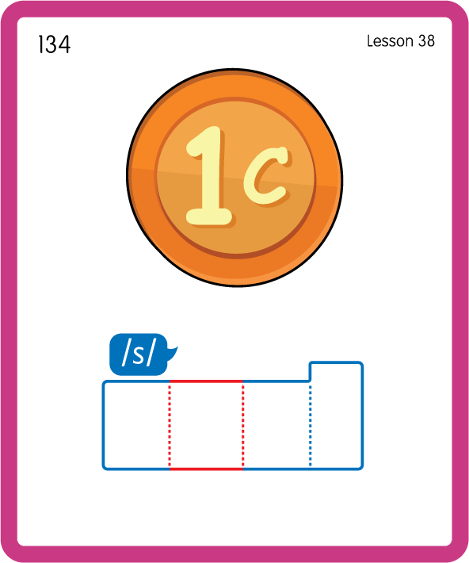
Build a Decodable Word
USING JN689
BACK

Slide 22
Build a Decodable Word
USING JN689
FRONT

Slide 23
Practise Common Exception Words
USING JN687
FRONT

Slide 24
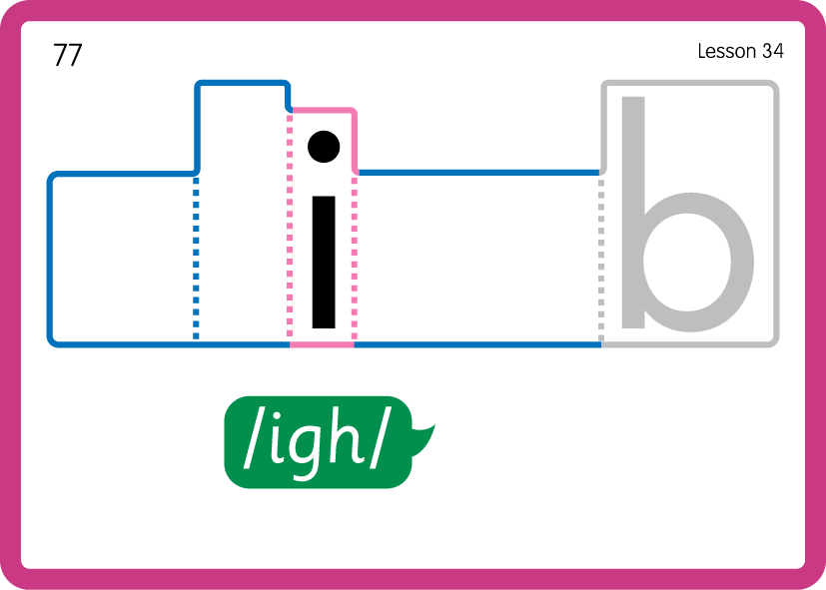
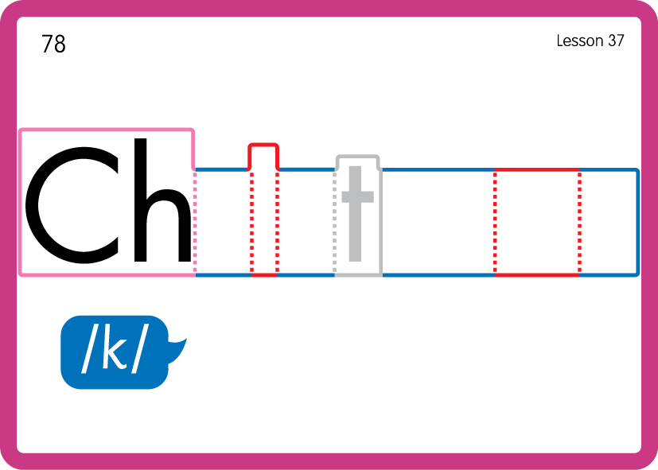
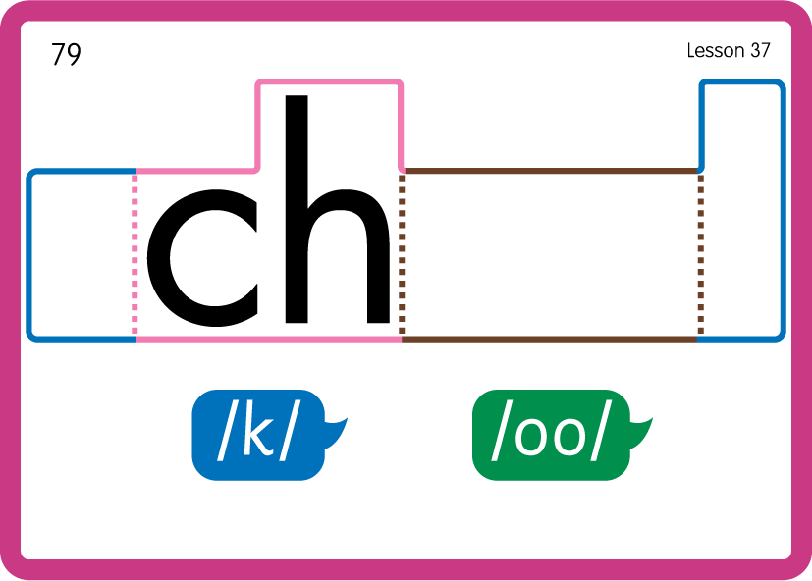
Practise Common Exception Words
USING JN687
BACK

Slide 25

Practise Building Words
PRACTISE – 10MINS
c
or
n
ar
d
a
t
oo
k
m
p
a-e
i-e
f
n
r
USING MAGNETIC LETTERS AND A WHITEBOARD
LAYOUT B

Slide 26
Practise Building Words
PRACTISE – 10MINS
c
or
n
ar
d
a
t
oo
k
m
p
a-e
i-e
f
n
r
acorn card cat cook camp ace ice face nice rice
USING MAGNETIC LETTERS AND A WHITEBOARD
LAYOUT B

