Slide 1




/ai/ | /ee/ | /igh/ | /oa/ | /oo/ | /y-oo/ | /r/
/n/ | /m/ | /ch/ | /k/ | /sh/ | /j/ | /v/
/u/ | /e/ | /i/ | /s/ | /zh/ | /z/ | /ar/
/or/ | /ur/ | /air/ | /ear/
Review Common Exception Words
Lesson 39

Slide 2




Learn and practise Common Exception Words and review sound families taught during the week.
Recall all GPCs learned so far using flashcards.
Common Exception Words Phase 2
Common Exception Words Phase 3
Common Exception Words Phase 4
Common Exception Words Phase 5
Common Exception Words Phase 5.5
JL687
JN687
JN687
JN687
JN687

Slide 3























Recall all GPCs learned so far using flashcards.

Slide 4





























Recall all GPCs learned so far using flashcards.

Slide 5









































Recall all GPCs learned so far using flashcards.

Slide 6

















Recall all GPCs learned so far using flashcards.

Slide 7













Review Phase 2 Common Exception Words as I is no go to into the put his has of pull full.

Slide 8



























Review Phase 3 Common Exception Words push they me we be he she my by looked you are there here were all sure.

Slide 9












Review Phase 4 Common Exception Words said like out have some come what was so old do little one.

Slide 10














Review Phase 5 Common Exception Words today house mouse hour because Mr Mrs Ms where should could would move use want.

Slide 11
















Review Phase 5.5 Common Exception Words people wild child mind kind behind eye oh most only both though through who prove shoe beautiful climb Christmas school.

Slide 12
Practise Common Exception Words
USING JN687
FRONT

Slide 13
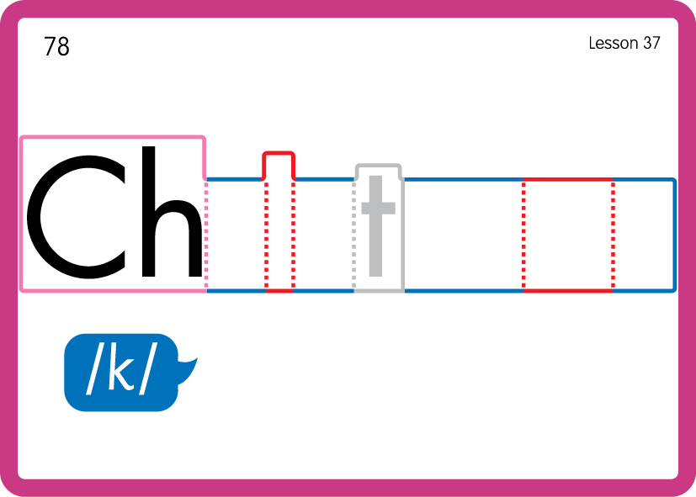
Practise Common Exception Words
USING JN687
BACK

Slide 14
Practise Common Exception Words
USING JN687
FRONT

Slide 15
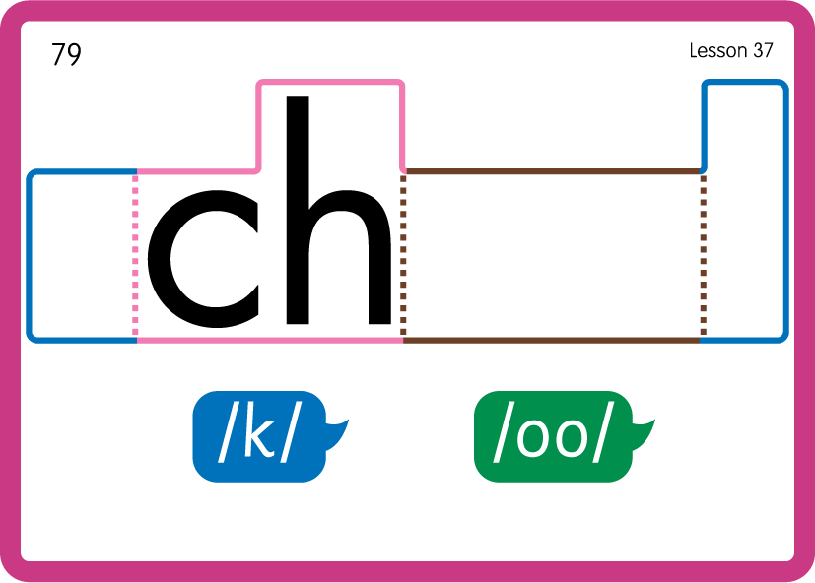
Practise Common Exception Words
USING JN687
BACK

Slide 16
Practise Common Exception Words
USING JN687
FRONT

