Slide 1


/ai/ | /ee/ | /igh/ | /oa/ | /oo/ | /y-oo/ | /r/
/n/ | /m/ | /ch/ | /k/ | /sh/ | /j/ | /v/
/u/ | /e/ | /i/ | /s/ | /zh/ | /z/ | /ar/
/or/ | /ur/ | /air/ | /ear/
Sound Family /ai/; ey
Lesson 4

Slide 2


Learn and practise /ai/ sound family spelling patterns.
Recall all GPCs learned so far using flashcards.
Recall Phase 3 Common Exception Words push they me we be he she my by looked you are there here were all sure.
Grapheme to Phoneme Cards
Phoneme Frame Cards
Common Exception Word Cards
JN686
JN689
JN687

Slide 3























Recall all GPCs learned so far using flashcards.

Slide 4





























Recall all GPCs learned so far using flashcards.

Slide 5








































Recall all GPCs learned so far using flashcards.

Slide 6

Recall all GPCs learned so far using flashcards.

Slide 7














Review Phase 2 Common Exception Words as I is no go to into the put his has of pull full.

Slide 8













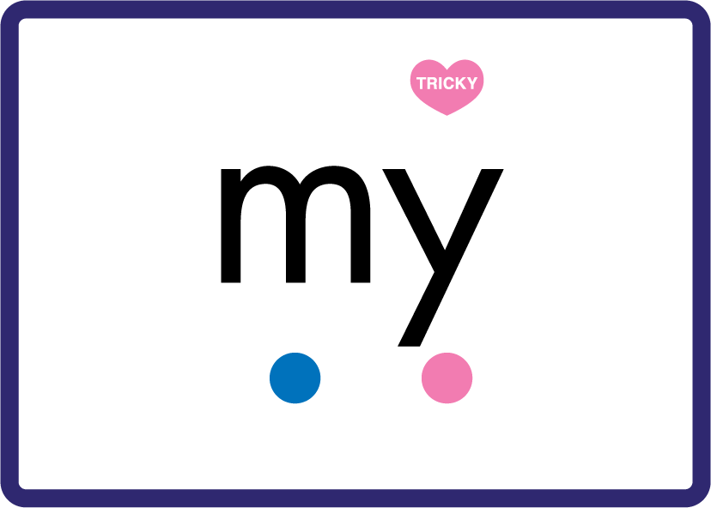













Review Phase 3 Common Exception Words push they me we be he she my by looked you are there here were all sure.

Slide 9













Review Phase 4 Common Exception Words said like out have some come what was so old do little one.

Slide 10














Review Phase 5 Common Exception Words today house mouse hour because Mr Mrs Ms where should could would move use.

Slide 11
Review Grapheme Caption
key
jersey
donkey
Phase 5, Lesson 19
USING JN686
FRONT

Slide 12
Teach Grapheme Caption
prey
obey
survey
Phase 5.5, Lesson 4
USING JN686
FRONT

Slide 13

Explain Decoding

Slide 14
Model Blending Phonemes
p
r
ey
USING SOUND BUTTONS
Sound Buttons
Vowel
Consonant
Consonant Digraph
Multi Sound
Long Vowel Sound
R-controlled Digraph
Split Digraph
Syllable / Silent Letter

Slide 15
Model Blending Phonemes
s
ur
v
ey
USING SOUND BUTTONS
Sound Buttons
Vowel
Consonant
Consonant Digraph
Multi Sound
Long Vowel Sound
R-controlled Digraph
Split Digraph
Syllable / Silent Letter

Slide 16

Explain Encoding

Slide 17
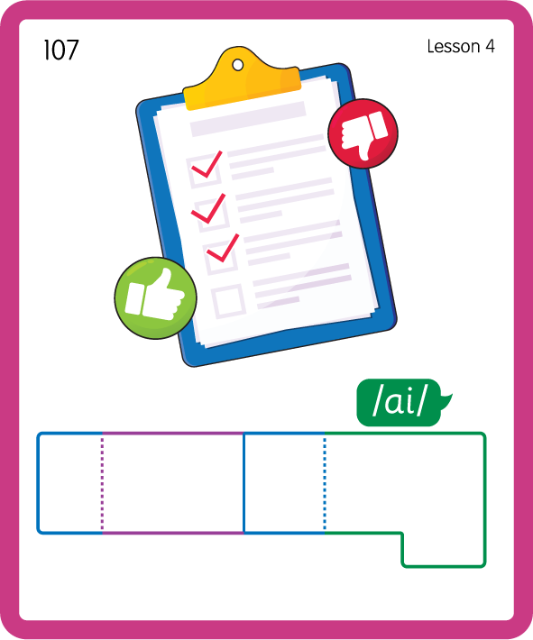
Build a Decodable Word
USING JN689
BACK

Slide 18
Build a Decodable Word
USING JN689
FRONT

Slide 19
Practise Common Exception Words
USING JN687
FRONT

Slide 20
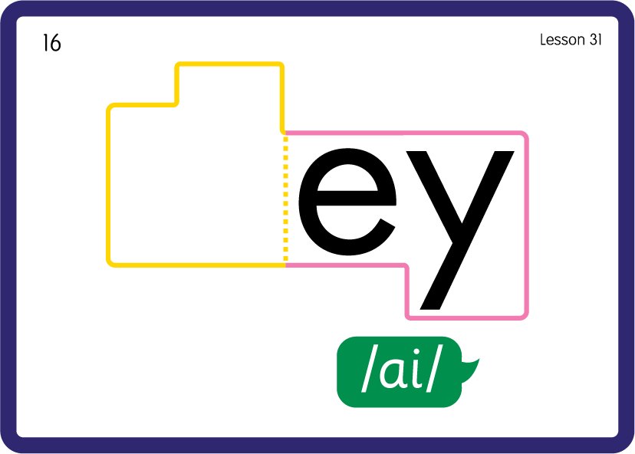
Practise Common Exception Words
USING JN687
BACK

Slide 21

Practise Building Words
PRACTISE – 10MINS
h
ey
o
b
th
p
r
s
ur
v
wh
USING MAGNETIC LETTERS AND A WHITEBOARD
LAYOUT A

Slide 22
Practise Building Words
PRACTISE – 10MINS
h
ey
o
b
th
p
r
s
ur
v
wh
hey obey they prey survey whey
USING MAGNETIC LETTERS AND A WHITEBOARD
LAYOUT A

