Slide 1




/ai/ | /ee/ | /igh/ | /oa/ | /oo/ | /y-oo/ | /r/
/n/ | /m/ | /ch/ | /k/ | /sh/ | /j/ | /v/
/u/ | /e/ | /i/ | /s/ | /zh/ | /z/ | /ar/
/or/ | /ur/ | /air/ | /ear/
Review Sound Family /ch/ & /k/
Lesson 40

Slide 2




Learn and practise /ch/ sound family spelling patterns, including homophones and Common Exception Words.
Recall all GPCs learned so far using flashcards.
Homophone Cards
Grapheme to Phoneme Cards
Phoneme Frame Cards
Alien Word Cards
Common Exception Word Cards
JN693
JN686
JN689
JN692
JN687

Slide 3






















Recall all GPCs learned so far using flashcards.

Slide 4




























Recall all GPCs learned so far using flashcards.

Slide 5









































Recall all GPCs learned so far using flashcards.

Slide 6















Recall all GPCs learned so far using flashcards.

Slide 7














Review Phase 2 Common Exception Words as I is no go to into the put his has of pull full.

Slide 8




























Review Phase 3 Common Exception Words push they me we be he she my by looked you are there here were all sure.

Slide 9













Review Phase 4 Common Exception Words said like out have some come what was so old do little one.

Slide 10















Review Phase 5 Common Exception Words today house mouse hour because Mr Mrs Ms where should could would move use want.

Slide 11



















Review Phase 5.5 Common Exception Words people wild child mind kind behind eye oh most only both though through who prove shoe beautiful climb Christmas school.

Slide 12
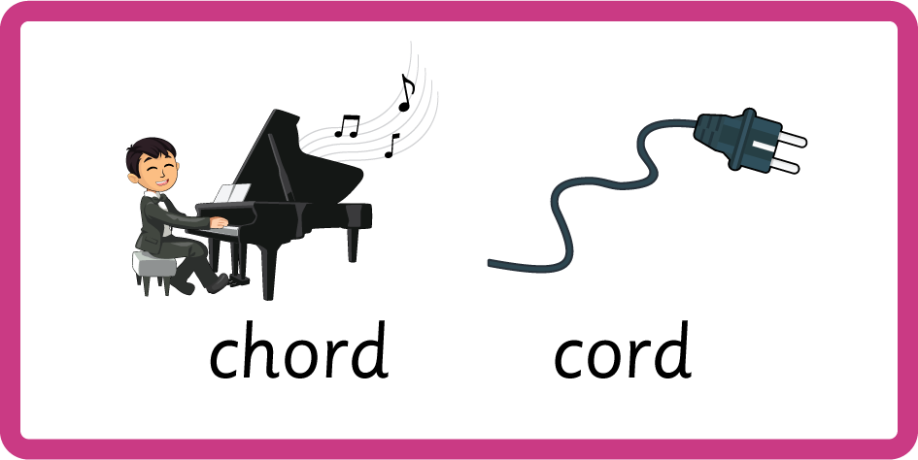
Teach Homophones: which / witch, chord / cord.

Slide 13
Review Common Exception Words Christmas school.

Slide 14
Review Grapheme Captions
USING JL686
FRONT

Slide 15


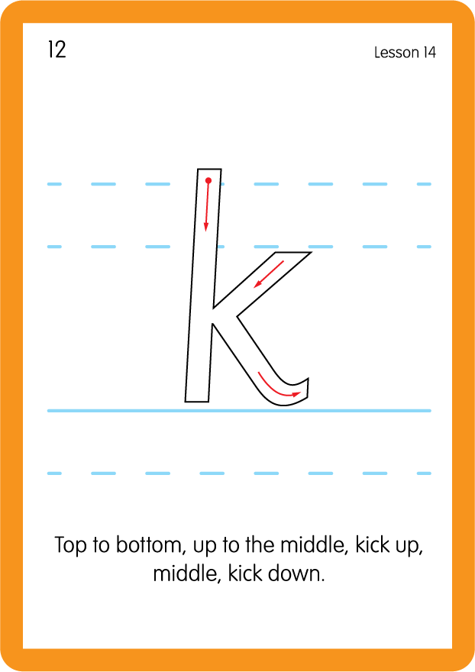

Review Grapheme Captions
USING JL686
BACK

Slide 16
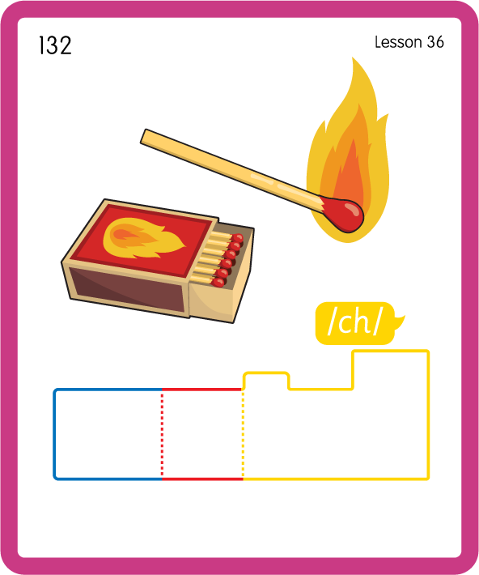
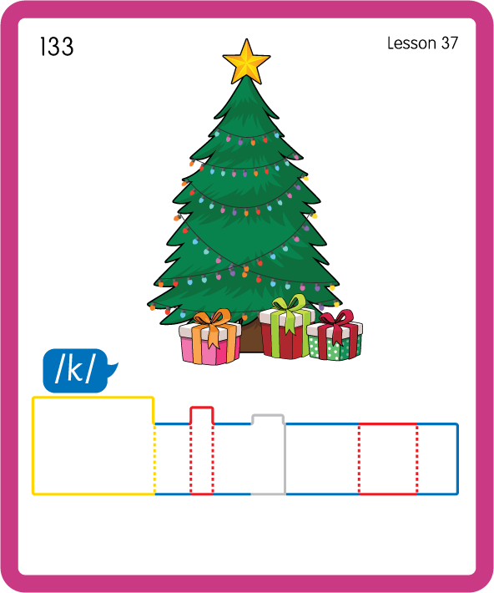
Build a Decodable Word
USING JL689
BACK

Slide 17

Build a Decodable Word
USING JL689
FRONT

Slide 18

Practise with Alien Words
USING JL692
BACK

Slide 19
Practise with Alien Words
USING JL692
FRONT

Slide 20
Practise Common Exception Words
USING JL687
FRONT

Slide 21
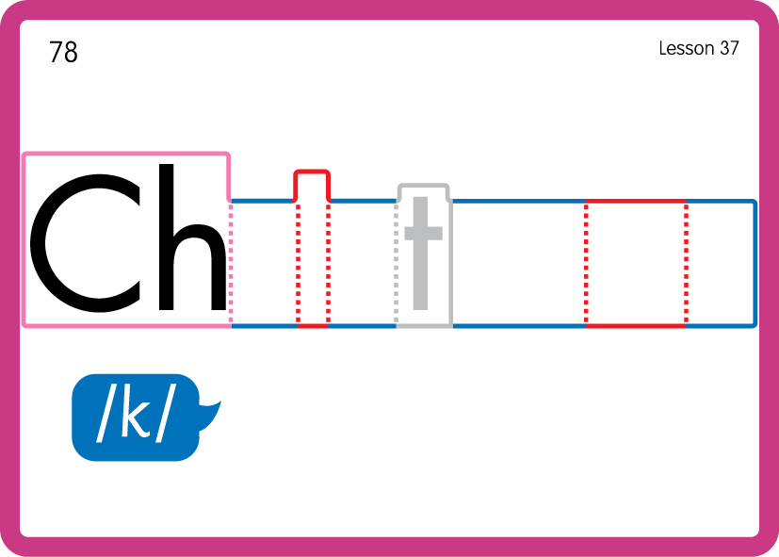
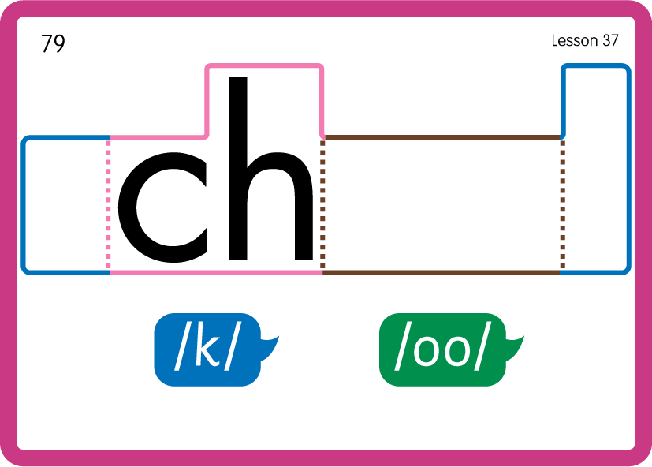
Practise Common Exception Words
USING JL687
BACK

Slide 22
Practise Common Exception Words
USING JL687
FRONT

Slide 23


