Slide 1





/ai/ | /ee/ | /igh/ | /oa/ | /oo/ | /y-oo/ | /r/
/n/ | /m/ | /ch/ | /k/ | /sh/ | /j/ | /v/
/u/ | /e/ | /i/ | /s/ | /zh/ | /z/ | /ar/
/or/ | /ur/ | /air/ | /ear/
Review Sound Family /sh/
Lesson 45

Slide 2



Learn and practise /sh/ sound family spelling patterns, including homophones and Common Exception Words.
Recall all GPCs learned so far using flashcards.
Homophone Cards
Grapheme to Phoneme Cards
Phoneme Frame Cards
Alien Word Cards
JN693
JN686
JN689
JN692

Slide 3























Recall all GPCs learned so far using flashcards.

Slide 4




























Recall all GPCs learned so far using flashcards.

Slide 5









































Recall all GPCs learned so far using flashcards.

Slide 6

















Recall all GPCs learned so far using flashcards.

Slide 7














Review Phase 2 Common Exception Words as I is no go to into the put his has of pull full.

Slide 8




























Review Phase 3 Common Exception Words push they me we be he she my by looked you are there here were all sure.

Slide 9













Review Phase 4 Common Exception Words said like out have some come what was so old do little one.

Slide 10















Review Phase 5 Common Exception Words today house mouse hour because Mr Mrs Ms where should could would move use want.

Slide 11




















Review Phase 5.5 Common Exception Words people wild child mind kind behind eye oh most only both though through who prove shoe beautiful climb Christmas school.

Slide 12

Teach Homophones: shoot / chute, marshal / martial.

Slide 13
Review Grapheme Captions
USING JN686
FRONT

Slide 14
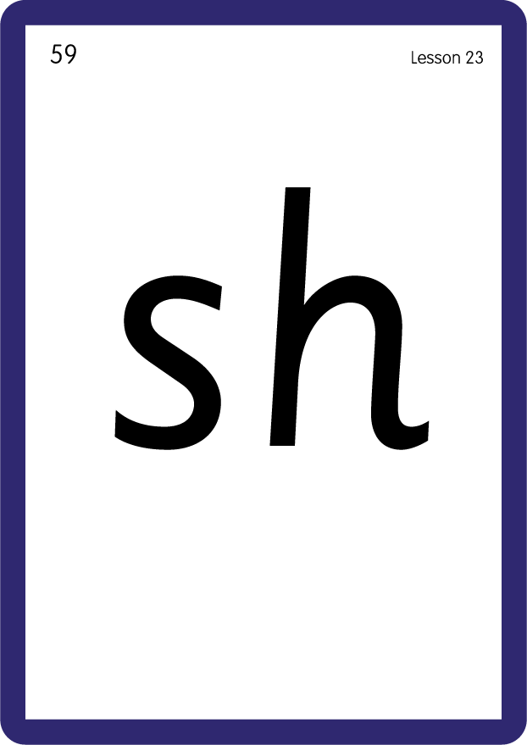




Review Grapheme Captions
USING JN686
BACK

Slide 15
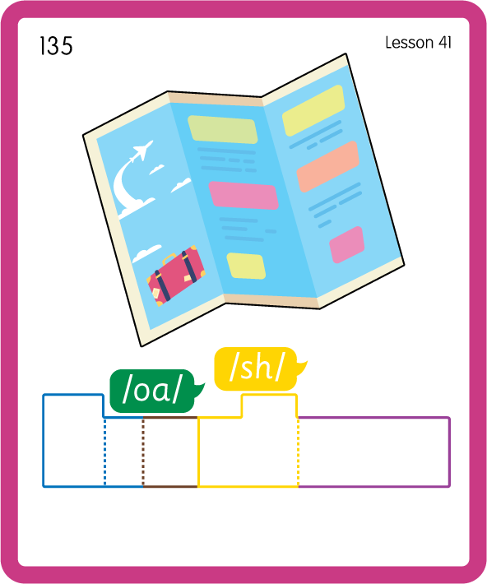
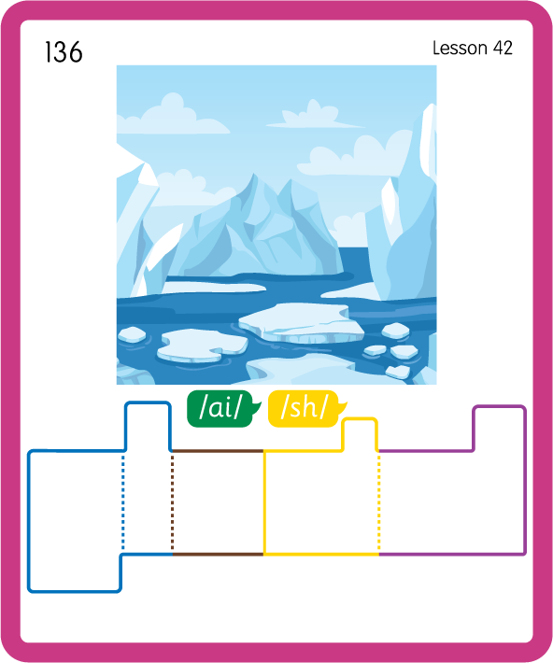
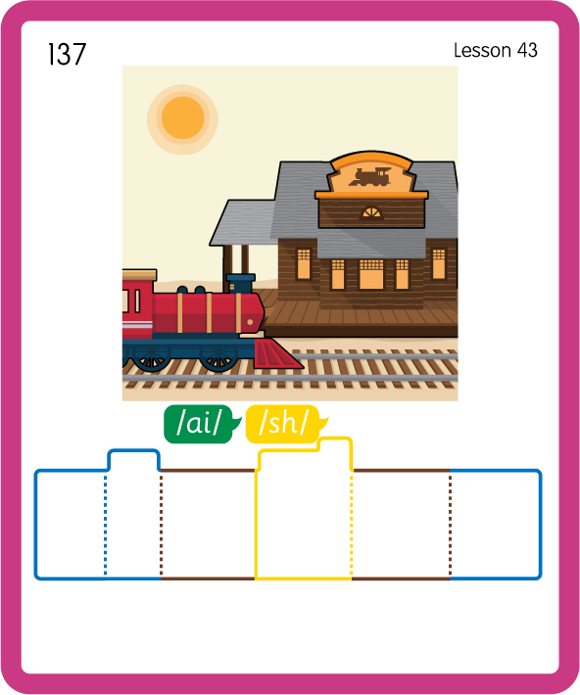
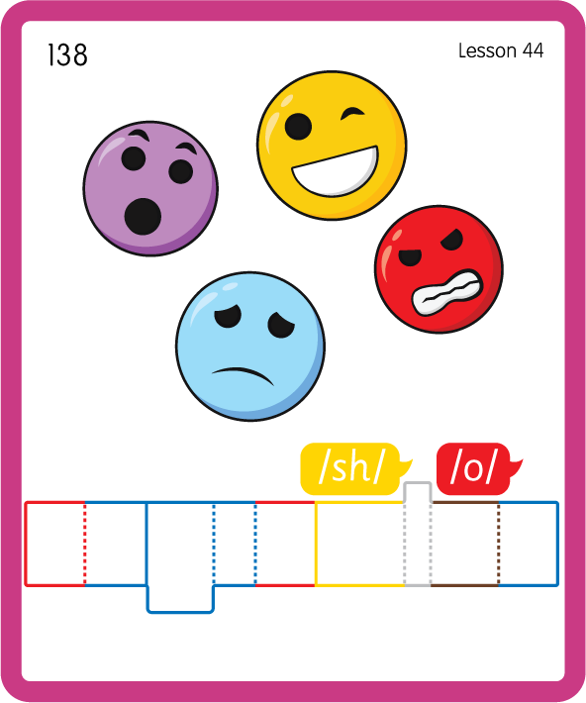
Build a Decodable Word
USING JN689
BACK

Slide 16



Build a Decodable Word
USING JN689
FRONT

Slide 17

Practise with Alien Words
USING JN692
BACK

Slide 18
Practise with Alien Words
USING JN692
FRONT

Slide 19

Practise Common Exception Words
USING JN687
FRONT

Slide 20
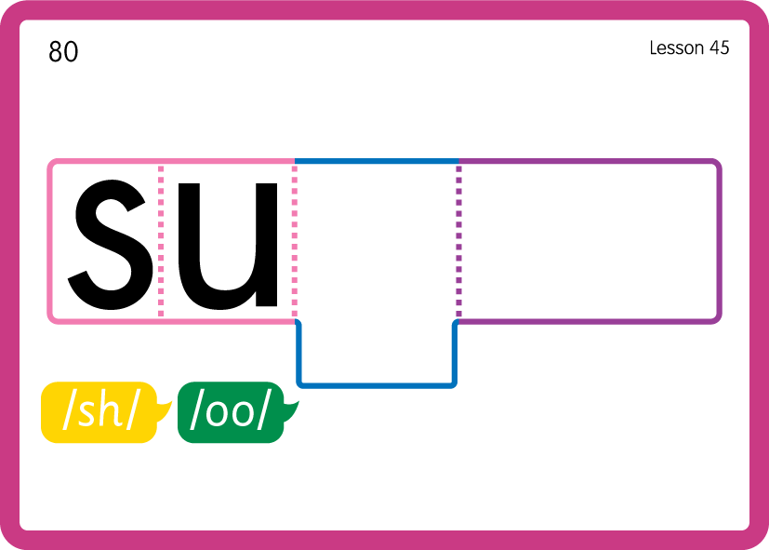
Practise Common Exception Words
USING JN687
FRONT

Slide 21
Practise Common Exception Words
USING JN687
FRONT

Slide 22
