Slide 1


/ai/ | /ee/ | /igh/ | /oa/ | /oo/ | /y-oo/ | /r/
/n/ | /m/ | /ch/ | /k/ | /sh/ | /j/ | /v/
/u/ | /e/ | /i/ | /s/ | /zh/ | /z/ | /ar/
/or/ | /ur/ | /air/ | /ear/
Sound Family /j/; g
Lesson 46

Slide 2


Learn and practise /j/ sound family spelling patterns.
Recall all GPCs learned so far using flashcards.
Grapheme to Phoneme Cards
Phoneme Frame Cards
Alien Word Cards
JN686
JN689
JN92

Slide 3























Recall all GPCs learned so far using flashcards.

Slide 4




























Recall all GPCs learned so far using flashcards.

Slide 5









































Recall all GPCs learned so far using flashcards.

Slide 6





















Recall all GPCs learned so far using flashcards.

Slide 7














Review Phase 2 Common Exception Words as I is no go to into the put his has of pull full.

Slide 8




























Review Phase 3 Common Exception Words push they me we be he she my by looked you are there here were all sure.

Slide 9













Review Phase 4 Common Exception Words said like out have some come what was so old do little one.

Slide 10















Review Phase 5 Common Exception Words today house mouse hour because Mr Mrs Ms where should could would move use want.

Slide 11




















Review Phase 5.5 Common Exception Words people wild child mind kind behind eye oh most only both though through who prove shoe beautiful climb Christmas school.

Slide 12
Review Grapheme Caption
job
jam
jet
Phase 3, Lesson 1
USING JN686
FRONT

Slide 13
Teach Grapheme Caption
magic
giraffe
stage
Phase 5.5, Lesson 46
USING JN686
FRONT

Slide 14

Explain Decoding

Slide 15
Model Blending Phonemes
a
g
e
n
t
USING SOUND BUTTONS
Sound Buttons
Vowel
Consonant
Consonant Digraph
Multi Sound
Long Vowel Sound
R-controlled Digraph
Split Digraph
Syllable / Silent Letter

Slide 16
Model Blending Phonemes
g
e
m
USING SOUND BUTTONS
Sound Buttons
Vowel
Consonant
Consonant Digraph
Multi Sound
Long Vowel Sound
R-controlled Digraph
Split Digraph
Syllable / Silent Letter

Slide 17

Explain Encoding

Slide 18
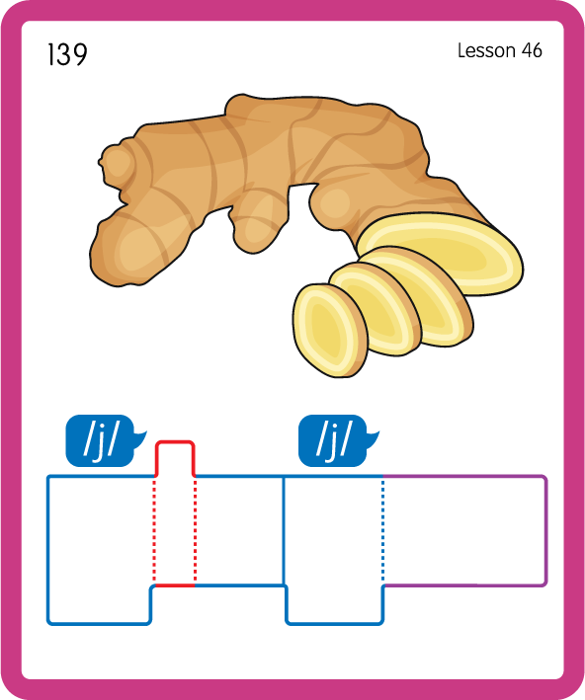
Build a Decodable Word
USING JN689
BACK

Slide 19
Build a Decodable Word
USING JN689
FRONT

Slide 20

Practise with Alien Words
USING JN692
BACK

Slide 21
Practise with Alien Words
USING JN692
FRONT

Slide 22

Practise Building Words
PRACTISE – 10MINS
g
e
i
n
t
l
e
i
a
er
y
d
USING MAGNETIC LETTERS AND A WHITEBOARD
LAYOUT A

Slide 23
Practise Building Words
PRACTISE – 10MINS
g
e
i
n
t
l
e
i
a
er
y
d
agent giant energy tragic digital
USING MAGNETIC LETTERS AND A WHITEBOARD
LAYOUT A

