Slide 1




/ai/ | /ee/ | /igh/ | /oa/ | /oo/ | /y-oo/ | /r/
/n/ | /m/ | /ch/ | /k/ | /sh/ | /j/ | /v/
/u/ | /e/ | /i/ | /s/ | /zh/ | /z/ | /ar/
/or/ | /ur/ | /air/ | /ear/
Compare g; /j/ and /g/
Lesson 49

Slide 2


Compare alternative phonemes /j/ and /g/ for grapheme 'g'.
Recall all GPCs learned so far using flashcards.
Grapheme to Phoneme Cards
Phoneme Frame Cards
Alien Word Cards
JN686
JN689
JN692

Slide 3






















Recall all GPCs learned so far using flashcards.

Slide 4




























Recall all GPCs learned so far using flashcards.

Slide 5









































Recall all GPCs learned so far using flashcards.

Slide 6






















Recall all GPCs learned so far using flashcards.

Slide 7














Review Phase 2 Common Exception Words as I is no go to into the put his has of pull full.

Slide 8




























Review Phase 3 Common Exception Words push they me we be he she my by looked you are there here were all sure.

Slide 9













Review Phase 4 Common Exception Words said like out have some come what was so old do little one.

Slide 10















Review Phase 5 Common Exception Words today house mouse hour because Mr Mrs Ms where should could would move use want.

Slide 11





















Review Phase 5.5 Common Exception Words people wild child mind kind behind eye oh most only both though through who prove shoe beautiful climb Christmas school sugar.

Slide 12
Review Grapheme Caption
USING JN686

Slide 13
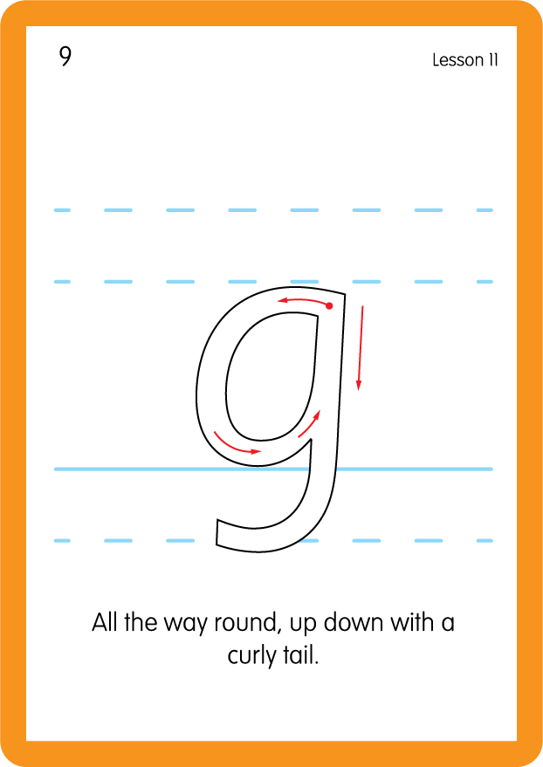
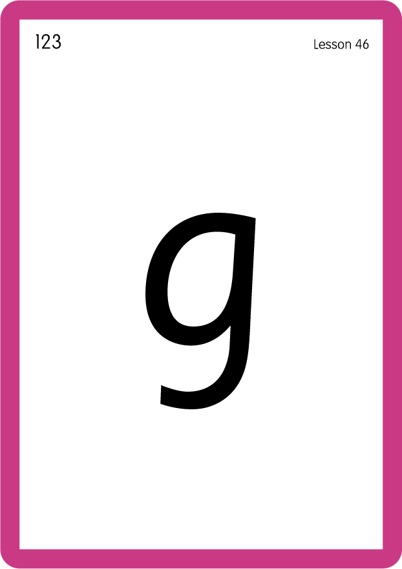
Review Grapheme Caption
USING JN686

Slide 14
Review Grapheme Caption
USING JN686

Slide 15
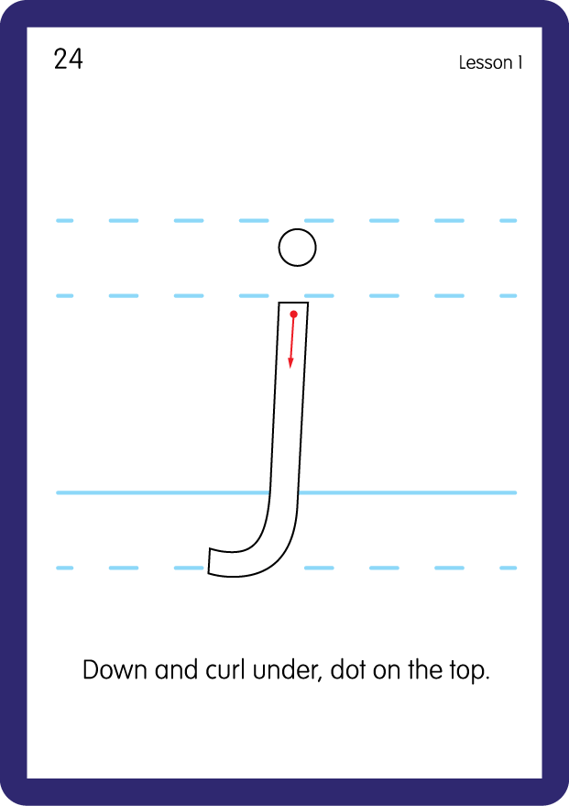

Review Grapheme Caption
USING JN686

Slide 16

Explain Decoding

Slide 17
Model Blending Phonemes
e
n
er
g
y
USING SOUND BUTTONS
Sound Buttons
Vowel
Consonant
Consonant Digraph
Multi Sound
Long Vowel Sound
R-controlled Digraph
Split Digraph
Syllable / Silent Letter

Slide 18
Model Blending Phonemes
a
g
e
n
t
USING SOUND BUTTONS
Sound Buttons
Vowel
Consonant
Consonant Digraph
Multi Sound
Long Vowel Sound
R-controlled Digraph
Split Digraph
Syllable / Silent Letter

Slide 19

Explain Encoding

Slide 20
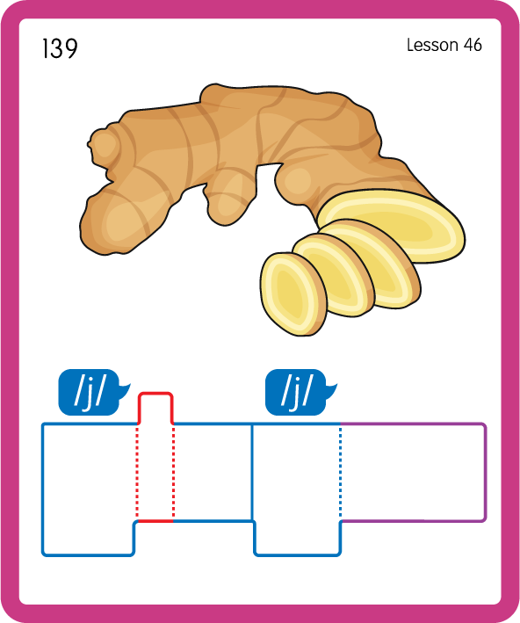
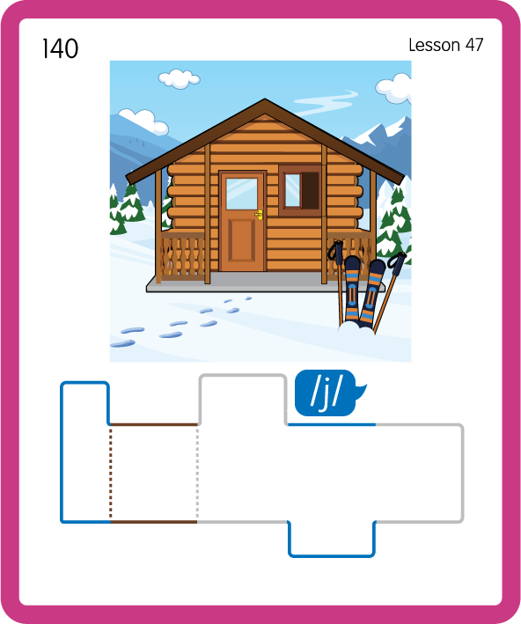
Build a Decodable Word
USING JN689
BACK

Slide 21

Build a Decodable Word
USING JN689
FRONT

Slide 22


Practise with Alien Word Cards
USING JN692
BACK

Slide 23

Practise with Alien Word Cards
USING JN692
FRONT

Slide 24

Practise Building Words
PRACTISE – 10MINS
g
e
m
er
i
s
t
o
l
f
u
ss
i-e
d
oo
a-e
USING MAGNETIC LETTERS AND A WHITEBOARD
LAYOUT B

Slide 25
Practise Building Words
PRACTISE – 10MINS
g
e
m
er
i
s
t
o
l
f
u
ss
i-e
d
oo
a-e
gem germ gist golf guide goose game
USING MAGNETIC LETTERS AND A WHITEBOARD
LAYOUT B

