Slide 1




/ai/ | /ee/ | /igh/ | /oa/ | /oo/ | /y-oo/ | /r/
/n/ | /m/ | /ch/ | /k/ | /sh/ | /j/ | /v/
/u/ | /e/ | /i/ | /s/ | /zh/ | /z/ | /ar/
/or/ | /ur/ | /air/ | /ear/
Sound Family /ee/; ee / ea / ey / e-e
Lesson 6

Slide 2


Learn and practise /ee/ sound family spelling patterns.
Recall all GPCs learned so far using flashcards.
Grapheme to Phoneme Cards
Phoneme Frame Cards
Alien Word Cards
JN686
JN689
JN692

Slide 3























Recall all GPCs learned so far using flashcards.

Slide 4




























Recall all GPCs learned so far using flashcards.

Slide 5






































Recall all GPCs learned so far using flashcards.

Slide 6
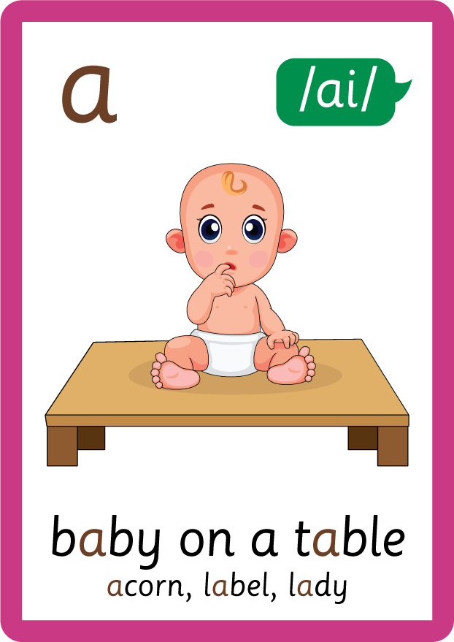

Recall all GPCs learned so far using flashcards.

Slide 7






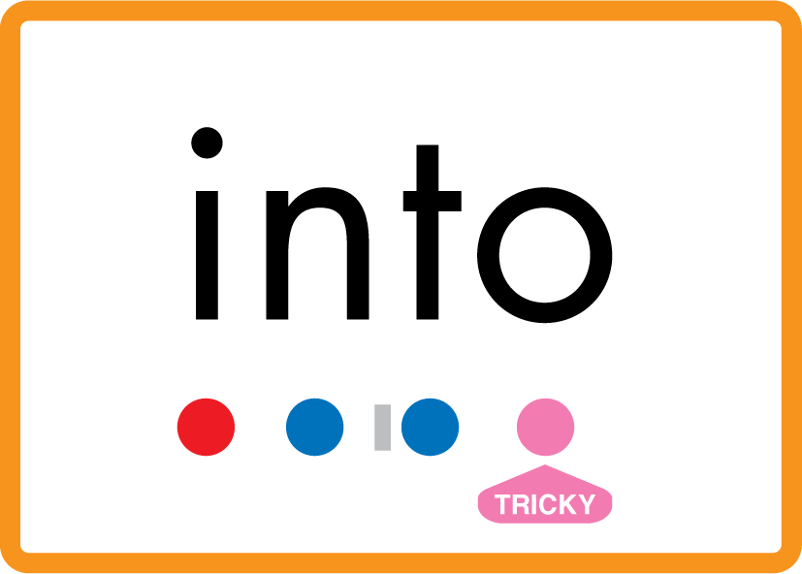
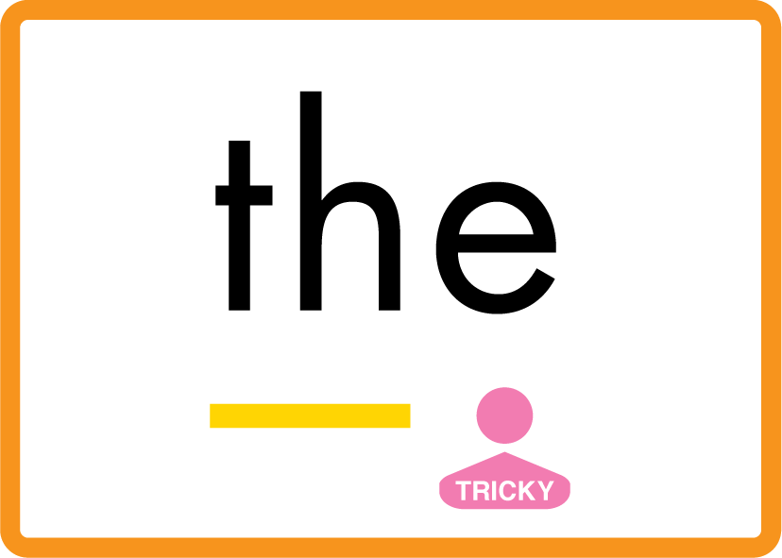

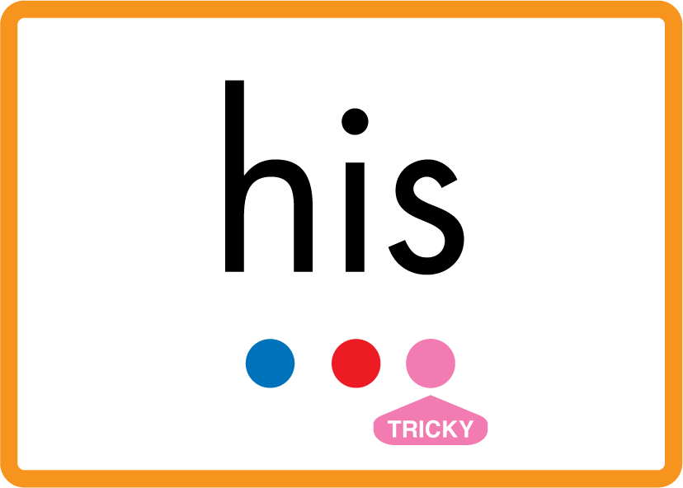



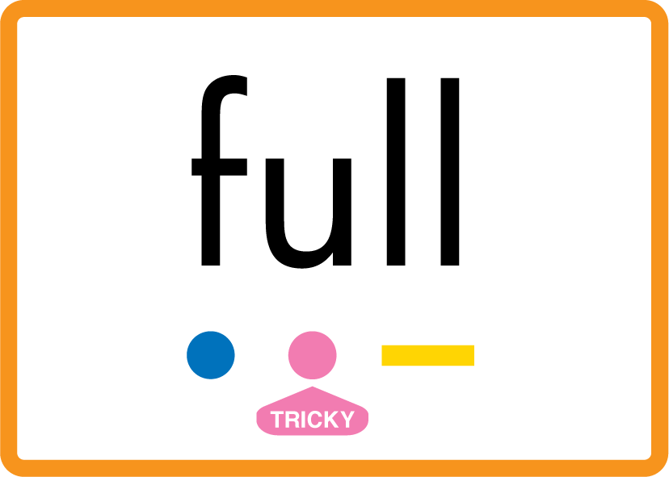
Review Phase 2 Common Exception Words as I is no go to into the put his has of pull full.

Slide 8


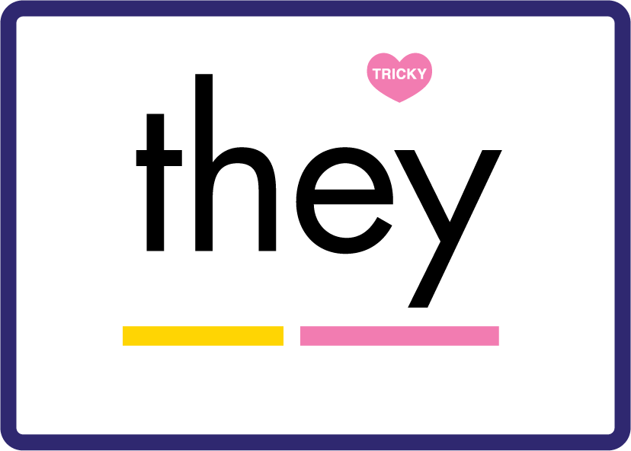
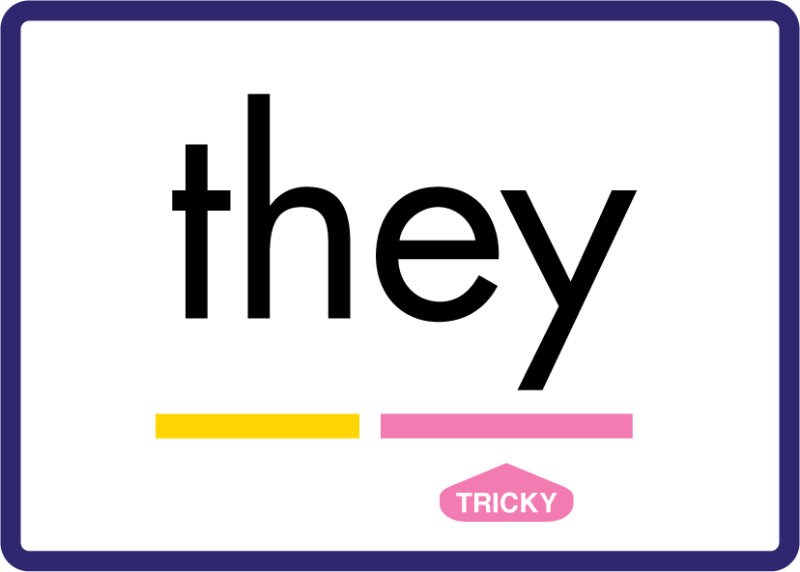


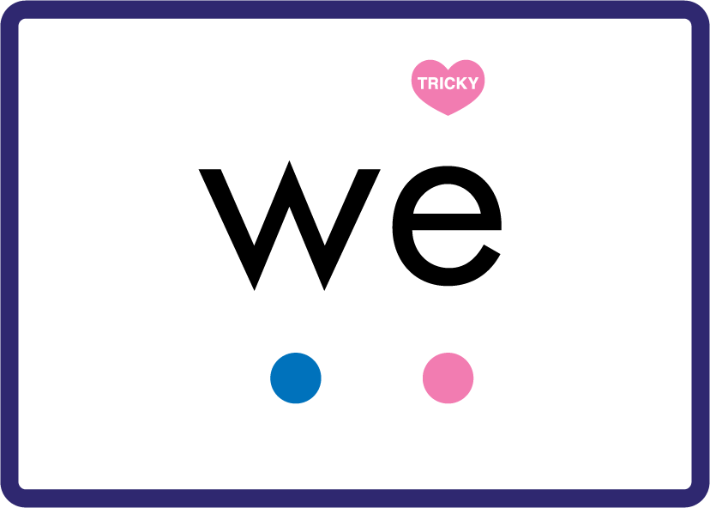
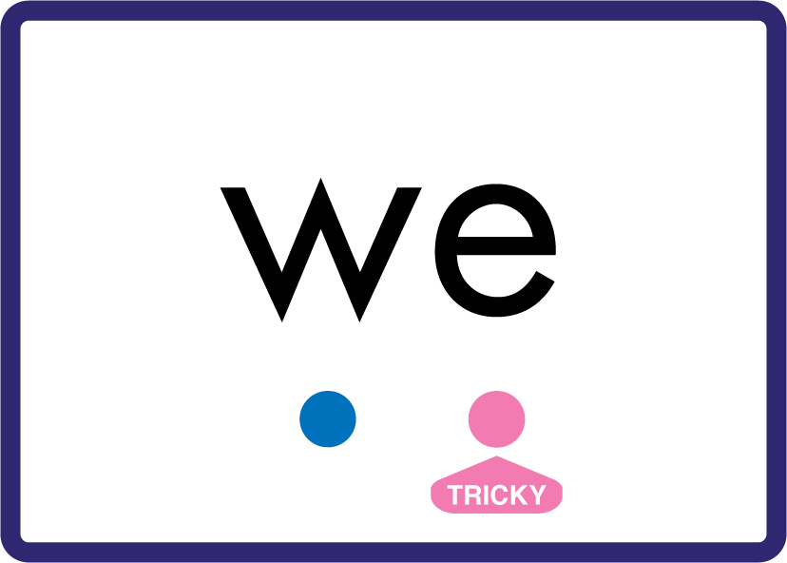
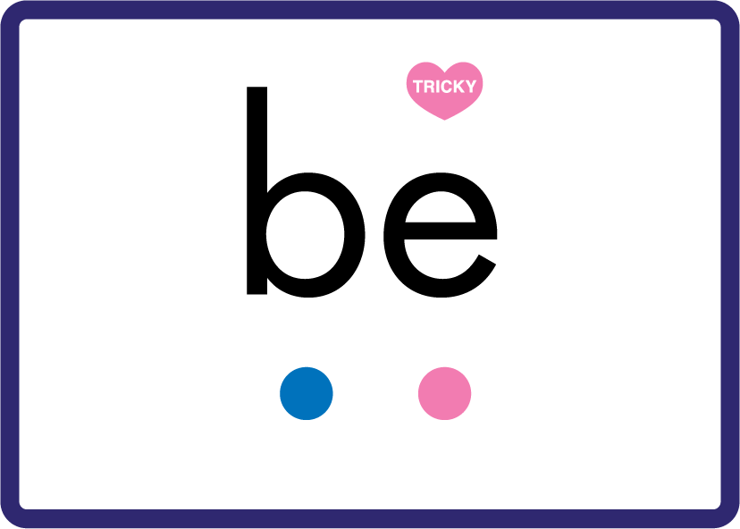

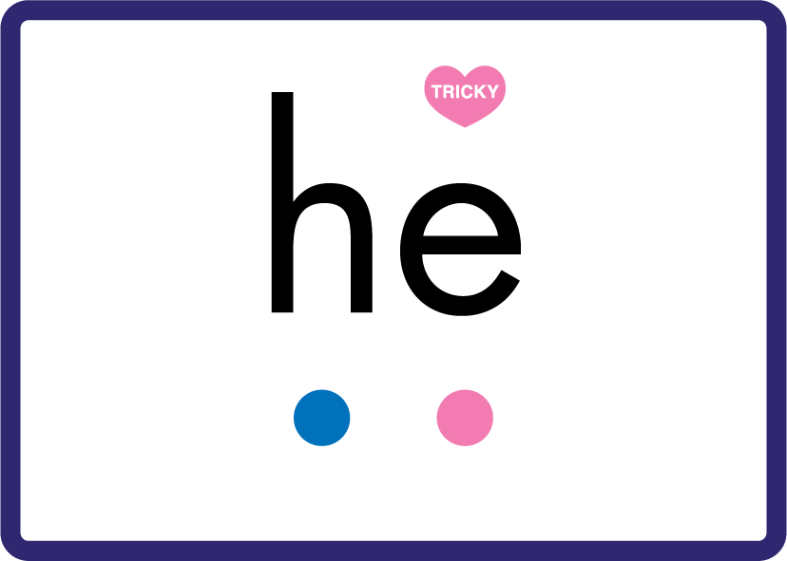

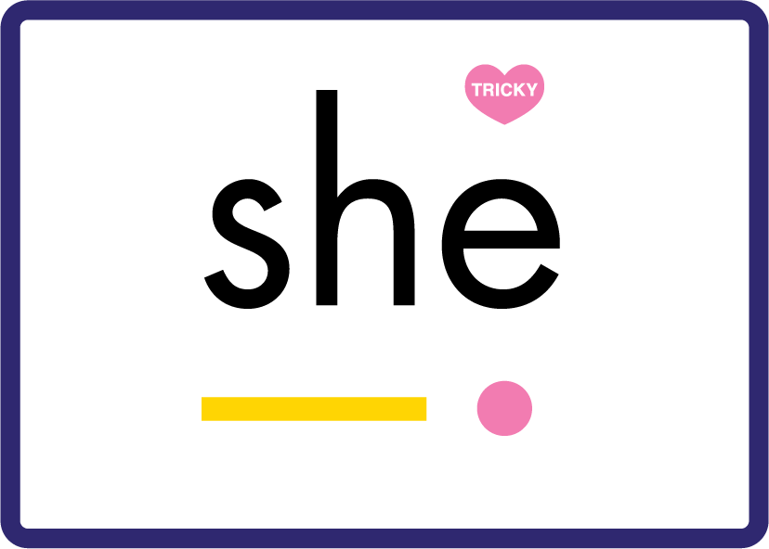
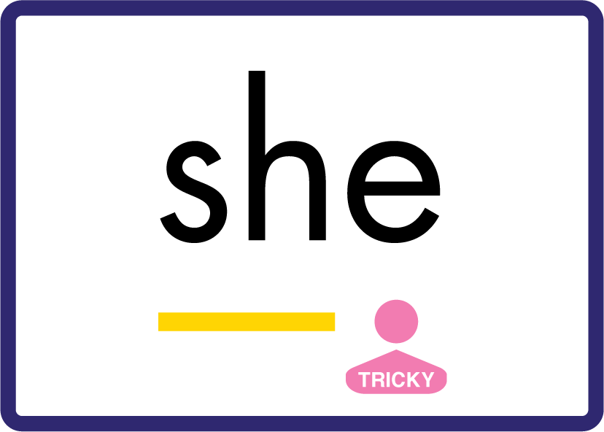
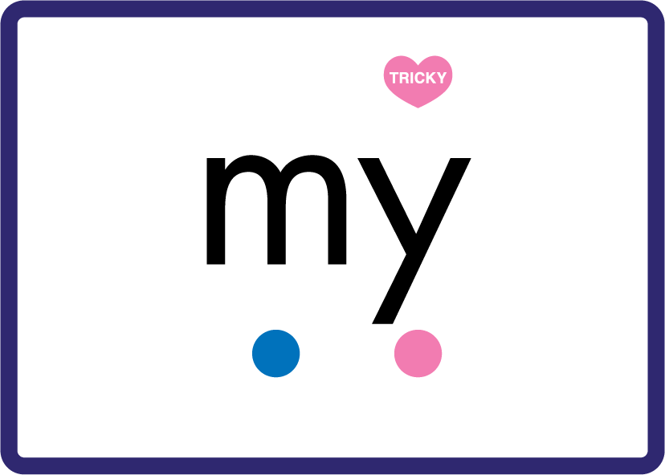

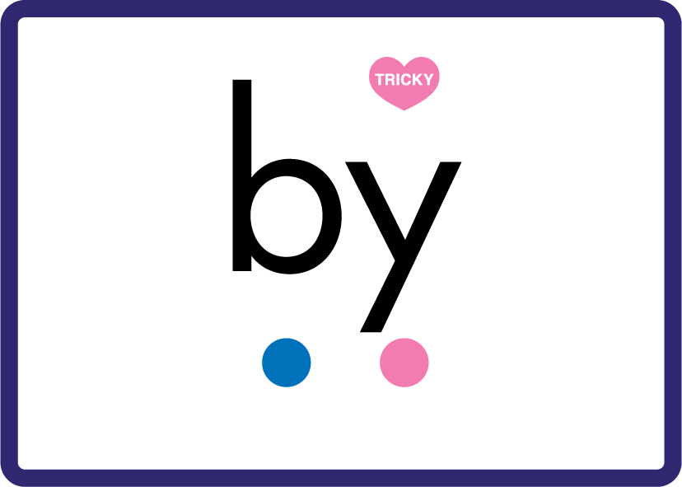




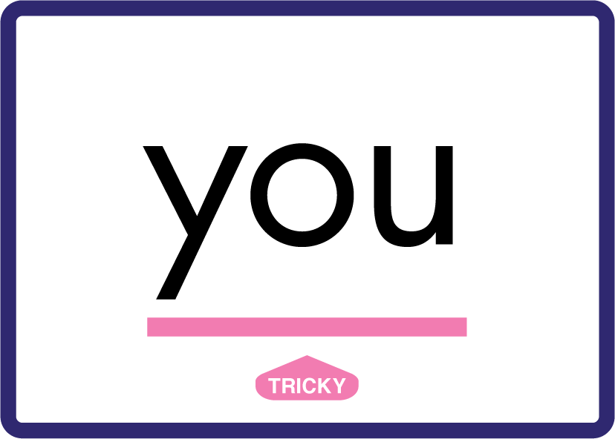






Review Phase 3 Common Exception Words push they me we be he she my by looked you are there here were all sure.

Slide 9









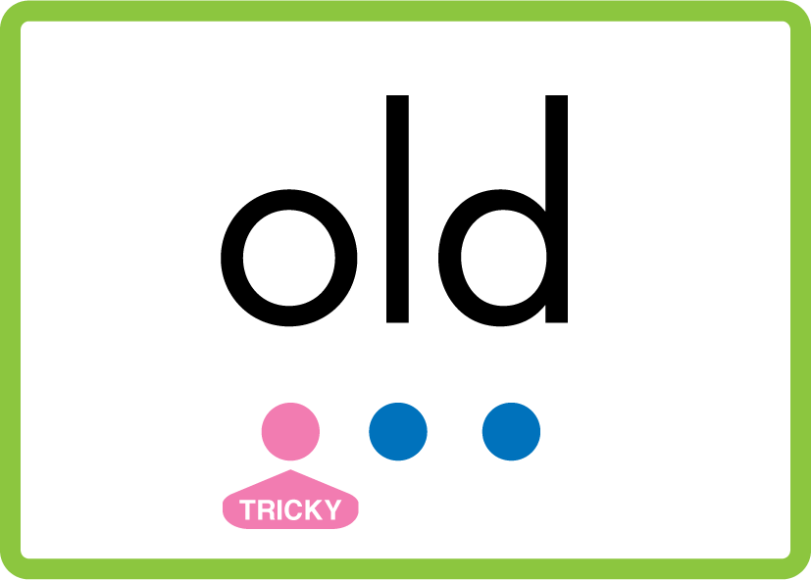
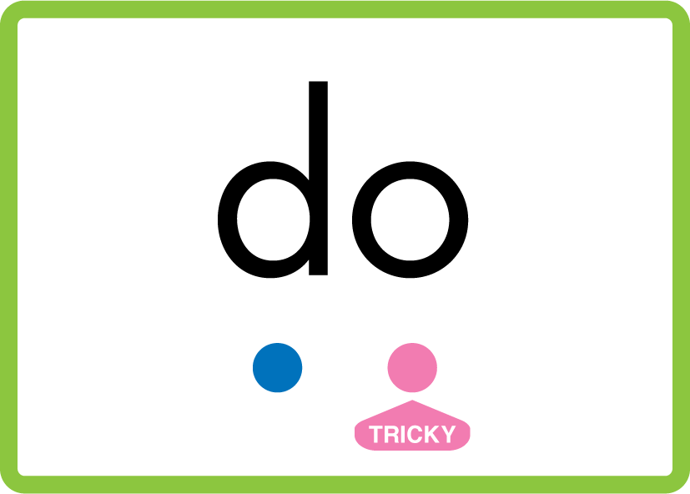


Review Phase 4 Common Exception Words said like out have some come what was so old do little one.

Slide 10

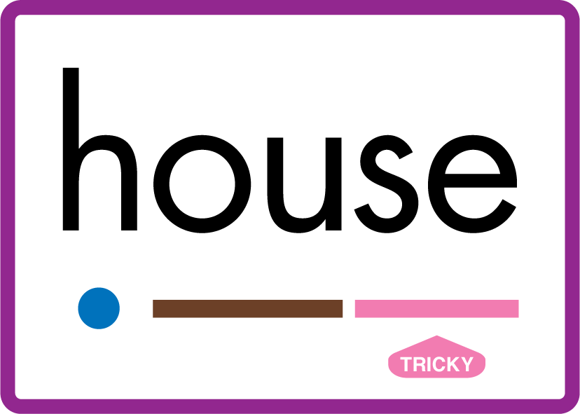

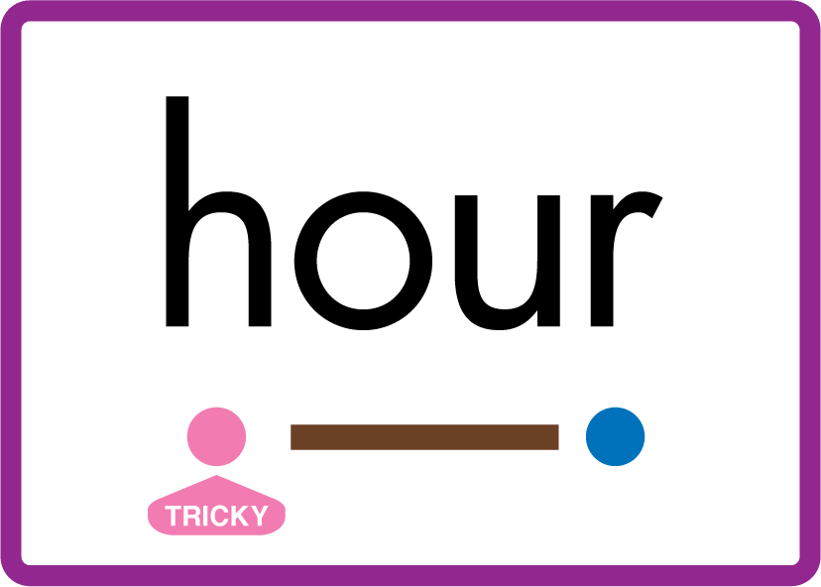










Review Phase 5 Common Exception Words today house mouse hour because Mr Mrs Ms where should could would move use.

Slide 11
Review Grapheme Caption
tree
three
sweet
Phase 3, Lesson 32
USING JN686
FRONT

Slide 12
Review Grapheme Caption
tea
leaf
scream
Phase 5, Lesson 4
USING JN686
FRONT

Slide 13
Review Grapheme Caption
donkey
turkey
key
Phase 5, Lesson 19
USING JN686
FRONT

Slide 14
Review Grapheme Caption
extreme
evening
theme
Phase 5, Lesson 22
USING JN686
FRONT

Slide 15
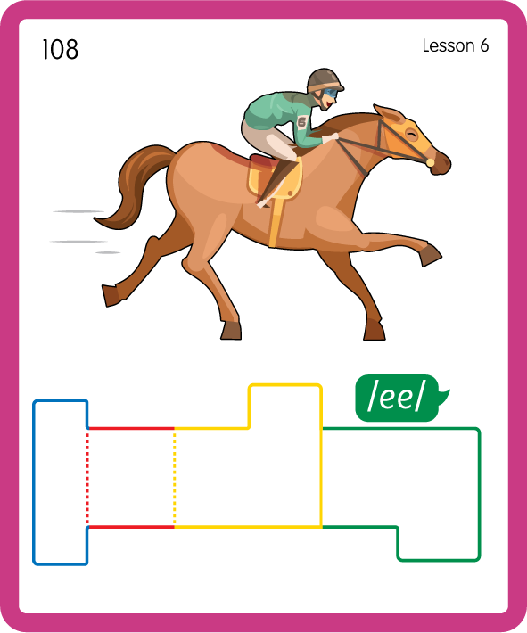
Build a Decodable Word
USING JN689
BACK

Slide 16
Build a Decodable Word
USING JN689
FRONT

Slide 17

Practise with Alien Words
USING JN692
BACK

Slide 18
Practise with Alien Words
USING JN692
FRONT

Slide 19

Practise Building Words
PRACTISE – 10MINS
s
ee
f
l
m
ea
n
k
ey
j
o
ck
v
a
l
th
e-e
m
d
t
e
USING MAGNETIC LETTERS AND A WHITEBOARD
LAYOUT B

Slide 20
Practise Building Words
PRACTISE – 10MINS
s
ee
f
l
m
ea
n
k
ey
j
o
ck
v
a
l
th
e-e
m
d
t
e
see feel eat mean key jockey valley theme delete
USING MAGNETIC LETTERS AND A WHITEBOARD
LAYOUT B

