Slide 1

/ai/ | /ee/ | /igh/ | /oa/ | /oo/ | /y-oo/ | /r/
/n/ | /m/ | /ch/ | /k/ | /sh/ | /j/ | /v/
/u/ | /e/ | /i/ | /s/ | /zh/ | /z/ | /ar/
/or/ | /ur/ | /air/ | /ear/
Sound Family /zh/; s
Lesson 61

Slide 2

Learn and practise /zh/ sound family spelling patterns.
Recall all GPCs learned so far using flashcards.
Grapheme to Phoneme Cards
Phoneme Frame Cards
JN686
JN689

Slide 3























Recall all GPCs learned so far using flashcards.

Slide 4





























Recall all GPCs learned so far using flashcards.

Slide 5









































Recall all GPCs learned so far using flashcards.

Slide 6





























Recall all GPCs learned so far using flashcards.

Slide 7














Review Phase 2 Common Exception Words as I is no go to into the put his has of pull full.

Slide 8




























Review Phase 3 Common Exception Words push they me we be he she my by looked you are there here were all sure.

Slide 9













Review Phase 4 Common Exception Words said like out have some come what was so old do little one.

Slide 10















Review Phase 5 Common Exception Words today house mouse hour because Mr Mrs Ms where should could would move use want.

Slide 11
























Review Phase 5.5 Common Exception Words people wild child mind kind behind eye oh most only both though through who prove shoe beautiful climb Christmas school sugar love money any…

Slide 12



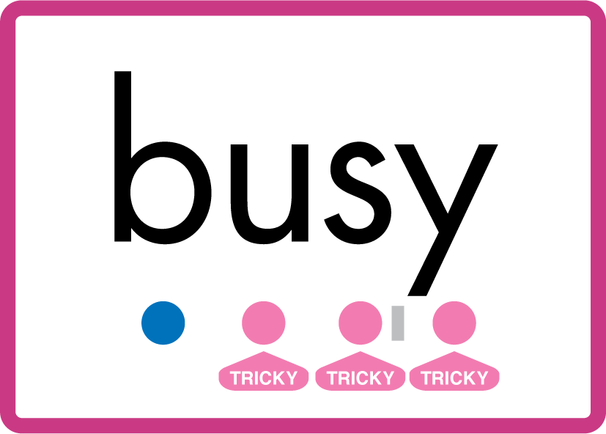


Review Phase 5.5 Common Exception Words… many friend very busy pretty once.

Slide 13
Review Grapheme Caption
Asia
division
television
Phase 5.5, Lesson 61
USING JN686
FRONT

Slide 14

Explain Decoding

Slide 15
Model Blending Phonemes
p
l
ea
s
ure
USING SOUND BUTTONS
Sound Buttons
Vowel
Consonant
Consonant Digraph
Multi Sound
Long Vowel Sound
R-controlled Digraph
Split Digraph
Syllable / Silent Letter

Slide 16
Model Blending Phonemes
e
x
p
l
o
s
i
o
n
USING SOUND BUTTONS
Sound Buttons
Vowel
Consonant
Consonant Digraph
Multi Sound
Long Vowel Sound
R-controlled Digraph
Split Digraph
Syllable / Silent Letter

Slide 17

Explain Encoding

Slide 18
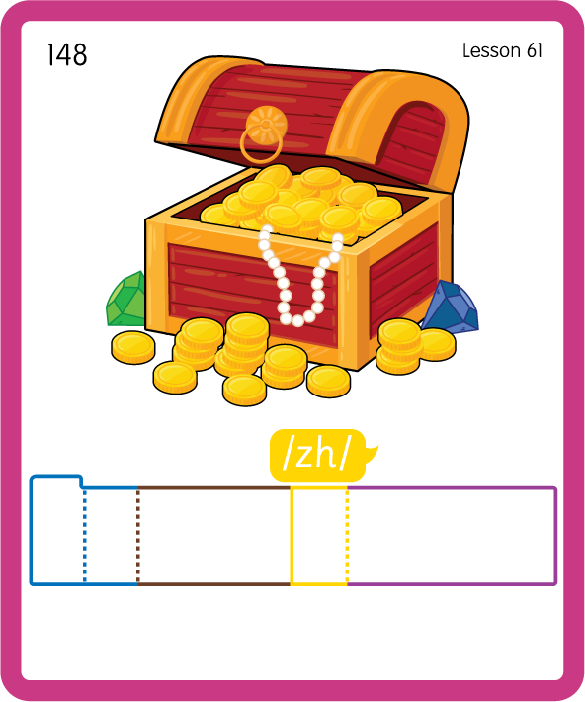
Build a Decodable Word
USING JN689
BACK

Slide 19

Build a Decodable Word
USING JN689
FRONT

Slide 20

Practise Building Words
PRACTISE – 10MINS
t
r
i
s
ure
m
d
i
v
ea
s
i
e
o
n
c
l
o
e
USING MAGNETIC LETTERS AND A WHITEBOARD
LAYOUT B

Slide 21
Practise Building Words
PRACTISE – 10MINS
t
r
i
s
ure
m
d
i
v
ea
s
i
e
o
n
c
l
o
e
treasure measure division decision television closure
USING MAGNETIC LETTERS AND A WHITEBOARD
LAYOUT B

