Slide 1



/ai/ | /ee/ | /igh/ | /oa/ | /oo/ | /y-oo/ | /r/
/n/ | /m/ | /ch/ | /k/ | /sh/ | /j/ | /v/
/u/ | /e/ | /i/ | /s/ | /zh/ | /z/ | /ar/
/or/ | /ur/ | /air/ | /ear/
Compare ou; /ow/ /oa/ /oo/
Lesson 64

Slide 2

Compare alternative phonemes /ow/ /oa/ and /oo/ for grapheme 'ou'.
Recall all GPCs learned so far using flashcards.
Grapheme to Phoneme Cards
Common Exception Word Cards
JN686
JN687

Slide 3























Recall all GPCs learned so far using flashcards.

Slide 4





























Recall all GPCs learned so far using flashcards.

Slide 5



















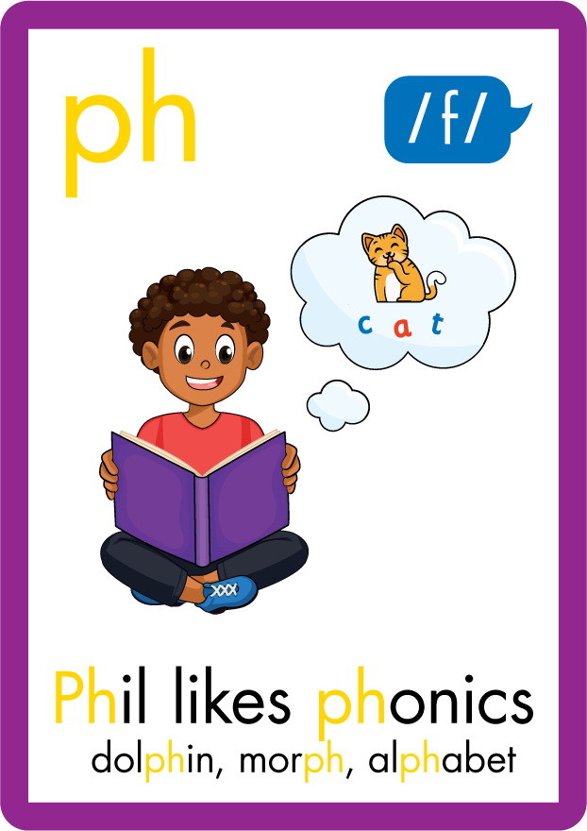




















Recall all GPCs learned so far using flashcards.

Slide 6














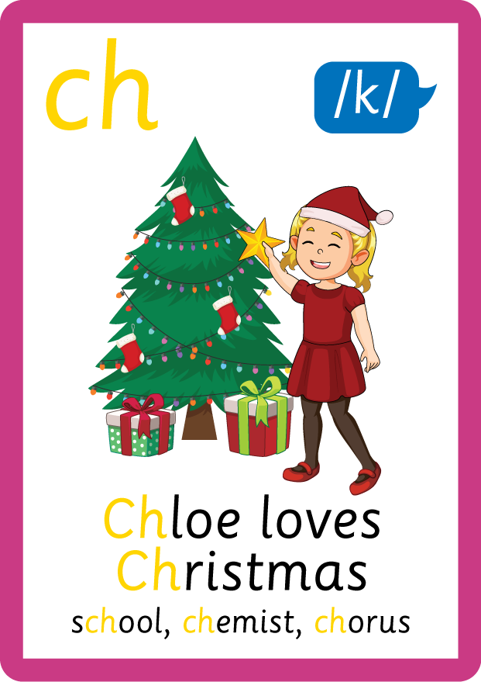








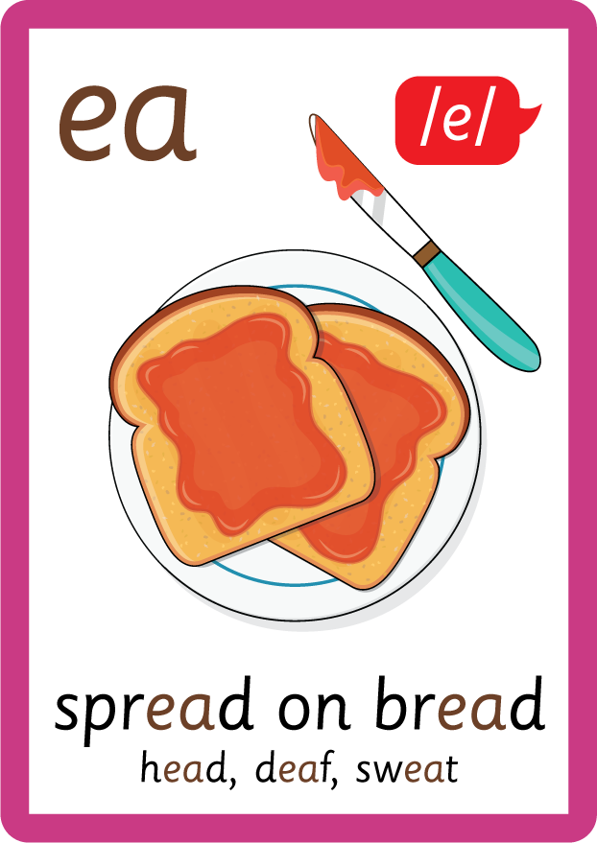




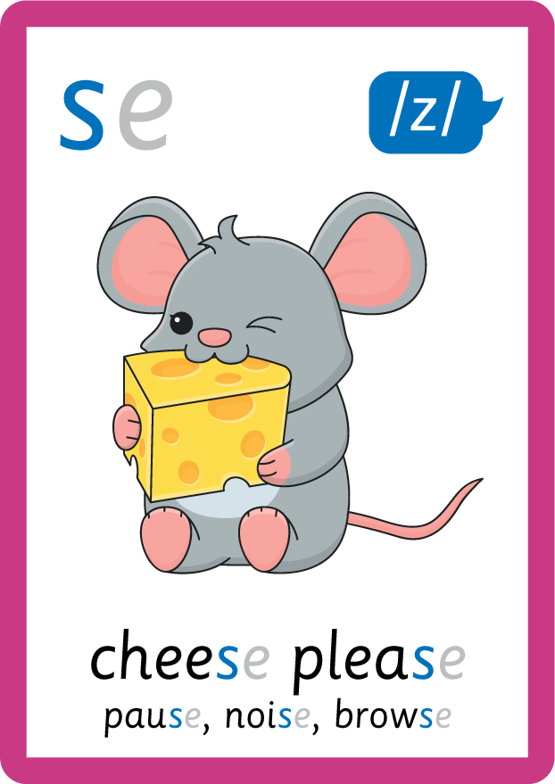
Recall all GPCs learned so far using flashcards.

Slide 7














Review Phase 2 Common Exception Words as I is no go to into the put his has of pull full.

Slide 8




























Review Phase 3 Common Exception Words push they me we be he she my by looked you are there here were all sure.

Slide 9













Review Phase 4 Common Exception Words said like out have some come what was so old do little one.

Slide 10













Review Phase 5 Common Exception Words today house mouse hour because Mr Mrs Ms where should could would move use.

Slide 11
























Review Phase 5.5 Common Exception Words people wild child mind kind behind eye oh most only both though through who prove shoe beautiful climb Christmas school sugar love money any…

Slide 12
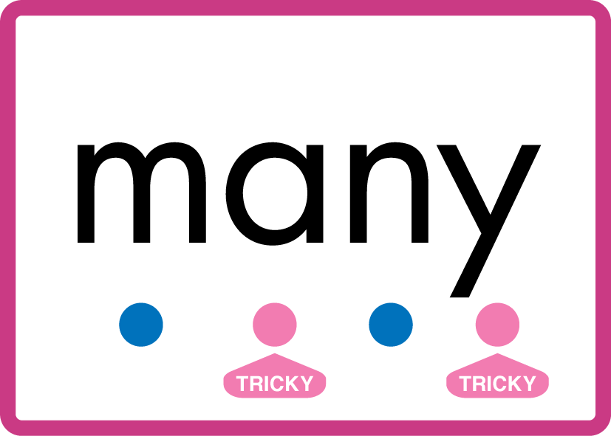


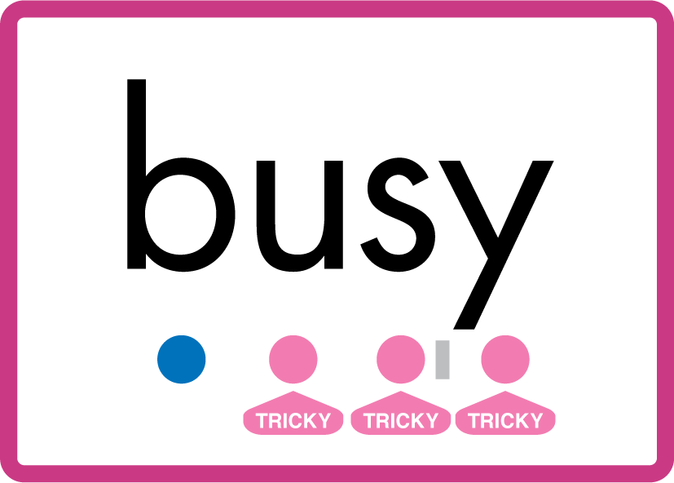



…many friend very busy pretty once please.

Slide 13
Review Grapheme Caption
USING JN686
FRONT

Slide 14
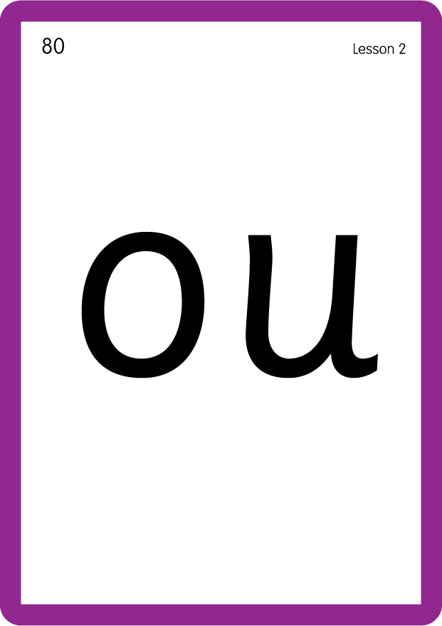
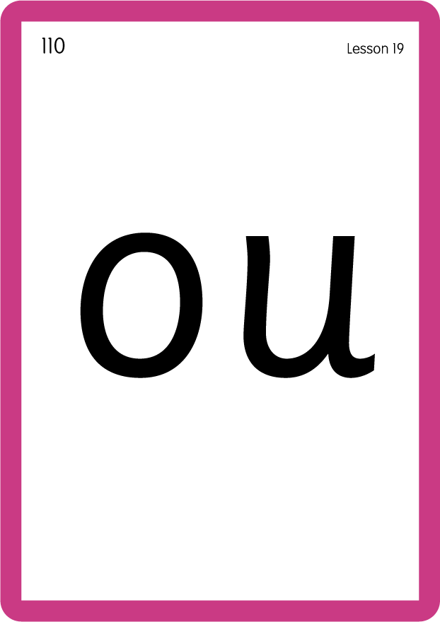
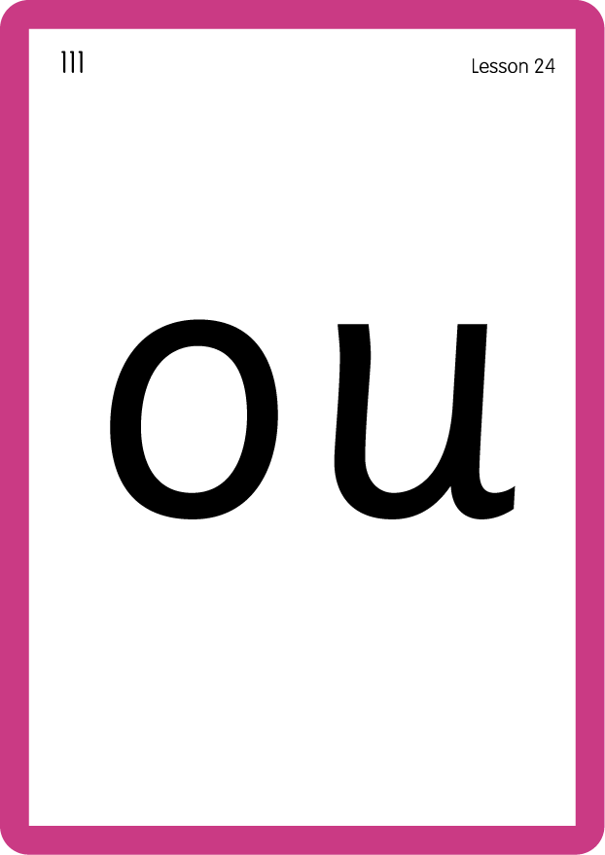
Review Grapheme Caption
USING JN686
FRONT

Slide 15

Explain Decoding

Slide 16
Model Blending Phonemes
sh
ou
t
USING SOUND BUTTONS
Sound Buttons
Vowel
Consonant
Consonant Digraph
Multi Sound
Long Vowel Sound
R-controlled Digraph
Split Digraph
Syllable / Silent Letter

Slide 17
Model Blending Phonemes
s
ou
l
USING SOUND BUTTONS
Sound Buttons
Vowel
Consonant
Consonant Digraph
Multi Sound
Long Vowel Sound
R-controlled Digraph
Split Digraph
Syllable / Silent Letter

Slide 18
Model Blending Phonemes
g
r
ou
p
USING SOUND BUTTONS
Sound Buttons
Vowel
Consonant
Consonant Digraph
Multi Sound
Long Vowel Sound
R-controlled Digraph
Split Digraph
Syllable / Silent Letter

Slide 19

Explain Encoding

Slide 20
Practise Common Exception Words
USING JN687
FRONT

Slide 21
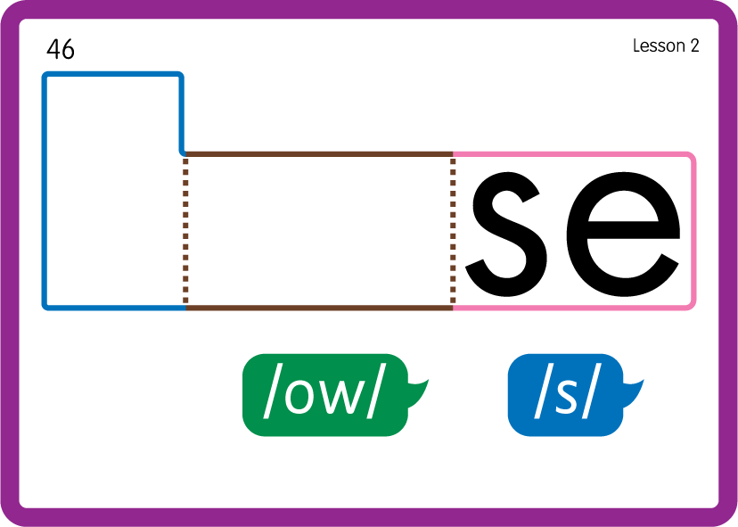
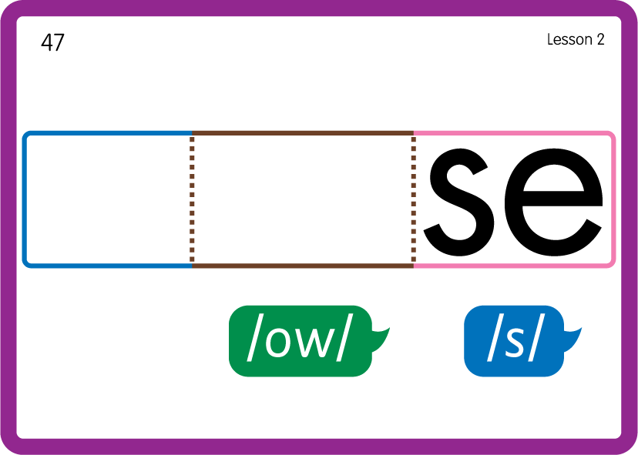
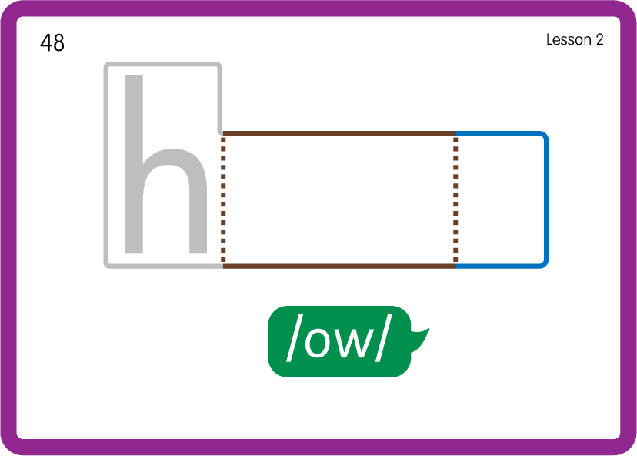
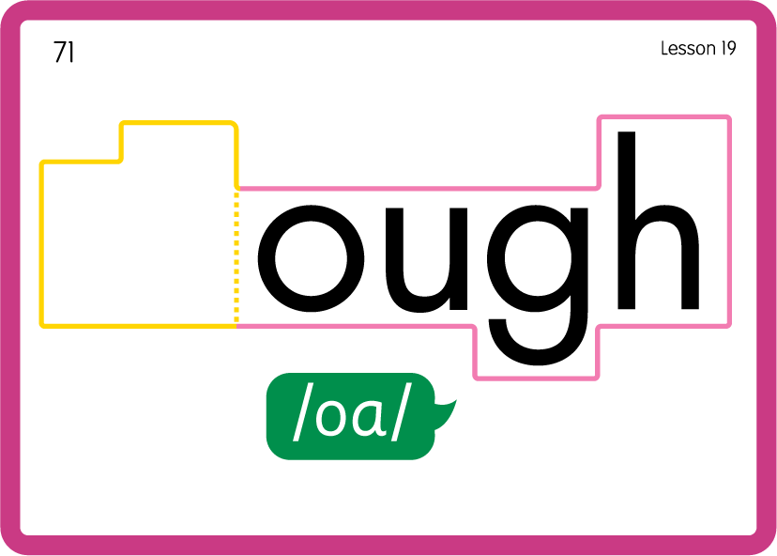
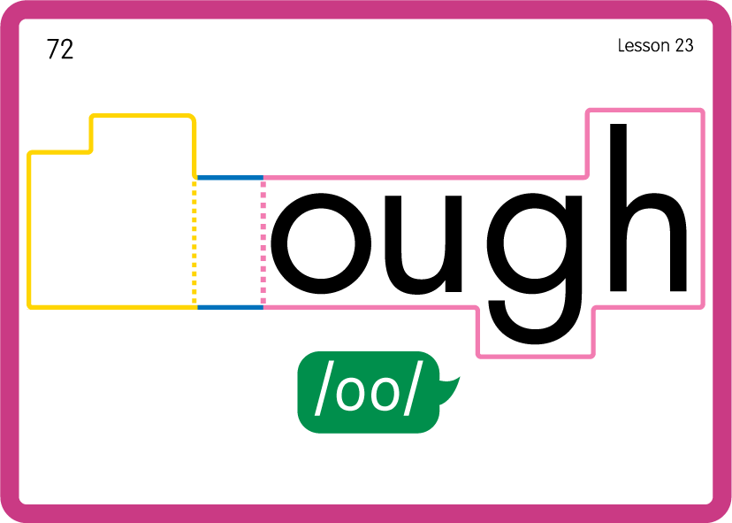
Practise Common Exception Words
USING JN687
BACK

Slide 22

Practise Building Words
PRACTISE – 10MINS
s
ou
p
g
r
w
n
d
e
c
t
m
th
l
USING MAGNETIC LETTERS AND A WHITEBOARD
LAYOUT B

Slide 23
Practise Building Words
PRACTISE – 10MINS
s
ou
p
g
r
w
n
d
e
c
t
m
th
l
soup group wound recoup count mouth cloud round soul
USING MAGNETIC LETTERS AND A WHITEBOARD
LAYOUT B

